Slide 1
Internet Of Things
By
Open Hardware Community, CET

Slide 2

It is a wireless network between objects
Things communicate with each other and with people using short range mobile transceivers.

Slide 3
Basically It is the Evolution of Internet!!!!

Slide 4
So What??????
Dynamic control of industry and daily life.
Improve the resource utilization ratio.
Integrating human society and physical systems.
Flexible Configuration
Acts as Technologies integrator
Intel IoT -- What Does The Internet of Things Mean- - YouTube.MKV

Slide 5
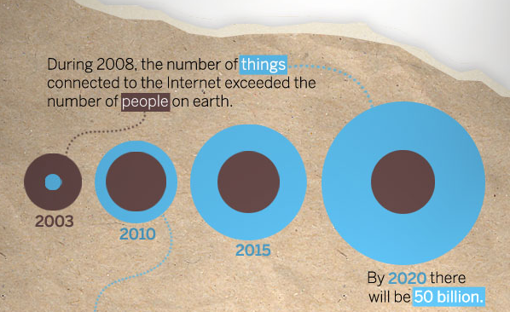
Growth

Slide 6
Understanding IOT
The Internet of Things - YouTube.MKV

Slide 7
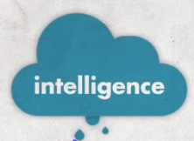
Wisdom
Knowledge
Information
Data

Slide 8
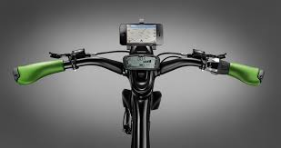


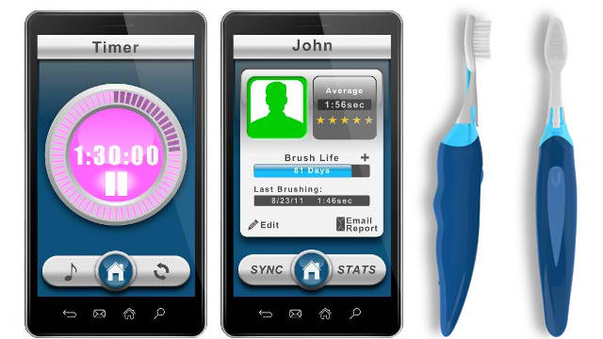
Fields

Slide 9
Is It Easy???
Technological standardization in most areas are still remain fragmented.
Managing and fostering rapid innovation is a challenge for governments.
Privacy
Absence of governance.

Slide 10
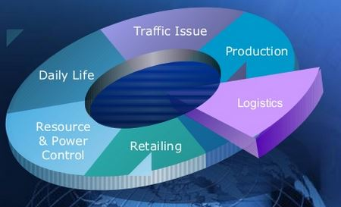
What’s Next???

Slide 11
Thank You

