Slide 1
Shopping Lists in the Cloud
SDLE Project Presentation
Jakub Popiel - up202501735
Mateusz Gieroba - up202501728
Rodrigo Tsou - up202208354

Slide 2
Context and Overview
This project implements a distributed shopping list application designed to explore key concepts of distributed systems, such as replication, fault tolerance, and network partitions.
The system follows a local-first approach, where clients store data locally and synchronize with a cloud cluster when connectivity is available. The cloud is composed of multiple shards with replicated nodes, ensuring scalability and resilience.
Communication between components is implemented using ZeroMQ, combining request–reply and gossip mechanisms to propagate updates across the system.
A key feature of the project is state-reconciliation between server nodes and clients and dynamic discovery, which allow for high fault tolerance and scalability.
Overall, the project demonstrates how a distributed application can remain functional and consistent under unreliable network conditions, while providing tools to observe and control its behavior in real time.

Slide 3
Technology
We designed the system with a focus on performance, reliability, and transparency, using low-level technologies that allow fine-grained control over distributed behavior.
The application is implemented in C++, enabling explicit management of concurrency, networking, and data consistency.
C++, as the main programming language for both client and cloud components;
ZeroMQ (cppzmq), for high-performance messaging using multiple communication patterns;
Pistache, used to expose a REST API and serve the web-based interface;
SQLite3, providing lightweight persistent storage;
MessagePack (msgpack-c), for efficient binary serialization of messages exchanged between nodes;
These technologies together enable a replicated, fault-tolerant distributed system, suitable for demonstrating failures, network partitions, and recovery in real time.

Slide 4
API
The API acts as the central coordination layer between the web interface, the local database, and the cloud cluster.
It exposes a REST interface (via Pistache) that allows clients to create, update, retrieve, and delete shopping lists and items, while transparently handling cloud communication and fault scenarios.
The API follows a local-first design:
All operations are first consulted with a local SQLite database.
Updates are then propagated to the cloud cluster using ZeroMQ request–reply communication.
  If the cloud is unavailable, the client continues to operate locally.
  If the cloud is available, results of the operations are merged
Final result of an operation is stored in a local database.
Overall, the API encapsulates cloud interaction, consistency handling, and failure simulation, providing a clean and simple interface to the frontend.

Slide 5
API
The API was designed to isolate distributed-system complexity from the frontend and provide a stable interaction layer.
Key design decisions include:
Frontend abstraction: the UI is unaware of shards, replicas, or node failures.
Explicit fault handling: cloud timeouts and disconnections are treated as normal execution paths.
Deterministic routing: shard selection is derived from list identifiers, ensuring consistent access to data.
Separation of concerns: data operations and control operations are handled independently.
By combining data access, cloud coordination, and failure control in a single component, the API simplifies client logic while enabling robust behavior under network partitions and node failures.

Slide 6
Local-First Approach
(Data Model and Initialization)
In the initial phase, the client initializes and validates the presence of a local SQLite database, following a predefined schema for shopping lists and items.
Each shopping list and item is assigned a locally generated unique identifier, ensuring:
Independence from user input;
No reliance on synchronized clocks or timestamps.
All data is created and stored locally first, allowing the system to operate independently of the cloud.
Only the creator of a shopping list (the originating client) can delete it, and this operation is irreversible and propagated throughout the system to ensure consistency.

Slide 7
Local-First Approach
(Execution and Synchronization)
Local state is the primary source of truth, with the cloud used for synchronization.
Frontend request management: all user actions are handled immediately by the client through the API.
Fault tolerance: the full state of the shopping list is persisted locally, allowing recovery after crashes or disconnections.
Cloud synchronization: when connectivity is available, the local state is sent to the cloud and merged with the remote state.
The cloud acts as a synchronization and replication layer, not as a single source of truth.
This design guarantees low latency, resilience to failures, and continuous usability, even during network partitions or cloud outages.

Slide 8
Cloud
(Architecture)
The cloud is composed of a cluster of nodes, organized into shards with multiple replicas to ensure scalability and fault tolerance.
Each node is responsible for:
Storing and managing shopping lists assigned to its shard;
Maintaining a list of alive nodes
Serving client requests via request–reply communication;
Propagating state to other replicas.
The system uses two communication patterns:
REQ/REP for client–node interactions;
Gossip (PUSH/PULL) for background state synchronization as well as dynamic discovery and eviction
This architecture allows the cloud to remain decentralized, with no single point of failure.

Slide 9
Cloud
(Replication and Fault Tolerance)
Each shard is replicated across multiple nodes, ensuring that data remains available even if some replicas fail or disconnect.
Key properties:
Replication within shards guarantees redundancy and resilience;
Eventual consistency is achieved through gossip and state merging;
Node failures and partitions are tolerated without stopping the system.
For demonstration purposes, nodes can be dynamically added, stopped, restarted and removed at runtime, reconnected nodes synchronize automatically via gossip, which is also used as heartbeat;
This design allows the system to simulate real-world cloud failures and recovery scenarios.

Slide 10
Cluster
(Setup and Execution)
The cluster is composed of:
Multiple shards, each responsible for a subset of shopping lists;
Multiple replicas per shard, providing redundancy and availability.
At startup:
Each node is assigned a unique identifier and its shard,;
Dedicated endpoints are allocated for client requests and gossip;
Nodes can be dynamically added as long as they know at least one live node
This centralized bootstrapping simplifies experimentation while preserving a fully decentralized runtime behavior.

Slide 11
Node
(Responsibilities and Behavior)
Each node operates as an independent replica responsible for managing shopping lists belonging to its shard.
Node responsibilities include:
Handling client requests via REQ/REP communication;
Storing data locally using SQLite;
Periodically synchronizing state via PUSH/PULL gossip.
Merging states received both from clients and other nodes
This design allows the system to demonstrate replication, eventual consistency, and recovery under real-world failure scenarios.

Slide 12
CRDT
(OR-Set)
The OR-Set is used to represent the set of items in a shopping list under concurrent updates.
Each add operation generates a unique tag.
Remove operations do not delete data, but invalidate specific add tags.
An item exists if at least one add tag has not been removed.
The OR-Set allows replicas to independently update item sets and later converge to the same state without conflicts.

Slide 13
CRDT
(PN-Counter)
The PN-Counter is used to model quantities (e.g. desired and current item counts) in a distributed setting.
Each replica maintains its own positive and negative counters.
The total value is computed as the sum of increments minus decrements.
During synchronization, counters are merged by taking the maximum value per replica.
This design allows concurrent increments and decrements without coordination, while guaranteeing eventual consistency.
Together with the OR-Set, the PN-Counter ensures that both structure and quantities of shopping lists converge correctly across replicas.

Slide 14
Web Interface
The web interface was designed as a simple and functional control panel for interacting with the system and demonstrating its distributed behavior.
Key design principles:
Simplicity and clarity: all actions are explicit and require minimal input.
Separation of concerns: list management and item management are clearly separated.
Immediate feedback: the interface reflects changes as soon as operations are executed.
Overall, the interface prioritizes demonstrability over complexity, making it suitable for showcasing local-first behavior, fault tolerance, and cloud synchronization in a live presentation.

Slide 15
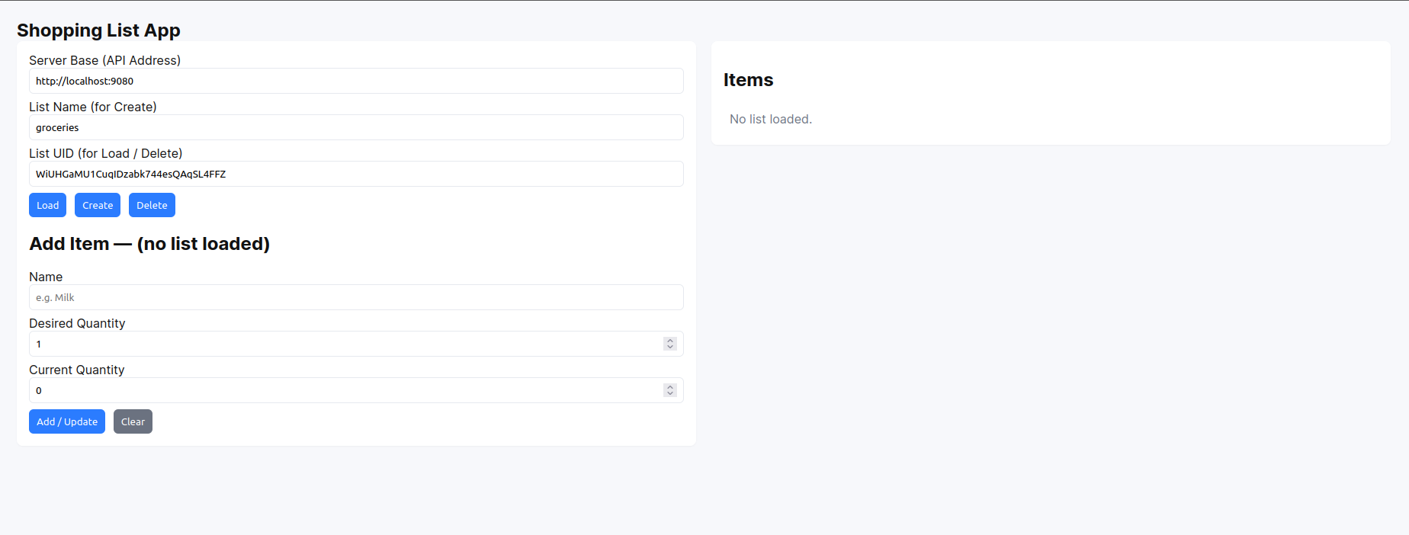
Web Interface

Slide 16
Improvements

