Slide 1
PDF-Downloader
C# Console app

Slide 2
Intro
Tech
Class Diagram
Main loop
Download
Tuples vs Class
Outro

Slide 3
Tech
C#
Tasks -> concurrency
OpenXml -> Excel
Console

Slide 4
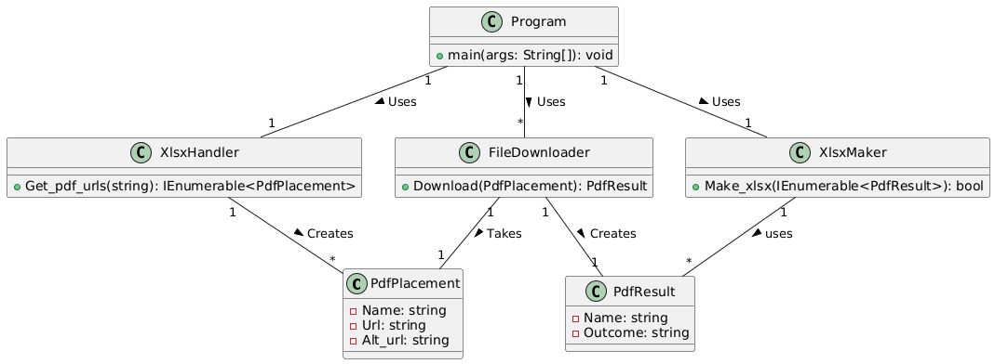
Class Diagram

Slide 5
List<PdfPlacement> pdfs; try { pdfs = [.. XlsxLoader.Get_pdf_urls(args[0])]; } catch (Exception e) { …; return;} List<Task<PdfResult>> tasks = []; foreach (PdfPlacement pdf in pdfs.Take(10)) { FileDownloader downloader = new(folderName); if (string.IsNullOrEmpty(pdf.Url)) continue; tasks.Add(downloader.Download(pdf)); } Task.WaitAll(tasks); Console.WriteLine("Download done"); if (XlsxMaker.Make_xlsx(tasks.Select(t => t.Result), folderName)) Console.WriteLine("Metadata sheet created"); else Console.WriteLine("Metadata sheet could not be created");
Main loop

Slide 6
Public async Task<PdfResult> Download(PdfPlacement pdfPlacement) try … using Stream downloadStream = await client.GetStreamAsync(pdfPlacement.Url); using Stream fileStream = new FileStream(Pdf_Path(pdfPlacement.Name), …); await downloadStream.CopyToAsync(fileStream); await fileStream.FlushAsync(); fileStream.Close(); return new PdfResult(pdfPlacement.Name, pdfPlacement.Name + " Downloaded Succesfully"); catch (HttpRequestException e) if (pdfPlacement.Alt_url != "") Console.WriteLine("\nException Caught! Trying alt...."); PdfResult result = await Download(new(pdfPlacement.Name, pdfPlacement.Alt_url, "")); return new PdfResult(result.Name, result.Outcome + " with alt url"); else {…}
Download

Slide 7
Tuples vs Class
(string, string, string)
VS
class PdfPlacement(string name, string url, string alt_url) { public string Name { get; set; } = name; public string Url { get; set; } = url; public string Alt_url { get; set; } = alt_url; }

Slide 8
End

