Slide 2
The social conflicts in the
Cameron director in 《Crash》

Slide 3
About this movie
When we see the opening line of the black police officer responding to the traffic accident, we will understand that the "crash" was just a prelude, and as the story goes backwards, we can better understand the meaning of this successful film .
It is not just car to car, person to person, country to country, race to race -- whenever there is a difference between one and others, there will be friction and collision.
The Movie uses a series of impacts to make the audience think.

Slide 4
The director’s terrible experience with police
Two white policemen were patrolling together when they saw a black TV director and his wife in a car. So they molested his wife in front of the black director in order to vent their personal desires.
As a director, he should have a certain social status. Even so, he apologized and walked away after being humiliated.
.
.

Slide 5
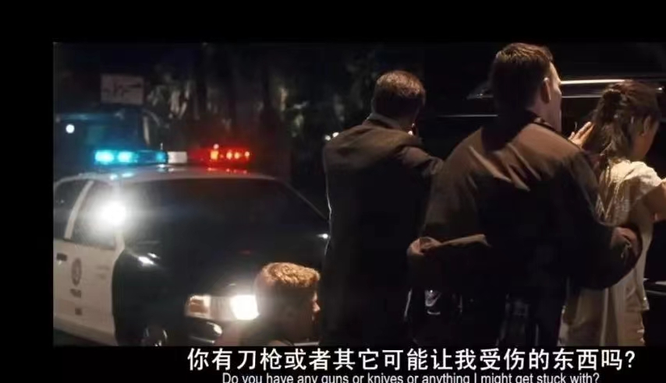


Slide 6
When his wife asked him why he kept quiet, he told her it was because the police had a gun, but the truth was that he was not overwhelmed by the gun, but by his own acceptance of discrimination. And when his wife scolds him, his identity is shaken. When his wife tried to protect his dignity, he gave it up.

Slide 7
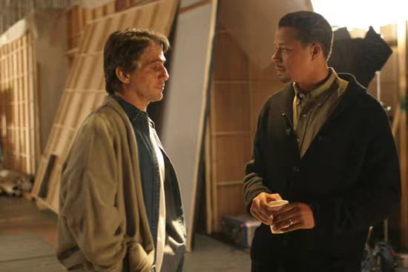
The plot of modifing actor’s lines
Black directors give in, because this is a white man's world, and they like to see black people gross. The director was the first to accept assimilation in the white world. He has gained status in the white world, he is the beneficiary of the white world, so he obeys the rules of the world.
After a series of events, the black director realized that he had forgotten the fact that he was a black man. Even if he entered the upper society and had a lot of fame and property, his race and blood could not be changed.

Slide 8
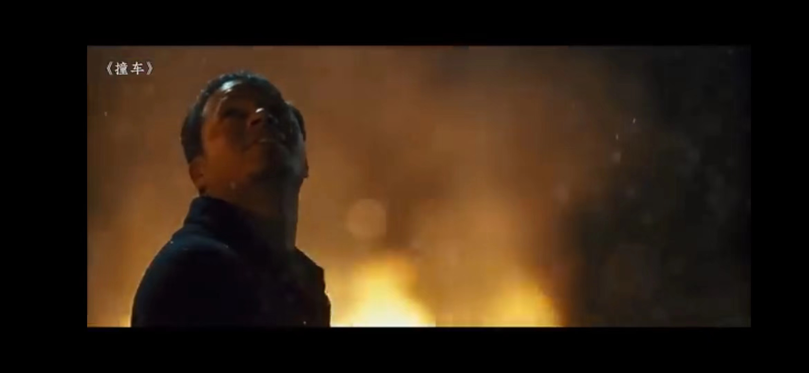
When he saw a group of black children gathering around a burning vehicle and throwing things into the fire, he did the same. It shows that he has accepted his identity and doing what it does.
.
.

Slide 9
Some thoughts
In some sympathetic experiences, we can see that in the melting pot of the United States, the problem of racial discrimination has run deep in everyone's blood. When discrimination does exist, we should not blindly blame the discriminator, because there are more complex social and historical reasons behind the individual discriminator. What can not be ignored is how should the discriminated people face the reality of discrimination, whether the discriminated should give up on themselves?

Slide 10
The director gave a good answer to this question.
When the young man met the director, the director finally said to him, "You make me feel ashamed", which is exactly a clear point of view: the discriminated should first respect themselves, and then strive for the respect of others.
At the end of the film, the young man drives the stowaway's car. After releasing the stowaway, the smile from the heart tries to leave a bright tail for the film, which can also be seen as the youth's self-redemption and resistance to self-identity.

Slide 11
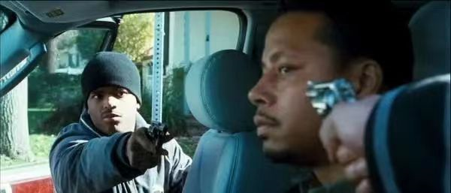
The self-awakening of the director
When the director was stopped by the police for the second time, he got out of the car regardless of fear of being killed, and he expressed his long-hidden and repressed discontent with an explosive gesture, even defiantly. With the help of the young white policeman, he was able to get safely back to his car. His greatest success was not his dignity, but his self-awakening.
.
.

Slide 12
Acutually,everyone has good side and evil side, even the white policeman who abused the director's wife before saved the black woman's wife from a car accident regardless of his own life.
Another policeman of justice shot and killed the young man just as he reached for his pocket.
In this society, everyone is under pressure, which is repressed and distorted. Once suffering from impact, it reflects endless conflicts.

Slide 13
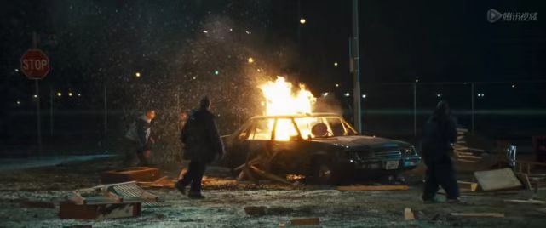
The ending of the movie
At the end of the film, there's not much dialogue. The locksmith watches the night sky after his daughter falls asleep. The husband of the noblewoman, the state senator,who stood quietly at the window, and lost in thought; The policeman who mistakenly killed a black man set fire to his car; A group of black children danced around the fire;

Slide 14
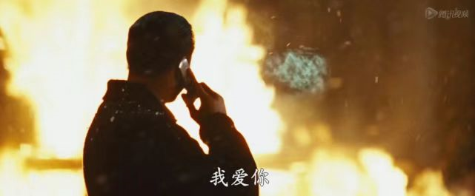
After the near-death experience, Cameron drove right past Tom's burning car, and a group of black children danced around the flames. Cameron's mood suddenly brightened. He no longer felt inferior because of his black identity, nor was he afraid of white people.
He stopped their cars, picked up debris and threw it into the flames; Snow is falling in Los Angeles,Then his wife called and said, "I love you." So he smiled happily...

Slide 15
Personal view about this movie
.
.

Slide 16
At the beginning of the film, the black police officer, after crashing his car, says this: "This is what impact feels like. You walk in any city, you're going to brush past people, and people are going to bump into you. In Los Angeles, no one will touch you, always behind this layer of metal and glass.
A two-hour movie can't simply tell the story of a car crash. Everyone's life is like the cars on the streets of Los Angeles, moving along orderly under a layer of metal and glass. But danger and insecurity are like undercurrents, and the two cars could rear-end each other at any moment.

Slide 17
No one is absolutely good, and the young policeman is the best example. No one is absolutely bad, and the racist police officer who tried to save director’s wife in the end is a proof. Everyone has a different problem and a different situation, all of these can make people feel disgusted and feel a little bit of compassion and sympathy at the same time.

Slide 18
In general, I am impressed and encouraged by the director,From his tolerance and compromise to his outburst ,and to his self-awakening finally,I believe that all the repressed audience will be filled with hope.
No man is an island, and those whose lives "collide" with each other will find their way home one day. It is hoped that make people brave enough to face a lonely, sad life.
We are encouraged and inspired, I think this is the real charm of this successful movie

Slide 19
Thankyou

