Slide 1
Cactus aligner
30.01.2025
Alena Akinshina

Slide 2
Align genomes from different species
Align genomes from same species
Build Pangenome graph
Progressive cactus
- Minigraph-cactus Pangenome pipeline
Minigraph-cactus Pangenome pipeline
How it works:
A graph-based progressive multiple genome aligner that reconstructs ancestral genomes by combining sub-alignments.

Slide 3
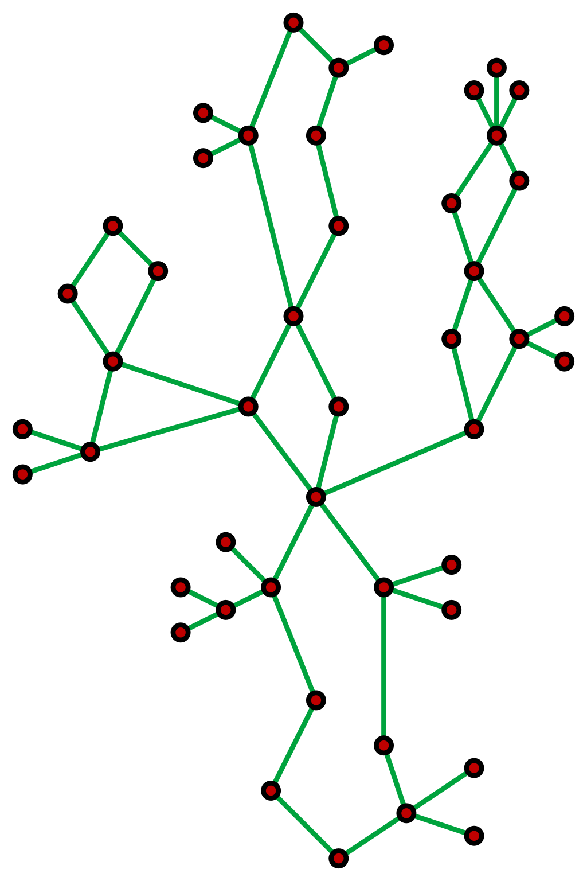
Cactus graph
In graph theory, a cactus (sometimes called a cactus tree) is a connected graph in which any two simple cycles have at most one vertex in common. Equivalently, it is a connected graph in which every edge belongs to at most one simple cycle, or (for nontrivial cacti) in which every block (maximal subgraph without a cut-vertex) is an edge or a cycle.
Connected graph in which two simple cycles have at most one vertex in common.
Input
E.g.
Guide tree is used to recursively split a large alignment problem into subproblems
Subproblem compares 2-5 genomes against one another
Guide tree
FASTA for each genome assembly
BUSINESS NAME

Slide 4
Progressive
Complex algorithms
Multiple alignment
Effective data manipulation
Allows detection of variance (indels)

Slide 5
Progressive Cactus improves upon the original Cactus program by focusing on the CAF (Cactus Alignment Filter) and BAR algorithms.
The CAF algorithm constructs a sequence graph from local alignments produced by LASTZ, representing the alignment of nucleotide strings. In this graph, alignments between substrings are shown as shared edges, termed "alignment blocks." These blocks define equivalence relations, possessing transitive, reflexive, and symmetric properties. A key challenge for CAF is judiciously selecting which local alignments to include, as the output from LASTZ can contain transitive inconsistencies that may lead to overly complex alignment blocks.

Slide 6
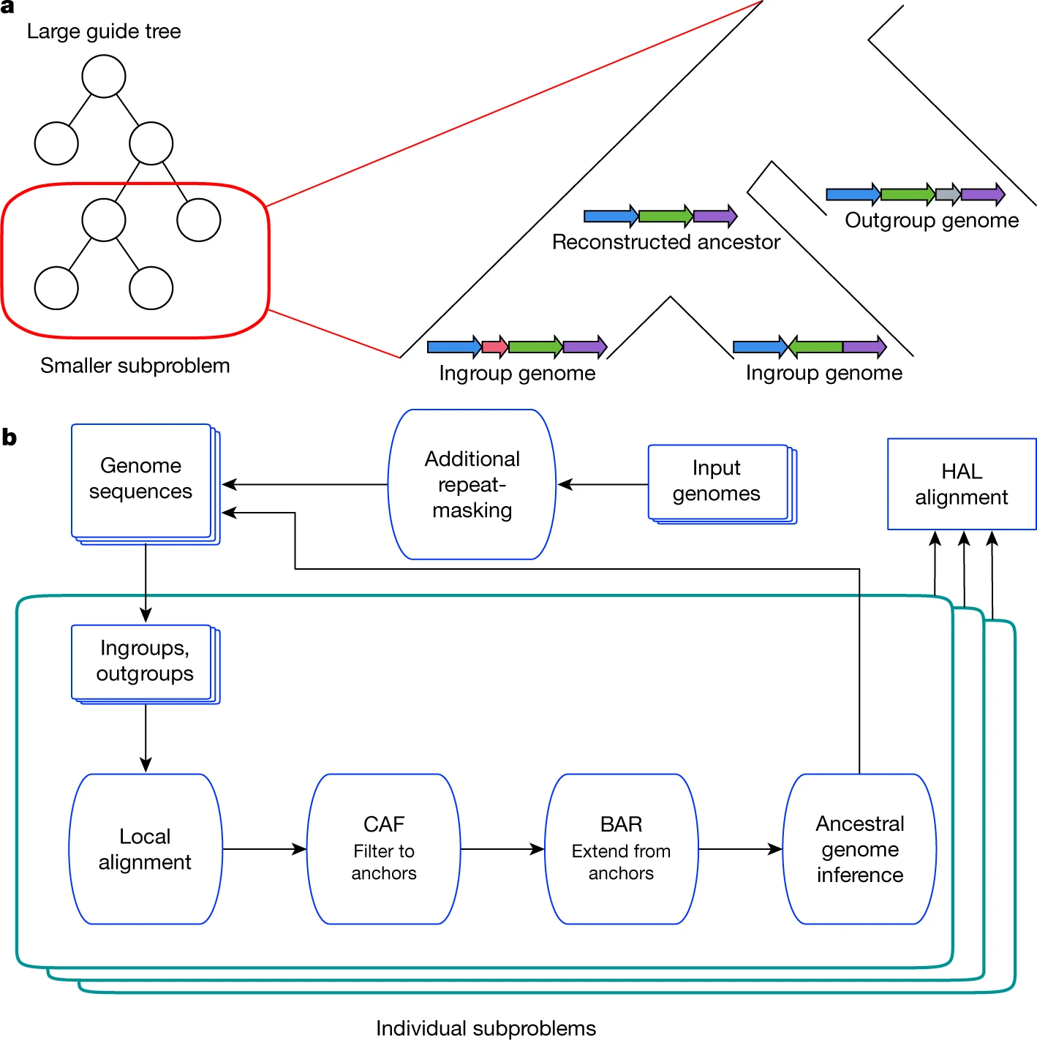
Armstrong, J., Hickey, G., Diekhans, M. et al. Progressive Cactus is a multiple-genome aligner for the thousand-genome era. Nature 587, 246–251 (2020).

Slide 7
Out: Graph files + Alignment files
1. Perform local alignments
With LASTZ to identify significant alignments generating alignment blocks
2. Cactus alignment filter (CAF)
Filters alignments based on quality and relevance for further analysis
3. Graph construction
where vertices represent the sequences and edges denote the alignment blocks

Slide 8
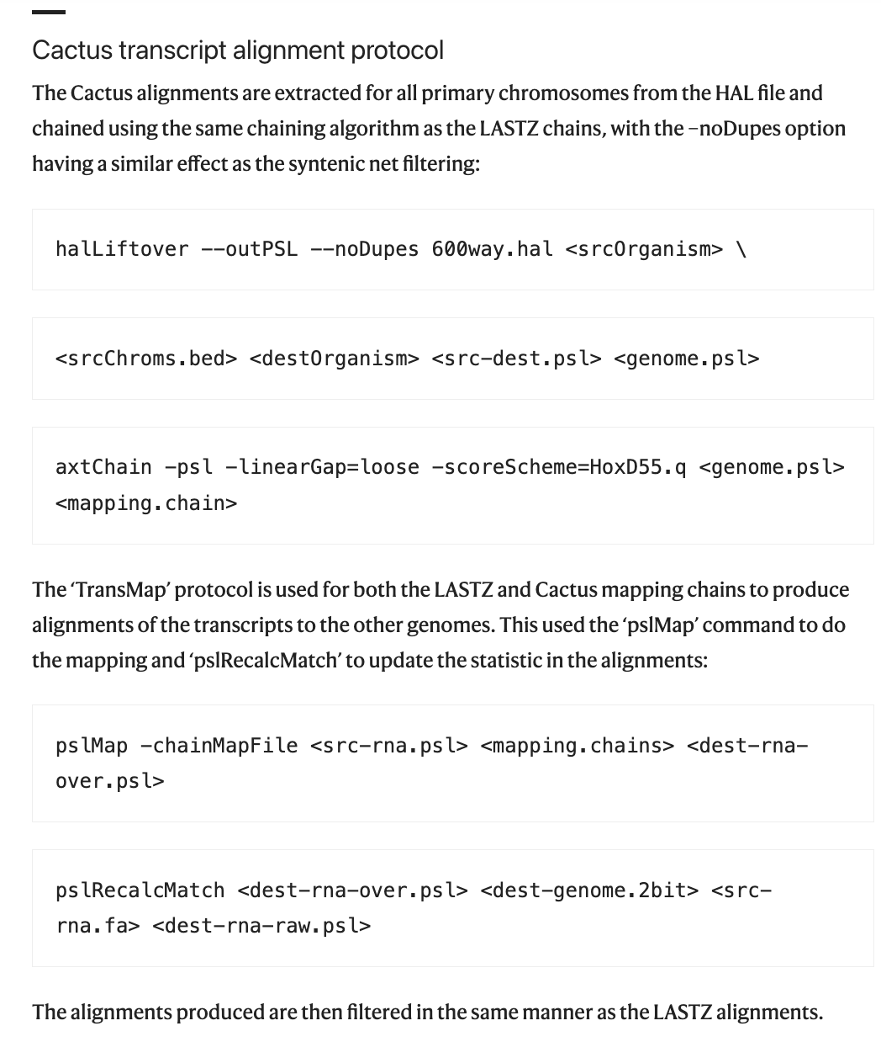
Armstrong, J., Hickey, G., Diekhans, M. et al. Progressive Cactus is a multiple-genome aligner for the thousand-genome era. Nature 587, 246–251 (2020).

Slide 9
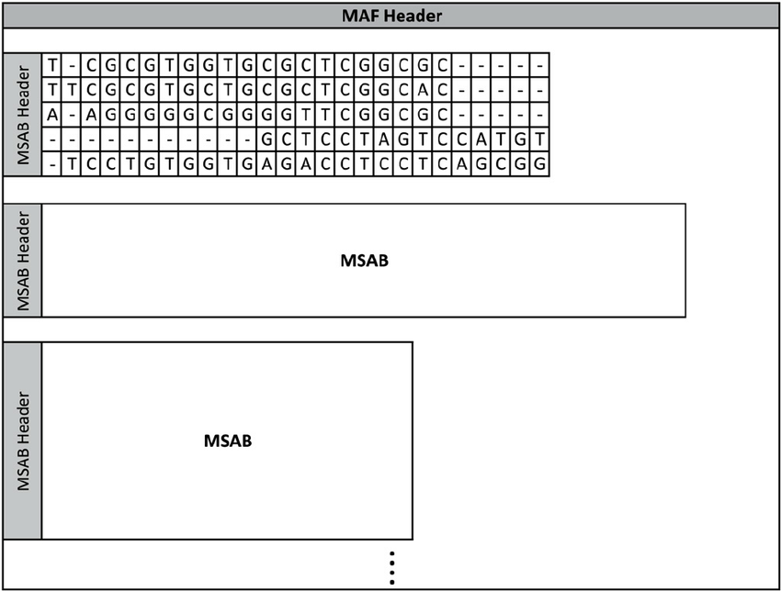
MAF
Multiple Sequence Alignment Block
Matos, Luís & Neves, António & Pratas, Diogo & Pinho, Armando. (2015). MAFCO: a compression tool for MAF files. PloS one. 10. e0116082. 10.1371/journal.pone.0116082.

Slide 10
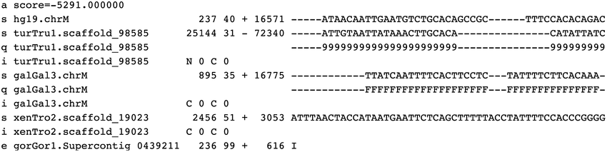
MAF
MSAB

Slide 11
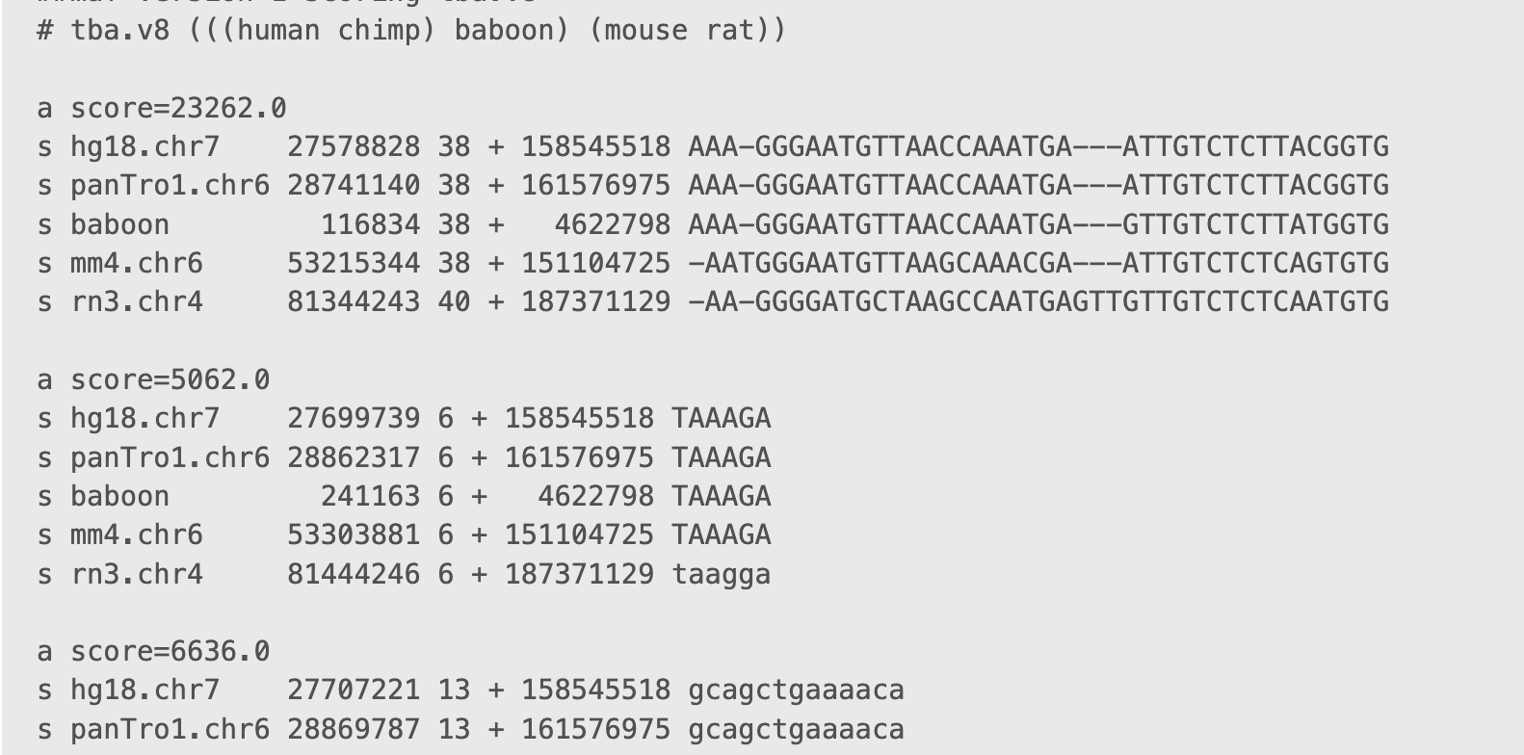
MAF

Slide 12
MAF | HAL
Comprised of alignment blocks - sequences against each other | Object structure (sequences, alignments, nodes)
Can be read and edited by human | Compatible with graphs
Non-hierarchical | Hierarchical where structures are branched alignments
For multiple simple alignments (faster analysis and visualisation) | Efficient for quick access to data (e.g. extracting subsets of sequences or alignments)

Slide 13
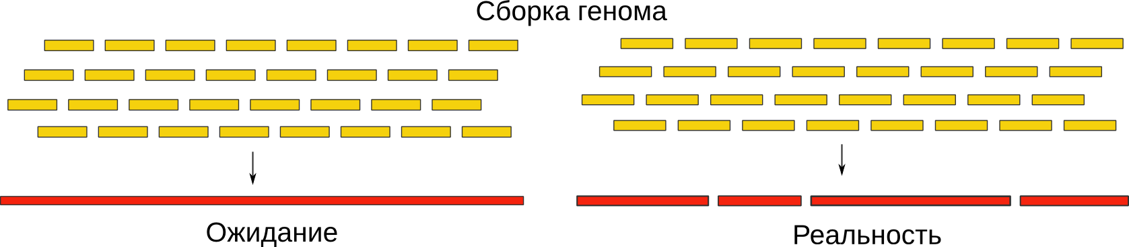
Plant genome alignment

Slide 14
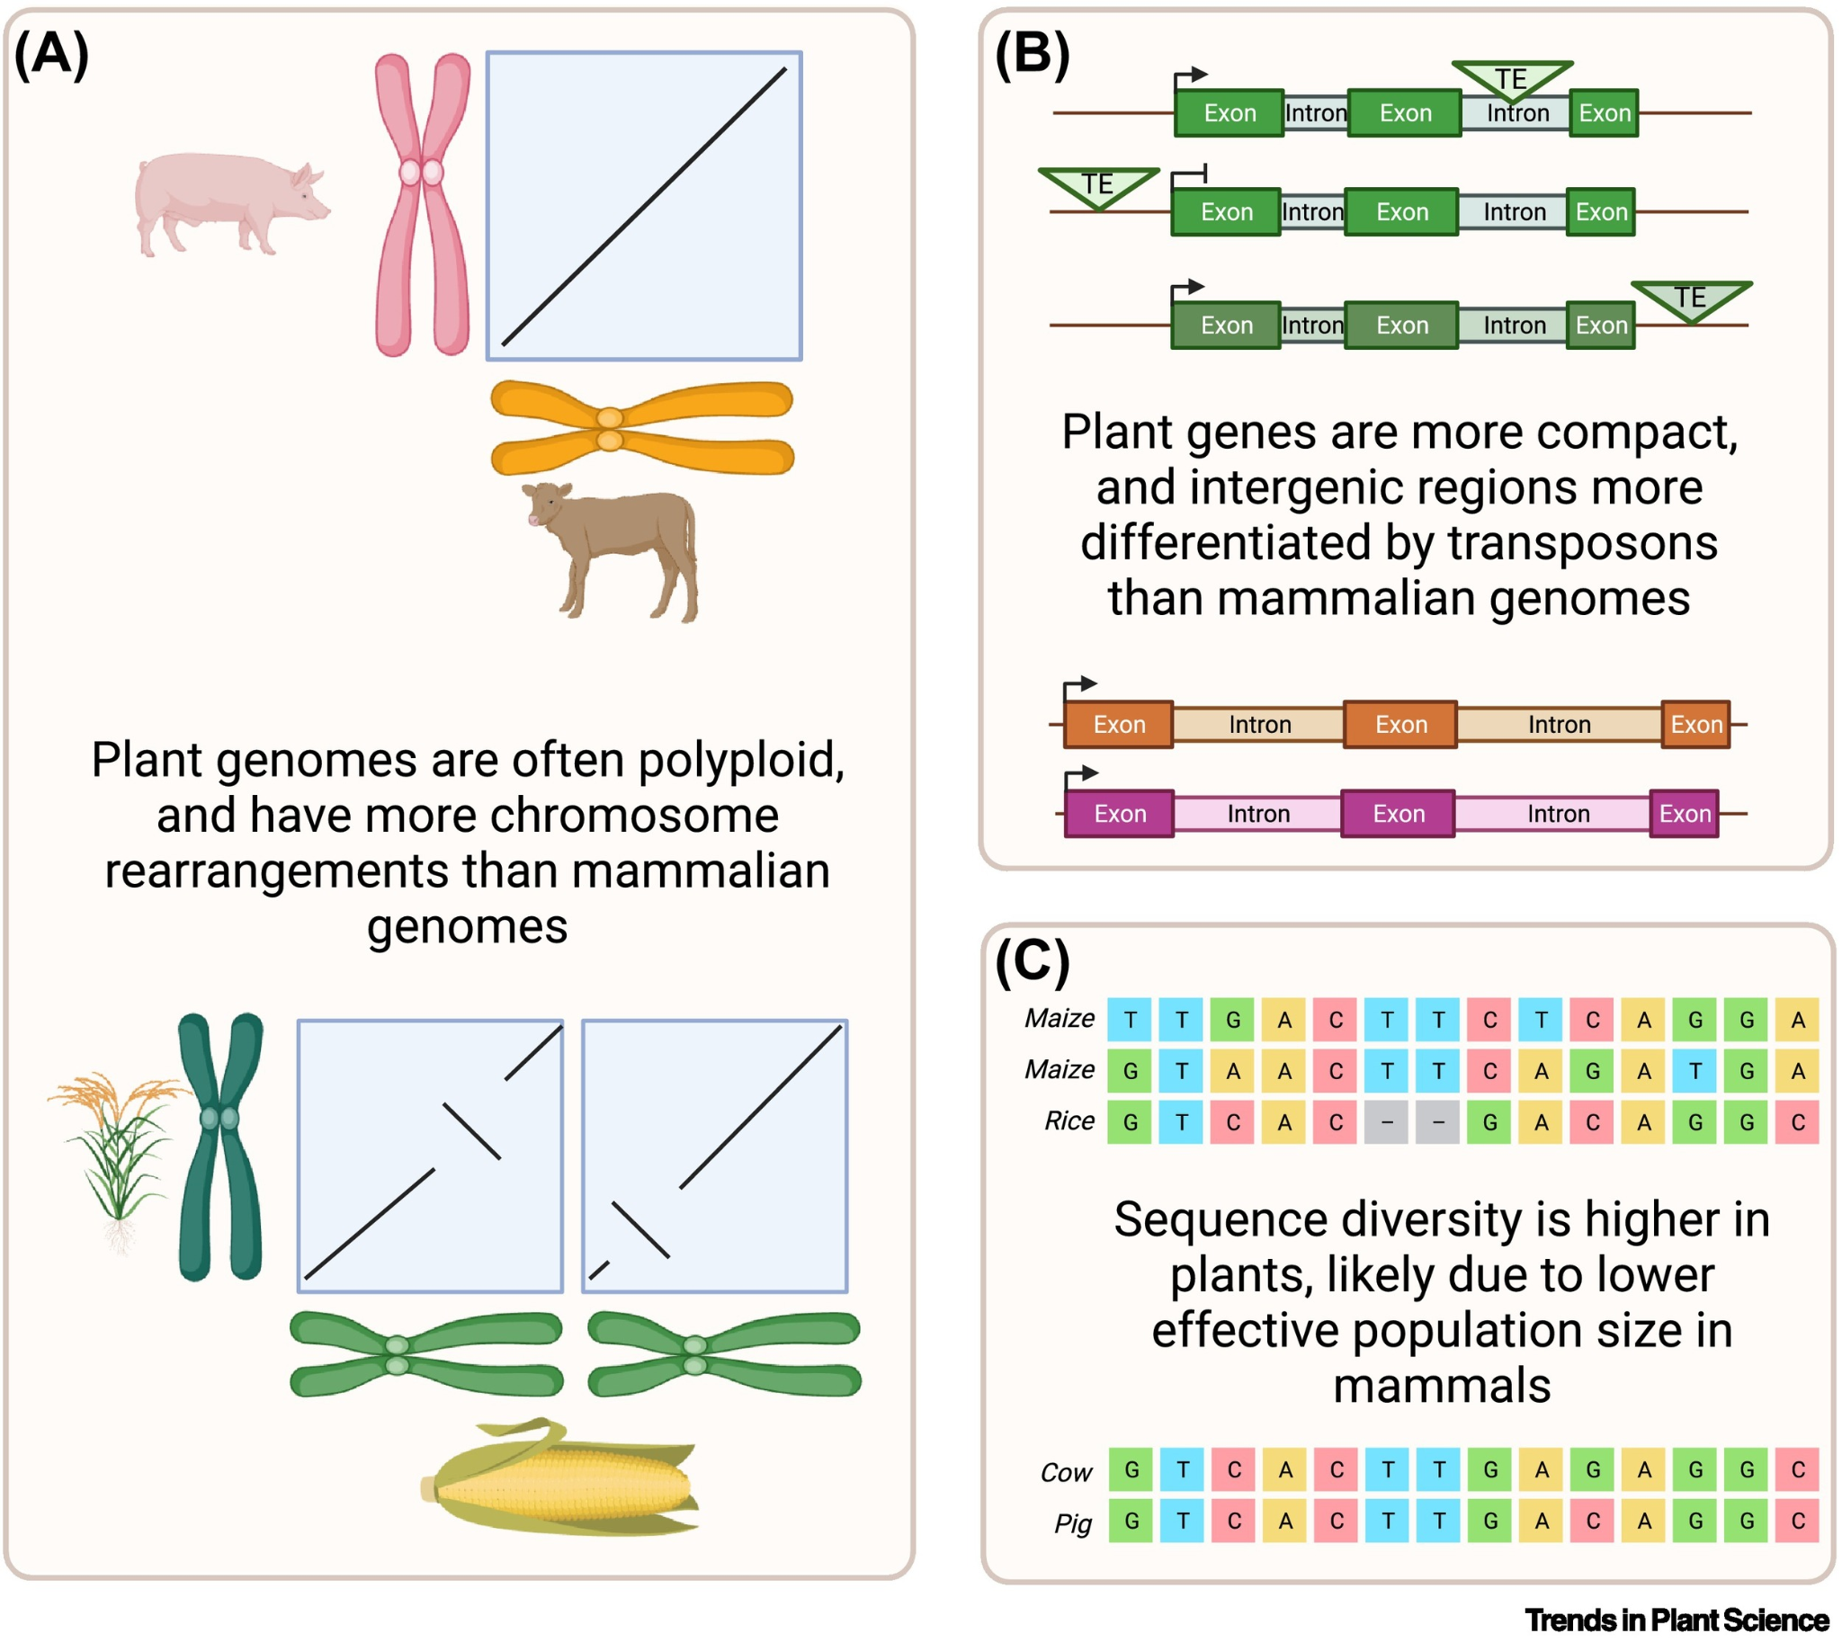
Plant genome alignment
Polyploidy is a major contributor to genome size differences in plants, where at least 35% of species are polyploid
Differences is transposable element (TE) content
TE presence or absence variation, PAV
Decay of TEs also cause long indel variants between genomes
Plants have higher sequence diversity
More uncertainty in alignment
New whole-genome alignment tools are needed for tapping into plant diversity
Song, Baoxing et al. Trends in Plant Science, Volume 29, Issue 3, 355 - 369

