Slide 1

The Role of Visual Perception in Medical Imaging Interpretation
LANS 2022
Hartford, CT
Presenter: Elena Ajayi
Mentor: Dr. Jonathan D. Victor
Weill Cornell Medicine

Slide 2
Plan
The visual system is tuned to characteristics of images in the real world
Main Findings: Select types of medical images differ in their characteristics (ex. power spectrum)
What are the future directions with this research?

Slide 3



Methods (Pipeline of Research Project)
Public Database
Select Images
Select ROIs
Make Patches
Calculate Fast Fourier Transform
"Padding"
Windowing
Mean Subtraction
Calculate Power Spectrum
Whitening

Slide 4

The visual system is tuned to characteristics of images in the real world
Barlow's principle of efficient coding
What are some of these characteristics?
Objects are usually not transparent; they block out what is behind them.
Natural scenes typically one main light source, and objects differ in their reflectance.
Objects in the natural scene can be viewed from any distance.
Edges are important in defining object shape.
A consequence is that nearby points in a natural image are correlated
Correlation leads to redundancy and hence inefficiency
Retinal processing removes this redundancy
This redundancy removal is only effective for the specific pattern of correlations in natural scenes
Notes:
Fix this slide

Slide 5
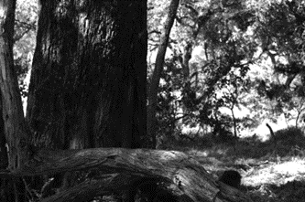
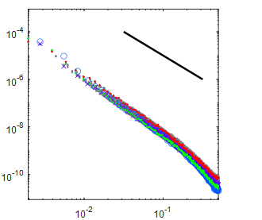

Image Sets
Natural Images
(Penn Database)
How do we measure these correlations?
Power Spectra
Quantifies and compares short and long-range correlations
The slope of the power spectra specifically compares the relative strength of these correlations
In natural scenes, the slope of the power spectrum is –2
What is the slope of the power spectra in medical images?
1519 x 1009 Pixels
Power spectra
1/f²
power
slope ~ -2
Spatial frequency (cycles/image pixel)

Slide 6
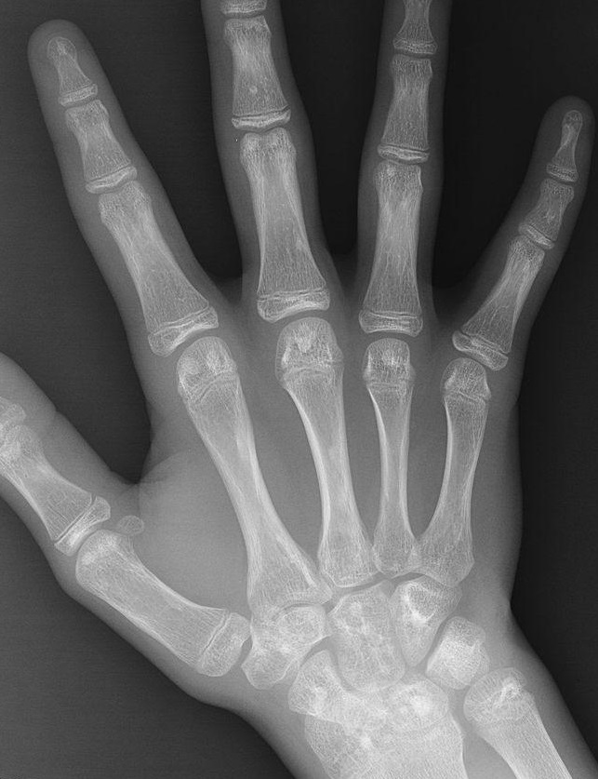
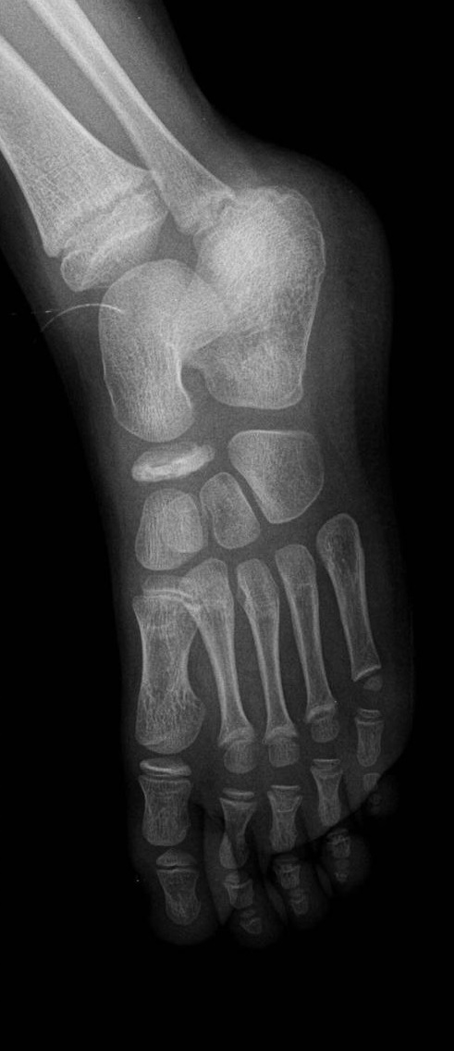
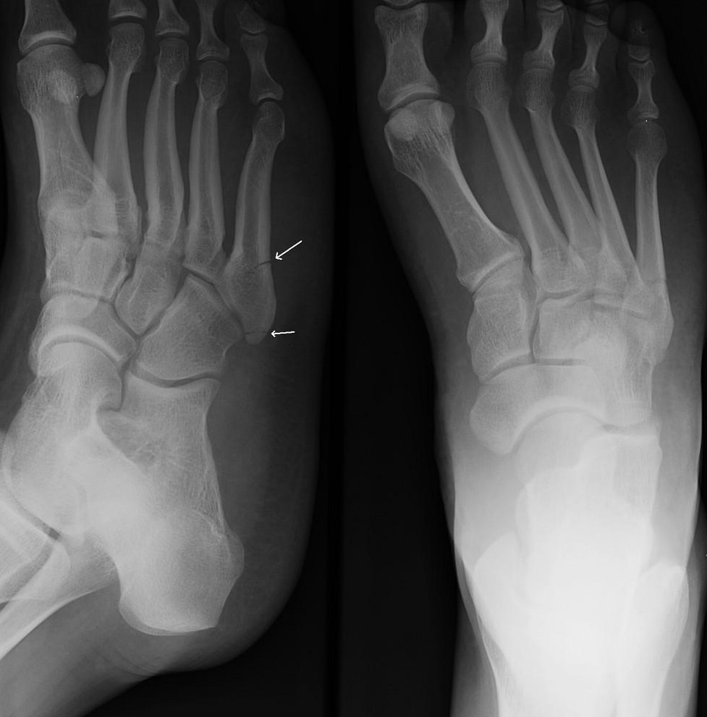
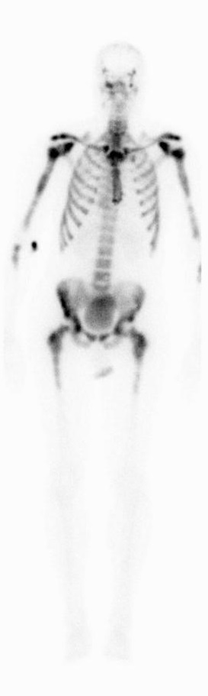
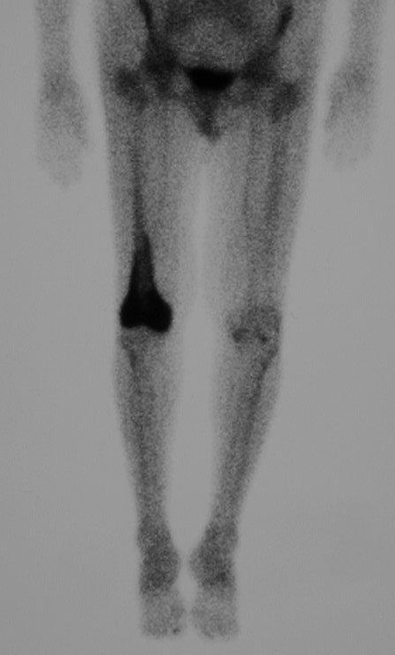
Some of Bone X-RAYS and Scintigraphy's analyzed...
Bone X-RAY​
MedPix​
643 x 837 pixels
​
Bone X-RAY
MedPix
521 x 703 pixels
Bone X-RAY​
MedPix​
977 x 991 pixels
​
Scintigraphy
MedPix
299 x 1200 pixels
​
Scintigraphy​
MedPix​
449 x 745 pixels
​​
Notes:
A scintigraphy uses radio active decay to determine lesions of interest.
An Xray used x-rays penetrate objects to show organs and bone

Slide 7
POWER SPECTRA OF BONE X-RAY
slope for all: -3.416
confidence limit: [ -3.431 -3.402]
An enlargement of the data points of the slope taken at different orientations differentiated by shape and color

Slide 8
POWER SPECTRA OF SCINTIGRAPHY
slope for all: -3.499
confidence limit: [ -3.511 -3.487]
An enlargement of the data points of the slope taken at different orientations differentiated by shape and color
Notes:
Power spectra here is –3, hence the way our visual system will interpret it is at -1

Slide 9
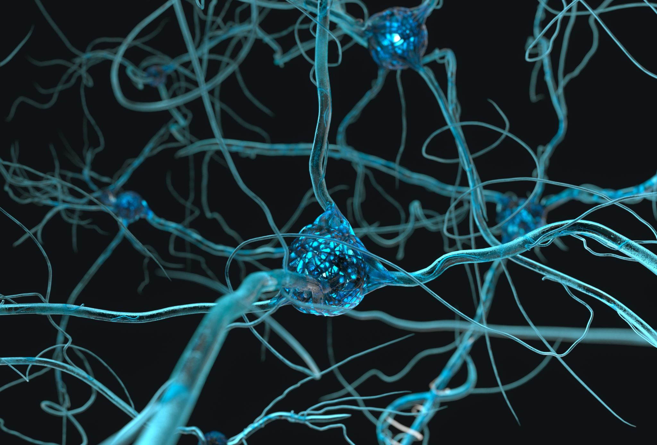
Future Directions?
The future goal is to understand human factors to understand medical image interpretation
It may lead to a better understanding of human expertise in radiology:
Does long-term viewing of a class of medical images change neural circuitry in an adaptive manner?
This may eventually lead to:
Changing the way medical images are presented for human interpretation
Development of new algorithms for computer aided diagnosis

Slide 10
Acknowledgements
1. Suniyya Waraich, PhD Candidate: Helped with Matlab setup
2. Dr. Jonathan Victor: Helped with Computation and Analysis.
3. Support: Feil Family Brain and Mind Research Institute and Department of Neurology, BMRI Summer Diversity Scholar Program at Weill Cornell Medicine NY, and CA241705 (PI, J. Victor).

