Slide 1
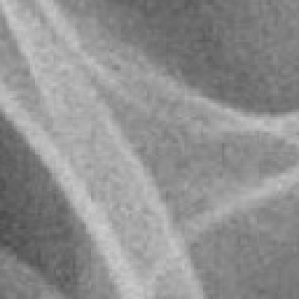

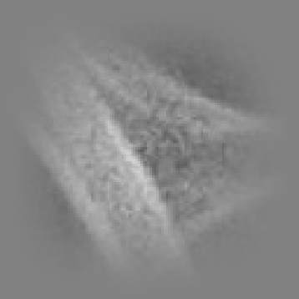

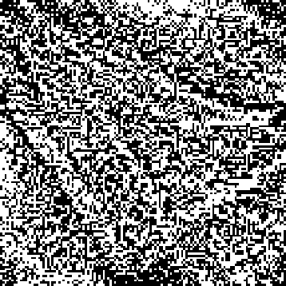

bigpatch 84
250
20
200
40
150
60
80
100
100
50
120
0
20
40
60
80
100
120
first patch ( 84)
250
downsampled by 1
250
windowed (none)
60
whitened (pad 2)
60
binarized
1
20
200
20
200
20
40
20
40
20
0.8
40
150
40
150
40
20
40
20
40
0.6
60
60
60
0
60
0
60
80
100
80
100
80
-20
80
-20
80
0.4
100
50
100
50
100
-40
100
-40
100
0.2
120
0
120
0
120
-60
120
-60
120
0
20
40
60
80
100
120
20
40
60
80
100
120
20
40
60
80
100
120
20
40
60
80
100
120
20
40
60
80
100
120
last patch ( 84)
250
downsampled by 1
250
windowed (none)
60
whitened (pad 2)
60
binarized
1
20
200
20
200
20
40
20
40
20
0.8
40
150
40
150
40
20
40
20
40
0.6
60
60
60
0
60
0
60
80
100
80
100
80
-20
80
-20
80
0.4
100
50
100
50
100
-40
100
-40
100
0.2
120
0
120
0
120
-60
120
-60
120
0
20
40
60
80
100
120
20
40
60
80
100
120
20
40
60
80
100
120
20
40
60
80
100
120
20
40
60
80
100
120
bigpatch 84 from roi 5 from image synpic45593.jpg N= 1 R= 128

Slide 2
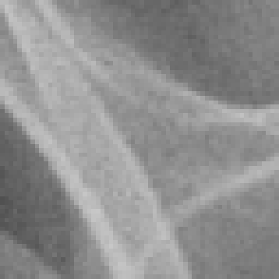

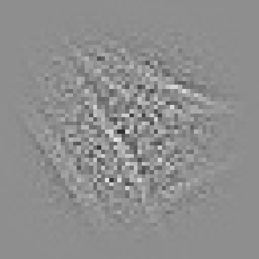
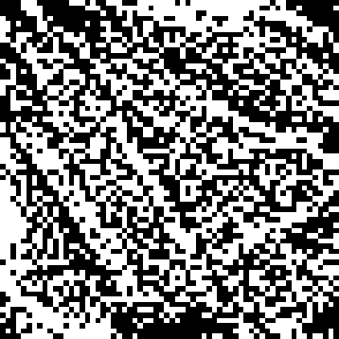
bigpatch 84
250
20
200
40
150
60
80
100
100
50
120
0
20
40
60
80
100
120
first patch ( 84)
250
downsampled by 2
250
windowed (none)
whitened (pad 2)
binarized
1
20
200
10
200
10
40
10
40
10
0.8
40
150
20
150
20
20
20
20
20
0.6
60
30
30
0
30
0
30
80
100
40
100
40
-20
40
-20
40
0.4
100
50
50
50
50
-40
50
-40
50
0.2
120
0
60
0
60
-60
60
-60
60
0
20
40
60
80
100
120
20
40
60
20
40
60
20
40
60
20
40
60
last patch ( 84)
250
downsampled by 2
250
windowed (none)
whitened (pad 2)
binarized
1
20
200
10
200
10
40
10
40
10
0.8
40
20
20
20
20
20
20
0.6
60
150
30
150
30
0
30
0
30
80
100
40
100
40
-20
40
-20
40
0.4
100
50
50
50
50
-40
50
-40
50
0.2
120
0
60
0
60
-60
60
-60
60
0
20
40
60
80
100
120
20
40
60
20
40
60
20
40
60
20
40
60
bigpatch 84 from roi 5 from image synpic45593.jpg N= 2 R= 64

Slide 3




bigpatch 84
250
20
200
40
150
60
80
100
100
50
120
0
20
40
60
80
100
120
first patch ( 84)
250
downsampled by 4
250
windowed (none)
whitened (pad 2)
binarized
1
20
5
5
40
5
40
5
0.8
40
200
10
200
10
20
10
20
10
60
150
15
150
15
0
15
0
15
0.6
80
100
20
100
20
-20
20
-20
20
0.4
100
50
25
50
25
-40
25
-40
25
0.2
120
0
30
0
30
30
30
0
20
40
60
80
100
120
10
20
30
10
20
30
10
20
30
10
20
30
last patch ( 84)
250
downsampled by 4
250
windowed (none)
whitened (pad 2)
binarized
1
20
5
5
40
5
40
5
0.8
40
200
10
200
10
20
10
20
10
60
150
15
150
15
0
15
0
15
0.6
80
100
20
100
20
-20
20
-20
20
0.4
100
50
25
50
25
-40
25
-40
25
0.2
120
0
30
0
30
30
30
0
20
40
60
80
100
120
10
20
30
10
20
30
10
20
30
10
20
30
bigpatch 84 from roi 5 from image synpic45593.jpg N= 4 R= 32

Slide 4




bigpatch 84
250
20
200
40
150
60
80
100
100
50
120
0
20
40
60
80
100
120
first patch ( 84)
250
downsampled by 8
250
windowed (none)
whitened (pad 2)
binarized
1
20
40
40
40
200
5
200
5
20
5
20
5
0.8
60
150
150
0
0
0.6
80
100
10
100
10
-20
10
-20
10
0.4
100
50
50
-40
-40
0.2
120
0
15
0
15
15
15
0
20
40
60
80
100
120
5
10
15
5
10
15
5
10
15
5
10
15
last patch ( 84)
250
downsampled by 8
250
windowed (none)
whitened (pad 2)
binarized
1
20
40
40
40
200
5
200
5
20
5
20
5
0.8
60
150
150
0
0
0.6
80
100
10
100
10
-20
10
-20
10
0.4
100
50
50
-40
-40
0.2
120
0
15
0
15
15
15
0
20
40
60
80
100
120
5
10
15
5
10
15
5
10
15
5
10
15
bigpatch 84 from roi 5 from image synpic45593.jpg N= 8 R= 16

Slide 5
N=1
downsampling
N=2
N=8
N1
20
40
60
80
100
120
20
40
60
80
100
120
Windowing,
whiting,
binarize
bigpatch 84 from roi 5 from image synpic45593.jpg N= 1 R= 128

