Slide 1

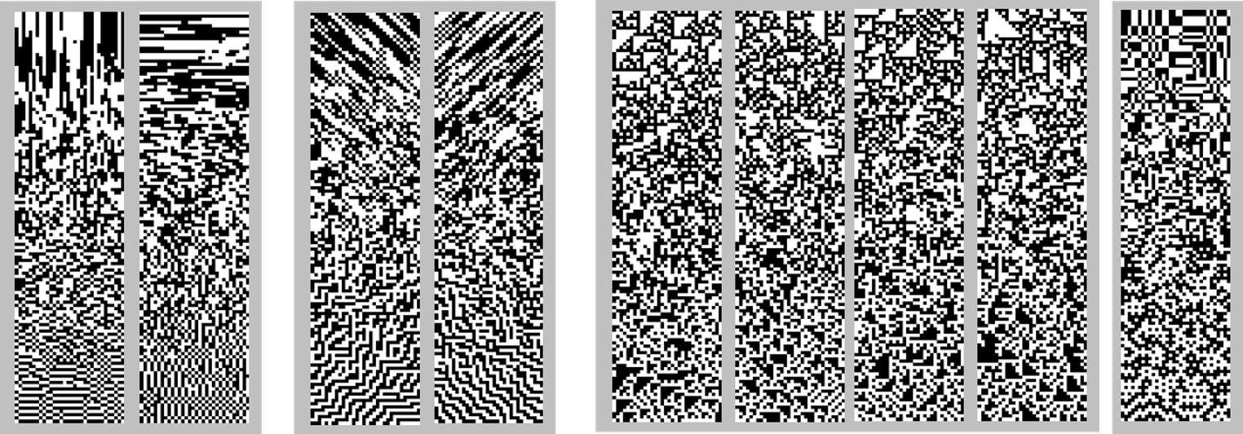

Overview A
Title and authors
Intro:
Visual Perception has evolved to process natural images.
Medical images, however, are formed by different physical processes than natural images and therefore may have different characteristics
We investigated the extent of these differences in two classes of medical images: bone radiographs and scintigrams.
For each, we analyzed two kinds of image statistics: power spectrum and local image statistics
Methods Pipeline:
Results:
Analysis of other image sets
Conclusions:
Local Image Statistics:​
Methods text and bullets:
Analysis was done on two kinds of bone images: radiographs and scintigrams, selected from MedPix (https://medpix.nlm.nih.gov).
Images included studies of extremities, cranium, spine, and thorax, and, for scintigrams, whole-body, and included studies of normal bone and a range of pathology. Images were hand-curated to remove all artifacts and labeling, and then partitioned into rectangular regions of interest (R0I’s). ROI’s were then randomly subdivided square patches of size 64 x 64 pixels, or smaller.
Radiographs
51 source images
67 ROI’s (1 to 3 per image)
ROI width: 336 to 1033 pixels
ROI height: 374 to 2021 pixels
1918 patches (64 x 64 pixels)
Scintigrams
23 source images
73 ROI’s (1 to 6 per image)
ROI width: 230 to 1024 pixels
ROI height: 134 to 1200 piAxels
1405 patches (64 x 64 pixels)
Image Formation:
Image formation caption:
Exoplain the definition between radiograph and scintigram
+1
0
-1
Second order
Third order
Refs:
Victor, J.D., and Conte, M.M. (2012) Local image statistics: maximum-entropy constructions and perceptual salience. Journal of the Optical Society of America A, 29, 1313-1345.
Hermundstad, A.H., Briguglio, J.J., Conte, M.M, Victor, J.D., Balasubramanian, V., and Tkačik, G., (2014) Variance predicts salience in central sensory processing. eLife 2014;10.7554/eLife.03722.
Fourth
order
Acknowledgments:
Supported by CA241705, EY07977

Slide 2
Overview B
Title and authors
Intro:
Visual Perception has evolved to process natural images.
Medical images, however, are formed by different physical processes than natural images and therefore may have different characteristics
We investigated the extent of these differences in two classes of medical images: bone radiographs and scintigrams.
For each, we analyzed two kinds of image statistics: power spectrum and local image statistics
Results:
Image Formation:
spectra
Local image statsitics
Image formation caption:
Exoplain the definition between radiograph and scintigram
Methods text and bullets:
Analysis was done on two kinds of bone images: radiographs and scintigrams, selected from MedPix (https://medpix.nlm.nih.gov).
Images included studies of extremities, cranium, spine, and thorax, and, for scintigrams, whole-body, and included studies of normal bone and a range of pathology. Images were hand-curated to remove all artifacts and labeling, and then partitioned into rectangular regions of interest (R0I’s). ROI’s were then randomly subdivided square patches of size 64 x 64 pixels, or smaller.
Radiographs
51 source images
67 ROI’s (1 to 3 per image)
ROI width: 336 to 1033 pixels
ROI height: 374 to 2021 pixels
1918 patches (64 x 64 pixels)
Scintigrams
23 source images
73 ROI’s (1 to 6 per image)
ROI width: 230 to 1024 pixels
ROI height: 134 to 1200 piAxels
1405 patches (64 x 64 pixels)
Methods Pipeline:
Local Image Statistics:​
Conclusions:
+1
0
-1
Second order
Third order
Fourth
order
Refs:
Victor, J.D., and Conte, M.M. (2012) Local image statistics: maximum-entropy constructions and perceptual salience. Journal of the Optical Society of America A, 29, 1313-1345.
Hermundstad, A.H., Briguglio, J.J., Conte, M.M, Victor, J.D., Balasubramanian, V., and Tkačik, G., (2014) Variance predicts salience in central sensory processing. eLife 2014;10.7554/eLife.03722.
Acknowledgments:
Supported by CA241705, EY07977

Slide 3
Methods Pipeline

