Slide 1

Bicimad Locator
A way to easily find nearby Bicimad Stations
Elena Arenal Barrantes
March 2024

Slide 2

Introduction
BICIMAD is the municipal bicycle rental service of the city of Madrid. It has 264 stations (*2024 update, it has about 600) in different districts of the city

Slide 3
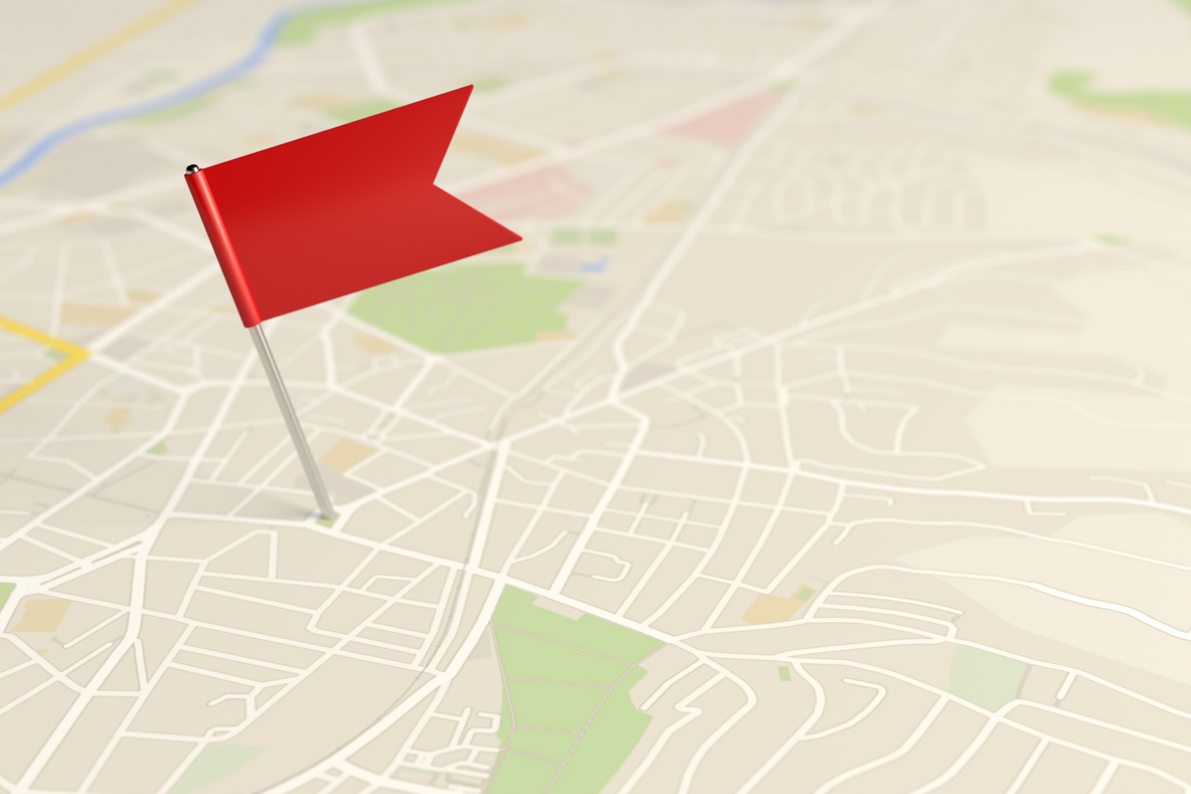
Purpose
The aim of this project is allowing the potential users to find the nearest BiciMAD station to a set of non-municipal accessible facilities of the city of Madrid (considered places of interest)using an app called BicimadLocator

Slide 4

Data Sources
Bicimad csv file (not updated) containing all the bicimad stations, their location, their operational status and other data that we found not relevant for the purpose of this Project.
API from cityhall containing all the accesible non-municipal facilities, its location, and other data that we found not relevant for the purpose of this Project.

Slide 5
Data Crossing
A new csv file has been creared containing the following data extracted from both data sources:
All the accesible non-municipal facilities, its location (longitude/latitude) matched with all the bicimad stations, it’s adress and location(longitude/latitude) and the distance between the two points. The distance have been calculated using geopandas.
General considerations:
Codification UTF-8 is requiered as the first draft of the table shows a high number of error characters. Eg: Leter ñ in Nuestra señora de la Almudena
The csv has been filtered in order to remove the non-available stations
As this information is static, it only gives a general reference of the problem. For an exact output we may have used the bicimad API (which indicates the actual number of bikes/parking spots available.

Slide 6
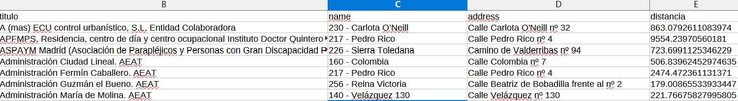
Data obtained
Example of output table filtered:
The outoput table shows the following information:
Non municipal accesible facility
The closest bicimad station and it exact address
The distance betwen the two points (straight-line distance)
Título | Name | Address | Distance
Instalation name | Name of the bicimad station | Address of the bicimad station | Distance between the two points

Slide 7
How to use it:argparse (via terminal)
Input→'-t', '--titulo’,
type=str,
help='Instalación accesible no municipal, input todos/as para listado completo')
OPTION 1(destination point)
For the user who wants to get the closest bicimad Station to a specific place:
The user shall input the name of the place of interest to be reached.
E.g: “Museo del Prado”
OPTION 2
For the user who wants to get the information for all the places of interest, the input shall be “todos” (the string todos is not case sensitive)
E.g: “TODAS”

Slide 8
Limitations & Improvements to be made
Conect with BiciMad API updated in real-time instead of using the CSV containing fixed data.
Improve the usability of your app by using FuzzyWuzzy (which matchs approximate names with actual results )
Make the data obtained bidirectional: allow the user introduce indistinctly the input for the place of interest or the bicimad station.

Slide 9
Thank you for your attention

