Slide 1
NYC Restaurant Inspection Analysis
Understanding Food Safety Patterns
Prepared by Elena Daniels

Slide 2
Objective
Analyze restaurant inspection outcomes across NYC from 2023 to 2025
Identify patterns in violation severity, cuisine type, and grading
Evaluate whether inspection grades reflect actual food safety risk

Slide 3
Dataset Overview
Source: NYC Department of Health and Mental Hygiene (NYC Open Data) https://data.cityofnewyork.us/Health/DOHMH-New-York-City-Restaurant-Inspection-Results/43nn-pn8j/about_data
~300,000 inspection records
~26,000 unique restaurants| ~90 cuisine types
The dataset is updated daily and contains current inspection data for permitted restaurants and college cafeterias (hereafter, restaurants) in NYC for the past several years.

Slide 4
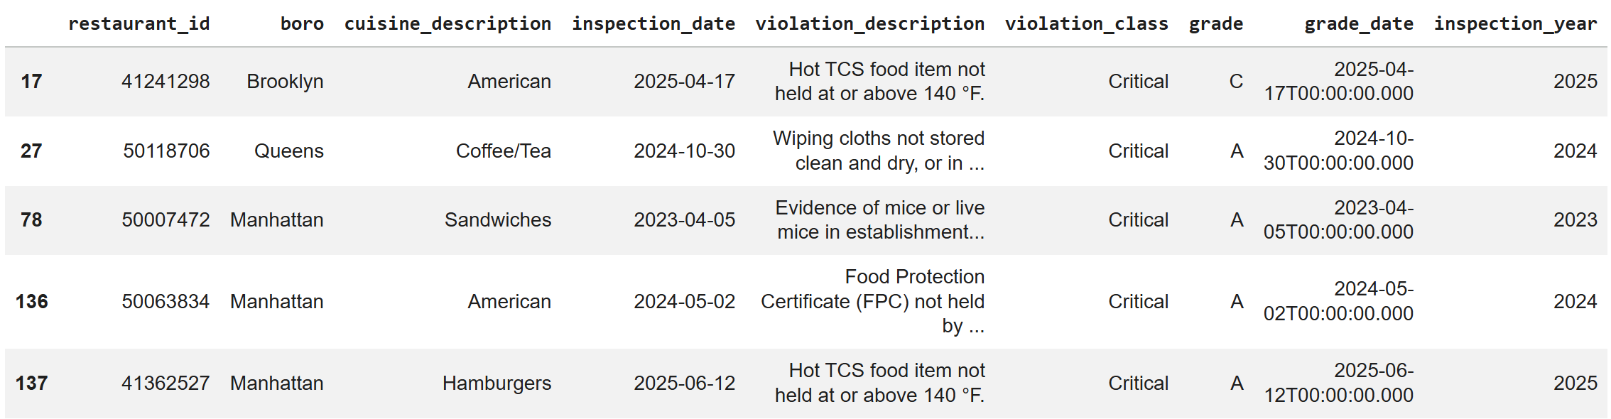
Data Cleaning & Preparation
Removed unnecessary columns to focus the analysis
Eliminated records with invalid placeholder dates (e.g., 1900-01-01)
Extracted inspection year for time-based analysis
Filtered out records with missing or invalid borough values
Renamed columns for clarity and consistency

Slide 5
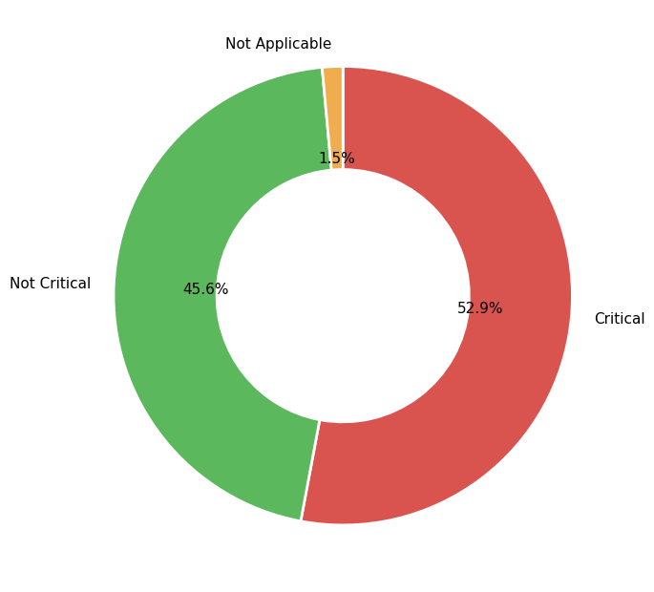
Violation Class Distribution (Overall)
NYC Inspection Scoring System
Critical Violations (5-7 points each)
Major food safety risks that can directly contribute to foodborne illness:
Food not cooked to required minimum temperature
Hot/cold food not held at proper temperature
Evidence of mice or live roaches
Food from unapproved or unknown source
General Violations (2-4 points each)
Less serious issues that can indirectly affect food safety:
Improper cleaning of utensils
Insufficient lighting or ventilation
Failure to properly post signs or permits
Minor maintenance issues

Slide 6
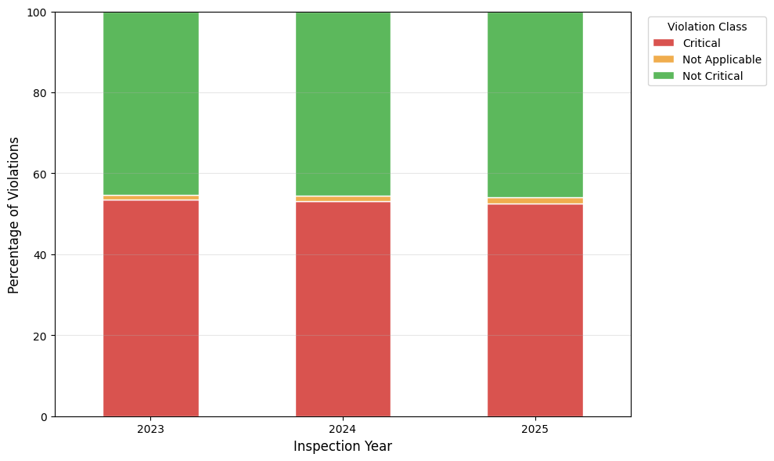
Violation Trends Over Time

Slide 7
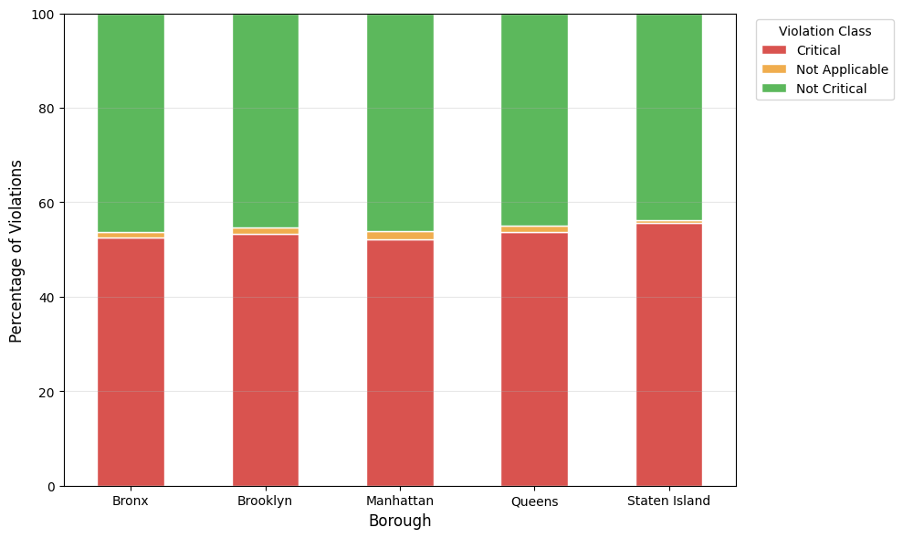
Violation Distribution by Borough

Slide 8
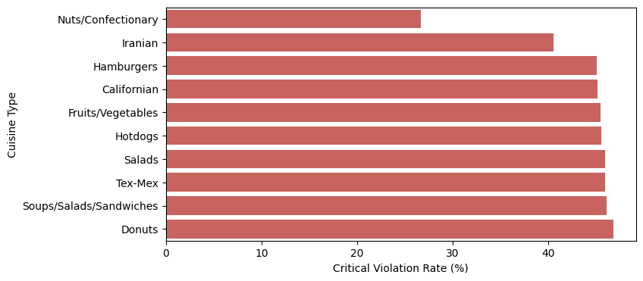
Cuisine Analysis (Lowest Critical Violation Rates)

Slide 9
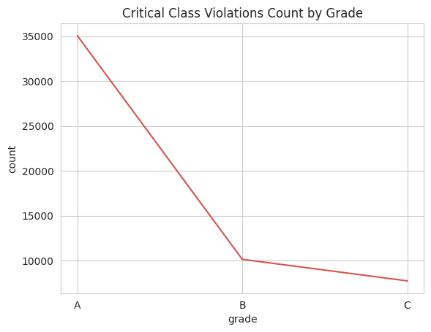
Are Grade “A” Restaurants Actually Safe?
Food Safety Grade System
Grade A (0-13 points)
Excellent
Grade B (14-27 points)
Good
Grade C (28+ points)
Poor

Slide 10
Key Findings
Most inspections result in at least one violation
Critical violations occur in ~50% of inspections
Patterns consistent across boroughs and years
Food safety challenges are not dependent on cuisine types
Grade A does not guarantee food safety

Slide 11
Conclusion
Food safety compliance is not ideal across NYC restaurants
Inspection grading may not fully reflect real-time risk
More compliance is needed

