Slide 2
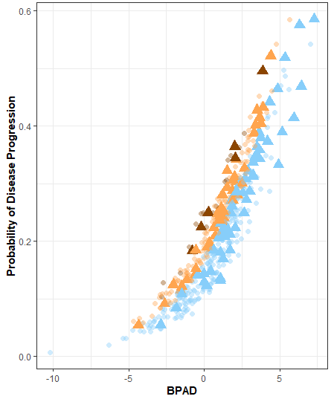
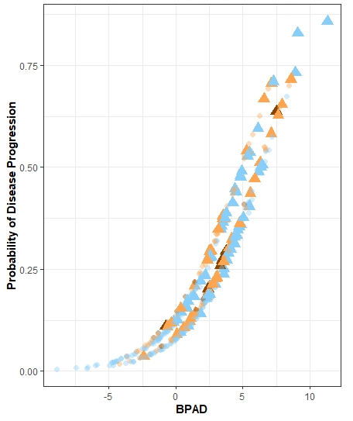
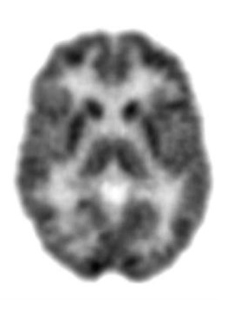
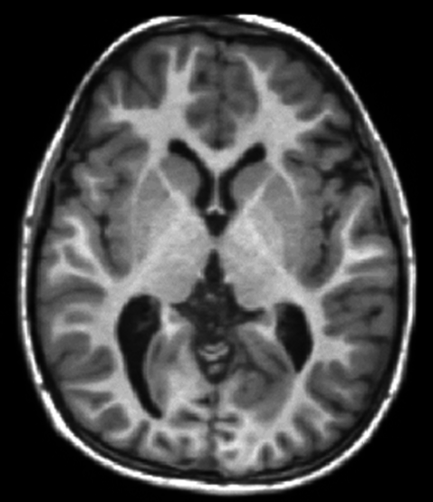
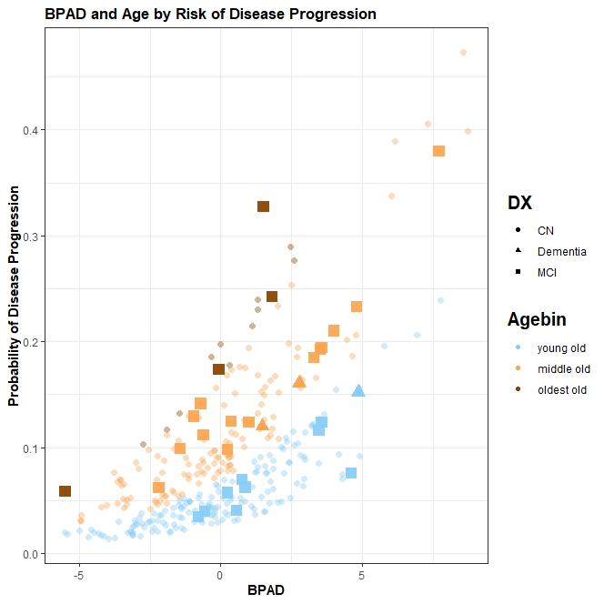
negative BPAD
Total: 131
Converters: 5 (4%)
negative BPAD
Total: 159
Converters: 16 (10%)
36%
***
46%
***
increased odds per 1 year BPAD to develop AD within 2 years
increased odds per 1 year BPAD to develop AD within 2 years
positive BPAD
Total: 303
Converters: 84 (28%)
positive BPAD
Total: 331
Converters: 95 (29%)
(A)
(B)
0
0
.
MCI (n=362) AD (n=100)
Diagnosis after 24 months
Age Category
<75 y. 75 – 84 y. > 85 y.
* Significant at p < 0.05, ** p < 0.01, *** p < 0.001

