Slide 1
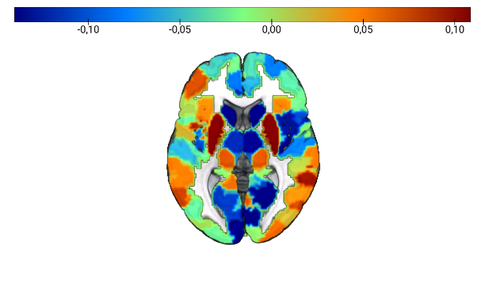
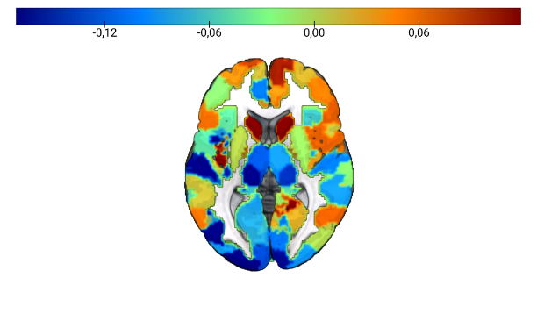
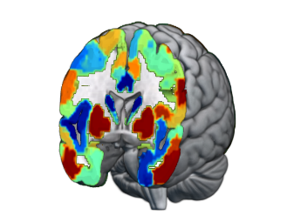
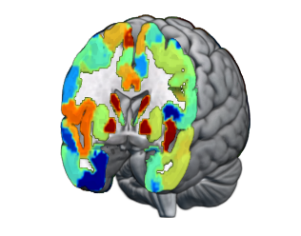
FDG-PET
MRI
a)
b)

Slide 2
ADNI_MEM
MCI
ρ = -.391**
ρ = -.208**
BPAD [years]
Sex
Male
Female
Modality
FDG-PET
MRI

Slide 3
ADNI_EF
ADNI_EF
CN
ρ = -.150**
ns
MCI
ρ = -.285**
ρ = -.246**
a)
BPAD [years]
b)
Male
Female
BPAD [years]
Sex
Modality
FDG-PET
MRI

Slide 4
CSF Aβ₁₋₄₂ [pg/ml]
CSF Aβ₁₋₄₂ [pg/ml]
CN
ρ = -.126*
ρ = -.160**
MCI
ρ = -.261**
ρ = -.216**
a)
b)
BPAD [years]
BPAD [years]
Sex
Male
Female
Modality
FDG-PET
MRI
pTau₁₈₁ [pg/ml]
MCI
ρ = .138**
ρ = ns
c)
BPAD [years]

Slide 5
CSF Aβ₁₋₄₂ [pg/ml]
CSF Aβ₁₋₄₂ [pg/ml]
CN
ρ = -.126*
ρ = -.160**
MCI
ρ = -.262**
ρ = -.216**
a)
b)
BPAD [years]
BPAD [years]
Sex
Male
Female
Modality
FDG-PET
MRI

Slide 6
Sample 1
Sample 2
Predicted Probability of Cognitive Decline [%]
OLD
Predicted Probability of Cognitive Decline [%]
a)
PET-BPAD [years]
b)
PET-BPAD [years]
DX after 2 years
CN
MCI
AD
Aβ status
-
NA
+

Slide 7
Sample 1
Sample 2
Predicted Probability of Cognitive Decline [%]
Predicted Probability of Cognitive Decline [%]
a)
PET-BPAD [years]
b)
PET-BPAD [years]
APOE-ε4 carriership
carrier
non-carrier
DX after 2 years
CN
MCI
AD
Aβ status
negative
positive

Slide 8
Sample 1
Sample 2
Predicted Probability of Cognitive Decline [%]
Predicted Probability of Cognitive Decline [%]
a)
MRI-BPAD [years]
b)
MRI-BPAD [years]
Sample 1
Sample 2
Predicted Probability of Cognitive Decline [%]
Predicted Probability of Cognitive Decline [%]
c)
MRI-BPAD [years]
d)
MRI-BPAD [years]
DX after 2 years
MCI
AD
APOE-ε4
carrier
non-carrier

Slide 9
Education
PET-BPAD
MRI-BPAD
APOE-e4 carrier
Aβ+
Aβ NA
Sample 1
Sample 2

Slide 10
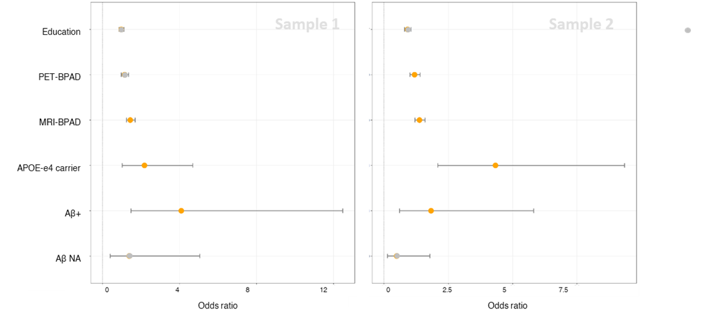
OLD

