Slide 1
Fully Homomorphic Encryption in a hospital management and analysis platform
Supervisor
Prof. Dr. Crivei Septimiu
Author
Isaia Elena

Slide 2
Table of contents
Homomorphism
Homomorphic Encryption
Fully Homomorphic Encryption
Application: MedIntel
Demo
Conclusions and future enhancements
Bibliography

Slide 3
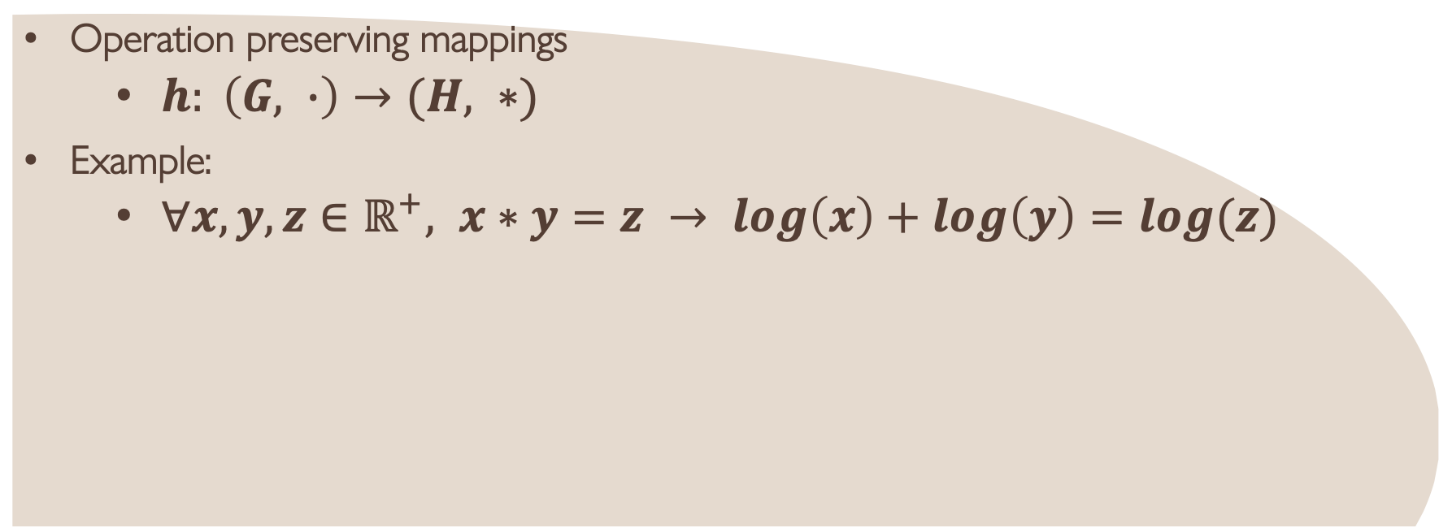
Homomorphism
Operation preserving mappings
  $h: \left(G, ∙\right)→(H, ∗)$
Example:
  $∀x,y,z∈ℝ^{+}, x∗y=z → log\left(x\right)+log\left(y\right)=log(z)$
Notes:
Depending on the institution or service, some examples of plaintext include email messages, word processor files, patient medical history, employee personal data, or ATM and credit card transaction information.
Homomorphic encryption was defined as a form of encryption where a specific algebraic operation performed on plaintext is equivalent to another algebraic operation performed on its ciphertext. In mathematics, these operations are called mappings or functions, and they are operation preserving (OP) mappings. Let (G, o) and (H, ∗) be two groups. An OP mapping h : (G, o) → (H, ∗) is called a homomorphism from (G, o) to (H, ∗). The h function is an operation that preserves the structure from one set of data to another.

Slide 4
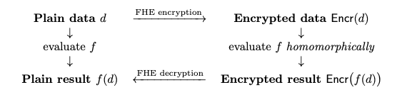
Homomorphic Encryption
Partially Homomorphic Encryption (RSA, El Gamal, Pailler)
Somewhat Homomorphic Encryption (BV, FV, CKKS)
Fully Homomorphic Encryption (Gentry, BFV, BGV; OpenFHE, Concrete, Microsoft SEAL)
Fig. 1: HE operation flow [1]
Notes:
Brakerski and Vaikuntanathan, Fanand and Vercauteren, Cheon, Kim, Kim and Song
Partial, oarecum, complet

Slide 5

Fully Homomorphic Encryption
Noise: leveled vs bootstrapping FHE
TFHE scheme – the best choice
Fig. 2: The three FHE goals [1]

Slide 6
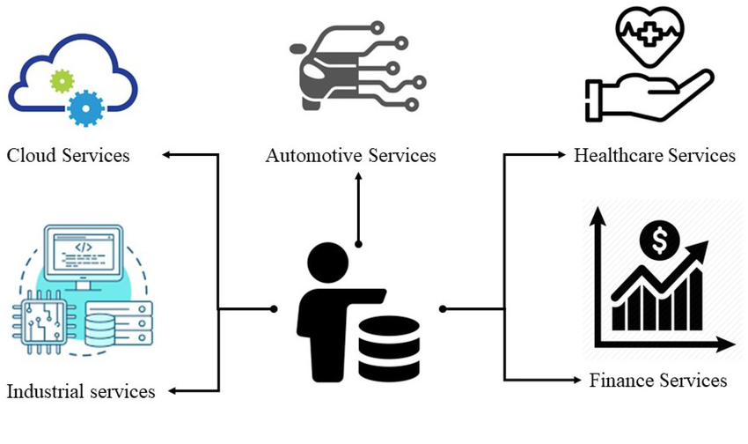
Fully Homomorphic Encryption
FHE usages in practice
Data privacy
and security
Fig. 3: FHE usages [2]

Slide 7
Application: MedIntel
Technology:
  Backend: Python, Concrete (Zama)
  Frontend: React, JavaScript, CSS, Bootstrap
Hospital management analytics application
  Measurements: average length of stay, costs per patient, hospital expenses, mortality rate
  CRUD operations: add expense, add/update patient hospitalization
  Data handling: FHE usage
Notes:
3600 entries

Slide 8

Application demo: MedIntel

Slide 9
Conclusions and future enhancements
New statistics and measurements
Cloud
Well-trained AI model

Slide 10
Thank you for your attention!

Slide 11
Bibliography
Jakub Klemsa. “Hitchhiker’s guide to the tfhe scheme”. Journal of Cryptographic Engineering, 2023.
Rafik Hamza, Alzubair Hassan, Awad Ali, Mohammed Bashir, Samar M. Alqhtani, Tawfeeg Mohmmed, and Adil Yousif. “Towards secure big data analysis via fully homomorphic encryption algorithms”. Entropy, 24:519, 04 2022.
 | Described fault-tolerance mechanism | Addressed types of fault | Factors leading to failure | Type of IoT system | Evaluation methods | Architecture layer where the fault-tolerance mechanism applies to | Security considerations
1 | AI-driven fault tolerance model using machine learning for proactive fault prediction | Hardware failures, communication faults, data corruption | environmental factores, hardware degradation, network interference | Wireless Sensor Networks(WSNs) | Simulation experiments, performance metrics analysis | Network layer | Basic security protocols to ensure data integrity
2 | Hybrid aproach combining static backups with dynamic timing monitoring to ensure cluster head reliability | Node failures, timing faults, synchronization issues | Node crashes, timing delays, network congestion | Clustered IoT networks | Experimetal setups, reliability and latency measurements | Network layer | Briefly mentioned availability
3 | Uses redundancy and real-time monitoring to ensure continuous data transmission and processing | Sensor malfunctions, data transmission errors, power failures | Hardware sensor failures, network instability, power outages | mHealth IoT systems(wearable health sensors) | Case studies, real-time performance | Application layer | Privacy and data security
4 | Blockchain-based key management system with redundancy to ensure secure and fault-tolerant key distribution in LoRaWAN networks | Key management faults, security breaches, unauthorized access | Key compromise, blockchain vulnerabiities, network attack | LoRaWAN IoT networks | Security analysis, blockchain simulation | Security layer | Blockchain ensures tamper-proof key management
5 | Byzantine fault-tolerance(BFT) mechanisc | Byzantine faults, node failures, malicious attacks | adversarial attacks, faulty nodes, network partitioning | Mission-critical IoT applications | Availability analysis, simulation studies | Network layer
6 | Fuzzy interferance base approach to enhance BFT | Security related faults, byzantine faults | Security attacks. node compromise | IoT security systems | Fuzzy logic simulations | Security layer
7 | Hierarhical byzantine fault tolerance protocol to improve scalability and reliability | Byzantine faults, malicious node behaviors | Network scalability issues | General IoT networks | Simulation studies | Network layer
8 | Optimization algorithm used for reliability, performance and resoure utilization | Resource failure, computational faults | Resource constraints, hardware limitations | Fog computing-based IoT applications | Algorithmic evaluation, simulation | Fog layer
9 | Transmission scheme incorporating redundancy and Software Defined Networking(SDN) | Transmission faults, network failures, data loss | Fiber link issues, wireless interface | Industrial IoT (IoT) networks | Performance testing, SDN simulation | Transmission layer | Basic security integrated with SDN controls
10 | Optimal placement strategies for deploying fault-tolerance components | Resource failure, node faults | Poor placement strategies, resource limitatons | General IoT systems | Optimization models, simulation | Network/application layer
11 | Dynamic Route Protection (DRP) | network failure (single or multiple link/switch failure) | device faults, link congestion, bandwidth issues | Industrial IoT (IoT) | network simulation with Mininet-IoT simulation, experimental hardware testbed | network layer | brief mention of resilience and cyber-security
12 | Fault Tolerant Node Placement Algorithm (FTNPA) with centralised and decentralised variants | sensor node and link failures | battery exhaustion, communication issues, node disconnections. | Wireless sensor network (WSN) based IoT | COOJA simulator for Contki OS nodes, multiple scenarios for both centralised and decentralised variants | network layer
13 | Complex Patterns of Failure (CPoF): approach providing reactive and proactive fault tolerance using Complex Event Processing (CEP) and Machine Learning (ML) | all | any | all | case study analysis of an indoor agriculture sysem | data processing layer
14 | data validation and hardware redundancy | transient or soft faults, permanent or hard faults, intermittent faults | temporary malfunctions that last for a limited period of time and will go away after a while, even if not addressed; physical damage or permanent malfunction in components or design; marginal factors | IoT based positioning system | analysing and comparing the reliability of the components of the system in their standard architecture and after the adoption of the proposed changes in the study, through the use of simulation | controller layer
15 | Deep Reinforcement Learning (DRL), cluster-based routing schemes, swarm intelligence algorithms, routing protocols with leader node in ad hoc networks, routing schemes based on the Ant Colony Optimization algorithm, particle swarm optimization (PMSO) routing approach, integrated multi-layer and learning automata routing, Free Poisson Law method | network failure (single or multiple link/switch failure) | breakdown of the wireless nodes' communication module, battery drain, changes in the network topology, node failure due to natural disasters | cloud-based IoT and WSN-based IoT | comparison of the protocols using qualitative parameters | network layer
16 | diagnosing faulty nodes and excluding them from the system | sensor faults, actuator faults, processing elements faults, communication links and system faults |  | military IoT | COOJA simulator, measuring parameters | sensor layer, network layer
17 | backup routing between nodes and advanced service mechanisms to maintain connectivity in case of failing connections | malfunction of sink node hardware, traffic bottleneck at a node | mechanical failures, high receiving data rates | medical IoT | case study with scenarios that include different configurations among the nodes | gateway layer
18 | fault-tolerant mechanism to increase the reliability of data transmission between fog devices that combines Directed Diffusion and Limited Flooding algorithms. | node/link failures, data packet loss. | relay node malfunction, data transmission errors | medical IoT | experimental simulations, performance comparison | Fog layer
19 | distributed agent-based fault-tolerance. | device faults, measurement anomalies | corruption of one or more electronic components, environmental effect on measurement due to a noise or software problem | medical IoT | experimental simulation, fault injection experiments | application and monitoring layer. | use of message signing for non-repudiation.
20 | fault-prevention by applying appropriate quality assurance techniques during the design and implementation process or by performing fault forecasting and removing a system component that is most likely to crash; fault-masking based on redundancy methods; fault monitoring with watchdog timers; fault detection and diagnosis. | hardware/software faults, transient and permanent, communication faults. | economic factors, unpredictability of a military operational environment | military IoT | none | all layers | integration with reliability, distributed trust, and cryptographic mechanisms.
21 | Energy-Aware Available and Fault-Tolerant System with Message Scheduling (EAAFTMS) that enhances IoT system reliability | Node failures, communication failures, energy depletion | Energy constraints, data loss in transmission, dynamic network conditions | Wireless Sensor Networks (WSNs) | Simulation via MATLAB, network lifetime, energy dissipation, number of alive nodes and brokers | network layer | Data backup and availability, fault recovery
22 | Fault-tolerant privacy-preserving data aggregation scheme (PDAF) based on the Paillier homomorphic encryption algorithm | False data injection attacks, device failures, and data modification attacks | False data injections, IoT device breakdowns, and compromised communication channels due to network vulnerabilities | Fog computing-based IoT environment | Computational cost, communication overhead, and privacy preservation efficiency | Fog layer | Paillier homomorphic encryption, batch verification techniques
23 | Hybrid fault-tolerance architecture called PRP-FRC that integrates both reactive and proactive policies to enhance reliability in IoT systemsA | Hardware Failures, software failures, communication failures, real-time failures | High dependency on wireless communication, cyberattacks, environmental factors, scalability challenges | real-time industrial IoT systems | CloudSim simulator, Pegasus-WMS simulator, fuzzy logic | communication platform layer | Cybersecurity measures, reliability testing
24 | Adaptive safety fault diagnosis model for industrial control systems based on ensemble learning | Mechanical failures, dynamic parameter failures, sensor-generated fault signals | Dynamic environmental changes, complex interactions between components, system scalability | Industrial Internet of Things (IIoT) systems | CWRU Bearing Fault dataset, dynamic testing, diagnostic accuracy comparison | application layer | System reliability, fault detection accuracy
25 | Fault-tolerance through Kubernetes' Horizontal Pod Autoscaling (HPA) and replica mechanisms, allowing services to scale automatically based on workload | Node disruptions, application-level failures, and container crashes | Resource exhaustion, network traffic overload, misconfigurations within the Kubernetes cluster, limitations in cluster scalability and replication | Smart home IoT system | Response time, CPU/memory usage, disk saturation, and successful request rates analysis using Grafana and Prometheus | Kubernetes orchestration layer | Attribute-based policies at the application level, Zero Trust principles, role-based access control, and resource isolation
26 | Byzantine Fault-Tolerance (BFT) | Byzantine Faults, Omission Faults, Malicious Attacks,Cloud Outages | Malicious Insider Behavior, Distributed Nature, Cloud Dependence, Network Delays, Resource Constraints | Real-time monitoring in agriculture, Smart city infrastructure. Industrial IoT systems | Voting Algorithm, Byzantine Fault Simulation, Communication Complexity | Edge Tier, Cloud Tier, Device Tier | Encryption, Authentication, Byzantine Fault Protection, Resilience to Cloud Outages
27 | Stateless Microservices, Dynamic Agent Recovery, Kubernetes Orchestration | Platform Faults, Agent Faults, Hardware Failures, Distributed System Failures: | Scalability Bottlenecks, Hardware Constraints, Synchronization Overheads, Faulty Components | SwarmGrid-X (decentralized control system for power grids), Agent-Based IoT | Benchmarks, SwarmGrid-X Simulation, Agent communication time, DF response time, and agent recovery time after failure | Platform Layer, Application Layer | Isolated Containers, Distributed Data Storage, Network Security, State Consistency
28 | Energy-Efficient Checkpoint Restore and Backup with Classification | System Faults, Execution Faults, Network Faults, Energy-Related Failures | Fog Device Failures, Heavy Workloads, Energy Inefficiency, Network Bottlenecks | Video Surveillance/Object Tracking, Smart Cities and Industrial IoT Systems | Simulation Environment, Energy Consumption, Execution Cost | Fog Layer, Cloud Layer, Device Layer | Primary and Backup Isolation, Redundancy, Efficient Load Balancing, Energy Optimization
29 | Practical Byzantine Fault Tolerance (PBFT) algorithm to enhance fault tolerance in IoT intrusion detection | Denial of service (DoS), unauthorized access, and inconsistencies in node data | Malicious node behavior, high false-positive rates in intrusion detection, and energy consumption inefficiencies | Mobile Internet of Things (IoT) environment | Detection rate, false positive rate, and energy consumption analysis by simulating various attack scenarios under different node and cluster configurations | Application layer | Game theory-based strategy for attacker and intrusion detection
30 | Fault-tolerant privacy-preserving data aggregation scheme (PDAF) based on the Paillier homomorphic encryption algorithm | False data injection attacks, device failures, and data modification attacks | False data injections, IoT device breakdowns, and compromised communication channels due to network vulnerabilities | Fog computing-based IoT environment | Computational cost, communication overhead, and privacy preservation efficiency | Fog layer | Paillier homomorphic encryption, batch verification techniques

