Slide 1
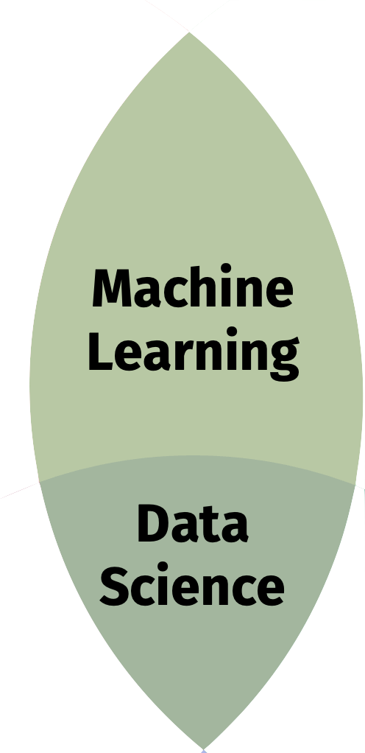

Slide 2
Substantive Expertise

Slide 3
Hacking Skills
Machine
Learning
Data
Science
Danger Zone!
Substantive Expertise

Slide 4
Ethics and Philosophy
Skills
Data Science Skills
Moral Machine
Data Science Ethics
Applied Data Science
Applied Ethics
Substantive
(and legal?) Expertise

Slide 5
Machine
Learning
Data
Science

Slide 6
