Slide 1
Understanding Idiomatic Langauge using Neural Networks
Ling 575 Group 1: Josh Tanner, Paige Finkelstein, Wes Rose, Elena Khasanova, and Daniel Campos
February 20th, 2020

Slide 2
Outline
Paper Introduction
Project Introduction
Idioms and Neural Networks (Daniel)
Q&A
Evaluating NLM language Understanding (Wes)
Q&A
Experiment Design
Method of Evaluation
Q&A

Slide 3
Papers Intoduction
What do Neural Networks Actually Learn, When They Learn to Identify Idioms? LINK
Still a Pain in the Neck: Evaluating Text Representations on Lexical Composition. LINK

Slide 4
Project Introduction
Can Neural Language Models Understand Idioms?

Slide 5
What do Neural Networks Actually Learn, When They Learn to Identify Idioms?
This paper describes a probing task, where the authors took a neural model designed for idiom detection and investigate what exactly allows the network to identify idioms. They present 2 hypotheses and then test the hypotheses through ablation, by removing training data in a targeted way. The first hypothesis is that the network could be using the idea of concreteness vs. abstractness to identify idioms as compared to literal phrases. The second is that the network uses ambiguity as a factor, with the idea being that idioms are more ambiguous on average than literal language. They test the model with the most concrete literals removed, then again with the most ambiguous idioms remove. They find that performance dropped significantly with concrete literals removed, and that the performance dropped only marginally with the more ambiguous idioms removed. This supports the hypothesis that idiom detection, at least in the neural model examined, relies on the distinction between concrete and abstract language.

Slide 6
Guiden Q&A
Sample Question 1
Sample Question 2

Slide 7
Still a Pain in the Neck: Evaluating Text Representations on Lexical Composition.
(Reference slide – remove later)
This paper addresses the challenge of understanding meanings of phrases. It gives some background on the problem before defining six classification tasks related to Lexical Compositionality and testing the performance of six different word representations on these tasks. The contextual representations, unsurprisingly, perform the best. Interestingly, they perform comparably to humans on the tasks intending to test meaning shift, while they perform far worse than humans on tasks related to implicit meaning.

Slide 8
Outline
Note: would be good to come up with some discussion questions.
Idea: Give some questions at the beginning. Ask people to consider them, then I’ll ask periodically for input?
Idea: What if I present results as I go through each task? First explain the models used, then give task + results?
Background
lexical semantics and compositionality.
Examples of difficult things?
Meaning Shift and MWEs. Note implicit meaning/ world knowledge
Intro to paper
Define an evaluation suite for lexical composition for NLP applications
Evaluate some common word representations using the suite.
Constructed a model using these word représentations.
Make some diagram showing 6 representations, 1 model each, 6 tasks each.
Collect some human baselines
Analyze the results
Note – departing a bit from the order/chronology of the paper. I thought it might help with understanding.
Représentations
Split into static embeddings vs. Contextual embeddings
List / briefly explain the 6 représentations used.
Classification Models
These are what were used to perform the six tasks.
Basically, operationalize the représentations.
Explain “embed, encode, predict”
Tasks from the evaluation suite:
Split into implicit meaning vs. Meaning Shift
Explain each task in some detail with examples from data set.
For each task, show the results of each model and human baseline.
Full summary of results
Analysis
MWEs and Implicit Meaning
Related work? Not sure if important
Summary

Slide 9
The Principle of Compositionality
“The meaning of a complex expression is determined by its structure and the meanings of its constituents.”
Lexical Semantics
Syntax
Given any complex expression e in a language L, lexical semantics and syntax determine the semantics of e.
https://plato.stanford.edu/entries/compositionality/
Notes:
Before delving into the details of this paper, I want to examine its motivations. First, I want to touch on the principle of compositionality. There is a lot of literature around compositionality, and variable definitions, but we don’t need to get too deep into the theory for this presentation so this should suffice. Compositionality is the idea that “The meaning of a complex expression is determined by its structure and the meanings of its constituents.” Furthermore, we can say that Given any complex expression e in a language L, lexical semantics and syntax determine the semantics of e.

Slide 10
Difficulties with Compositionality
Keep Calm and Carry On ?
used as a function word to indicate the location of something
used as a function word to indicate a source of attachment or support
used as a function word to indicate a time frame during which something takes place
used as a function word to indicate manner of doing something
to move while supporting
to convey by direct communication
to contain and direct the course of
to cause to remain in a given place, situation, or condition
free from agitation, excitement, or disturbance
Example from Schwartz et al.
Definitions from m-w.com

Slide 11
Difficulties with Compositionality
The tea is heating up
To become warm or hot
The argument is heating up
To excite
Which meaning to select?
Example from Schwartz et al.
Definitions from m-w.com

Slide 12
Difficulties with Compositionality
Meaning Shift
The meaning of the phrase departs from the meaning of its constituent words
E.g. Carry on, guilt trip, pain in the neck
Common in multi-word expressions
Implicit meaning
A meaning resulting from composition that requires world knowledge
E.g. hot argument vs. hot tea, olive oil vs. baby oil.
Schwartz et al.

Slide 13
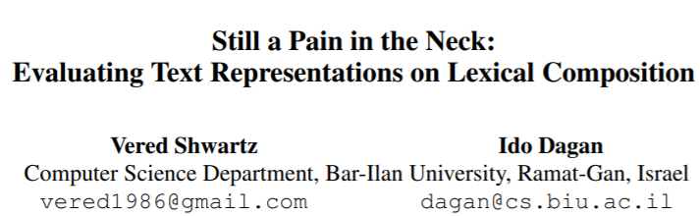
Goals of the paper:
Define an evaluation suite for lexical composition for NLP models.
- Based on meaning shift and implicit meaning.
2) Evaluate some common word representations using this suite.
- Word2Vec, GloVe, fasttext, ELMo, OpenAI GPT, BERT
Notes:
Now that we’ve explored a bit of the motivation, we’re ready to dive into the paper. You all may recognize the name on the left, Vered Schwartz, from the Treehouse talk a few weeks ago. The name, “Still a Pain in the Neck” is a reference to a paper by Ivan Sag from 2002 (whose name we all recognize from our syntax class). So this is a problem that the community has been looking at for many years.
This paper provided two major contributions: The primary purpose of the paper is to define an evaluation suite for lexical composition for NLP models based on meaning shift and implicit meaning. The authors understand that this is still a troublesome field and are providing a way to evaluate future models as NLP practitioners try to solve this problem. The suite is a set of 6 classification tasks focused on targeted groups of lexical compositions.
Additionally, the others evaluate some common word representations using their suite, to paint a picture of how well applications can handle lexical composition today. You can see a list of the word representations that they use on the slide. They build straightforward models around these representations and then evaluate them against each other, against a naïve baseline, and against a human baseline.

Slide 14
Overview of Methodology
Lexical Composition Tasks
Verb-Particle Construction
Light Verb Construction
Noun Compound Literality
Noun Compound Relations
Adjective Noun Attributes
Identifying Phrase Types
Classifiers
Baselines
Global Embeddings
Contextual Embeddings
Word2Vec
GloVe
fasttext
ELMo
OpenAI GPT
BERT
Don’t love the diagram here… It’s not really a network architecture. Maybe concept bubbles instead?

Slide 15
Overview of methodology
Train 6 classification models, one for each of 6 types of word representations.
For 6 tasks, test each of these models. Compare to each other and to baselines.
Lexical Composition Tasks
Classification Models
Baseline Models
Verb-Particle Construction
Noun Compound Relations
Word2Vec
ELMo
Human Baseline
GloVe
GPT
Majority_{ALL} Baseline
Light Verb Construction
Adjective Noun Attributes
fasttext
BERT
Majority₁ Baseline
Majority₂ Baseline
Noun Compound Literality
Identifying Phrase Types

Slide 16
Overview of Methodology
 |  | Task
 |  | Verb-Particle Construction | Light Verb Construction | Noun Compound Literality | Noun Compound Relations | Adjective Noun Attributes | Identifying Phrase Types
Classification Model | Word2Vec
 | GloVe
 | fasttext
 | ELMo
 | GPT
 | BERT
 | Human Baseline
 | Majority_ALL
 | Majority_1
 | Majority_2

Slide 17
Overview of methodology
Train 6 classification models, one for each of 6 types of word representations.
For 6 tasks, test each of these models. Compare to each other and to baselines.
Lexical Composition Tasks
Classification Models
Baseline Models
Verb-Particle Construction
Noun Compound Relations
Word2Vec
ELMo
Human Baseline
GloVe
GPT
Majority_{ALL} Baseline
Light Verb Construction
Adjective Noun Attributes
fasttext
BERT
Majority₁ Baseline
Majority₂ Baseline
Noun Compound Literality
Identifying Phrase Types

Slide 18
Classification Models
Embed-Encode-Predict
Input Sentence
Embed
(Pre-trained representation)
Encode
(Transform the embedding)
Predict
(Perform Classification)

Slide 19
Classification Models
Embed-Encode-Predict
Input Sentence
Embed
(Pre-trained representation)
Encode
(Transform the embedding)
Predict
(Perform Classification)

Slide 20
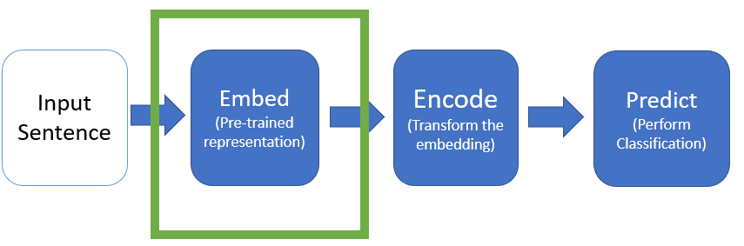
Classification Model: Embed (Word Representations)
Global Embeddings
Contextual Embeddings
Word2Vec
Using Skip-Gram
GloVe
fasttext
ELMo
OpenAI GPT
BERT
(Use top layer or scalar mix)
Notes:
The authors evaluated 6 different well-known word representations, including 3 global embeddings and 3 contextual embeddings.
I think we’re all pretty familiar with most of these, but I’ll give a quick summary of each type of embedding.
Word2Vec can be trained with two different objectives, and they chose skip-gram. The model learns to predict context words given the target word
GloVe learns to estimate log-probabilities of a word pair co-occurrence.
Fasttest extends Word2Vec by adding information about subwords, or bag-of-character n-grams.
ELMo is a bi-LSTM trained on a language modeling task. It is a combination of a left-to-right and right-to-left LM.
OpenAI GPT is a transformer using subwords as the basic unit, and it is strictly left-to-right.
BERT is a transformer that learns a bi-directional LM, with access to the full sentence at training time.
For the Contextual Embeddings, the authors experiment with using only the top layer and a learned scalar mix of all layers.

Slide 21
Classification Models
Embed-Encode-Predict
Input Sentence
Embed
(Pre-trained representation)
Encode
(Transform the embedding)
Predict
(Perform Classification)

Slide 22
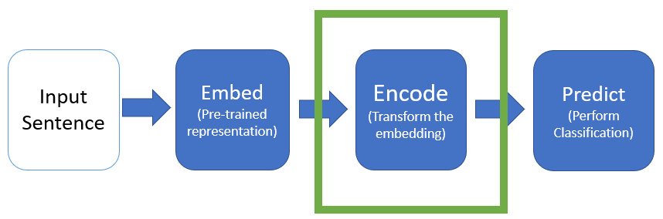
Classification Model: Encode
Input to encode layer is sequence of pretrained embeddings V = <v1,…,vn>
Output is U = <u₁, …, u_{n}>
biLM
Att
None
Encode embedded sequence using biLSTM
U = biLSTM(V)
Encode embedded sequence using self-attention
U_{i} = [v_{i} Σa_{i,j} . V_{j}]
Don’t encode the embedded text
Use the embeddings as they are
U = U
Notes:
Attention: Each word is the concatentation of the embedded word and a weighted average over other words in sentence

Slide 23
Classification Models
Embed-Encode-Predict
Input Sentence
Embed
(Pre-trained representation)
Encode
(Transform the embedding)
Predict
(Perform Classification)

Slide 24
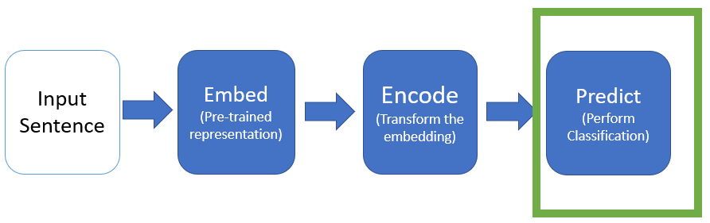
Classification Model: Predict
Takes output U from Encode layer, and passes it to a feed-forward Neural Network Classifier
Represent a “span” of text by concatenating end-point vectors
E.g. u_{i,…,i+k} = [u_{i} ; u_{i+k}]
X = [u_{i};u_{i+k};u’₁;u’_{l}]
u’₁ and u’_{l} may be empty. For some tasks, a 2nd span is needed.
X is passed into classifier
Classifier output o is a softmax over all categories

Slide 25
Overview of methodology
Train 6 classification models, one for each of 6 types of word representations.
For 6 tasks, test each of these models. Compare to each other and to baselines.
Lexical Composition Tasks
Classification Models
Baseline Models
Verb-Particle Construction
Noun Compound Relations
Word2Vec
ELMo
Human Baseline
GloVe
GPT
Majority_{ALL} Baseline
Light Verb Construction
Adjective Noun Attributes
fasttext
BERT
Majority₁ Baseline
Majority₂ Baseline
Noun Compound Literality
Identifying Phrase Types

Slide 26
Baselines
Human Baseline
Majority Baselines
Used Amazon Mechanical Turk
Classified 100 examples for each task
Worker agreement of 80% - 87%
Majority_{ALL}
Assign Most common label in training set to all test items
Majority₁
For each test item, assign most common label in the training set for items with same 1st constituent
Majority₂
For each test item, assign label based on final constituent

Slide 27
Overview of methodology
Train 6 classification models, one for each of 6 types of word representations.
For 6 tasks, test each of these models. Compare to each other and to baselines.
Lexical Composition Tasks
Classification Models
Baseline Models
Verb-Particle Construction
Noun Compound Relations
Word2Vec
ELMo
Human Baseline
GloVe
GPT
Majority_{ALL} Baseline
Light Verb Construction
Adjective Noun Attributes
fasttext
BERT
Majority₁ Baseline
Majority₂ Baseline
Noun Compound Literality
Identifying Phrase Types

Slide 28
Lexical Composition Tasks
Task Name | Meaning Shift? | Implicit Meaning?
Verb-Particle Construction | X
Light Verb Construction | X
Noun Compound Literality | X
Noun Compound Relations |  | X
Adjective Noun Attributes |  | X
Identifying Phrase Type | X | X

Slide 29
Lexical Composition Tasks
Task Name | Meaning Shift? | Implicit Meaning?
Verb-Particle Construction | X
Light Verb Construction | X
Noun Compound Literality | X
Noun Compound Relations |  | X
Adjective Noun Attributes |  | X
Identifying Phrase Type | X | X

Slide 30
Task 1: Verb Particle Construction
Given a sentence S that includes a verb V followed by a preposition P, determine is S is a VPC
Data: 1,348 tagged sentences from the BNC tagged y/n for phrasal verb
Taken from Tu and Roth (2012)
E.g. Carry on

Slide 31
Task 1: Verb Particle Construction
 | VPC Classification (Acc) | LVC Classification (Acc) | NC Literality (Acc) | NC Relations (Acc) | AN Attributes (Acc) | Phrase Type (F1)
Majority Baseline | 23.6
Best Global Embedding | 60.5
Best Contextual Embedding | 90.0
Human Baseline | 93.8

Slide 32
Lexical Composition Tasks
Task Name | Meaning Shift? | Implicit Meaning?
Verb-Particle Construction | X
Light Verb Construction | X
Noun Compound Literality | X
Noun Compound Relations |  | X
Adjective Noun Attributes |  | X
Identifying Phrase Type | X | X

Slide 33
Task 2: Light Verb Construction

Slide 34
Task 2: Light Verb Construction
 | VPC Classification (Acc) | LVC Classification (Acc) | NC Literality (Acc) | NC Relations (Acc) | AN Attributes (Acc) | Phrase Type (F1)
Majority Baseline | 23.6 | 43.7
Best Global Embedding | 60.5 | 74.6
Best Contextual Embedding | 90.0 | 82.5
Human Baseline | 93.8 | 83.8

Slide 35
Lexical Composition Tasks
Task Name | Meaning Shift? | Implicit Meaning?
Verb-Particle Construction | X
Light Verb Construction | X
Noun Compound Literality | X
Noun Compound Relations |  | X
Adjective Noun Attributes |  | X
Identifying Phrase Type | X | X

Slide 36
Task 3: Noun Compound Literality

Slide 37
Task 3: Noun Compound Literality
 | VPC Classification (Acc) | LVC Classification (Acc) | NC Literality (Acc) | NC Relations (Acc) | AN Attributes (Acc) | Phrase Type (F1)
Majority Baseline | 23.6 | 43.7 | 72.5
Best Global Embedding | 60.5 | 74.6 | 80.4
Best Contextual Embedding | 90.0 | 82.5 | 91.3
Human Baseline | 93.8 | 83.8 | 91.0

Slide 38
Lexical Composition Tasks
Task Name | Meaning Shift? | Implicit Meaning?
Verb-Particle Construction | X
Light Verb Construction | X
Noun Compound Literality | X
Noun Compound Relations |  | X
Adjective Noun Attributes |  | X
Identifying Phrase Type | X | X

Slide 39
Task 4: Noun Compound Relations

Slide 40
Task 4: Noun Compound Relations
 | VPC Classification (Acc) | LVC Classification (Acc) | NC Literality (Acc) | NC Relations (Acc) | AN Attributes (Acc) | Phrase Type (F1)
Majority Baseline | 23.6 | 43.7 | 72.5 | 50.0
Best Global Embedding | 60.5 | 74.6 | 80.4 | 51.2
Best Contextual Embedding | 90.0 | 82.5 | 91.3 | 54.3
Human Baseline | 93.8 | 83.8 | 91.0 | 77.8

Slide 41
Lexical Composition Tasks
Task Name | Meaning Shift? | Implicit Meaning?
Verb-Particle Construction | X
Light Verb Construction | X
Noun Compound Literality | X
Noun Compound Relations |  | X
Adjective Noun Attributes |  | X
Identifying Phrase Type | X | X

Slide 42
Task 5: Adjective Noun Attributes

Slide 43
Task 5: Adjective Noun Attributes
 | VPC Classification (Acc) | LVC Classification (Acc) | NC Literality (Acc) | NC Relations (Acc) | AN Attributes (Acc) | Phrase Type (F1)
Majority Baseline | 23.6 | 43.7 | 72.5 | 50.0 | 50.0
Best Global Embedding | 60.5 | 74.6 | 80.4 | 51.2 | 53.8
Best Contextual Embedding | 90.0 | 82.5 | 91.3 | 54.3 | 65.1
Human Baseline | 93.8 | 83.8 | 91.0 | 77.8 | 86.4

Slide 44
Lexical Composition Tasks
Task Name | Meaning Shift? | Implicit Meaning?
Verb-Particle Construction | X
Light Verb Construction | X
Noun Compound Literality | X
Noun Compound Relations |  | X
Adjective Noun Attributes |  | X
Identifying Phrase Type | X | X

Slide 45
Task 6: Identifying Phrase Type

Slide 46
Task 6: Identifying Phrase Type
 | VPC Classification (Acc) | LVC Classification (Acc) | NC Literality (Acc) | NC Relations (Acc) | AN Attributes (Acc) | Phrase Type (F1)
Majority Baseline | 23.6 | 43.7 | 72.5 | 50.0 | 50.0 | 26.6
Best Global Embedding | 60.5 | 74.6 | 80.4 | 51.2 | 53.8 | 44.0
Best Contextual Embedding | 90.0 | 82.5 | 91.3 | 54.3 | 65.1 | 64.8
Human Baseline | 93.8 | 83.8 | 91.0 | 77.8 | 86.4

Slide 47
Analysis of Results

Slide 48
Model Performance on Two Phenomena
Meaning Shift
Implicit Meaning
Both
 | VPC Classification (Acc) | LVC Classification (Acc) | NC Literality (Acc) | NC Relations (Acc) | AN Attributes (Acc) | Phrase Type (F1)
Majority Baseline | 23.6 | 43.7 | 72.5 | 50.0 | 50.0 | 26.6
Best Global Embedding | 60.5 | 74.6 | 80.4 | 51.2 | 53.8 | 44.0
Best Contextual Embedding | 90.0 | 82.5 | 91.3 | 54.3 | 65.1 | 64.8
Human Baseline | 93.8 | 83.8 | 91.0 | 77.8 | 86.4
Best Model – Human Baseline | -3.8 | -1.3 | .3 | -23.5 | -21.3
Notes:
Discuss difference between Meaning Shift and Implicit Meaning

Slide 49
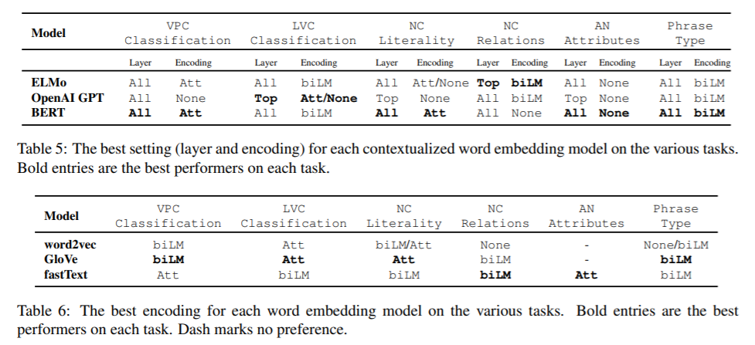
Best Encodings and Layers

Slide 50
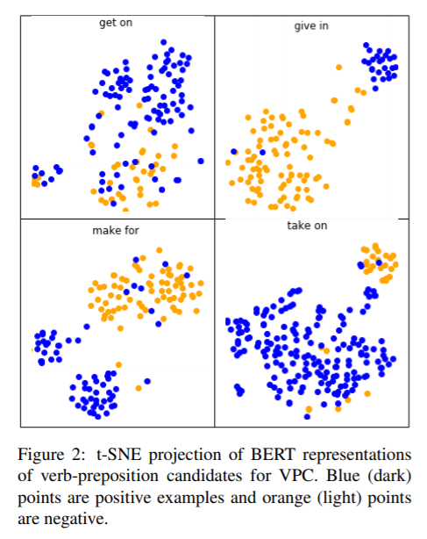
Meaning Shift: Verb-Particle Constructions

Slide 51
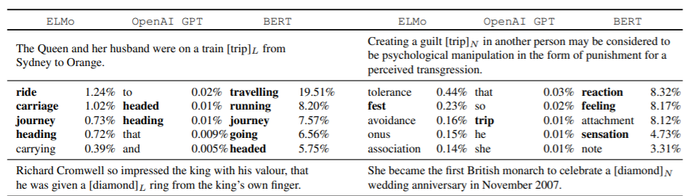
Meaning Shift: Non-literality as Rare Sense

Slide 52
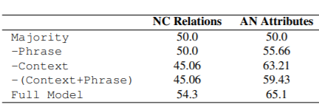
Implicit Meaning: Mini-probing task

Slide 53
References (informal)
Stanford Encyclopedia of Philosophy
https://plato.stanford.edu/entries/compositionality/
Merriam-Webster
https://www.merriam-webster.com/dictionary
a
A
A
A

Slide 54
Guiden Q&A
Sample Question 1
Sample Question 2

Slide 55
Experiment Design

Slide 56
Method of Evaluation

Slide 57
Guiden Q&A
Sample Question 1
Sample Question 2

