Slide 1
Understanding Idiomatic Langauge using Neural Networks
Ling 575 Group 1: Josh Tanner, Paige Finkelstein, Wes Rose, Elena Khasanova, and Daniel Campos
February 20th, 2020

Slide 2
Outline
Paper Introduction
Group A Project Introduction
Evaluating NLM language Understanding (Wes)
Idioms and Neural Networks (Daniel)
Group A Project Overview
Q&A

Slide 3
Papers Introduction
Still a Pain in the Neck: Evaluating Text Representations on Lexical Composition. LINK
What do Neural Networks Actually Learn, When They Learn to Identify Idioms? LINK

Slide 4
Project Introduction
Can Neural Language Models Understand Idioms?
In context of regular language usage(Aka forums like reddit)
Do contextual word representations have a variability in contextual embedding of words in idioms?
How close is the cat in “the cat is out of the bag” to words like secret, kitty, or English shorthair

Slide 5
Outline
Note: would be good to come up with some discussion questions.
Idea: Give some questions at the beginning. Ask people to consider them, then I’ll ask periodically for input?
Idea: What if I present results as I go through each task? First explain the models used, then give task + results?
Background
lexical semantics and compositionality.
Examples of difficult things?
Meaning Shift and MWEs. Note implicit meaning/ world knowledge
Intro to paper
Define an evaluation suite for lexical composition for NLP applications
Evaluate some common word representations using the suite.
Constructed a model using these word représentations.
Make some diagram showing 6 representations, 1 model each, 6 tasks each.
Collect some human baselines
Analyze the results
Note – departing a bit from the order/chronology of the paper. I thought it might help with understanding.
Représentations
Split into static embeddings vs. Contextual embeddings
List / briefly explain the 6 représentations used.
Classification Models
These are what were used to perform the six tasks.
Basically, operationalize the représentations.
Explain “embed, encode, predict”
Tasks from the evaluation suite:
Split into implicit meaning vs. Meaning Shift
Explain each task in some detail with examples from data set.
For each task, show the results of each model and human baseline.
Full summary of results
Analysis
MWEs and Implicit Meaning
Related work? Not sure if important
Summary

Slide 6
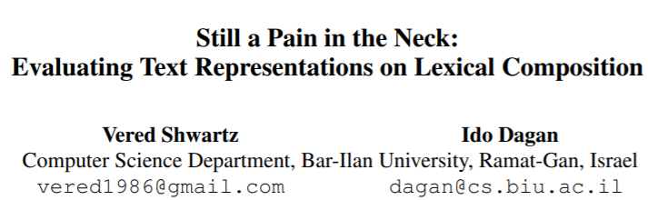

Slide 7
Outline
Note: would be good to come up with some discussion questions.
Idea: Give some questions at the beginning. Ask people to consider them, then I’ll ask periodically for input?
Idea: What if I present results as I go through each task? First explain the models used, then give task + results?
Background
lexical semantics and compositionality.
Examples of difficult things?
Meaning Shift and MWEs. Note implicit meaning/ world knowledge
Intro to paper
Define an evaluation suite for lexical composition for NLP applications
Evaluate some common word representations using the suite.
Constructed a model using these word représentations.
Make some diagram showing 6 representations, 1 model each, 6 tasks each.
Collect some human baselines
Analyze the results
Note – departing a bit from the order/chronology of the paper. I thought it might help with understanding.
Représentations
Split into static embeddings vs. Contextual embeddings
List / briefly explain the 6 représentations used.
Classification Models
These are what were used to perform the six tasks.
Basically, operationalize the représentations.
Explain “embed, encode, predict”
Tasks from the evaluation suite:
Split into implicit meaning vs. Meaning Shift
Explain each task in some detail with examples from data set.
For each task, show the results of each model and human baseline.
Full summary of results
Analysis
MWEs and Implicit Meaning
Related work? Not sure if important
Summary

Slide 8
The Principle of Compositionality
“The meaning of a complex expression is determined by its structure and the meanings of its constituents.”
Lexical Semantics
Syntax
Given any complex expression e in a language L, lexical semantics and syntax determine the semantics of e.
https://plato.stanford.edu/entries/compositionality/
Notes:
Before delving into the details of this paper, I want to examine its motivations. First, I want to touch on the principle of compositionality. There is a lot of literature around compositionality, and variable definitions, but we don’t need to get too deep into the theory for this presentation so this should suffice. Compositionality is the idea that “The meaning of a complex expression is determined by its structure and the meanings of its constituents.” Furthermore, we can say that Given any complex expression e in a language L, lexical semantics and syntax determine the semantics of e.

Slide 9
Difficulties with Compositionality
Keep Calm and Carry On ?
used as a function word to indicate the location of something
used as a function word to indicate a source of attachment or support
used as a function word to indicate a time frame during which something takes place
used as a function word to indicate manner of doing something
to move while supporting
to convey by direct communication
to contain and direct the course of
to cause to remain in a given place, situation, or condition
free from agitation, excitement, or disturbance
Example from Schwartz et al.
Definitions from m-w.com

Slide 10
Difficulties with Compositionality
The tea is heating up
To become warm or hot
The argument is heating up
To excite
Which meaning to select?
Example from Schwartz et al.
Definitions from m-w.com

Slide 11
Difficulties with Compositionality
Meaning Shift
The meaning of the phrase departs from the meaning of its constituent words
E.g. Carry on, guilt trip, pain in the neck
Common in multi-word expressions
Implicit meaning
A meaning resulting from composition that requires world knowledge
E.g. hot argument vs. hot tea, olive oil vs. baby oil.
Schwartz et al.

Slide 12
Goals of the paper:
Define an evaluation suite for lexical composition for NLP models.
- Based on meaning shift and implicit meaning.
2) Evaluate some common word representations using this suite.
- Word2Vec, GloVe, fasttext, ELMo, OpenAI GPT, BERT
Notes:
Now that we’ve explored a bit of the motivation, we’re ready to dive into the paper. You all may recognize the name on the left, Vered Schwartz, from the Treehouse talk a few weeks ago. The name, “Still a Pain in the Neck” is a reference to a paper by Ivan Sag from 2002 (whose name we all recognize from our syntax class). So this is a problem that the community has been looking at for many years.
This paper provided two major contributions: The primary purpose of the paper is to define an evaluation suite for lexical composition for NLP models based on meaning shift and implicit meaning. The authors understand that this is still a troublesome field and are providing a way to evaluate future models as NLP practitioners try to solve this problem. The suite is a set of 6 classification tasks focused on targeted groups of lexical compositions.
Additionally, the others evaluate some common word representations using their suite, to paint a picture of how well applications can handle lexical composition today. You can see a list of the word representations that they use on the slide. They build straightforward models around these representations and then evaluate them against each other, against a naïve baseline, and against a human baseline.

Slide 13
Overview of Methodology
Lexical Composition Tasks
Verb-Particle Construction
Light Verb Construction
Noun Compound Literality
Noun Compound Relations
Adjective Noun Attributes
Identifying Phrase Types
Classifiers
Baselines
Global Embeddings
Contextual Embeddings
Word2Vec
GloVe
fasttext
ELMo
OpenAI GPT
BERT
Don’t love the diagram here… It’s not really a network architecture. Maybe concept bubbles instead?

Slide 14
Overview of methodology
Train 6 classification models, one for each of 6 types of word representations.
For 6 tasks, test each of these models. Compare to each other and to baselines.
Lexical Composition Tasks
Classification Models
Baseline Models
Verb-Particle Construction
Noun Compound Relations
Word2Vec
ELMo
Human Baseline
GloVe
GPT
Majority_{ALL} Baseline
Light Verb Construction
Adjective Noun Attributes
fasttext
BERT
Majority₁ Baseline
Majority₂ Baseline
Noun Compound Literality
Identifying Phrase Types

Slide 15
Overview of Methodology
 |  | Task
 |  | Verb-Particle Construction | Light Verb Construction | Noun Compound Literality | Noun Compound Relations | Adjective Noun Attributes | Identifying Phrase Types
Classification Model | Word2Vec
 | GloVe
 | fasttext
 | ELMo
 | GPT
 | BERT
 | Human Baseline
 | Majority_ALL
 | Majority_1
 | Majority_2

Slide 16
Overview of methodology
Train 6 classification models, one for each of 6 types of word representations.
For 6 tasks, test each of these models. Compare to each other and to baselines.
Lexical Composition Tasks
Classification Models
Baseline Models
Verb-Particle Construction
Noun Compound Relations
Word2Vec
ELMo
Human Baseline
GloVe
GPT
Majority_{ALL} Baseline
Light Verb Construction
Adjective Noun Attributes
fasttext
BERT
Majority₁ Baseline
Majority₂ Baseline
Noun Compound Literality
Identifying Phrase Types

Slide 17
Classification Models
Embed-Encode-Predict
Input Sentence
Embed
(Pre-trained representation)
Encode
(Transform the embedding)
Predict
(Perform Classification)

Slide 18
Classification Models
Embed-Encode-Predict
Input Sentence
Embed
(Pre-trained representation)
Encode
(Transform the embedding)
Predict
(Perform Classification)

Slide 19
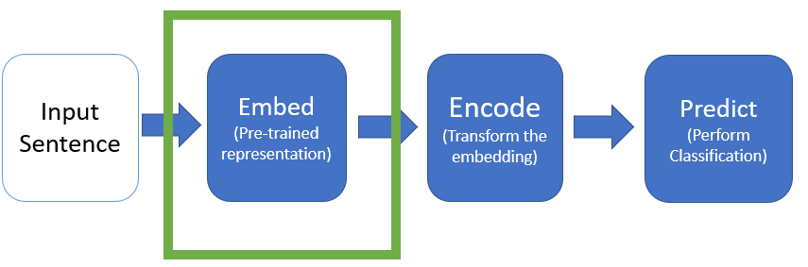
Classification Model: Embed (Word Representations)
Global Embeddings
Contextual Embeddings
Word2Vec
Using Skip-Gram
GloVe
fasttext
ELMo
OpenAI GPT
BERT
(Use top layer or scalar mix)
Notes:
The authors evaluated 6 different well-known word representations, including 3 global embeddings and 3 contextual embeddings.
I think we’re all pretty familiar with most of these, but I’ll give a quick summary of each type of embedding.
Word2Vec can be trained with two different objectives, and they chose skip-gram. The model learns to predict context words given the target word
GloVe learns to estimate log-probabilities of a word pair co-occurrence.
Fasttest extends Word2Vec by adding information about subwords, or bag-of-character n-grams.
ELMo is a bi-LSTM trained on a language modeling task. It is a combination of a left-to-right and right-to-left LM.
OpenAI GPT is a transformer using subwords as the basic unit, and it is strictly left-to-right.
BERT is a transformer that learns a bi-directional LM, with access to the full sentence at training time.
For the Contextual Embeddings, the authors experiment with using only the top layer and a learned scalar mix of all layers.

Slide 20
Classification Models
Embed-Encode-Predict
Input Sentence
Embed
(Pre-trained representation)
Encode
(Transform the embedding)
Predict
(Perform Classification)

Slide 21
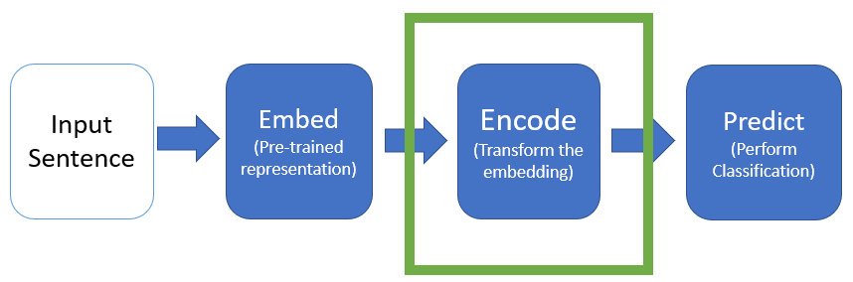
Classification Model: Encode
Input to encode layer is sequence of pretrained embeddings V = <v1,…,vn>
Output is U = <u₁, …, u_{n}>
biLM
Att
None
Encode embedded sequence using biLSTM
U = biLSTM(V)
Encode embedded sequence using self-attention
U_{i} = [v_{i} Σa_{i,j} . V_{j}]
Don’t encode the embedded text
Use the embeddings as they are
U = U
Notes:
Attention: Each word is the concatentation of the embedded word and a weighted average over other words in sentence

Slide 22
Classification Models
Embed-Encode-Predict
Input Sentence
Embed
(Pre-trained representation)
Encode
(Transform the embedding)
Predict
(Perform Classification)

Slide 23
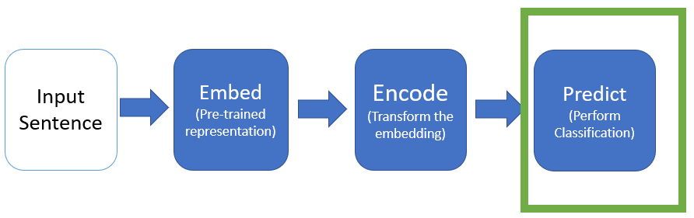
Classification Model: Predict
Takes output U from Encode layer, and passes it to a feed-forward Neural Network Classifier
Represent a “span” of text by concatenating end-point vectors
E.g. u_{i,…,i+k} = [u_{i} ; u_{i+k}]
X = [u_{i};u_{i+k};u’₁;u’_{l}]
u’₁ and u’_{l} may be empty. For some tasks, a 2nd span is needed.
X is passed into classifier
Classifier output is a softmax over all categories

Slide 24
Overview of methodology
Train 6 classification models, one for each of 6 types of word representations.
For 6 tasks, test each of these models. Compare to each other and to baselines.
Lexical Composition Tasks
Classification Models
Baseline Models
Verb-Particle Construction
Noun Compound Relations
Word2Vec
ELMo
Human Baseline
GloVe
GPT
Majority_{ALL} Baseline
Light Verb Construction
Adjective Noun Attributes
fasttext
BERT
Majority₁ Baseline
Majority₂ Baseline
Noun Compound Literality
Identifying Phrase Types

Slide 25
Baselines
Human Baseline
Majority Baselines
Used Amazon Mechanical Turk
Classified 100 examples for each task
Worker agreement of 80% - 87%
Majority_{ALL}
Assign Most common label in training set to all test items
Majority₁
For each test item, assign most common label in the training set for items with same 1st constituent
Majority₂
For each test item, assign label based on final constituent

Slide 26
Overview of methodology
Train 6 classification models, one for each of 6 types of word representations.
For 6 tasks, test each of these models. Compare to each other and to baselines.
Lexical Composition Tasks
Classification Models
Baseline Models
Verb-Particle Construction
Noun Compound Relations
Word2Vec
ELMo
Human Baseline
GloVe
GPT
Majority_{ALL} Baseline
Light Verb Construction
Adjective Noun Attributes
fasttext
BERT
Majority₁ Baseline
Majority₂ Baseline
Noun Compound Literality
Identifying Phrase Types

Slide 27
Lexical Composition Tasks
Task Name | Meaning Shift? | Implicit Meaning?
Verb-Particle Construction | X
Light Verb Construction | X
Noun Compound Literality | X
Noun Compound Relations |  | X
Adjective Noun Attributes |  | X
Identifying Phrase Type | X | X

Slide 28
Lexical Composition Tasks
Task Name | Meaning Shift? | Implicit Meaning?
Verb-Particle Construction | X
Light Verb Construction | X
Noun Compound Literality | X
Noun Compound Relations |  | X
Adjective Noun Attributes |  | X
Identifying Phrase Type | X | X

Slide 29
Task 1: Verb Particle Construction
Data
1,348 tagged sentences from BNC
Classification Model
Word2Vec
ELMo
Yes / No
GloVe
GPT
fasttext
BERT
Example Sentence | Is Verb-Particle Construction?
How many Englishmen gave in to their emotions like that ? | Yes
It is just this denial of anything beyond what is directly given in experience that marks Berkeley out as an empiricist . | No
Tu and Roth 2012
Notes:
Note – Verb-Particle Constructions ~= Phrasal Verb

Slide 30
Task 1: Verb Particle Construction
Can the meaning of the verb-noun construction be derived primarily from the meaning of its noun object?
Dataset:
1,348 tagged sentences from the BNC
Example Sentence | Is Verb Particle Construction?
How many Englishmen gave in to their emotions like that ? | Yes
It is just this denial of anything beyond what is directly given in experience that marks Berkeley out as an empiricist . | No
Data
Classification Model
Yes / No
Tu and Roth 2011
Notes:
Note – Verb-Particle Constructions ~= Phrasal Verb

Slide 31
Task 1: Verb Particle Construction
 | VPC Classification (Acc) | LVC Classification (Acc) | NC Literality (Acc) | NC Relations (Acc) | AN Attributes (Acc) | Phrase Type (F1)
Majority Baseline | 23.6
Best Global Embedding | 60.5
Best Contextual Embedding | 90.0
Human Baseline | 93.8

Slide 32
Lexical Composition Tasks
Task Name | Meaning Shift? | Implicit Meaning?
Verb-Particle Construction | X
Light Verb Construction | X
Noun Compound Literality | X
Noun Compound Relations |  | X
Adjective Noun Attributes |  | X
Identifying Phrase Type | X | X

Slide 33
Task 2: Light Verb Construction
Can the meaning of the verb-noun construction be derived primarily from the meaning of its noun object?
Dataset:
1,348 tagged sentences from the BNC
Example Sentence | Is Light Verb Construction?
I’ve arranged for you to have a look at his file in our library | Yes
He had a look of childish bewilderment on his face | No
Data
Classification Model
Yes / No
Tu and Roth 2011

Slide 34
Task 2: Light Verb Construction
 | VPC Classification (Acc) | LVC Classification (Acc) | NC Literality (Acc) | NC Relations (Acc) | AN Attributes (Acc) | Phrase Type (F1)
Majority Baseline | 23.6 | 43.7
Best Global Embedding | 60.5 | 74.6
Best Contextual Embedding | 90.0 | 82.5
Human Baseline | 93.8 | 83.8

Slide 35
Lexical Composition Tasks
Task Name | Meaning Shift? | Implicit Meaning?
Verb-Particle Construction | X
Light Verb Construction | X
Noun Compound Literality | X
Noun Compound Relations |  | X
Adjective Noun Attributes |  | X
Identifying Phrase Type | X | X

Slide 36
Task 3: Noun Compound Literality
Given a sentence with a {noun1, noun2} compound, is each of the nouns literal or non-literal?
Dataset:
90 annotated examples from ukWaC^{[1]}
3,096 literal examples from Tratz^{[2]} and the WSJ
Example Sentence | {n1,n2} are literal?
AND tickets for an air boat ride in the Everglades. Wow! Still on cloud nine ^{[1]} | {no, no}
Could you also include your snail mail address so I can send you a 1999 New Zealand Calendar in Appreciation.^{[1]} | {no, yes}
Data
Classification Model
{Y/N, Y/N}
[1] Reddy et al. 2011
[2] Tratz 2011
[3]ukWaC
Notes:
Note:
The ukWaC is a text corpus of British English collected from the .uk domain with using medium-frequency words from the British National Corpus as seed words. These two facts are fair to argue that it is a corpus of mainly British English although other variants are likely to be included as long as they were found on a .uk domain.
The corpus was prepared by Adriano Ferraresi and word sketches enabling to explore the grammatical relations of words were prepared by David Tugwell. The whole preparation of the corpus is described in Introducing and evaluating ukWaC, a very large web-derived corpus of English (LREC conference, 2008; crawled from Webarchive).
Sketch Engine provides access to the version of ukWaC tagged with SuperSenseTagger (sst-light) described in Ciaramita and Altun (2006).
Note – my example is from the Reddy paper. I think Schwartz et al. found their own examples from Wikipedia. Hard for me to track down.

Slide 37
Task 3: Noun Compound Literality
 | VPC Classification (Acc) | LVC Classification (Acc) | NC Literality (Acc) | NC Relations (Acc) | AN Attributes (Acc) | Phrase Type (F1)
Majority Baseline | 23.6 | 43.7 | 72.5
Best Global Embedding | 60.5 | 74.6 | 80.4
Best Contextual Embedding | 90.0 | 82.5 | 91.3
Human Baseline | 93.8 | 83.8 | 91.0

Slide 38
Lexical Composition Tasks
Task Name | Meaning Shift? | Implicit Meaning?
Verb-Particle Construction | X
Light Verb Construction | X
Noun Compound Literality | X
Noun Compound Relations |  | X
Adjective Noun Attributes |  | X
Identifying Phrase Type | X | X

Slide 39
Task 4: Noun Compound Relations
Given a sentence with a {noun1, noun2} compound and a paraphrase p, does p describe the semantic relation between noun1 and noun2?
Dataset:
From SemEval 2013^{[1]}: 356 Noun-Compound, annotated with 12,446 paraphrases.
Example Sentence | Valid paraphrase?
{Vietnam has a US$900 million trade surplus in car parts, totaling US$4.4 billion of car part exports; replacement part bought for car} | Yes
{an appendage (or outgrowth) is an external body part, or natural prolongation, that protrudes from an organism's body ; replacement part bought for body} | no
Data
Classification Model
Y/N
[1] Hendrickx et al., 2013
Notes:
Note: Example sentences weren’t taken directly from the paper, but were gathered in the way they described.

Slide 40
Task 4: Noun Compound Relations
 | VPC Classification (Acc) | LVC Classification (Acc) | NC Literality (Acc) | NC Relations (Acc) | AN Attributes (Acc) | Phrase Type (F1)
Majority Baseline | 23.6 | 43.7 | 72.5 | 50.0
Best Global Embedding | 60.5 | 74.6 | 80.4 | 51.2
Best Contextual Embedding | 90.0 | 82.5 | 91.3 | 54.3
Human Baseline | 93.8 | 83.8 | 91.0 | 77.8

Slide 41
Lexical Composition Tasks
Task Name | Meaning Shift? | Implicit Meaning?
Verb-Particle Construction | X
Light Verb Construction | X
Noun Compound Literality | X
Noun Compound Relations |  | X
Adjective Noun Attributes |  | X
Identifying Phrase Type | X | X

Slide 42
Task 5: Adjective Noun Attributes
Given a sentence s with Adjective-Noun combination AN paired with an attribute AT: Is AT implicitly conveyed in AN?
Dataset:
HeiPLAS[1] with 1,589 annotated examples from WordNet
Example Sentence | Is AT attribute of AN?
{Heat traps are valves or loops of pipe installed on the cold water inlet and hot water outlet pipes on water heaters, temperature} | Yes
{A hot argument takes place between Sanjana and her father, and she runs away to Charan, temperature} | No
Data
Classification Model
Y/N
[1]Hartung 2015
Notes:
Authors take positive examples directly from dataset. Create negative examples by shuffling labels. Compute Wu-Palmer similarity between original and negative attribute to make sure they’re not too close.
Note – example sentences from Wikipedia.

Slide 43
Task 5: Adjective Noun Attributes
 | VPC Classification (Acc) | LVC Classification (Acc) | NC Literality (Acc) | NC Relations (Acc) | AN Attributes (Acc) | Phrase Type (F1)
Majority Baseline | 23.6 | 43.7 | 72.5 | 50.0 | 50.0
Best Global Embedding | 60.5 | 74.6 | 80.4 | 51.2 | 53.8
Best Contextual Embedding | 90.0 | 82.5 | 91.3 | 54.3 | 65.1
Human Baseline | 93.8 | 83.8 | 91.0 | 77.8 | 86.4

Slide 44
Lexical Composition Tasks
Task Name | Meaning Shift? | Implicit Meaning?
Verb-Particle Construction | X
Light Verb Construction | X
Noun Compound Literality | X
Noun Compound Relations |  | X
Adjective Noun Attributes |  | X
Identifying Phrase Type | X | X

Slide 45
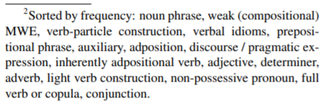
Task 6: Identifying Phrase Type
Given a sentence s with words {w₁, w₂, …, w_{n}}, output a sequence of BIO labels for each word w_{i.} For each word w_{i}: is it part of a phrase, and if so what is the phrase type?
Dataset:
STREUSEL corpus^{[1]} based on reviews section of English Web Treebank
Types of Phrases
Data
{w₁, …, w_{n}}
Classification Model
{t₁, …, t_{n}}
[1]Schneider and Smith 2015
Notes:
Authors take all examples right from dataset.
Note – Had trouble finding specific examples of this task.

Slide 46
Task 6: Identifying Phrase Type
 | VPC Classification (Acc) | LVC Classification (Acc) | NC Literality (Acc) | NC Relations (Acc) | AN Attributes (Acc) | Phrase Type (F1)
Majority Baseline | 23.6 | 43.7 | 72.5 | 50.0 | 50.0 | 26.6
Best Global Embedding | 60.5 | 74.6 | 80.4 | 51.2 | 53.8 | 44.0
Best Contextual Embedding | 90.0 | 82.5 | 91.3 | 54.3 | 65.1 | 64.8
Human Baseline | 93.8 | 83.8 | 91.0 | 77.8 | 86.4

Slide 47
Analysis of Results

Slide 48
Model Performance on Two Phenomena
Meaning Shift
Implicit Meaning
Both
 | VPC Classification (Acc) | LVC Classification (Acc) | NC Literality (Acc) | NC Relations (Acc) | AN Attributes (Acc) | Phrase Type (F1)
Majority Baseline | 23.6 | 43.7 | 72.5 | 50.0 | 50.0 | 26.6
Best Global Embedding | 60.5 | 74.6 | 80.4 | 51.2 | 53.8 | 44.0
Best Contextual Embedding | 90.0 | 82.5 | 91.3 | 54.3 | 65.1 | 64.8
Human Baseline | 93.8 | 83.8 | 91.0 | 77.8 | 86.4
Best Model – Human Baseline | -3.8 | -1.3 | .3 | -23.5 | -21.3
Notes:
Discuss difference between Meaning Shift and Implicit Meaning

Slide 49
Best Encodings and Layers
Input Sentence
Embed
(Pre-trained representation)
Encode
(Transform the embedding)
Predict
(Perform Classification)
For contextual representations:
Top layer or learned scalar mix
Used BiLSTM, Self-Attention (att), or unmodified embeddings
Notes:
Remind of model structure

Slide 50
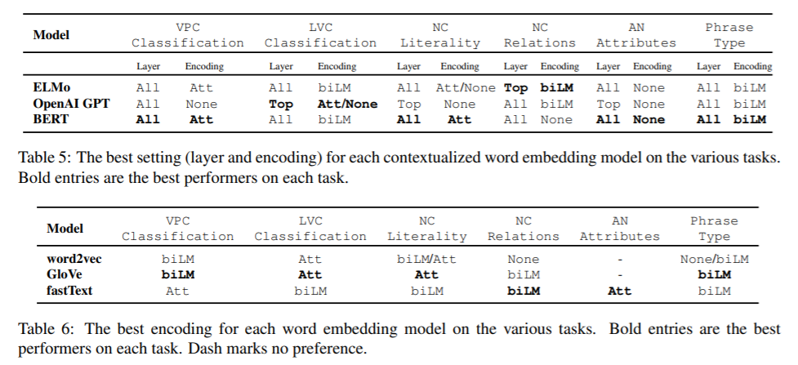
Best Encodings and Layers
Notes:
(Point out some interesting trends)

Slide 51
Analysis of Meaning Shift
Meaning Shift
Implicit Meaning
Both
 | VPC Classification (Acc) | LVC Classification (Acc) | NC Literality (Acc) | NC Relations (Acc) | AN Attributes (Acc) | Phrase Type (F1)
Majority Baseline | 23.6 | 43.7 | 72.5 | 50.0 | 50.0 | 26.6
Best Global Embedding | 60.5 | 74.6 | 80.4 | 51.2 | 53.8 | 44.0
Best Contextual Embedding | 90.0 | 82.5 | 91.3 | 54.3 | 65.1 | 64.8
Human Baseline | 93.8 | 83.8 | 91.0 | 77.8 | 86.4
Best Model – Human Baseline | -3.8 | -1.3 | .3 | -23.5 | -21.3

Slide 52
Meaning Shift: Verb-Particle Classification
 | VPC Classification (Acc)
Majority Baseline | 23.6
Best Global Embedding | 60.5
Best Contextual Embedding | 90.0
Human Baseline | 93.8
Best Model – Human Baseline | -3.8
Best Performer: BERT + All + Att
Do BERT embeddings really have all of the information necessary?
Ablation Task:
Choose several ambiguous verb-preposition pairs.
Compute BERT representation for each example of each pair.
Project Model into 2D Space using t-SNE

Slide 53
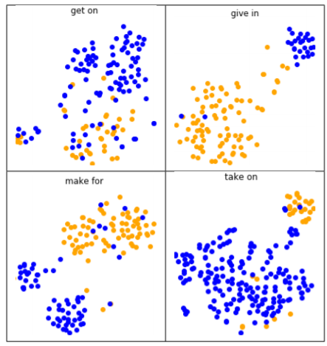
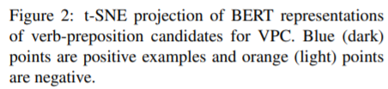
Meaning Shift: Verb-Particle Classification

Slide 54
Meaning Shift: Non-literality as Rare Sense
Spelling Bee
?
“the process or activity of writing or naming the letters of a word”
“competition”

Slide 55
Meaning Shift: Non-literality as Rare Sense
Can word embeddings be used for “word sense induction?
Sample target words that appear in literal and non-literal examples
Use contextualized word embeddings in these examples to predict best substitute for target word

Slide 56
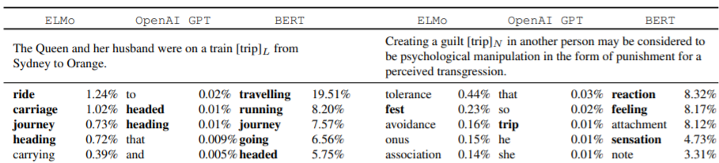
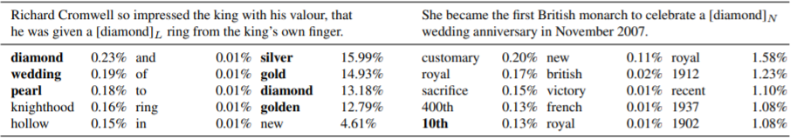
Meaning Shift: Non-literality as Rare Sense

Slide 57
Analysis of Implicit Meaning
Meaning Shift
Implicit Meaning
Both
 | VPC Classification (Acc) | LVC Classification (Acc) | NC Literality (Acc) | NC Relations (Acc) | AN Attributes (Acc) | Phrase Type (F1)
Majority Baseline | 23.6 | 43.7 | 72.5 | 50.0 | 50.0 | 26.6
Best Global Embedding | 60.5 | 74.6 | 80.4 | 51.2 | 53.8 | 44.0
Best Contextual Embedding | 90.0 | 82.5 | 91.3 | 54.3 | 65.1 | 64.8
Human Baseline | 93.8 | 83.8 | 91.0 | 77.8 | 86.4
Best Model – Human Baseline | -3.8 | -1.3 | .3 | -23.5 | -21.3

Slide 58
Analysis of Implicit Meaning
Where does the knowledge of the implicit meaning originate?
Is it encoded in the phrase in question?
Or, is it encoded explicitly in the context sentence around the phrase?
Why is the performance so bad?
Could it be that the models are learning probability of paraphrases alone, without regard to the original phrase?
3 Ablation Tests

Slide 59
Analysis of Implicit Meaning
3 Ablation Tests
Original Phrase: “Today, the house has become a wine bar or bistro called Barokk”
Test 1 (-phrase):
Mask the phrase in the context sentence.
“Today, the house has become a something or bistro called Barokk”
Test 2
(-Context):
Replace the context sentence with the phrase itself
“wine bar”
Test 3 (-context + phrase):
Omit the context sentence all together. Provide only the paraphrase
“bar where people drink wine”
Take each modified context sentence, and evaluate on NC Relations and AN attributes tasks

Slide 60
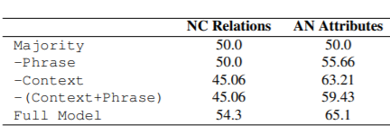
Analysis of Implicit Meaning
Notes:
Conclusions:
Full model works best on every task, so implicit meaning comes from multiple sources.
NC Relations: All variants perform worse than the majority baseline.
AN Attributes: all variants better than majority baseline. –Phrase performs the worst, indicating that valuable implicit meaning comes from the phrase.

Slide 61
References for pain in the neck (informal)
Stanford Encyclopedia of Philosophy
https://plato.stanford.edu/entries/compositionality/
Merriam-Webster
https://www.merriam-webster.com/dictionary
Tu and Roth (2012): https://www.aclweb.org/anthology/S12-1010/
ukWaC corpus: https://www.sketchengine.eu/ukwac-british-english-corpus/
Reddy et al. (2011) https://www.aclweb.org/anthology/I11-1024/
Tratz (2011) http://digitallibrary.usc.edu/cdm/ref/collection/p15799coll3/id/176191
Hartung (2015) https://archiv.ub.uni-heidelberg.de/volltextserver/20013/
Schneider and Smith (2015) https://www.aclweb.org/anthology/N15-1177/

Slide 62
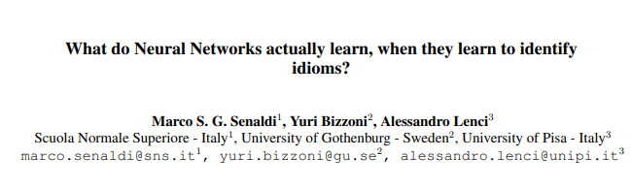

Slide 63
Overview
Probing task focused on model performance with selective dataset pruning.
What kind of features in an idiom’s vector are exploited by a NN in classification of idioms vs literals?
Hypothesis #1: the network could be using the idea of concreteness vs. abstractness to identify idioms as compared to literal phrases.
Hypothesis #2:the network uses ambiguity as a factor, with the idea being that idioms are more ambiguous on average than literal language.

Slide 64
Definitions
“metaphors(e.g., my job is a jail) reflect a transparent mapping from concrete examples in a source domain (e.g., the physical confinement of a jail) to the abstract concept in the target domain(e.g., the psychological constraints and tediousness of a job)” - Senaldi et al. 2019
“idioms (e.g. buy the farm ‘to pass away’, shoot the breeze ‘to chat idly’) synchronically appear as a heterogeneous class of semantically non-compositional multiword units that all exhibit greater lexicosyntactic rigidity, proverbiality and emotional valence with respect to literal expressions.

Slide 65
ELI5 aka Explain like I’m 5
Metaphors map something real to a non-specific representation in a specific domain.
Idioms are a broad range of multiword units which map to some literal expression that only work if the complete structure is preserved(e.g. my heart aches != my myocardium hurts)

Slide 66
Related Work
Neural networks using Word2Vec do well on classification of metaphors. Bizzoni et al. (2017a)
In exploring the cosine distance between the nouns and learned metaphorical representation authors found the NN leveraged the concrete-> abstract shift mapping to established linguistic knowledge of metaphors.
They also do well on classifying idioms! Bizzoni et al. (2017b)
In Italian.
Entire phrase is treated as one token(e.g. spill the beans is one token)
No exploration in what kind of shift is happening in NN
Idioms, like metaphors, tend to be used to convey abstract concepts and are, generally speaking, less concrete in meaning with respect to literals (Citron et al., 2016)

Slide 67
Guiding Question
What kind of features in an idiom’s vector are exploited by a NN in classification of idioms vs literals?

Slide 68
Dataset
174 Italian and 120 English idiomatic and literal verb noun constructions
Italian
87 randomly chosen Italian verbal idioms from idiomatic dictionaries.
Extract usage from itWaC corpus
Some rare(63 occurrences) other common(15,784)
87 only literal verb phrases selected randomly that matched the idiomatic distribution
English
120 VN idiomatic and literal expressions from COCA corpus
60 Idioms and 60 literals following similar procedure to Italian.
Annotation of correctness and ambiguity
Linguistics students/researchers
Rating for abstractness/concreteness (1-7)
Rating for plausibility of regular usage of VN literal usage (1-7)
Rating for ambiguity (1-7)
Literals rated as more concrete
4.84 average for Italian literals
3.16 average for Italian idioms
6.20 average for English literals
2.43 average for English idioms

Slide 69
Method
Train Word2Vec and fastText embeddings on custom corpus and use vectors in a classifier to classify idiom vs literal
Test model performance with training on various subsets of dataset
Trained on complete dataset(with random subsamples)
Trained with concrete literals removed from training set.
Removed all literals with concreteness > 5
If NN relied on differences in concreteness between literals and idioms model performance should greatly drop here
Trained with semantically ambiguous idioms removed from training data
Removed all idioms with average ambiguity of >5
Since idioms can have literal and idiomatic representation model should learn a more varied distribution.

Slide 70
Training
FastText and Word2Vec trained on itWAC(Italian) and COCA(English)
300 dimensions
SkipGram
5 word window
10 negative samples
Classifier on idiom or not
3 hidden layers
300 -> 12 -> 8 -> 1
Sigmoid activation

Slide 71
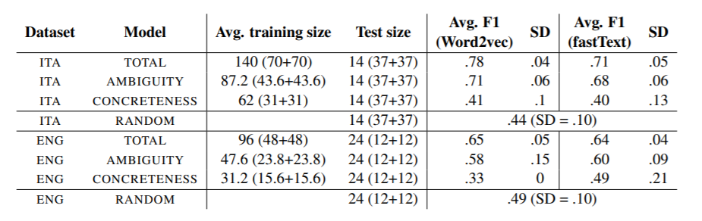
Results
NN is likely exploiting a difference in concreteness/ambiguity of expression.
When NN are trained to spot idioms they exploit underlying sematic features.
Suggest further annotation of idioms to explore what NNs are learning.

Slide 72
Our Research: NLM Understanding of Idioms

Slide 73
Overview
Broad research question: can NLMs understand idioms and their underlying meaning?
What do contextual representations of idioms capture in vector space? Do their approximate the non idiomatic meaning?
To evaluate we create a custom corpus
1000 idioms curated from SLIDE dataset
2000 idioms in context of regular language usage(Reddit Comments)with paraphrases and non paraphrases (2 of each per sample) created by our team.
Evaluation of performance on custom dataset and exploration of vector similarity of idiomatic vs non idiomatic language.

