Slide 1
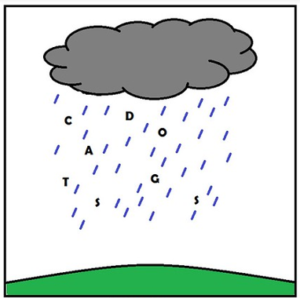
Understanding Idiomatic Langauge using Neural Networks
Ling 575 Group 1:
Josh Tanner, Paige Finkelstein, Wes Rose, Elena Khasanova, and Daniel Campos
February 20th, 2020

Slide 2

Roadmap
Overall Introduction
Evaluating NLM and Lexical Composition (Wes)
Q&A
Idioms and Neural Networks (Daniel)
Q&A
Our Group Project- Idiom paraphrase evaluation
Q&A
This Photo by Unknown Author is licensed under CC BY-NC

Slide 3
Roadmap
Overall Introduction
Evaluating NLM and Lexical Composition (Wes)
Q&A
Idioms and Neural Networks (Daniel)
Q&A
Our Group Project- Idiom paraphrase evaluation
Q&A
This Photo by Unknown Author is licensed under CC BY-NC

Slide 4
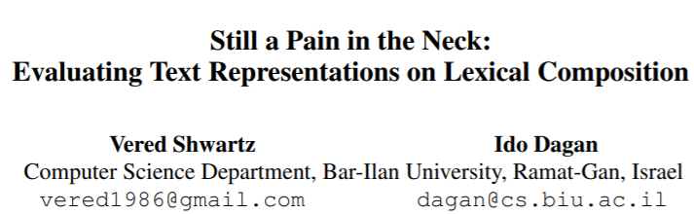

Slide 5
The Principle of Compositionality
“The meaning of a complex expression is determined by its structure and the meanings of its constituents.”
Lexical Semantics
Syntax
Given any complex expression e in a language L, lexical semantics and syntax determine the semantics of e.
https://plato.stanford.edu/entries/compositionality/
Notes:
Before delving into the details of this paper, I want to examine its motivations. First, I want to touch on the principle of compositionality. There is a lot of literature around compositionality, and variable definitions, but we don’t need to get too deep into the theory for this presentation so this should suffice. Compositionality is the idea that “The meaning of a complex expression is determined by its structure and the meanings of its constituents.” Furthermore, we can say that Given any complex expression e in a language L, lexical semantics and syntax determine the semantics of e.

Slide 6
The Principle of Compositionality
“The meaning of a complex expression is determined by its structure and the meanings of its constituents.”
Given any complex expression e in a language L, lexical semantics and syntax determine the semantics of e.
Is this always true?
https://plato.stanford.edu/entries/compositionality/
Notes:
Before delving into the details of this paper, I want to examine its motivations. First, I want to touch on the principle of compositionality. There is a lot of literature around compositionality, and variable definitions, but we don’t need to get too deep into the theory for this presentation so this should suffice. Compositionality is the idea that “The meaning of a complex expression is determined by its structure and the meanings of its constituents.” Furthermore, we can say that Given any complex expression e in a language L, lexical semantics and syntax determine the semantics of e.

Slide 7
Difficulties with Compositionality
Keep Calm and Carry On ?
used as a function word to indicate the location of something
used as a function word to indicate a source of attachment or support
used as a function word to indicate a time frame during which something takes place
used as a function word to indicate manner of doing something
to move while supporting
to convey by direct communication
to contain and direct the course of
to cause to remain in a given place, situation, or condition
free from agitation, excitement, or disturbance
Example from Schwartz et al.
Definitions from m-w.com

Slide 8
Difficulties with Compositionality
The tea is heating up
To become warm or hot
The argument is heating up
To excite
Which meaning to select?
Example from Schwartz et al.
Definitions from m-w.com

Slide 9
Difficulties with Compositionality
Meaning Shift
The meaning of the phrase departs from the meaning of its constituent words
E.g. Carry on, guilt trip, pain in the neck
Common in multi-word expressions
Implicit meaning
A meaning resulting from composition that requires world knowledge
E.g. hot argument vs. hot tea, olive oil vs. baby oil.
Schwartz et al.

Slide 10
Difficulties with Compositionality
Meaning Shift
The meaning of the phrase departs from the meaning of its constituent words
E.g. Carry on, guilt trip, pain in the neck
Implicit meaning
A meaning resulting from composition that requires world knowledge
E.g. hot argument vs. hot tea, olive oil vs. baby oil.
How do you think Neural Networks will handle these?
Schwartz et al.

Slide 11
Goals of the paper:
Define an evaluation suite for lexical composition for NLP models
- Based on meaning shift and implicit meaning
2) Evaluate some common word representations using this suite
- Word2Vec, GloVe, fasttext, ELMo, OpenAI GPT, BERT
Notes:
Now that we’ve explored a bit of the motivation, we’re ready to dive into the paper. You all may recognize the name on the left, Vered Schwartz, from the Treehouse talk a few weeks ago. The name, “Still a Pain in the Neck” is a reference to a paper by Ivan Sag from 2002 (whose name we all recognize from our syntax class). So this is a problem that the community has been looking at for many years.
This paper provided two major contributions: The primary purpose of the paper is to define an evaluation suite for lexical composition for NLP models based on meaning shift and implicit meaning. The authors understand that this is still a troublesome field and are providing a way to evaluate future models as NLP practitioners try to solve this problem. The suite is a set of 6 classification tasks focused on targeted groups of lexical compositions.
Additionally, the others evaluate some common word representations using their suite, to paint a picture of how well applications can handle lexical composition today. You can see a list of the word representations that they use on the slide. They build straightforward models around these representations and then evaluate them against each other, against a naïve baseline, and against a human baseline.

Slide 12
Food for Thought
Would you expect Neural Networks to do better with Meaning Shift or Implicit Meaning?
What do you think of the tasks that were chosen? Should any tasks be added or expanded?
How can we improve NLP applications to handle these phenomena?
(How do humans handle them?)

Slide 13
Overview of Methodology
Train 6 classification models, one for each of 6 types of word representations
For 6 tasks, test each of these models. Compare to each other and to baselines
Lexical Composition Tasks
Classification Models
Baseline Models
Verb-Particle Construction
Noun Compound Relations
Word2Vec
ELMo
Human Baseline
GloVe
GPT
Majority_{ALL} Baseline
Light Verb Construction
Adjective Noun Attributes
fasttext
BERT
Majority₁ Baseline
Majority₂ Baseline
Noun Compound Literality
Identifying Phrase Types

Slide 14
Overview of Methodology
 |  | Task
 |  | Verb-Particle Construction | Light Verb Construction | Noun Compound Literality | Noun Compound Relations | Adjective Noun Attributes | Identifying Phrase Types
Classification Model | Word2Vec
 | GloVe
 | fasttext
 | ELMo
 | GPT
 | BERT
 | Human Baseline
 | Majority_ALL
 | Majority_1
 | Majority_2

Slide 15
Overview of Methodology
Train 6 classification models, one for each of 6 types of word representations
For 6 tasks, test each of these models. Compare to each other and to baselines
Lexical Composition Tasks
Classification Models
Baseline Models
Verb-Particle Construction
Noun Compound Relations
Word2Vec
ELMo
Human Baseline
GloVe
GPT
Majority_{ALL} Baseline
Light Verb Construction
Adjective Noun Attributes
fasttext
BERT
Majority₁ Baseline
Majority₂ Baseline
Noun Compound Literality
Identifying Phrase Types

Slide 16
Classification Models
Embed-Encode-Predict
Input Sentence
Embed
(Pre-trained representation)
Encode
(Transform the embedding)
Predict
(Perform Classification)

Slide 17
Classification Models
Embed-Encode-Predict
Input Sentence
Embed
(Pre-trained representation)
Encode
(Transform the embedding)
Predict
(Perform Classification)

Slide 18
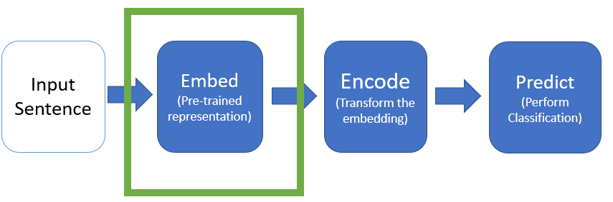
Classification Model: Embed (Word Representations)
Global Embeddings
Contextual Embeddings
Word2Vec
Using Skip-Gram
GloVe
fasttext
ELMo
OpenAI GPT
BERT
(Use top layer or scalar mix)
Notes:
The authors evaluated 6 different well-known word representations, including 3 global embeddings and 3 contextual embeddings.
I think we’re all pretty familiar with most of these, but I’ll give a quick summary of each type of embedding.
Word2Vec can be trained with two different objectives, and they chose skip-gram. The model learns to predict context words given the target word
GloVe learns to estimate log-probabilities of a word pair co-occurrence.
Fasttest extends Word2Vec by adding information about subwords, or bag-of-character n-grams.
ELMo is a bi-LSTM trained on a language modeling task. It is a combination of a left-to-right and right-to-left LM.
OpenAI GPT is a transformer using subwords as the basic unit, and it is strictly left-to-right.
BERT is a transformer that learns a bi-directional LM, with access to the full sentence at training time.
For the Contextual Embeddings, the authors experiment with using only the top layer and a learned scalar mix of all layers.

Slide 19
Classification Models
Embed-Encode-Predict
Input Sentence
Embed
(Pre-trained representation)
Encode
(Transform the embedding)
Predict
(Perform Classification)

Slide 20
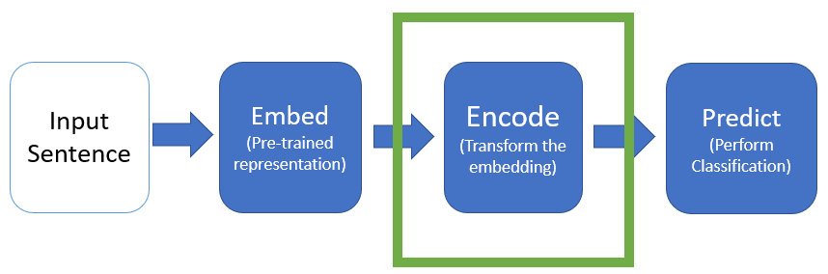
Classification Model: Encode
Input to encode layer is sequence of pretrained embeddings V = <v1,…,vn>
Output is U = <u₁, …, u_{n}>
biLM
Att
None
Encode embedded sequence using biLSTM
U = biLSTM(V)
Encode embedded sequence using self-attention
U_{i} = [v_{i} Σa_{i,j} . V_{j}]
Don’t encode the embedded text
Use the embeddings as they are
U = U
Notes:
Attention: Each word is the concatentation of the embedded word and a weighted average over other words in sentence

Slide 21
Classification Models
Embed-Encode-Predict
Input Sentence
Embed
(Pre-trained representation)
Encode
(Transform the embedding)
Predict
(Perform Classification)

Slide 22
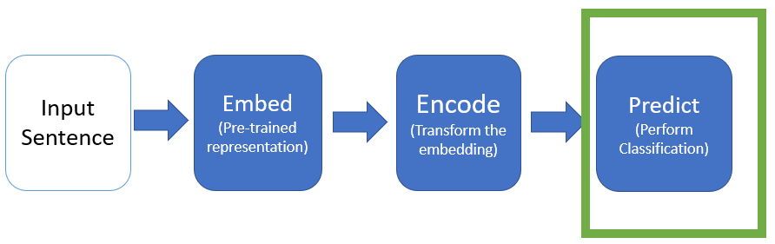
Classification Model: Predict
Takes output U from Encode layer, and passes it to a feed-forward Neural Network Classifier
Represent a “span” of text by concatenating end-point vectors
E.g. u_{i,…,i+k} = [u_{i} ; u_{i+k}]
X = [u_{i};u_{i+k};u’₁;u’_{l}]
u’₁ and u’_{l} may be empty. For some tasks, a 2nd span is needed.
X is passed into classifier
Classifier output is a softmax over all categories

Slide 23
Overview of methodology
Train 6 classification models, one for each of 6 types of word representations
For 6 tasks, test each of these models. Compare to each other and to baselines
Lexical Composition Tasks
Classification Models
Baseline Models
Verb-Particle Construction
Noun Compound Relations
Word2Vec
ELMo
Human Baseline
GloVe
GPT
Majority_{ALL} Baseline
Light Verb Construction
Adjective Noun Attributes
fasttext
BERT
Majority₁ Baseline
Majority₂ Baseline
Noun Compound Literality
Identifying Phrase Types

Slide 24
Baselines
Human Baseline
Majority Baselines
Used Amazon Mechanical Turk
Classified 100 examples for each task
Worker agreement of 80% - 87%
Majority_{ALL}
Assign most common label in training set to all test items
Majority₁
For each test item, assign most common label in the training set for items with same 1st constituent
Majority₂
For each test item, assign label based on final constituent

Slide 25
Overview of methodology
Train 6 classification models, one for each of 6 types of word representations
For 6 tasks, test each of these models. Compare to each other and to baselines
Lexical Composition Tasks
Classification Models
Baseline Models
Verb-Particle Construction
Noun Compound Relations
Word2Vec
ELMo
Human Baseline
GloVe
GPT
Majority_{ALL} Baseline
Light Verb Construction
Adjective Noun Attributes
fasttext
BERT
Majority₁ Baseline
Majority₂ Baseline
Noun Compound Literality
Identifying Phrase Types

Slide 26
Lexical Composition Tasks
Task Name | Meaning Shift? | Implicit Meaning?
Verb-Particle Construction | X
Light Verb Construction | X
Noun Compound Literality | X
Noun Compound Relations |  | X
Adjective Noun Attributes |  | X
Identifying Phrase Type | X | X

Slide 27
Lexical Composition Tasks
Task Name | Meaning Shift? | Implicit Meaning?
Verb-Particle Construction | X
Light Verb Construction | X
Noun Compound Literality | X
Noun Compound Relations |  | X
Adjective Noun Attributes |  | X
Identifying Phrase Type | X | X

Slide 28
Task 1: Verb Particle Construction
Given a (verb, preposition) pair from a sentence, is it a verb particle construction?
(Is the verb’s meaning changed by the preposition?)
Dataset:
1,348 tagged sentences from the BNC
Example Sentence | Is Verb Particle Construction?
How many Englishmen gave in to their emotions like that ? | Yes
It is just this denial of anything beyond what is directly given in experience that marks Berkeley out as an empiricist . | No
Data
Classification Model
Yes / No
Tu and Roth 2012
Notes:
Note – Verb-Particle Constructions ~= Phrasal Verb

Slide 29
Task 1: Verb Particle Construction
 | VPC Classification (Acc) | LVC Classification (Acc) | NC Literality (Acc) | NC Relations (Acc) | AN Attributes (Acc) | Phrase Type (F1)
Majority Baseline | 23.6
Best Global Embedding | 60.5
Best Contextual Embedding | 90.0
Human Baseline | 93.8

Slide 30
Lexical Composition Tasks
Task Name | Meaning Shift? | Implicit Meaning?
Verb-Particle Construction | X
Light Verb Construction | X
Noun Compound Literality | X
Noun Compound Relations |  | X
Adjective Noun Attributes |  | X
Identifying Phrase Type | X | X

Slide 31
Task 2: Light Verb Construction
Can the meaning of the verb-noun construction be derived primarily from the meaning of its noun object?
Dataset:
2,162 tagged sentences from the BNC
Example Sentence | Is Light Verb Construction?
I’ve arranged for you to have a look at his file in our library. | Yes
He had a look of childish bewilderment on his face. | No
Data
Classification Model
Yes / No
Tu and Roth 2011

Slide 32
Task 2: Light Verb Construction
 | VPC Classification (Acc) | LVC Classification (Acc) | NC Literality (Acc) | NC Relations (Acc) | AN Attributes (Acc) | Phrase Type (F1)
Majority Baseline | 23.6 | 43.7
Best Global Embedding | 60.5 | 74.6
Best Contextual Embedding | 90.0 | 82.5
Human Baseline | 93.8 | 83.8

Slide 33
Lexical Composition Tasks
Task Name | Meaning Shift? | Implicit Meaning?
Verb-Particle Construction | X
Light Verb Construction | X
Noun Compound Literality | X
Noun Compound Relations |  | X
Adjective Noun Attributes |  | X
Identifying Phrase Type | X | X

Slide 34
Task 3: Noun Compound Literality
Given a sentence with a {noun1, noun2} compound, is each of the nouns literal or non-literal?
Dataset:
90 annotated examples from ukWaC^{[6]}
3,096 literal examples from Tratz^{[2]} and the PTB-WSJ
Example Sentence | {n1,n2} are literal?
AND tickets for an air boat ride in the Everglades. Wow! Still on cloud nine. ^{[6]} | {no, no}
Could you also include your snail mail address so I can send you a 1999 New Zealand Calendar in Appreciation?^{[1]} | {no, yes}
Data
Classification Model
{Y/N, Y/N}
[6] Reddy et al. 2011
[7] Tratz 2011
[5]ukWaC
Notes:
Note:
The ukWaC is a text corpus of British English collected from the .uk domain with using medium-frequency words from the British National Corpus as seed words. These two facts are fair to argue that it is a corpus of mainly British English although other variants are likely to be included as long as they were found on a .uk domain.
The corpus was prepared by Adriano Ferraresi and word sketches enabling to explore the grammatical relations of words were prepared by David Tugwell. The whole preparation of the corpus is described in Introducing and evaluating ukWaC, a very large web-derived corpus of English (LREC conference, 2008; crawled from Webarchive).
Sketch Engine provides access to the version of ukWaC tagged with SuperSenseTagger (sst-light) described in Ciaramita and Altun (2006).
Note – my example is from the Reddy paper. I think Schwartz et al. found their own examples from Wikipedia. Hard for me to track down.

Slide 35
Task 3: Noun Compound Literality
 | VPC Classification (Acc) | LVC Classification (Acc) | NC Literality (Acc) | NC Relations (Acc) | AN Attributes (Acc) | Phrase Type (F1)
Majority Baseline | 23.6 | 43.7 | 72.5
Best Global Embedding | 60.5 | 74.6 | 80.4
Best Contextual Embedding | 90.0 | 82.5 | 91.3
Human Baseline | 93.8 | 83.8 | 91.0

Slide 36
Lexical Composition Tasks
Task Name | Meaning Shift? | Implicit Meaning?
Verb-Particle Construction | X
Light Verb Construction | X
Noun Compound Literality | X
Noun Compound Relations |  | X
Adjective Noun Attributes |  | X
Identifying Phrase Type | X | X

Slide 37
Task 4: Noun Compound Relations
Given a sentence with a {noun1, noun2} compound and a paraphrase p, does p describe the semantic relation between noun1 and noun2?
Dataset:
From SemEval 2013^{[10]}: 356 Noun-Compound, annotated with 12,446 paraphrases.
Example Sentence | Valid paraphrase?
{Vietnam has a US$900 million trade surplus in car parts, totaling US$4.4 billion of car part exports; replacement part bought for car} | Yes
{an appendage (or outgrowth) is an external body part, or natural prolongation, that protrudes from an organism's body ; replacement part bought for body} | no
Data
Classification Model
Y/N
[10] Hendrickx et al., 2013
Notes:
Note: Example sentences weren’t taken directly from the paper, but were gathered in the way they described.

Slide 38
Task 4: Noun Compound Relations
 | VPC Classification (Acc) | LVC Classification (Acc) | NC Literality (Acc) | NC Relations (Acc) | AN Attributes (Acc) | Phrase Type (F1)
Majority Baseline | 23.6 | 43.7 | 72.5 | 50.0
Best Global Embedding | 60.5 | 74.6 | 80.4 | 51.2
Best Contextual Embedding | 90.0 | 82.5 | 91.3 | 54.3
Human Baseline | 93.8 | 83.8 | 91.0 | 77.8

Slide 39
Lexical Composition Tasks
Task Name | Meaning Shift? | Implicit Meaning?
Verb-Particle Construction | X
Light Verb Construction | X
Noun Compound Literality | X
Noun Compound Relations |  | X
Adjective Noun Attributes |  | X
Identifying Phrase Type | X | X

Slide 40
Task 5: Adjective Noun Attributes
Given a sentence s with Adjective-Noun combination AN paired with an attribute AT: Is AT implicitly conveyed in AN?
Dataset:
HeiPLAS[8] with 1,589 annotated examples from WordNet
Example Sentence | Is AT attribute of AN?
{Heat traps are valves or loops of pipe installed on the cold water inlet and hot water outlet pipes on water heaters, temperature} | Yes
{A hot argument takes place between Sanjana and her father, and she runs away to Charan, temperature} | No
Data
Classification Model
Y/N
[8]Hartung 2015
Notes:
Authors take positive examples directly from dataset. Create negative examples by shuffling labels. Compute Wu-Palmer similarity between original and negative attribute to make sure they’re not too close.
Note – example sentences from Wikipedia.

Slide 41
Task 5: Adjective Noun Attributes
 | VPC Classification (Acc) | LVC Classification (Acc) | NC Literality (Acc) | NC Relations (Acc) | AN Attributes (Acc) | Phrase Type (F1)
Majority Baseline | 23.6 | 43.7 | 72.5 | 50.0 | 50.0
Best Global Embedding | 60.5 | 74.6 | 80.4 | 51.2 | 53.8
Best Contextual Embedding | 90.0 | 82.5 | 91.3 | 54.3 | 65.1
Human Baseline | 93.8 | 83.8 | 91.0 | 77.8 | 86.4

Slide 42
Lexical Composition Tasks
Task Name | Meaning Shift? | Implicit Meaning?
Verb-Particle Construction | X
Light Verb Construction | X
Noun Compound Literality | X
Noun Compound Relations |  | X
Adjective Noun Attributes |  | X
Identifying Phrase Type | X | X

Slide 43
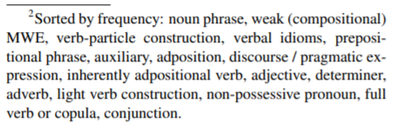
Task 6: Identifying Phrase Type
Given a sentence s with words {w₁, w₂, …, w_{n}}, output a sequence of BIO labels for each word w_{i.} For each word w_{i}: is it part of a phrase, and if so what is the phrase type?
Dataset:
STREUSEL corpus^{[9]} based on reviews section of English Web Treebank
Types of Phrases
Data
{w₁, …, w_{n}}
Classification Model
{t₁, …, t_{n}}
[9]Schneider and Smith 2015
Notes:
Authors take all examples right from dataset.
Note – Had trouble finding specific examples of this task.

Slide 44
Task 6: Identifying Phrase Type
 | VPC Classification (Acc) | LVC Classification (Acc) | NC Literality (Acc) | NC Relations (Acc) | AN Attributes (Acc) | Phrase Type (F1)
Majority Baseline | 23.6 | 43.7 | 72.5 | 50.0 | 50.0 | 26.6
Best Global Embedding | 60.5 | 74.6 | 80.4 | 51.2 | 53.8 | 44.0
Best Contextual Embedding | 90.0 | 82.5 | 91.3 | 54.3 | 65.1 | 64.8
Human Baseline | 93.8 | 83.8 | 91.0 | 77.8 | 86.4

Slide 45
Model Performance on Two Phenomena
Meaning Shift
Implicit Meaning
Both
 | VPC Classification (Acc) | LVC Classification (Acc) | NC Literality (Acc) | NC Relations (Acc) | AN Attributes (Acc) | Phrase Type (F1)
Majority Baseline | 23.6 | 43.7 | 72.5 | 50.0 | 50.0 | 26.6
Best Global Embedding | 60.5 | 74.6 | 80.4 | 51.2 | 53.8 | 44.0
Best Contextual Embedding | 90.0 | 82.5 | 91.3 | 54.3 | 65.1 | 64.8
Human Baseline | 93.8 | 83.8 | 91.0 | 77.8 | 86.4
Best Model – Human Baseline | -3.8 | -1.3 | .3 | -23.5 | -21.3
Notes:
Discuss difference between Meaning Shift and Implicit Meaning

Slide 46
Extra Analysis Tasks (If Time)
Notes:
If not enough time, skip ahead to summary slide (56?)

Slide 47
Best Encodings and Layers
Input Sentence
Embed
(Pre-trained representation)
Encode
(Transform the embedding)
Predict
(Perform Classification)
For contextual representations:
Top layer or learned scalar mix
Used BiLSTM, Self-Attention (att), or unmodified embeddings
Notes:
Remind of model structure

Slide 48
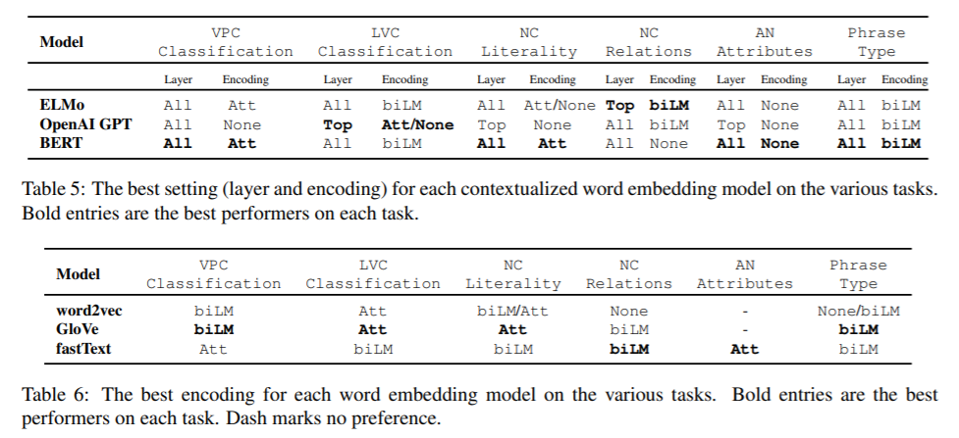
Best Encodings and Layers
Notes:
(Point out some interesting trends)

Slide 49
Analysis of Meaning Shift
Meaning Shift
Implicit Meaning
Both
 | VPC Classification (Acc) | LVC Classification (Acc) | NC Literality (Acc) | NC Relations (Acc) | AN Attributes (Acc) | Phrase Type (F1)
Majority Baseline | 23.6 | 43.7 | 72.5 | 50.0 | 50.0 | 26.6
Best Global Embedding | 60.5 | 74.6 | 80.4 | 51.2 | 53.8 | 44.0
Best Contextual Embedding | 90.0 | 82.5 | 91.3 | 54.3 | 65.1 | 64.8
Human Baseline | 93.8 | 83.8 | 91.0 | 77.8 | 86.4
Best Model – Human Baseline | -3.8 | -1.3 | .3 | -23.5 | -21.3

Slide 50
Meaning Shift: Verb-Particle Classification
 | VPC Classification (Acc)
Majority Baseline | 23.6
Best Global Embedding | 60.5
Best Contextual Embedding | 90.0
Human Baseline | 93.8
Best Model – Human Baseline | -3.8
Best Performer: BERT + All + Att
Do BERT embeddings really have all of the information necessary?
Ablation Task:
Choose several ambiguous verb-preposition pairs
Compute BERT representation for each example of each pair
Project representations into 2D Space using t-SNE

Slide 51
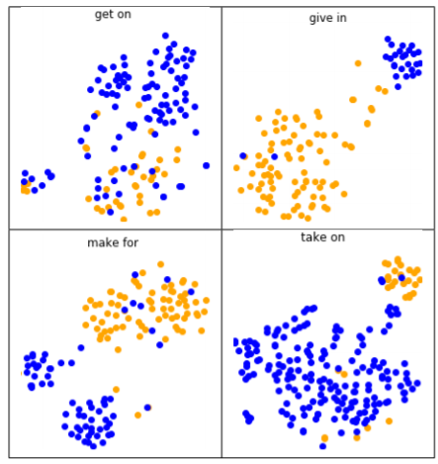
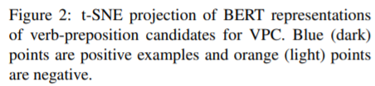
Meaning Shift: Verb-Particle Classification

Slide 52
Meaning Shift: Non-literality as Rare Sense
Spelling Bee
?
“the process or activity of writing or naming the letters of a word”
“competition”

Slide 53
Meaning Shift: Non-literality as Rare Sense
Can word embeddings be used for “word sense induction?”
Sample target words that appear in literal and non-literal examples
Use contextualized word embeddings in these examples to predict best substitute for target word

Slide 54
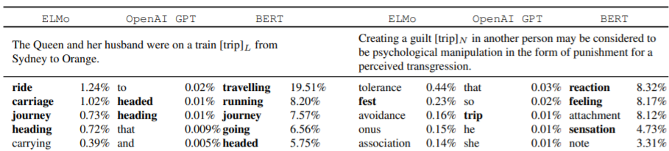
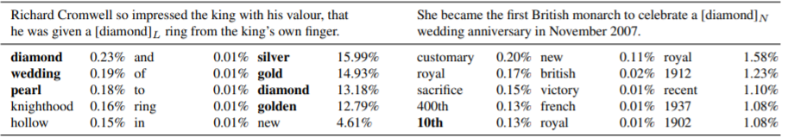
Meaning Shift: Non-literality as Rare Sense

Slide 55
Analysis of Implicit Meaning
Meaning Shift
Implicit Meaning
Both
 | VPC Classification (Acc) | LVC Classification (Acc) | NC Literality (Acc) | NC Relations (Acc) | AN Attributes (Acc) | Phrase Type (F1)
Majority Baseline | 23.6 | 43.7 | 72.5 | 50.0 | 50.0 | 26.6
Best Global Embedding | 60.5 | 74.6 | 80.4 | 51.2 | 53.8 | 44.0
Best Contextual Embedding | 90.0 | 82.5 | 91.3 | 54.3 | 65.1 | 64.8
Human Baseline | 93.8 | 83.8 | 91.0 | 77.8 | 86.4
Best Model – Human Baseline | -3.8 | -1.3 | .3 | -23.5 | -21.3

Slide 56
Analysis of Implicit Meaning
Where does the knowledge of the implicit meaning originate?
Is it encoded in the phrase in question?
Or, is it encoded explicitly in the context sentence around the phrase?
Why is the performance so bad?
Could it be that the models are learning probability of paraphrases alone, without regard to the original phrase?
3 Ablation Tests

Slide 57
Analysis of Implicit Meaning
3 Ablation Tests
Original Phrase: “Today, the house has become a wine bar or bistro called Barokk”
Test 1 (-phrase):
Mask the phrase in the context sentence
“Today, the house has become a something or bistro called Barokk”
Test 2
(-Context):
Replace the context sentence with the phrase itself
“wine bar”
Test 3 (-context + phrase):
Omit the context sentence all together. Provide only the paraphrase
“bar where people drink wine”
Take each modified context sentence, and evaluate on NC Relations and AN attributes tasks

Slide 58
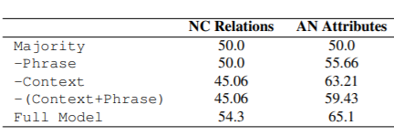
Analysis of Implicit Meaning
Notes:
Conclusions:
Full model works best on every task, so implicit meaning comes from multiple sources.
NC Relations: All variants perform worse than the majority baseline.
AN Attributes: all variants better than majority baseline. –Phrase performs the worst, indicating that valuable implicit meaning comes from the phrase.

Slide 59
Summary – “Still a pain in the neck”
Understanding the meanings of phrases is not straightforward
Meaning Shift and Implicit Meaning
6 tasks were developed to evaluate model understanding of these phenomena
6 pre-trained language models were evaluated on these tasks
The models do pretty well with meaning shift. They struggle with implicit meaning

Slide 60
References for pain in the neck
Stanford Encyclopedia of Philosophy - https://plato.stanford.edu/entries/compositionality/
Merriam-Webster - https://www.merriam-webster.com/dictionary
Tu and Roth (2012) - https://www.aclweb.org/anthology/S12-1010/
Tu and Roth (2011) - https://www.aclweb.org/anthology/W11-0807/
ukWaC corpus - https://www.sketchengine.eu/ukwac-british-english-corpus/
Reddy et al. (2011) - https://www.aclweb.org/anthology/I11-1024/
Tratz (2011) - http://digitallibrary.usc.edu/cdm/ref/collection/p15799coll3/id/176191
Hartung (2015) - https://archiv.ub.uni-heidelberg.de/volltextserver/20013/
Schneider and Smith (2015) - https://www.aclweb.org/anthology/N15-1177/
Hendrickx et al. (2010) - https://www.aclweb.org/anthology/S13-2025/

Slide 61
Questions / Comments?
Would you expect Neural Networks to do better with Meaning Shift or Implicit Meaning?
According to the results – meaning shift. Is this surprising?
What do you think of the tasks that were chosen? Should any tasks be added or expanded?
Our group is interested in examining idioms more closely
How can we improve NLP applications to handle these phenomena?
(How do humans handle them?)
For implicit meaning / world knowledge, see Vered Schwartz’ Treehouse talk

Slide 62
Roadmap
Overall Introduction
Evaluating NLM and Lexical Composition (Wes)
Q&A
Idioms and Neural Networks (Daniel)
Q&A
Our Group Project- Idiom paraphrase evaluation
Q&A
This Photo by Unknown Author is licensed under CC BY-NC

Slide 63
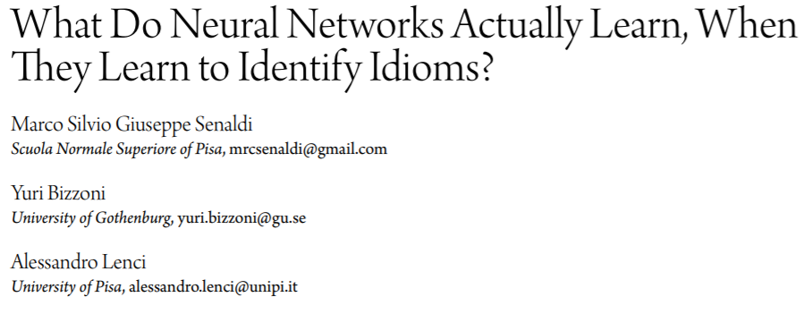

Slide 64
Overview
Start with a neural idiom detection model that works fairly well
Probe to understand what type of information the model uses
(Probe with Data Ablation)
Does the model use concreteness or ambiguity as a predictor?

Slide 65
Method
Start with an existing dataset
Create 2 modified datasets
For one, remove the most concrete literals
For the other, remove most ambiguous idioms
How does the model perform on modified datasets?

Slide 66
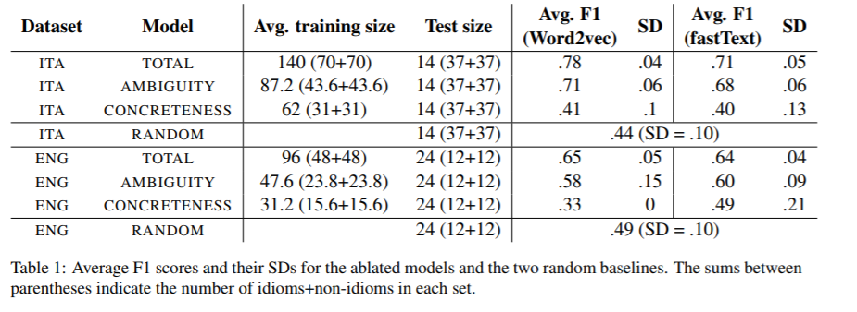
Results

Slide 67

Questions?
This Photo by Unknown Author is licensed under CC BY-NC-ND

Slide 68
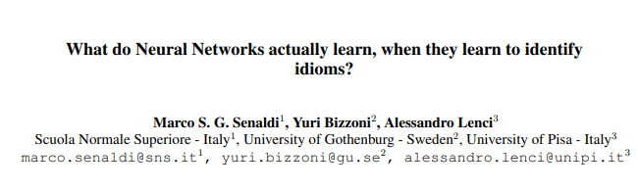

Slide 69
Overview
Probing task focused on model performance with selective dataset pruning.
What kind of features in an idiom’s vector are exploited by a NN in classification of idioms vs literals?
Hypothesis #1: the network could be using the idea of concreteness vs. abstractness to identify idioms as compared to literal phrases.
Hypothesis #2:the network uses ambiguity as a factor, with the idea being that idioms are more ambiguous on average than literal language.

Slide 70
Definitions
“metaphors(e.g., my job is a jail) reflect a transparent mapping from concrete examples in a source domain (e.g., the physical confinement of a jail) to the abstract concept in the target domain(e.g., the psychological constraints and tediousness of a job)” - Senaldi et al. 2019
“idioms (e.g. buy the farm ‘to pass away’, shoot the breeze ‘to chat idly’) synchronically appear as a heterogeneous class of semantically non-compositional multiword units that all exhibit greater lexicosyntactic rigidity, proverbiality and emotional valence with respect to literal expressions.

Slide 71
ELI5 aka Explain like I’m 5
Metaphors map something real to a non-specific representation in a specific domain.
Idioms are a broad range of multiword units which map to some literal expression that only work if the complete structure is preserved(e.g. my heart aches != my myocardium hurts)

Slide 72
Related Work
Neural networks using Word2Vec do well on classification of metaphors. Bizzoni et al. (2017a)
In exploring the cosine distance between the nouns and learned metaphorical representation authors found the NN leveraged the concrete-> abstract shift mapping to established linguistic knowledge of metaphors.
They also do well on classifying idioms! Bizzoni et al. (2017b)
In Italian.
Entire phrase is treated as one token(e.g. spill the beans is one token)
No exploration in what kind of shift is happening in NN
Idioms, like metaphors, tend to be used to convey abstract concepts and are, generally speaking, less concrete in meaning with respect to literals (Citron et al., 2016)

Slide 73
Guiding Question
What kind of features in an idiom’s vector are exploited by a NN in classification of idioms vs literals?

Slide 74
Dataset
174 Italian and 120 English idiomatic and literal verb noun constructions
Italian
87 randomly chosen Italian verbal idioms from idiomatic dictionaries.
Extract usage from itWaC corpus
Some rare(63 occurrences) other common(15,784)
87 only literal verb phrases selected randomly that matched the idiomatic distribution
English
120 VN idiomatic and literal expressions from COCA corpus
60 Idioms and 60 literals following similar procedure to Italian.
Annotation of correctness and ambiguity
Linguistics students/researchers
Rating for abstractness/concreteness (1-7)
Rating for plausibility of regular usage of VN literal usage (1-7)
Rating for ambiguity (1-7)
Literals rated as more concrete
4.84 average for Italian literals
3.16 average for Italian idioms
6.20 average for English literals
2.43 average for English idioms

Slide 75
Method
Train Word2Vec and fastText embeddings on custom corpus and use vectors in a classifier to classify idiom vs literal
Test model performance with training on various subsets of dataset
Trained on complete dataset(with random subsamples)
Trained with concrete literals removed from training set.
Removed all literals with concreteness > 5
If NN relied on differences in concreteness between literals and idioms model performance should greatly drop here
Trained with semantically ambiguous idioms removed from training data
Removed all idioms with average ambiguity of >5
Since idioms can have literal and idiomatic representation model should learn a more varied distribution.

Slide 76
Training
FastText and Word2Vec trained on itWAC(Italian) and COCA(English)
300 dimensions
SkipGram
5 word window
10 negative samples
Classifier on idiom or not
3 hidden layers
300 -> 12 -> 8 -> 1
Sigmoid activation

Slide 77
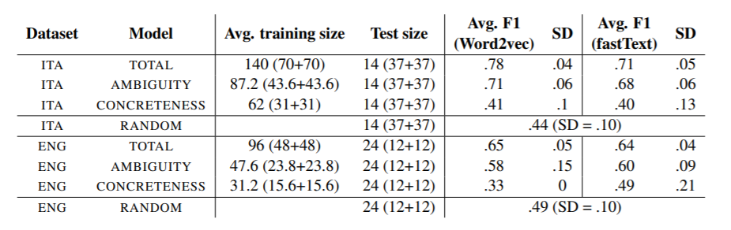
Results
NN is likely exploiting a difference in concreteness/ambiguity of expression.
When NN are trained to spot idioms they exploit underlying sematic features.
Suggest further annotation of idioms to explore what NNs are learning.

Slide 78
Our Research: NLM Understanding of Idioms

Slide 79
Roadmap
Overall Introduction
Evaluating NLM and Lexical Composition (Wes)
Q&A
Idioms and Neural Networks (Daniel)
Q&A
Our Group Project- Idiom paraphrase evaluation
Q&A
This Photo by Unknown Author is licensed under CC BY-NC

Slide 80
Questions?
This Photo by Unknown Author is licensed under CC BY-NC-ND

Slide 81
Overview
Broad research question: can NLMs understand idioms and their underlying meaning?
What do contextual representations of idioms capture in vector space? Do their approximate the non idiomatic meaning?

Slide 82
Dataset
To evaluate we create a custom corpus
1000 idioms curated from SLIDE dataset
Selected for min length > 3 and variation in concreteness, abstractness etc.
2000 idioms in context of regular language usage(Reddit Comments)with paraphrases and non paraphrases (2 of each per sample) created by our team.

Slide 83
Idiom Paraphrase Evaluation
Given Sentence 1 and Sentence 2:
Can a pretrained language model tell us if Sentence 1 is a Paraphrase of Sentence 2?
2 Probing Tasks
Classification
Vector Similarity

Slide 84

Idiom Paraphrase - Classification
Paraphrase?
Paraphrase List
Linear Classifier
Original Sentences
Find Context Sentences
Build Sentence Pairs
Literal Paraphrases
Literal non-paraphrase
https://www.clipart.email/

Slide 85
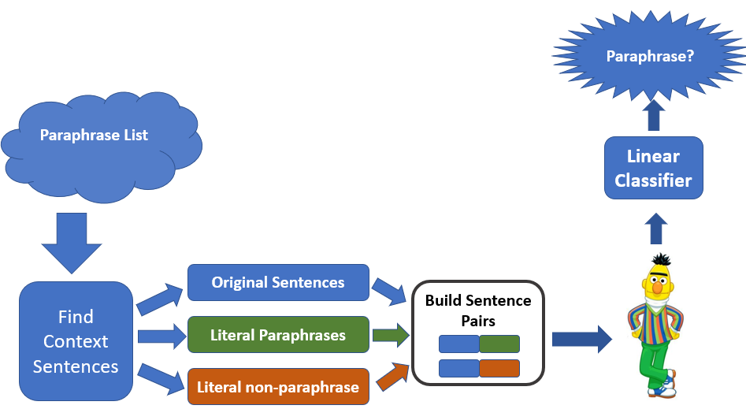
Classification - Variations
2 areas of variation with 2 options each
Which embeddings to use?
Which Bert to Use?
Feed s1 through BERT
Feed s2 through BERT
Combine embedding_{s1} and embedding_{s2}
BERT Base with no fine-tuning
Feed s1 + s2 through BERT
Use CLS token
BERT finetuned on paraphrase detection (but not on idioms)

Slide 86
Idiom Paraphrase – Vector Similarity
Original Sentences
Paraphrase List
Find Context Sentences
Literal Paraphrases
Literal non-Paraphrases
Original Sentences
Vector 1
Compare distances between output vectors
Literal Paraphrases
Vector 2
Literal non- Paraphrases
Vector 3

Slide 87
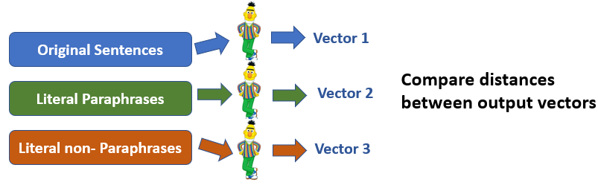
Vector Similarity – Details
Choice of non-paraphrases is important – lexical overlap
She let the cat out of the bag
She revealed the secret
The cat jumped out of the bag

Slide 88
Vector Similarity – Variations
Which vectors to look at?
Representation of full sentence, or select words?
“cat” vs. “secret”
Which layer(s) of BERT?
What comparison measure to use?

Slide 89
Summary – Idiom Paraphrase Experiment
Two Tasks:
Classifier: Given two sentences, where one contains an idiom, classify as paraphrase or not paraphrase.
Vector Similarity: Gather BERT representations for variations on sentences with idioms (true paraphrases, false paraphrases). Compare the distances between these vectors.
Look for trends in results – does vector similarity relate to classifier success?

Slide 90
Questions?
This Photo by Unknown Author is licensed under CC BY-NC-ND

Slide 91
Thanks! Group 1: Josh Tanner, Paige Finkelstein, Wes Rose, Elena Khasanova, and Daniel Campos

