Slide 1
Deliverable #3
Multi-document Summarization System
LING 573
Group 1 - Elena Khasanova, Erica Gardner, Saumya Shah, Sophia Chan and Vikash Kumar

Slide 2
Focus for deliverable #3
R&D - experimentation
  Content Selection - Graph-based methods
  Information Ordering - Cosine similarity to filter out redundant sentences and find coherent order
Content realization
  Regular expressions to remove material

Slide 3
System Overview
Doc set
Content Selection
Data Extraction - Arrange documents by topic id and extract documents in XML format
Content Selection
  Preprocessing - Stop word removal, lemmatization, sentence segmentation and tokenization
  LDA - Produce a set of topics over document and a vocabulary over the topics
Information Ordering
  Removing redundant sentences - Use cosine similarity with sentence embeddings
  Compute coherence score - Use pairwise cosine similarity to find the most coherent ordering
Content Realization
  Removing parentheses, removing adverbs, eliminating sentences shorter than 8 words
Evaluation
Preprocessing
ROUGE
Lemmatization
POS Tagging
Content Realization
Tokenization
Regular expressions
Sentence segmentation
Information Ordering
Coherence score
Topic Modelling
Remove redundant sentences
LDA Topic Modeling
Notes:
Saumya

Slide 4
Content Selection - Literature Review
The methods we came across that perform extractive summarization are given below:
“Latent Dirichlet Allocation” - Topic modelling that estimate latent/hidden topics in any given set of document (Blei et al. (2003))
“Variations of the Similarity Function of TextRank for Automated Summarization” - Use a TextRank matrix that shows the cosine similarity between sentences to generate the top N sentences that will be used for the summary (Barrios et al. (2016))
Skip-thought vectors - The use of skip-thought vectors for sentence similarity and clustering to find topic clusters within a sentence (Kiros et al. (2015))
Notes:
Saumya

Slide 5
Content Selection R&D
TextRank Matrix Implementation
  Networkx
    Advantage: Takes care of multi-document summarization
    Disadvantage: If the graph does not converge at a node, it raises an Exception
  Gensim Summarizer
    Advantage: Renders summaries quickly and supports word limits
    Disadvantage: Did not perform well with ROUGE metrics, does not support multi-document summarization
Skip-thought Vectors Implementation
  Still in progress, but the main implementation is in Python 2.

Slide 6
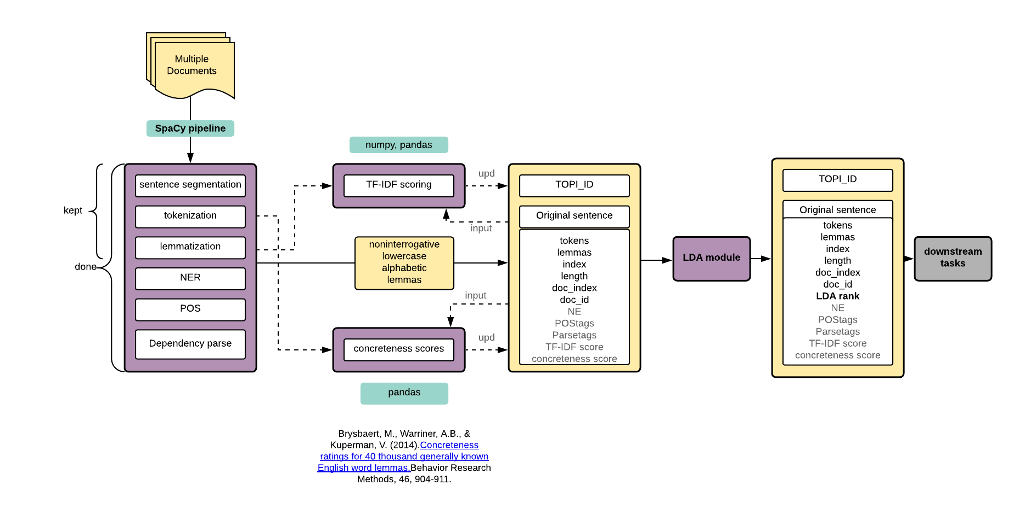
Preprocessing

Slide 7
Future steps in preprocessing
TF-IDF scoring :
  sent.TF-IDF = sum (lemma.TF-IDF)
Concreteness scoring:
  sent.C = sum (lemma.C) if lemma in concreteness_df
Overall sentence score:
  a * sent.LDAscore + b * sent.TF-IDF + c * sent.C; a, b, c - estimated coeff
  sent.LDAscore*sent.TF-IDF*sent.C, rescaled from 0 to 1
Input delexicalization :
  replace x with y if sim(x, y) > thres; pick thres
Skip-thought vectors

Slide 8
Content Selection - Topic modelling
Latent Dirichlet Allocation (LDA) is a popular algorithm to estimate latent/hidden topics in any given set of document
It treats the corpus as bag of words and outputs two probability distributions :
  Distribution of topics over documents
  Distribution of words over topics
We used Genism’s multi core implementation
Included the topic title sentence

Slide 9
Content Selection - LDA parameters
Number of topics:
  Hyperparameter - Limitation of the model
  Difficult to evaluate intrinsically
  Topic coherence can be used to prune out irrelevant topics
  3 topics for each document set for D2
Alpha
  This prior intuitively controls the distribution of topics over the documents. A higher alpha value means that each document is likely to contain mixture of all the topics, a low alpha value gives preference to a distribution where documents belong to a single topic
  Set to 1/{num of topics} = 0.33
Beta
  This prior controls for the distribution of words among topics. A higher beta-value yields overlapping topics while a low beta value one word to strongly belong to multiple topics.

Slide 10
Content Selection - Sample topic
[(0, '0.028*"nepal" + 0.021*"say" + 0.019*"king" + 0.018*"gyanendra" + 0.014*"government" + 0.012*"democracy" + 0.010*"minister" + 0.008*"prime" + 0.008*"china" + 0.008*"new"'),
(1, '0.007*"report" + 0.006*"peace" + 0.005*"news" + 0.005*"street" + 0.005*"katmandu" + 0.004*"deuba" + 0.004*"calm" + 0.004*"china" + 0.004*"unrest" + 0.004*"colleague"'),
(2, '0.005*"non" + 0.004*"state" + 0.003*"nepal" + 0.003*"principle" + 0.003*"police" + 0.003*"violence" + 0.003*"end" + 0.003*"patrol" + 0.003*"launch" + 0.003*"estimate"')]

Slide 11
LDA Limitations
Topics are abstract entities which may not always be comprehensible or semantically meaningful and have no ordinal ranking.
Document-Topic distribution is skewed towards one topic(even after controlling for the alpha parameter)
Overlap of terms among topics, this makes it difficult to isolate words that uniquely represent a new theme.

Slide 12
Experiments
We experimented with bigrams as input to the LDA document term matrix but with much lower success. This may be due to the fact that bigrams have a lot lower distinct counts compared to unigrams so almost every bigram ends up getting almost equal weightage.
We used the tf-idf variation to reorder the topic-term significance scores. The idea is to use the calculate ‘phi’ value for every word for every topic as a substitute for term frequency
We tried to select sentences in the proportion of document-topic probabilities but this was discarded as most the documents had skewed distributions towards one topic.

Slide 13
Information Ordering and Content Realization - Literature Review
For our approach, we drew inspiration from the following papers:
  Information Ordering/Coherence:
    “Modeling Local Coherence: An Entity-Based Approach” - Barzilay and Lapata (2008)
    “The measurement of textual coherence with latent semantic analysis” - Foltz, Kintsch, and Landauer (1998)
  Content Realization
    “Back to Basics: CLASSY 2006” - Conroy et al. (2006)
Notes:
Erica

Slide 14
Information Ordering - Removing redundant sentences
Calculate cosine similarity across pairs of sentences
  GloVe vectors via SpaCy
  Pretrained sentence embeddings via Hugging Face and sentence-transformers
    Base
    Fine-tuned
      NLI
      MRPC (Microsoft Research Paraphrase Corpus)
Notes:
Sophia

Slide 15
Information Ordering - Removing redundant sentences
To select a redundancy threshold to filter out redundant sentences:
Annotate with labels redundant and coherent
    Find average cosine similarity within each set
Review pairs of training sentence ordered based on cosine similarity
Observe changes in ROUGE scores and in outputs
Notes:
Sophia

Slide 16
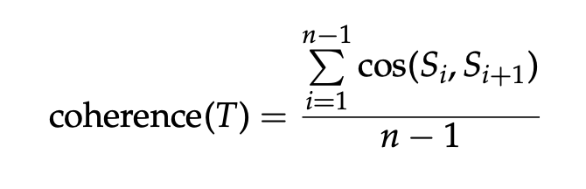
Information Ordering - Coherence scores
After removing redundant sentences, we generate different permutations of the summary sentences
We generate a coherence score for each ordering
  Average pairwise cosine similarity across the sentences
Pick the ordering that gives us the highest coherence score
Barzilay & Lapata, 2008 (from Foltz et al., 1998):
Notes:
Sophia

Slide 17
Content Realization
Kept heuristics from D2 submission
  Did not include sentences with < 8 words, added max word count
  Removed some parenthetical expressions, those with (), [], added -- --
  Removed adverbs, except for sentence-final adverbs
Looked at CLASSY 2006 for additional sentence trimming techniques:
    Removed phrases like “as a matter of fact”, “however”, “also”
    Removed ages
    Removed gerund phrases
    Removed attributions
Evaluated effect on ROUGE scores for each successive addition and only included heuristics that brought up the score
Tracked changes in overall summary word counts
Notes:
Erica
content realization with added regular expressions from classy
Word count differences

Slide 18
Information Ordering
Determined sentence order based on LDA score
  LDA score output had the top 5 sentences
  Added these to summary in order of rank
To do for next deliverable:
  Adjust approach to place more emphasis on cohesion, coherence
  Incorporate chronology by considering document time stamp
  Incorporate topicality by using cosine similarity to add sentences most similar to those already in summary
Notes:
Erica/Sophia

Slide 19
Results: D2 ROUGE-2
ROUGE-2
  Average Recall: 0.04340
  Average Precision: 0.06116
  Average F-1: 0.05031
Notes:
Sophia

Slide 20
Results - D3
ROUGE-2
  Average Recall: 0.05427
  Average Precision: 0.06700
  Average F-1: 0.05981
Notes:
Sophia

Slide 21
Results - Comparison
 | ROUGE-2 (Average Recall)
LEAD Baseline | 0.05376
MEAD Baseline | 0.05927
D2 System | 0.04340
D3 System | 0.05427

Slide 22
Error Analysis: ordering + selection
D1001 - Columbine Massacre
"The young killers of Columbine High School do stand for the spirit of America," Gore said.
The nation and the world have joined in grieving for the students of Columbine.
The day that Columbine High School students are to return to class has been delayed because many have been attending funerals for students killed in the April 20 massacre.
Two days, a massacre by two students at Columbine High, whose teams are called the Rebels, left 15 people dead and dozens wounded.
Better ordering: 4, 3, 2
Notes:
Selecting a sentence to add up to 100 words - out of place sentence

Slide 23
Error Analysis: abundant named entities
D1004 - Papua tsunami
Igara said reports indicated that a community school Catholic mission station and the Nimas village in the Sissano area west of Aitape had been destroyed, 30 people were dead.
The Papua New Guinea Defense Force, the police and health services are on standby to help the victims of a tsunami that wiped out several villages on PNG's remote north-west coast Friday night.
Prime Minister Bill Skate, National Disaster Services Chairman Colin Travertz and National Disaster Services Director-General Ludwig Kembu were reported to inspect the affected areas Sunday.
Notes:
The sentences are selected well length-vise and they do contain relevant but not the most representative of the topic information
LDA, even if normalized by length, favors longer sentences with more topical components - > they get filtered out when we are trying to get to 100 words
Ordering could also be different

Slide 24
Error Analysis: more attribution, redundant fragments
D1012
A Cypriot Helios Airways Boeing 737 jetliner with 115 passengers and six crew members on board crashed Sunday north of Athens, Greek news media reported.
Airport officials in Larnaka said the pilot of the airliner reported problems with the air-conditioning system minutes before losing contact with Greek and Cypriot traffic controllers.
The Cypriot airliner that crashed Sunday in Greece may have experienced a catastrophic loss of cabin pressure that starved the pilots of oxygen.
Aviation experts were baffled, saying it was rare for a plane to crash because of depressurization.
Notes:
Sentences with redundant fragments receive low redundancy scores (cosine sim) because the redundant piece is small in proportion to the length of the sentence

Slide 25
Error Analysis: coreference
D1013
In July, a new civil law became effective, forcing credit agencies to clear the records of identity-theft victims who can present a police report documenting the fraud.
Last fall, she said, she watched an NBC News report on thieves needed a name and address to steal a person's identity, using that information to set up fraudulent credit accounts.
She had no idea what identity theft was until 1995, she received a call from the Bank of New York demanding that Frank pay up on her $11,000 credit card balance.
Notes:
We still don’t know who!

Slide 26
Error Analysis: connectors
D1030
But the revised guidelines allow companies to advertise the health effects of herbal supplements without having to prove their effectiveness as the wording does suggest that the products prevent, treat or cure disease.
The federal Food and Drug Administration says it has received hundreds of reports from physicians, health authorities and others about adverse reactions to ephedrine-based products.
But some local authorities have recognized the seriousness of the problem, and have done to crack down on drug-related crime.

Slide 27
Results: Missing fragments
D1014
Original:
Many spoiled teenagers from one-child families eat only a particular kind of food, such as meat or sweets, which might easily lead them to develop obesity, diabetes or heart disease.
Post-processed:
Many spoiled teenagers from one-child families eat a particular kind of food, such as meat or sweets diabetes or heart disease.
Notes:
Removal of embedded clauses may be overgenerated - > deep processing approaches

Slide 28
Error Analysis
Why did it happen?
  Content: several sentences receive the same LDA rank, content realization makes the most coherent but not the most relevant selection
  Redundancy: hard to measure similarity of sentence fragments
  Coreference: no specific treatment of coreference, no punishment for pronominal subjects
  Connectors: not adapted to the selected context
  Missing fragments: surface level postprocessing
  Attribution: not enough diverse cases were considered
  Pipelines are difficult: error propagation, fixing one issue breaks another

Slide 29
Potential Solutions
What can be changed?
  Irrelevant content: distribute sentences across LDA subtopics
  Redundancy: hard to measure similarity of sentence fragments
  Coreference: penalize pronominal subjects
  Missing fragments: do post-processing on a phrase-structure level
  Attribution: consider more cases
  Connectors: apply a new heuristic
  Error propagation: perform ablation study and select the best configurations of each model, then solve the resulting issues

Slide 30
Error Analysis: Summary
Much less redundancy: sentence - 13 %, fragments - 22%
About 46 % of summaries need minor improvements
26% of summaries have injections of short out-of-place sentences
44% can benefit from reordering of the selected sentences

Slide 31
Improvements for D4
Content Selection
  Selecting spans instead of entire sentences. We have re-ordered our topic term distribution and can now use this to extract spans around the most important terms.
  Delexicalization of the input based on word vector similarity
  Explore skip-thought vectors and clustering methods
Information Ordering
  Weight cosine similarity by LDA topic and document ID
  Store pairwise cosine similarities instead of calculating on-the-fly so that we can get more sentence permutations
Content Realization
  Use phrase structure to ensure cohesion
  Incorporate entity linking and coreference resolution
  Select among different versions of the same sentence to get us closer to the word count limit
Notes:
Together!

Slide 32
Conclusion
The end-to-end system achieved the ROUGE-1 and ROUGE-2 scores comparable with the baselines and outperformed the baseline in one out of three cases. The scores show that our approach has the potential to yield good results.
This deliverable is largely focused on experimenting information ordering and content realization methods and improving the concerns in the last deliverable such as redundancy. We also experimented with several content selection methods and built the scaffolding for a more refined versions of this module.
Notes:
Saumya

Slide 33
Thank you!

