Slide 1
Deliverable #2
Multi-document Summarization System LING 573
Group 1 - Elena Khasanova, Erica Gardner, Saumya Shah, Sophia Chan and Vikash Kumar

Slide 2
System Overview
Doc set
Content Selection
Data Extraction - Arrange documents by topic id and extract documents in XML format
Content Selection
Preprocessing - Stop word removal, lemmatization, sentence segmentation and tokenization
LDA - Produce a set of topics over document and a vocabulary over the topics
Information Ordering - Pick the top sentences from the LDA module for the summary
Content Realization - Removing parentheses, removing adverbs, eliminating sentences shorter than 8 words
Preprocessing
Lemmatization
POS Tagging
Tokenization
Evaluation
Sentence segmentation
ROUGE
Topic Modelling
Information Ordering
LDA Topic Modeling
Chronological Ordering

Slide 3
Literature Review
The methods we came across that perform extractive summarization are given below:
Using word-frequency algorithms to choose the sentences to be included in the summary
TextRank matrix that shows the cosine similarity between sentences and use of universal sentence embeddings to generate the top N sentences that will be used for the summary
The use of skip-thought vectors for sentence similarity and clustering to find topic clusters within a sentence
For all these methods, we found that a ranking component is essential. And since this method is predominantly unsupervised, an unsupervised technique to find different topics/clusters within a document is useful to identify the important aspects of the text.

Slide 4
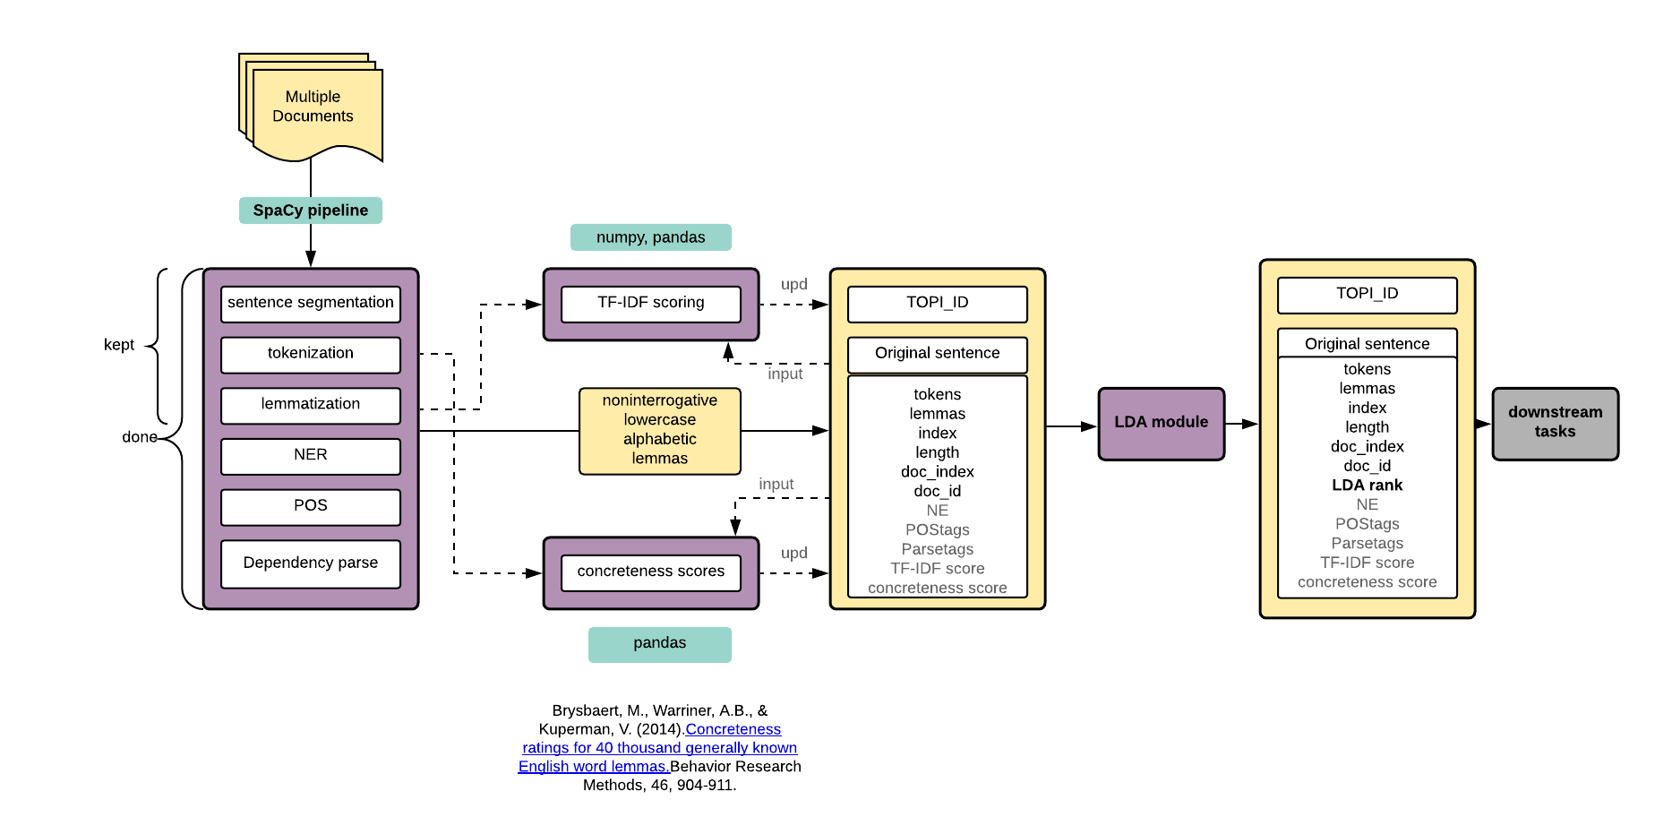
Preprocessing

Slide 5
Future steps in preprocessing
TF-IDF scoring :
sent.TF-IDF = sum (lemma.TF-IDF)
Concreteness scoring:
sent.C = sum (lemma.C) if lemma in concreteness_df
Overall sentence score:
a * sent.LDAscore + b * sent.TF-IDF + c * sent.C; a, b, c - estimated coeff
sent.LDAscore*sent.TF-IDF*sent.C, rescaled from 0 to 1
Input delexicalization :
replace x with y if sim(x, y) > thres; pick thres
Skip-thought vectors

Slide 6
Content Selection - Topic Modelling
Latent Dirichlet Allocation(LDA) is a popular algorithm to estimate latent/hidden topics in any given set of document.
It treats the corpus as bag of words and outputs two probability distributions :
Distribution of topics over documents
Distribution of words over topics
We used Genism’s multi core implementation

Slide 7
LDA Parameters
Number of topics:
Hyperparameter - Limitation of the model
Difficult to evaluate intrinsically
Topic coherence can be used to prune out irrelevant topics
3 topics for each document set for D2
Alpha
This prior intuitively controls the distribution of topics over the documents. A higher alpha value means that each document is likely to contain mixture of all the topics, a low alpha value gives preference to a distribution where documents belong to a single topic
Set to 1/{num of topics} = 0.33
Beta
This prior controls for the distribution of words among topics. A higher beta-value yields overlapping topics while a low beta value one word to strongly belong to multiple topics.

Slide 8
Sample topic
[(0, '0.028*"nepal" + 0.021*"say" + 0.019*"king" + 0.018*"gyanendra" + 0.014*"government" + 0.012*"democracy" + 0.010*"minister" + 0.008*"prime" + 0.008*"china" + 0.008*"new"'),
(1, '0.007*"report" + 0.006*"peace" + 0.005*"news" + 0.005*"street" + 0.005*"katmandu" + 0.004*"deuba" + 0.004*"calm" + 0.004*"china" + 0.004*"unrest" + 0.004*"colleague"'),
(2, '0.005*"non" + 0.004*"state" + 0.003*"nepal" + 0.003*"principle" + 0.003*"police" + 0.003*"violence" + 0.003*"end" + 0.003*"patrol" + 0.003*"launch" + 0.003*"estimate"')]

Slide 9
Information Ordering
Determined sentence order based on LDA score
LDA score output had the top 5 sentences
Added these to summary in order of rank
To do for next deliverable:
Adjust approach to place more emphasis on cohesion, coherence
Incorporate chronology by considering document time stamp
Incorporate topicality by using cosine similarity to add sentences most similar to those already in summary

Slide 10
Content Realization
Incorporated several basic heuristics to cut down on irrelevant information:
Did not include sentences with < 8 words
Removed some parenthetical expressions, those with (), []
Removed adverbs
If output was less than 100 words, added a sentence that would bring it as close to 100 words as possible, even if it wasn’t the next highly ranked sentence
For next time:
Incorporate additional heuristics
Exploring learning or phrase structure-based approaches

Slide 11
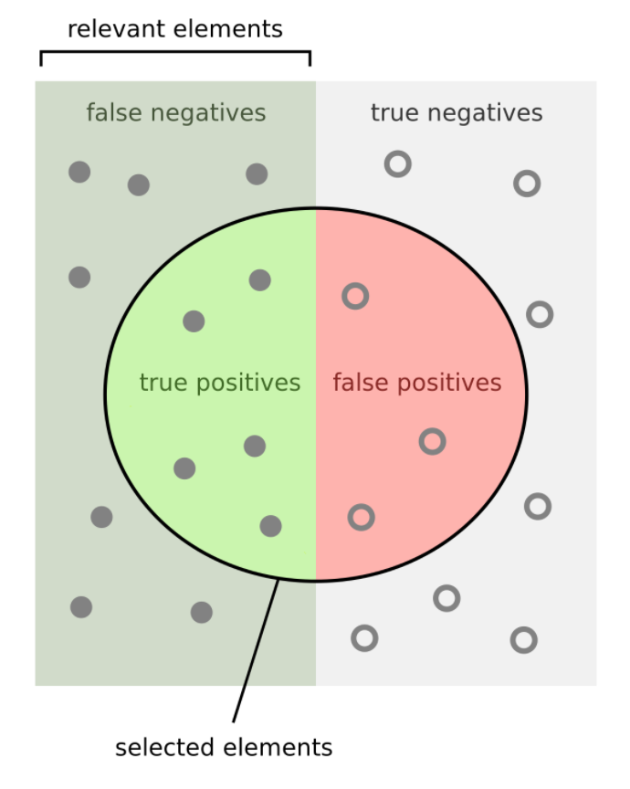
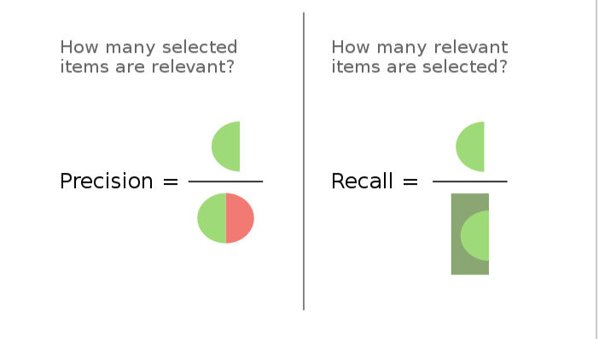
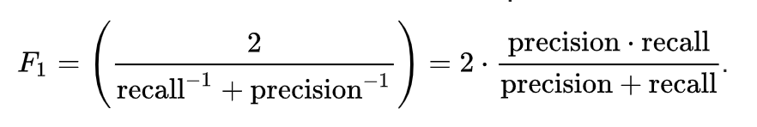
Results: ROUGE-1 and ROUGE-2
ROUGE-1
Average Recall: 0.18334
Average Precision: 0.25957
Average F-1: 0.21316
ROUGE-2
Average Recall: 0.04340
Average Precision: 0.06116
Average F-1: 0.05031

Slide 12
Results: Comparison to baselines
 | ROUGE-2 (Average F)
D2 System | 0.05031 (95% CI [0.04008, 0.06069])
LEAD Baseline | 0.05376
MEAD Baseline | 0.05927

Slide 13
Error Analysis
D1002
Some of the police officers who shot and killed Amadou Diallo have told associates that their attention was drawn to Diallo when they saw him standing on the stoop of a Bronx apartment building and thought they saw him peering into the window of a first-floor apartment, according to people with knowledge of the case.
D1014
Many spoiled teenagers from one-child families eat a particular kind of food, such as meat or sweets, which might lead them to develop obesity, diabetes or heart disease.
The study shows that the 12 percent obesity is to the standard in developed countries.
The research showed that the ratio of adults suffering from obesity has reached 12.6 percent, and that of youngsters is 11.35 percent.

Slide 14
Error Analysis
Why did it happen?
Attribution: no filtering mechanism
Redundancy
No metric to measure similarity between sentences
Lost mapping to LDA topics and documents during content selection
Pipelines are difficult
Errors can propagate from one layer to the next

Slide 15
Potential Solutions
What can be changed?
Preserve information about LDA topics and which document the sentence came from
Use date of publication
Distribute sentences across subtopics
Prevent against summary with two sentences with high cosine similarity
Use a heuristic to remove attribution
e.g. Remove portion that contains attributive word + occurs after comma and before period

Slide 16
Results: Attribution
D1002
Some of the police officers who shot and killed Amadou Diallo have told associates that their attention was drawn to Diallo when they saw him standing on the stoop of a Bronx apartment building and thought they saw him peering into the window of a first-floor apartment, according to people with knowledge of the case.

Slide 17
Results: Redundancy
D1014
Many spoiled teenagers from one-child families eat a particular kind of food, such as meat or sweets, which might lead them to develop obesity, diabetes or heart disease.
The study shows that the 12 percent obesity is to the standard in developed countries.
The research showed that the ratio of adults suffering from obesity has reached 12.6 percent, and that of youngsters is 11.35 percent.

Slide 18
For the next deliverable
Content Selection
We are aiming to experiment with hyper parameters in LDA and also augment LDA topic modeling with TF-IDF and concreteness scoring
Delexicalization of the input based on word vector similarity.
Explore skip-thought vectors and clustering methods
Information ordering
We plan to use the document meta-information
Experiment with chronological ordering
Promote coherence using cosine similarity.
Content Realization
Use phrase structure to ensure cohesion
Experiment with learning methods

Slide 19
Conclusion
We largely focused working out the system architecture and ensuring that the separate components run smoothly following one another. We also experimented with several content selection methods and built the scaffolding for a more refined versions of this module.
The end-to-end system achieved the ROUGE-1 and ROUGE-2 scores comparable with the baselines and outperformed the baseline in one out of three cases. The scores show that our approach has the potential to yield good results.

Slide 20
Thank you!

