Slide 1
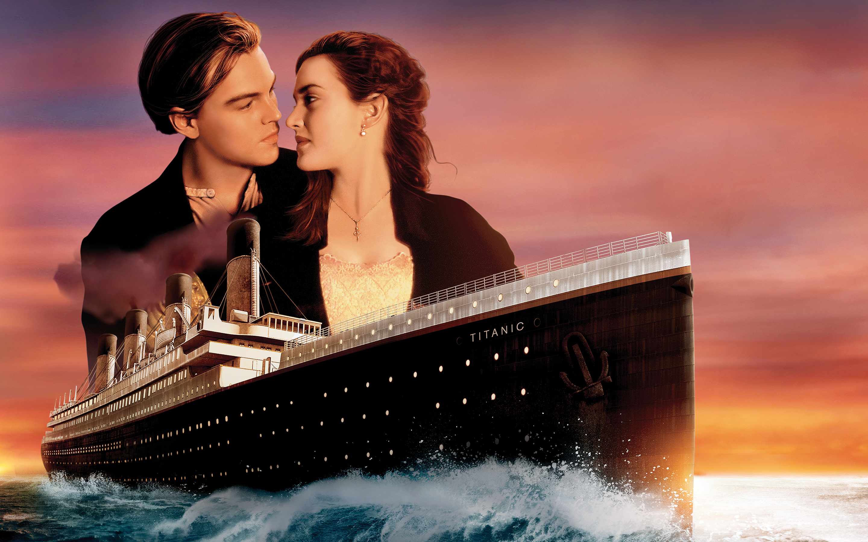
ARE YOU ROSE OR JACK?
Would you survive the Titanic crash or not?
Why Rose survived and Jack didn’t?

Slide 2
Introduction
One of the reasons that the shipwreck led to such loss of life was that there were not enough lifeboats for the passengers and crew. Although there was some element of luck involved in surviving the sinking, some groups of people were more likely to survive than others, such as women, children, and the upper-class.
In this challenge, I am asked to complete the analysis of what sorts of people were likely to survive. In particular, we ask you to apply the tools of machine learning to predict which passengers survived the tragedy.

Slide 3
Data
PassengerId: 1
Pclass: 1, 2, 3
Name: the name of the passenger
Sex
Age
SibSp: # of siblings / spouses aboard the Titanic
Parch: # of parents / children aboard the Titanic
Ticket: Ticket number
Fare: Passenger fare
Cabin: Cabin number
Embarked: Port of Embarkation
Survived: 0, 1

Slide 4

Formatting
Changing data types
Filtering
Checking the presence of NAs

Slide 5
Formatting
Changing data types
Filtering
Checking the presence of NAs
Feature creation

Slide 6
Missing value treatment
Filling by medians
Building decision tree

Slide 7
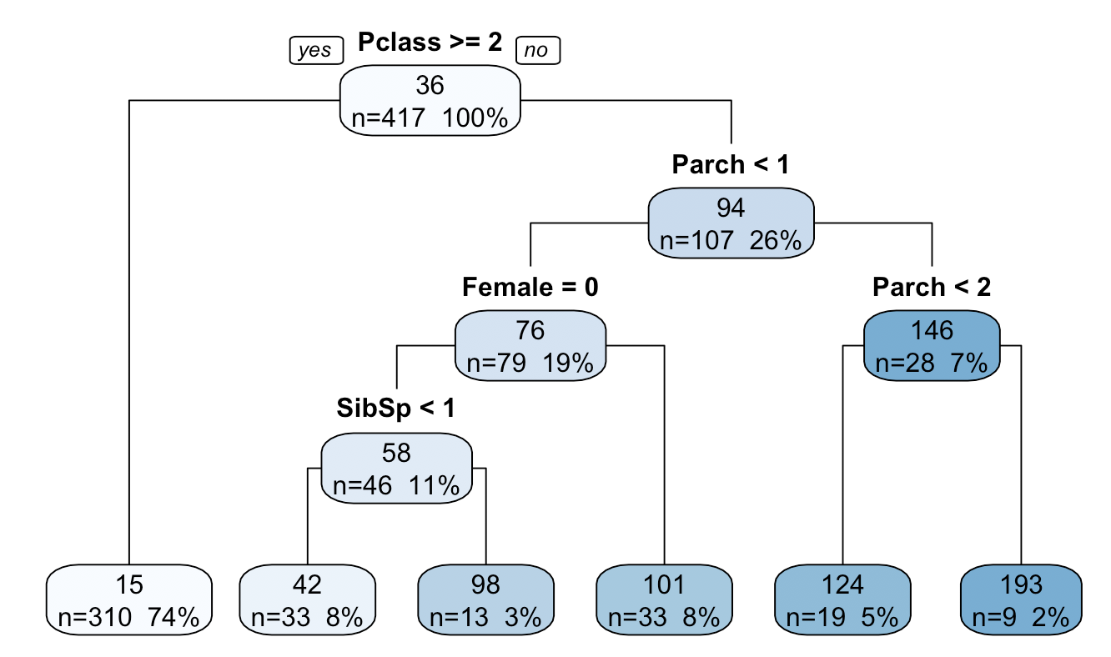
Decision tree

Slide 8
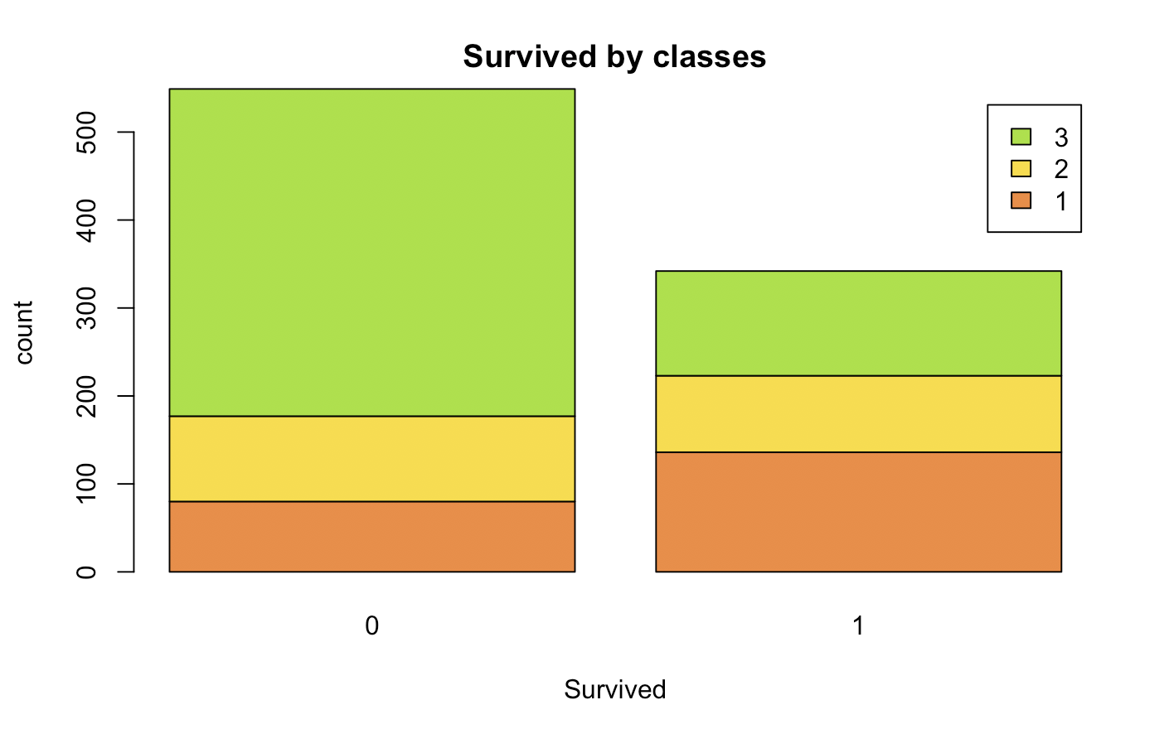
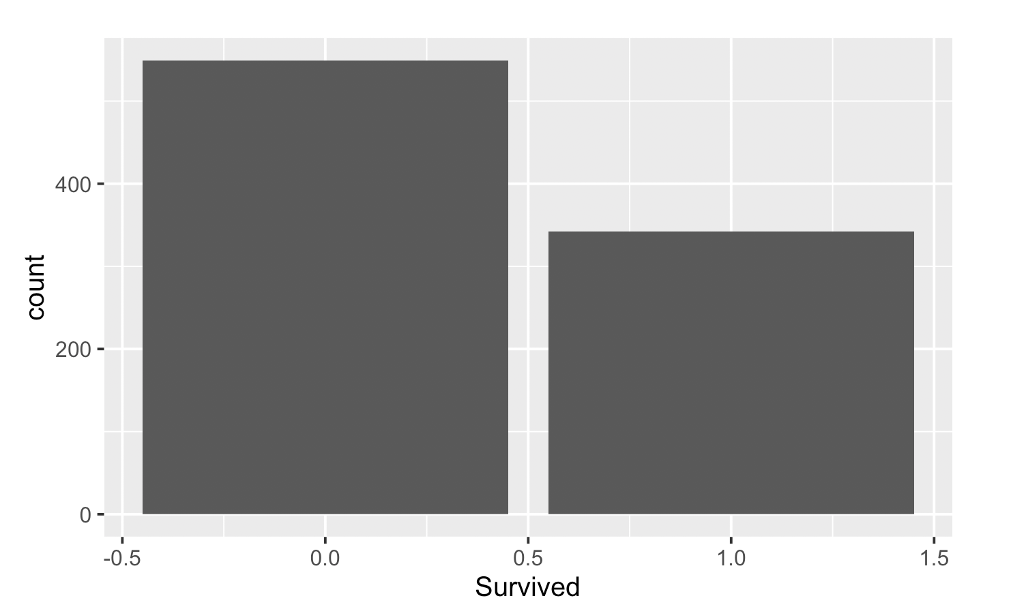
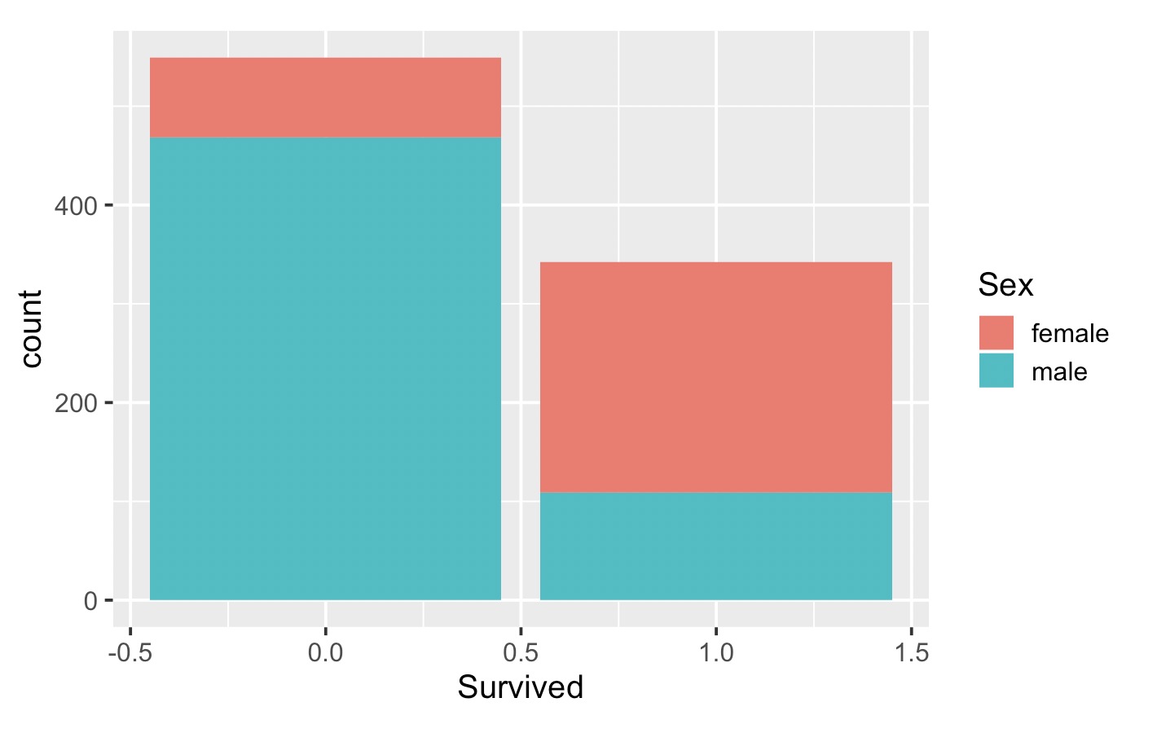
Visualization

Slide 9
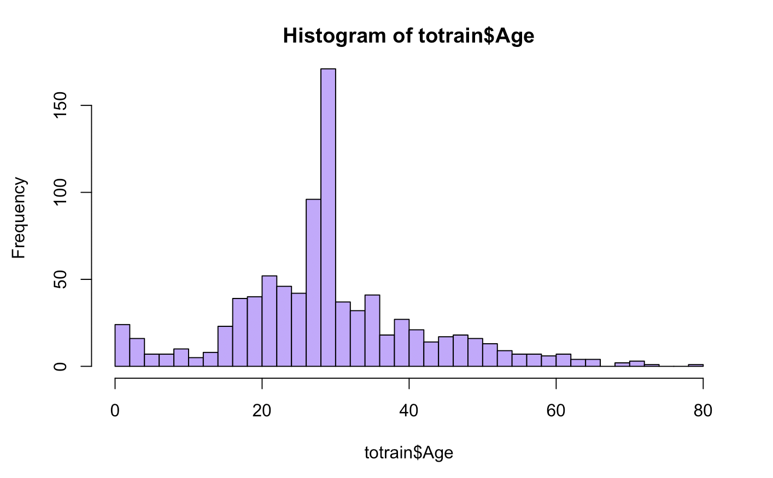
Visualization

Slide 10
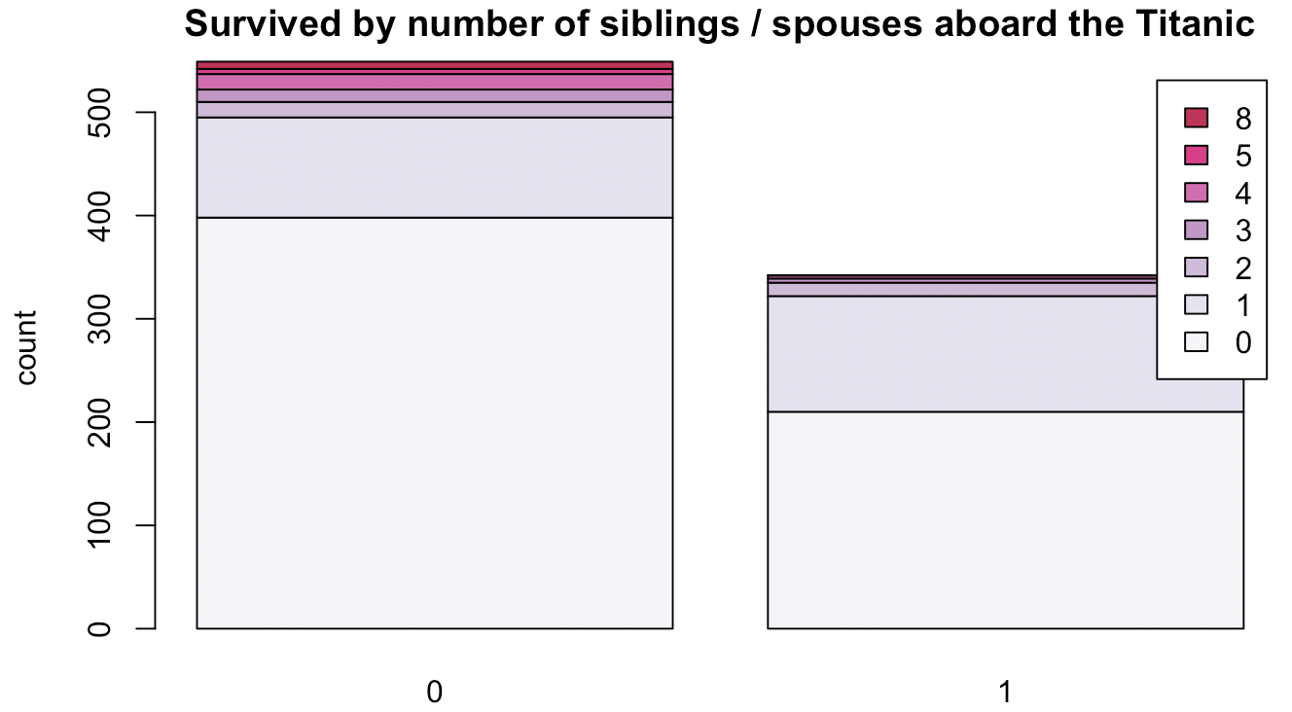
Visualization

Slide 11
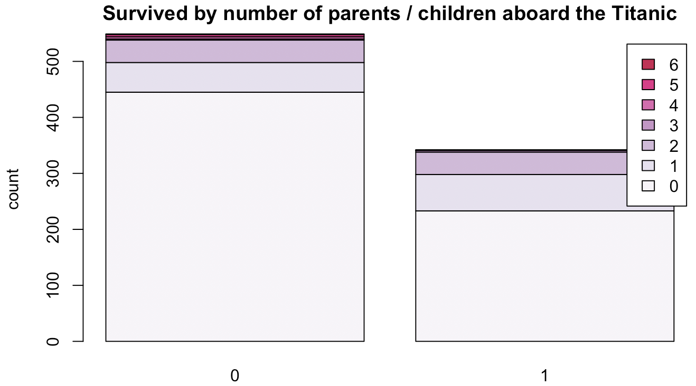
Visualization

Slide 12
Modeling
Logit Regression
Random Forest
Caret

Slide 13
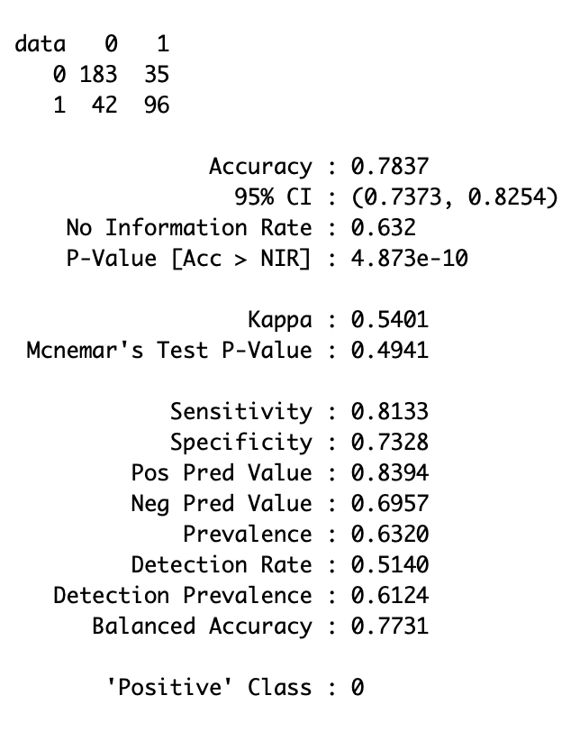
Logistic regression with caret

Slide 14
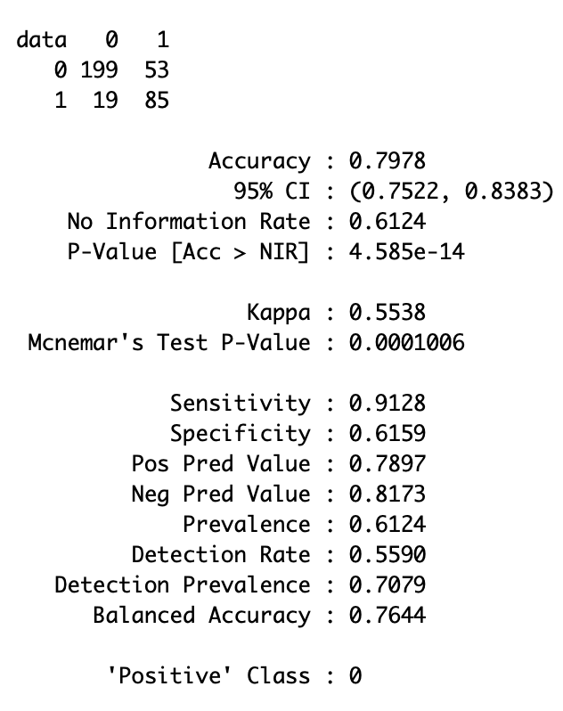
Logistic regression with random forest

Slide 15
So who was likely to survive?
Young
Women
Reach
Lonely

Slide 16

Thanks for you attention!

