Slide 1
Arrays

Slide 2
Inhoud
What is an array
Declare
Initialize
Default Values of an array
Write to values to an array
Read values of an array
Access an index of an array that doesn’t exists

Slide 3
What is an array
An array is a datatype which can be used to store multiple values.
You can see it as a list of values.
If we want to store a list of numbers
Every element in that list needs to be of the same datatype
(1, 55, -94, 5) GOOD
(1, Sunday, -94, 5) BAD -> due to ‘Sunday’

Slide 4

Declare an array
In this code we declared an array where we can store integer values in. we called this array getallen.
Datatype of the values stored in the array
[], this is the way to say that it is an array.
In our example we call ‘int[]’, a int array.
The identifier of the variable.

Slide 5




Declare an array
Code example | Datatype of elements in the array | Identifier
 | Float | metingenInCm
 | Char | Klinkers
 | Decimal | Koers
 | Bool | lights

Slide 6

Initialize Way1
MEMORY
getallen[0] | 1
getallen[1] | 55
getallen[2] | -99
getallen[3] | 5
Every array has a fixed length. What this means is that ones an array is initialized with a length of 4. It will stay 4 for the rest of its lifetime.

Slide 7
Initialize Way2
The ‘new’ keyword says the we will create a whole new array white the default values.
The amount of elements that we can store in this array.
Datatype of the values of the array we want to create
MEMORY
getallen[0] | 0
getallen[1] | 0
getallen[2] | 0

Slide 8
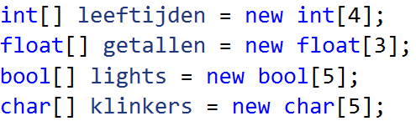
Default values of array
MEMORY
leeftijden[0] | 0
leeftijden[1] | 0
leeftijden[2] | 0
leeftijden[3] | 0
getallen[0] | 0
getallen[1] | 0
getallen[2] | 0
lights[0] | False
lights[1] | False
lights[2] | False
lights[3] | False
lights[4] | false
klinkers[0] | 0 (decimal)
klinkers[1] | 0 (decimal)
klinkers[2] | 0 (decimal)
klinkers[3] | 0 (decimal)
klinkers[4] | 0 (decimal)
When initializing an array eg. ‘new int[4]’ . C# will immediately reserve 4 spots for us in the computers memory. Because of that we need to assure that every element of the array has a valid value.

Slide 9
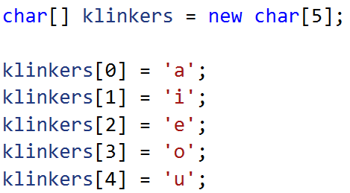
Write values to an array (line by line)
MEMORY
klinkers[0] | 0 (decimal)
klinkers[1] | 0 (decimal)
klinkers[2] | 0 (decimal)
klinkers[3] | 0 (decimal)
klinkers[4] | 0 (decimal)
‘a'
‘i'
‘e'
‘o'
‘u'

Slide 10
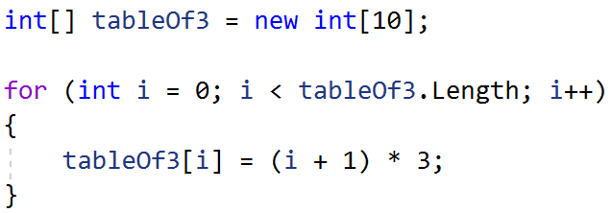
Write values to an array (iteration)
MEMORY
tableOf3[0] | 3
tableOf3[1] | 6
tableOf3[2] | 9
tableOf3[3] | 12
tableOf3[4] | 15
tableOf3[5] | 18
tableOf3[6] | 21
tableOf3[7] | 24
tableOf3[8] | 27
tableOf3[9] | 30

Slide 11

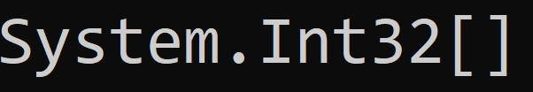
Read values of an array
Imagine we want to print our array from previous slide.
MEMORY
tableOf3[0] | 3
tableOf3[1] | 6
tableOf3[2] | 9
tableOf3[3] | 12
tableOf3[4] | 15
tableOf3[5] | 18
tableOf3[6] | 21
tableOf3[7] | 24
tableOf3[8] | 27
tableOf3[9] | 30
If we print this array out, we get the namespace of the datatype of our array. The reason we get the namespace of out array is because an array is a reference type.

Slide 12

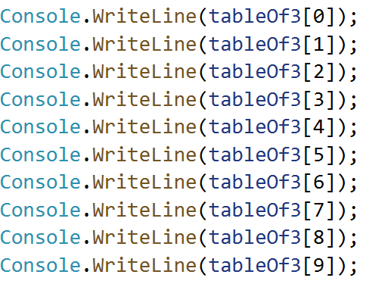
Read values of an array (line by line)
MEMORY
tableOf3[0] | 3
tableOf3[1] | 6
tableOf3[2] | 9
tableOf3[3] | 12
tableOf3[4] | 15
tableOf3[5] | 18
tableOf3[6] | 21
tableOf3[7] | 24
tableOf3[8] | 27
tableOf3[9] | 30

Slide 13
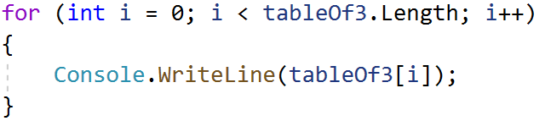
Read values of an array (Iteration)
MEMORY
tableOf3[0] | 3
tableOf3[1] | 6
tableOf3[2] | 9
tableOf3[3] | 12
tableOf3[4] | 15
tableOf3[5] | 18
tableOf3[6] | 21
tableOf3[7] | 24
tableOf3[8] | 27
tableOf3[9] | 30

Slide 14
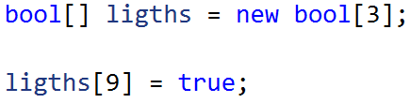
Access an index of an array that doesn’t exists
MEMORY
ligths[0] | False
ligths[1] | False
ligths[2] | false

