Slide 1


Elena Schmitt

Slide 2
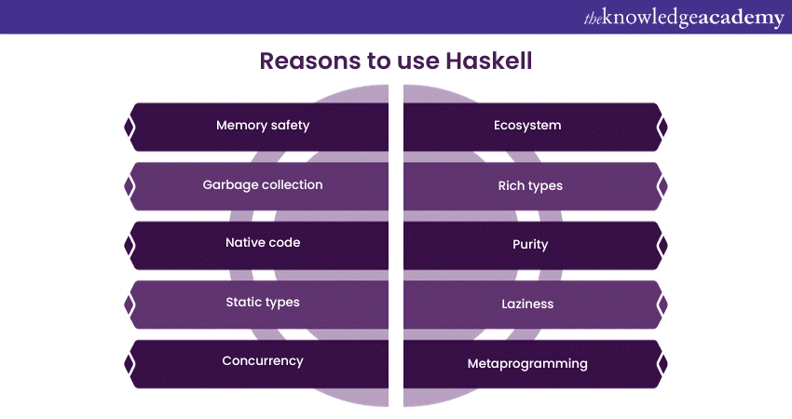
What is Haskell?
Purely functional language
No side-effects
Statically typed
Types of expressions are checked before the program runs and do not change during execution
Higher-order Functions
Can take in other functions as parameters and return functions
Lazy Evaluation
Expressions not evaluated until needed

Slide 3
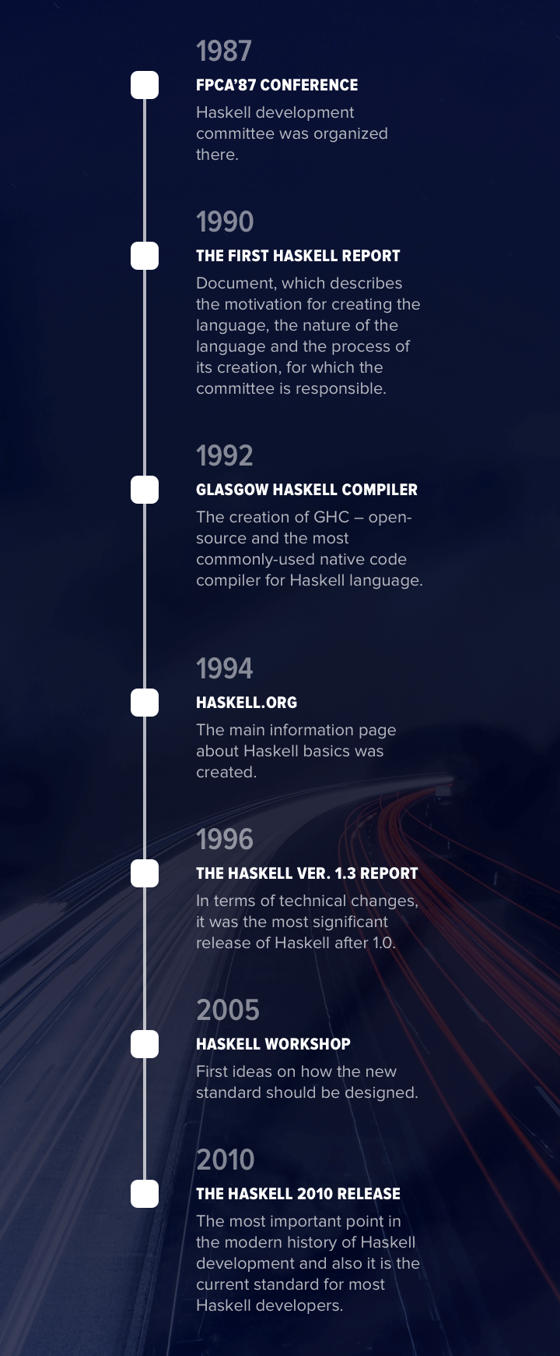
History of Haskell
Named after mathematician Haskell Brooks Curry
In 1987 a committee was formed to create a common functional programming language
Haskell 98 released and a standard library was published
In 2006 work on a successor to Haskell 98 began
Haskell 2010 is released
GHC Haskell is the implementation widely used today

Slide 4



Where It’s Used
Pure Functional
Strong Type System
Parallel Programming
Reasoning
Efficiency
TEACHING
Good for learning programming concepts.
RESEARCH
Strength in reasoning, useful for statistics.
Ability to handle large datasets.
INDUSTRY
Used in areas like aerospace, finance, and healthcare.
Good at handling real-time data streams.

Slide 5
Return Return :: a -> m a Bind (>>=) :: m a -> (a -> m b) -> m b Then (>>) :: m a -> m b -> m
Monads
class Monad m where
(>>=) :: m a -> ( a -> m b) -> m b
(>>) :: m a -> m b -> m b
return :: a -> m a
m monadic type constructor (Maybe, IO, Reader, etc.).
a, b type variables- a is the type input to the monad, b is the type input you get out of the monad
Return: Wraps a value in a monad
Bind: Allows for chaining together monadic operations
Then: Similar to bind, but ignores the result of the first monadic operation

Slide 6
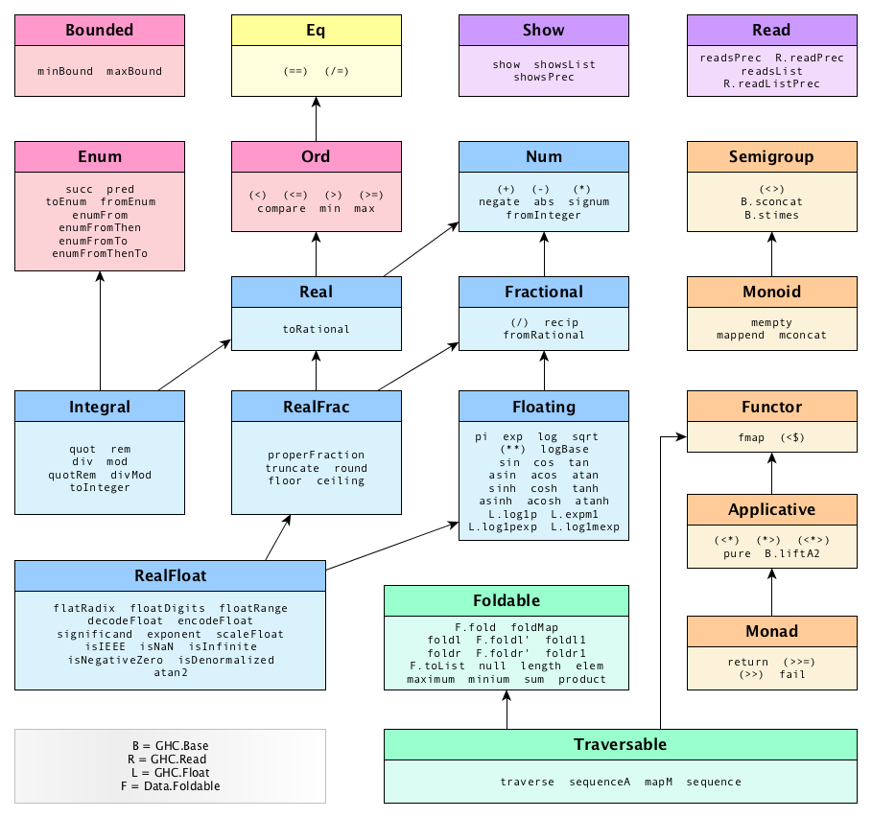
Typeclasses
Define a set of methods that are shared between multiple types
Only able to accept certain types for a function
Compile-time type restraints
Types are checked before running
Have set operations so that they behave consistently
Inheritance allows for creating more specific types
Polymorphism

Slide 7
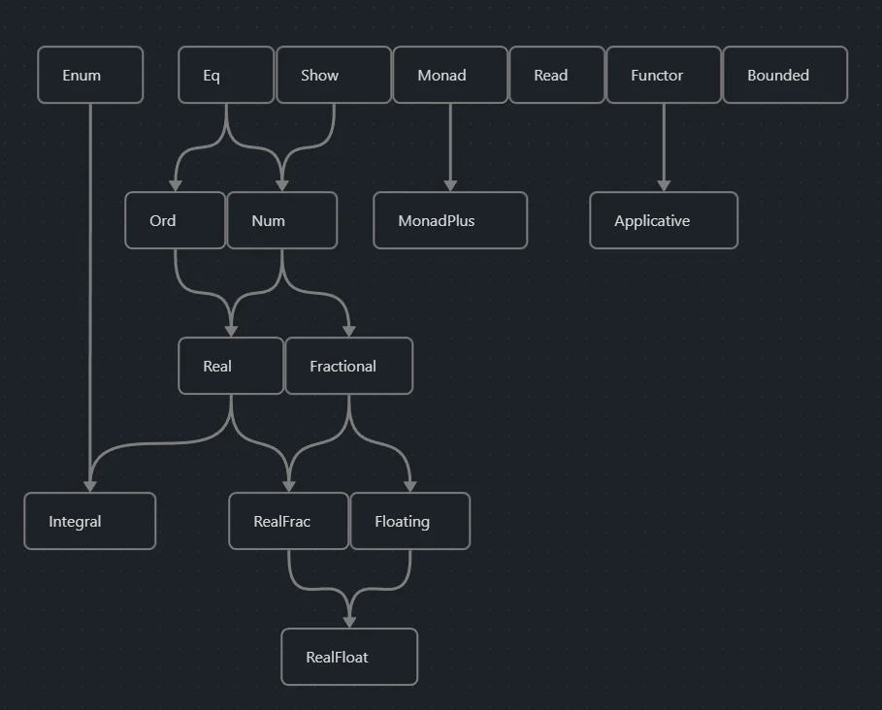

Slide 8
Demonstration

Slide 9
Sources
https://cs.lmu.edu/~ray/notes/introhaskell/
https://scrapingrobot.com/blog/haskell-programing-language/#programming-in-haskell
https://serokell.io/blog/haskell-history
https://medium.com/sourcescribes/what-is-haskell-853b6949a800
https://wiki.haskell.org/Monad

