Slide 1
Fashionable Analytics
A Kimball star-schema build on 129k rows of raw sales data
Trade-offs, decisions, and what I'd add for production

Slide 2
Architecture at a glance
CSV ──(scripts/load_raw.py)──▶ raw.fashionable_sales_raw │ ▼ stg_fashionable__orders (staging schema) │ ┌──────────────┬─────────────────────┼──────────────────┬────────────────┐ ▼ ▼ ▼ ▼ ▼ dim_date dim_product dim_geography dim_order_status (fact) └──────────────┴─────────────────────┴──────────────────┘ │ │ │ └───────────► fct_sales ◄────────────┘ (marts schema) │ ▼ BI / dashboards (semantic layer)
raw / seeds hold source data · staging is 1:1 · marts is the star exposed to BI

Slide 3
Data exploration
Metric | Finding
Records | 128,975
Unique orders | 120,378
Source columns | 24
Date range | 2022-03-31 → 2022-06-29 (91 distinct days)
SKUs | 7,195
Styles | 1,377
Categories | 9
Sizes | 11
Ship cities | 8,955
Business concepts: Orders · Products · Sales · Location · Fulfilment

Slide 4
Source grain: one row ≠ one order
One order ≠ one row
Product hierarchy Style → SKU → Size
Metric | Finding
Records | 128,975
Unique orders | 120,378
Extra line items | 8,597
Orders w/ multiple rows | 6,846
Max rows for one order | 12
Exact-dup (Order ID, SKU) groups | 7
Metric | Finding
Styles | 1,377
SKUs | 7,195
Sizes | 11
Styles w/ multiple SKUs | 1,180
Max SKUs for one style | 14
Fact grain = order × SKU line item. (Order ID, SKU) needs DISTINCT in staging (D2).

Slide 5
Data quality — completeness & uniqueness
Check | Result
Business-level exact duplicate rows (excl. `index`) | 6
Missing Amount | 7,795
Qty = 0 | 12,807
Negative Qty / Negative Amount | 0 / 0
Invalid dates (format %m-%d-%y) | 0
Missing shipping info | 33
SKU → Style / Category / Size drift | 0 / 0 / 0
Status ↔ Courier Status contradictions | 218 (0.17%)
Master data is clean. (Order ID, SKU) is almost unique — dedupe required.

Slide 6
Data quality — cross-field & geography
Amount / currency null pattern
Casing collapse (D7)
• Both NULL: 7,795 · Only Amount NULL: 0 · Only currency NULL: 0
• Perfectly correlated → drop `currency` (D4)
Column | Raw | Normalized | % dup
ship-city | 8,955 | 7,297 | 19%
ship-state | 69 | 47 | 32%
ship-country | 1 | 1 | 0%
Fulfilment ↔ fulfilled-by
Fulfilment | fulfilled-by | count
Fashionable | <NULL> | 89,698
Merchant | Easy Ship | 39,277
India has 36 states + UTs officially — even normalized we see 47 (residual misspellings).

Slide 7
Not every anomaly is bad data
Condition | Total | Cancelled | Shipped
Qty = 0 | 12,807 | 12,703 | 104
Amount missing | 7,795 | 7,576 | 219
• Cancelled + Amount > 0: 10,766 rows — list price at cancel time. Naïve sum inflates revenue ~15%. → D1 is_cancelled + derived revenue_amount.
• Active-order anomalies to FLAG (not delete): Shipped + Qty=0 = 104, Shipped + Amount missing = 219.
• promotion-ids: 79,822 rows carry data (62%), up to 36 promos/row. → D3 promo_count on fact, bridge deferred.
• Key insight: NULL / unusual values ≠ bad data. Silent filtering destroys signal.

Slide 8
Data quality treatment strategy
Action | Examples
CLEAN | Types, snake_case names, whitespace/casing, city/state normalization, date parsing
KEEP | Cancelled orders, valid business NULLs, `_raw` audit columns
FLAG | Shipped + Qty = 0 · Shipped + missing Amount · Status/Courier contradictions
EXCLUDE | Technical `index`, `Unnamed: 22` (79,925 rows literal 'False'), `fulfilled-by` (redundant), constants `currency` / `ship-country`
TEST | PK uniqueness · fact↔dim relationships · accepted values · reconciliation vs raw
Visible in detail in dbt docs.

Slide 9
D1–D8 locked decisions
Ref | Decision
D1 | Cancelled orders kept · is_cancelled flag + derived revenue_amount
D2 | Fact grain = order × SKU line item · SK from (order_id, sku)
D3 | promo_count on fact · bridge_order_promotion + dim_promotion deferred
D4 | Drop Unnamed:22, fulfilled-by, currency, ship-country in staging
D5 | dim_order_status with status_detail + 5-group status_group
D6 | Contradictions pass through · warn-level dbt test at 250 threshold
D7 | UPPER(TRIM()) canonical city/state · keep _raw audit columns
D8 | Cast Date → DATE with strptime('%m-%d-%y') in staging
Full rationale + interview soundbites in speaker notes.

Slide 10
The star schema
┌─────────────────┐ │ dim_date │ │─────────────────│ │ date_key (PK) │ │ full_date │ │ year, quarter, │ │ month, week │ │ season │◀── 'trend by season' └────────┬────────┘ │ ┌────────────────┐ │ ┌────────────────┐ │ dim_product │ │ │ dim_geography │ │────────────────│ │ │────────────────│ │ product_key(PK)│ │ │geography_key │ │ sku, style, │ │ │ ship_city/ │ │ category, size │ │ │ state/postal │ └───────┬────────┘ │ │ region ← seed │ │ │ └───────┬────────┘ │ ┌──────────────────┴──────────────────┐ │ └───────► fct_sales ◄───┘ │ sales_key (PK), date_key, product_key,│ │ geography_key, status_key │ │ Degen: order_id, sku, fulfilment, │ │ sales_channel, service_level │ │ Measures: qty, amount, revenue_amount,│ │ promo_count │ │ Flags: is_cancelled, is_b2b │ └──────────────────┬────────────────────┘ │ ┌──────────▼──────────┐ │ dim_order_status │ │ status_detail (NK) │ │ status_group ← D5 │ │ is_terminal │ └─────────────────────┘

Slide 11
Grain decision: order × SKU line item (D2)
Consideration | Line-item grain (chosen) | Order-level (rejected)
Row count | 128,968 | 120,378
Style analysis | ✓ direct join to dim_product | ✗ lost — SKU column collapses
Size analysis | ✓ direct join to dim_product | ✗ lost
Basket analysis | ✓ same order_id across rows | harder — need array/JSON
Aggregation to order-level | ✓ trivial roll-up | n/a
Kimball fit | canonical transactional fact | aggregated fact
"Aggregating up is trivial; disaggregating down is impossible."
PK: sales_key = dbt_utils.generate_surrogate_key(['order_id', 'sku'])

Slide 12
Dimension contracts
Dim | Grain | PK | Rows | SCD | Notes
dim_date | 1 day | YYYYMMDD int | 4,018 | Type 0 | date_spine 2020-2030, season CASE (C4)
dim_product | SKU | md5(sku) | 7,195 | Type 1 | 0 style/category/size drift proven in profiling
dim_geography | (city, state, postal) | md5(3-tuple) | 14,470 | Type 1 | UNKNOWN sentinel row + region seed
dim_order_status | status_detail | md5(detail) | 13 | Type 1 | hardcoded VALUES() list, D5 grouping
All PKs are md5 surrogate keys via dbt_utils.generate_surrogate_key().
Type 1 for all: source lacks effective dates. Snapshot-based Type 2 is a Phase-10 item.

Slide 13
dim_geography — two design calls
1. UNKNOWN sentinel row (Kimball pattern)
• 33 fact rows in staging have missing shipping fields (ship-city / state / postal all NULL).
• Rather than drop them, dim_geography has one row where city = state = postal = 'UNKNOWN'.
• COALESCE-before-join in fct_sales resolves the 33 to the sentinel — every fact row has a valid FK.
• Tested by relationships(fct_sales.geography_key → dim_geography.geography_key), not_null.
2. Region via seed `state_to_region.csv`
• 36 rows: 28 Indian states + 8 UTs, uppercase names to match staging's UPPER(TRIM) form.
• LEFT JOIN in dim_geography; unmatched → 'Unknown' region (COALESCE fallback).
• Today: 1,160 fact rows land on region='Unknown' — assert_fact_unknown_region_rate WARNs at 3,000, ERRORs at 10,000.
• State-name aliasing ('ANDAMAN & NICOBAR' vs seed) is a documented FUTURE_IMPROVEMENTS item.

Slide 14
dim_order_status — 13 raw values → 5 buckets (D5)
status_group | is_terminal | status_detail rows covered
Delivered | TRUE | Shipped - Delivered to Buyer · Shipped - Picked Up · Shipped - Out for Delivery
Shipped | FALSE | Shipped (in transit)
Pending | FALSE | Pending · Pending - Waiting for Pick Up · Shipping
Cancelled | TRUE | Cancelled
Returned | TRUE | Shipped - Returned to Seller · Shipped - Returning to Seller · Shipped - Rejected by Buyer · Shipped - Damaged · Shipped - Lost in Transit
Protected by two tests:
• accepted_values on stg_fashionable__orders.status_detail — catches new statuses at source.
• assert_is_terminal_matches_status_group — catches wrong-row edits in the hardcoded VALUES().

Slide 15
dbt project structure
dbt/ ├── dbt_project.yml # medallion defaults: staging=view, marts=table, +tags ├── profiles.yml # in-repo, env-var driven DBT_DUCKDB_PATH ├── packages.yml # dbt_utils only ├── macros/ │ └── generate_schema_name.sql # clean schema names — no target_ prefix ├── models/ │ ├── staging/fashionable/ # 1 model (view) │ │ ├── _fashionable__sources.yml │ │ ├── _fashionable__models.yml │ │ └── stg_fashionable__orders.sql │ └── marts/ │ ├── dimensions/ # 4 models (tables) │ └── facts/ # 1 model (table) ├── seeds/state_to_region.csv # 36 rows └── tests/ # 8 singular tests
4 medallion schemas in DuckDB: raw · seeds · staging · marts

Slide 16
Materialization + config choices
Layer | Materialization | Why
raw | table (via load script) | external landing, mirrors an EL tool
seeds | table (via `dbt seed`) | small static reference data (36 rows)
staging | view | cheap, always fresh, easy to iterate
marts | table | BI expects stable performant tables
• Folder-level config in dbt_project.yml — one place to change layer-wide defaults.
• No inline `{{ config() }}` on any model — the folder default already sets everything (view/table + schema + tags).
• Tags: staging/fashionable, dim, fact — `dbt run --select tag:dim` etc.
• Would revisit marts as `incremental` if fct_sales grew past a few million rows.

Slide 17
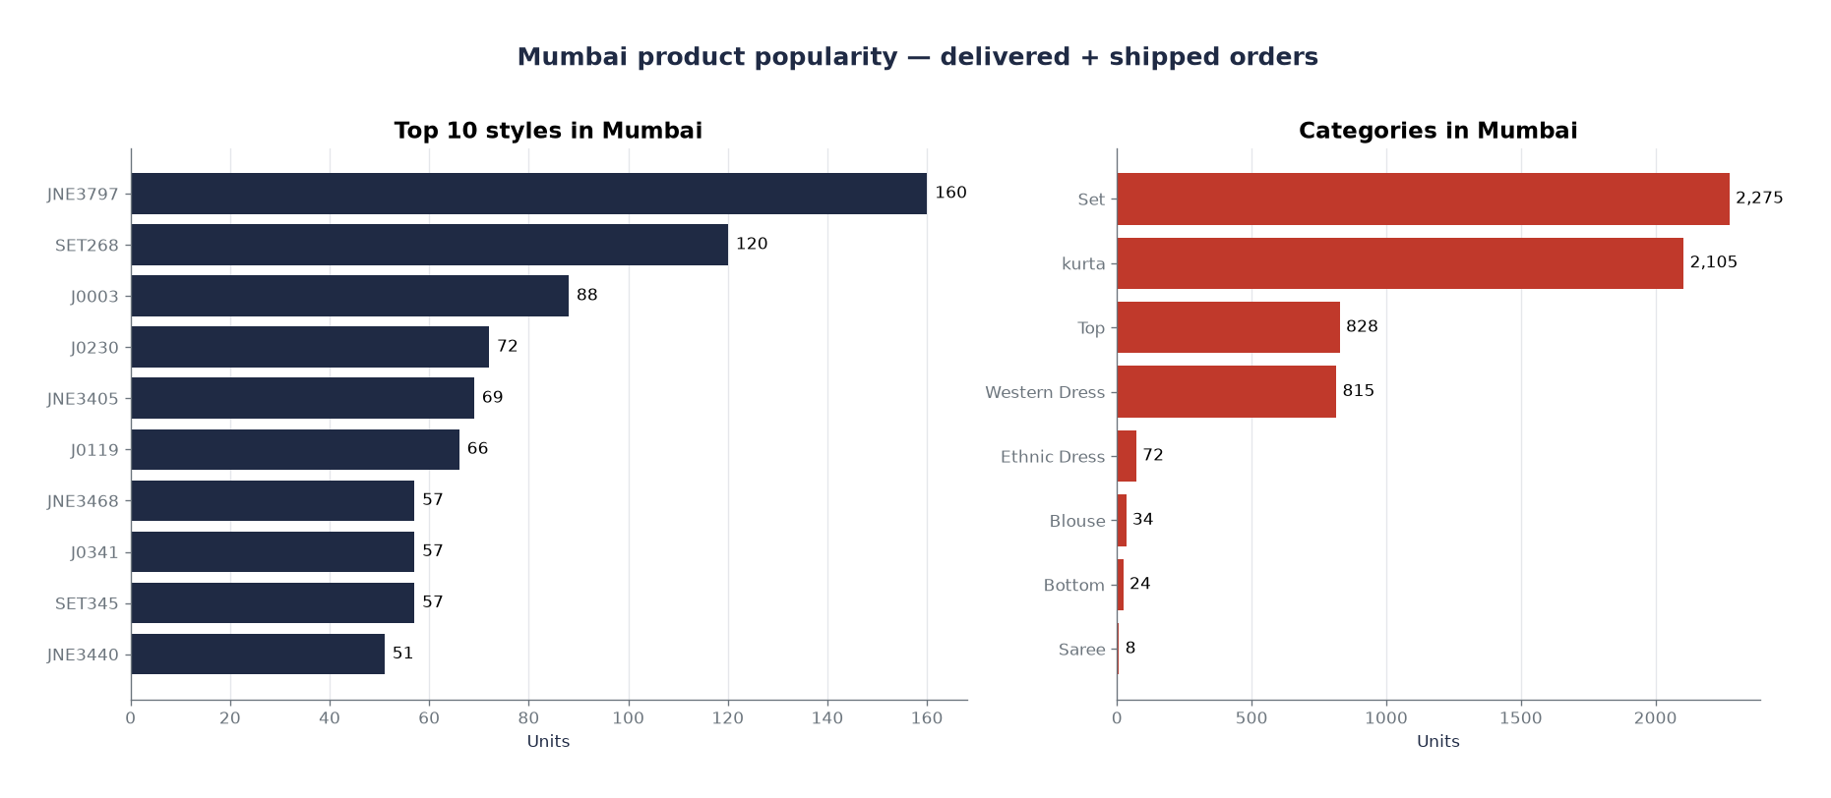
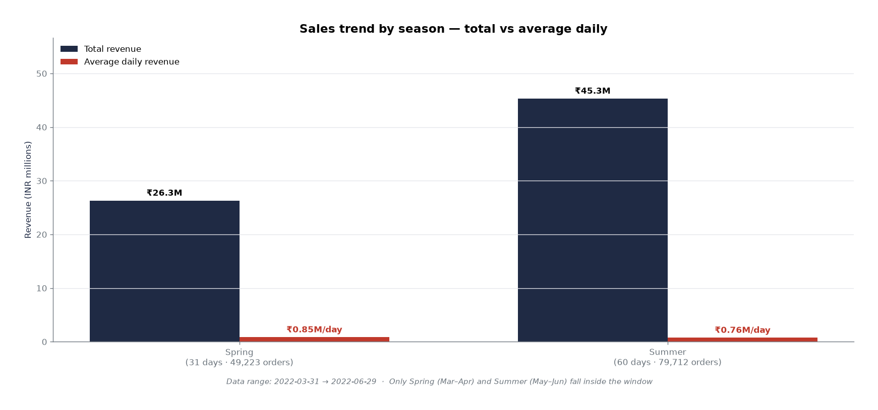
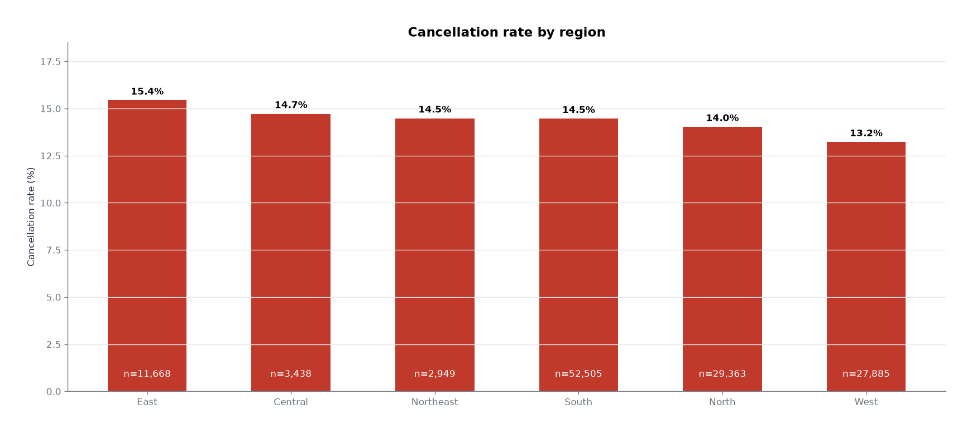
Star schema in action — 3 BI charts
Mumbai styles + categories
Seasonal revenue trend
Cancellation rate by region
dim_product × dim_geography × dim_order_status
dim_date.season × fct_sales
dim_geography × is_cancelled flag
Every chart = one SELECT with visible joins — the star schema is doing the work.
Every query filters `WHERE ship_country = 'IN'` — a no-op today because the source is India-only, but the pattern makes the dashboards resilient to international expansion. If the accepted-values canary in staging fires (source contains `US`), the dashboard doesn't silently start mixing markets.
Findings: Mumbai buys Sets (2,275) + kurtas (2,105) · Summer ₹45.3M total but Spring ₹0.85M/day beats Summer ₹0.76M/day · East cancel rate 15.4% vs West 13.2% — ~14% systemic baseline.

Slide 18
Testing strategy — 79 tests, tiered severity
Layer | Test count | Catches
Source integrity | 1 (source freshness — off, static CSV) | Missing source table
Staging column contracts | 11 (schema.yml) | Type violations, NULL PKs, unknown statuses
Staging shape | 2 singular | Raw→stg row-count · Status/Courier drift
Dimension integrity | 40 (schema.yml) | Non-unique keys, NULL attributes, unexpected values
Fact FK integrity | 4 relationships | Orphan FK values pointing to non-existent dim rows
Fact column contracts | 14 (schema.yml) | NULL keys/measures, non-unique PK
End-to-end business rules | 5 singular (assert_*) | D1 revenue accounting, D5 is_terminal, D3 promo, etc.

Slide 19
Interesting test choices
Test | Threshold | Protects
status_courier_contradictions | WARN >250 · ERROR >1000 (today: 218) | D6 — surface real data-quality drift rather than silently coerce.
assert_no_cancelled_with_revenue | ERROR on any row (today: 0) | D1 — the derivation contract. Fails immediately if revenue_amount stops zeroing for cancelled.
assert_fact_unknown_region_rate | WARN >3,000 · ERROR >10,000 (today: 1,160) | Geography seed health — degradation of state-name coverage.

Slide 20
What I'd add for production
• FUTURE_IMPROVEMENTS.md

