Slide 1
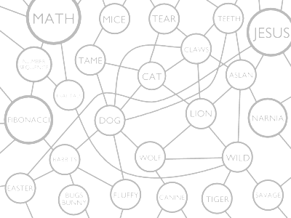
A Concept-Label Web
Model of Language
By Lee Burnette

Slide 2
Concepts, Labels, Links
Concept: the idea or object
Label: the sound, word, image, or other entity used to represent a concept
Concept-label pair: an association of a label with a concept
Link: an association between two concept-label pairs

Slide 3
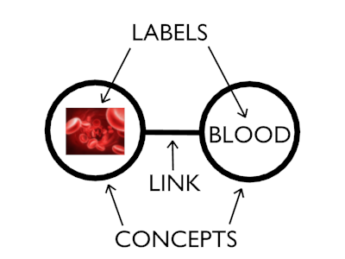
Concepts, Labels, Links

Slide 4
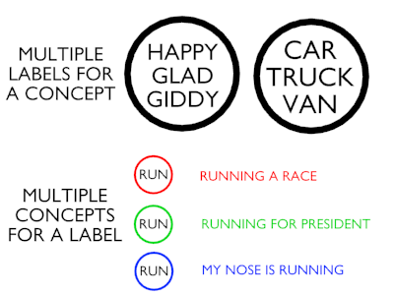
Concepts, Labels, Links

Slide 5
Correlation with Semiotics
Similar to Saussure's semiotics
  Concept ↔ signified
  Label ↔ signifier
  Concept-label pair ↔ sign
But...
  Labels are more general
  Semiotics doesn't deal with concept-label webs

Slide 6
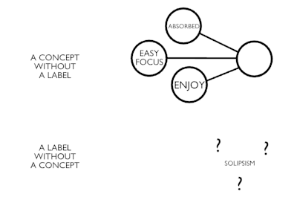
Lacks

Slide 7
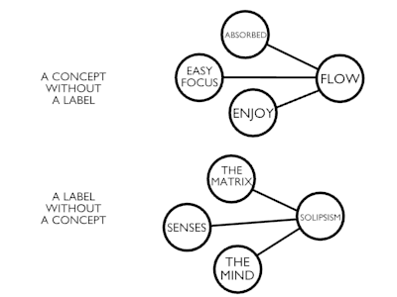
Lacks

Slide 8
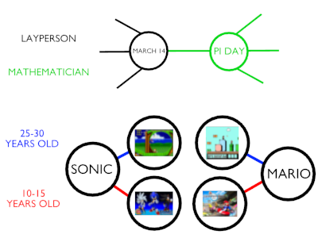
Lacks

Slide 9
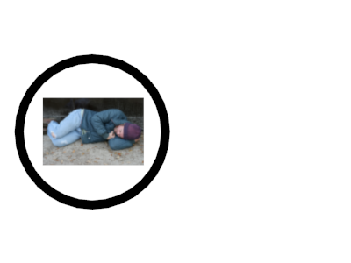
Additions

Slide 10
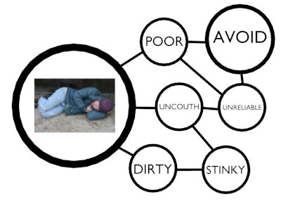
Additions

Slide 11

Additions

Slide 12
Translation
Many-to-many
Context
Connotations
Culture and history

Slide 13
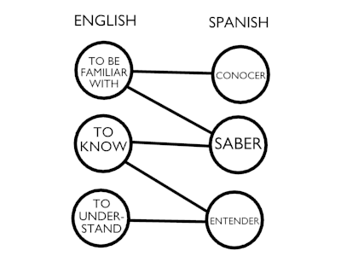
Translation

Slide 14
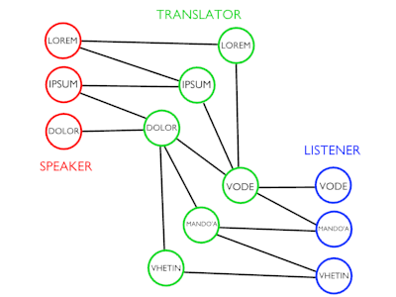
“Every translation is an interpretation.” - Gadamer

Slide 15
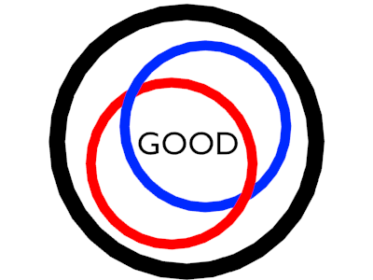
Same-language “translation”

Slide 16
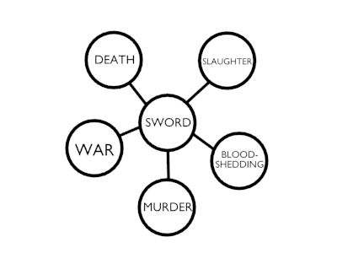
Same-language “translation”

Slide 17
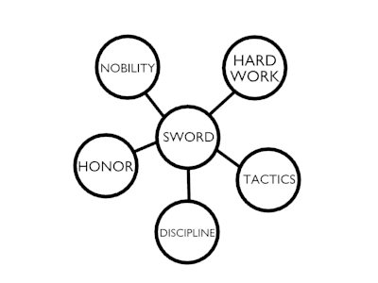
Same-language “translation”

Slide 18
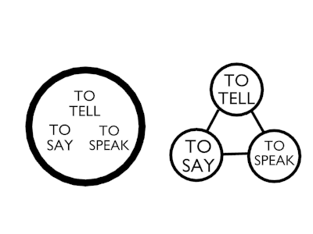
Nuances

Slide 19
Common Ground
Due to shared experiences
Education builds on the common ground
Necessary for effective communication

Slide 20
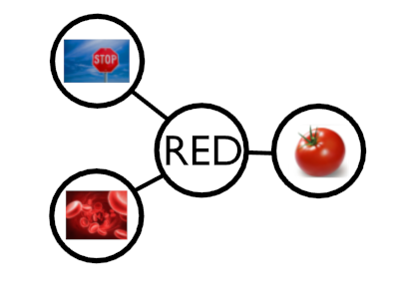
Common Ground

Slide 21
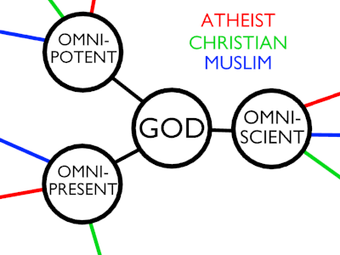
Common Ground

Slide 22
Poetry vs. Prose
“I got into bed and pulled the covers over myself.”
“I fell into the bed's embrace, cocooning myself inside the covers.”

Slide 23
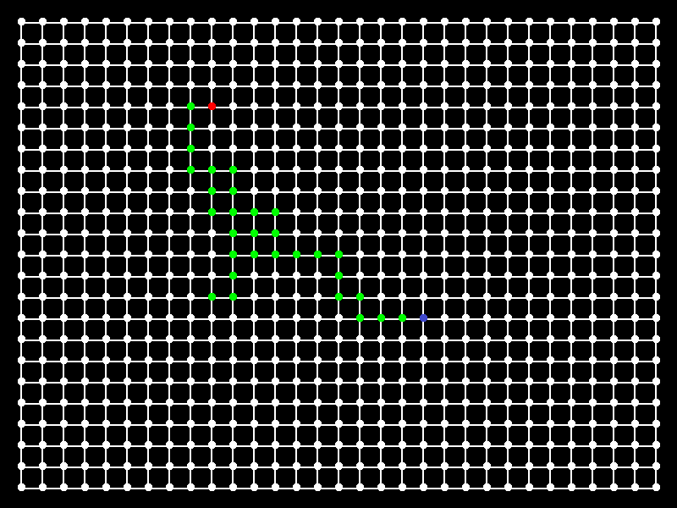
Poetry vs. Prose

Slide 24
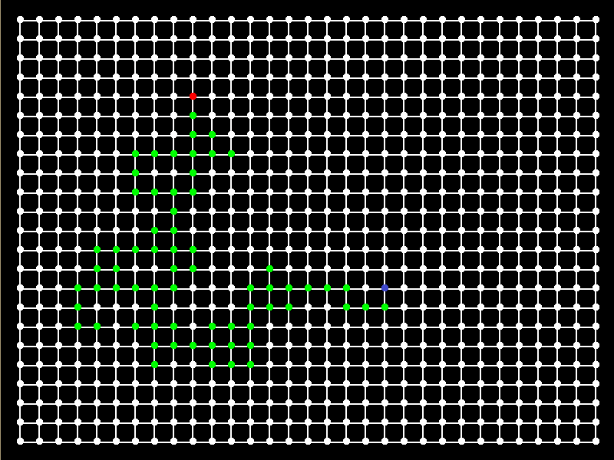
Poetry vs. Prose

Slide 25
Quine's Web of Belief
Harder to change beliefs in the middle, as opposed to the edge
Harder to modify concept-labels or links in the middle, as opposed to the edge

Slide 26
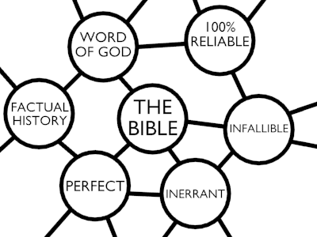
Quine's Web of Belief

Slide 27
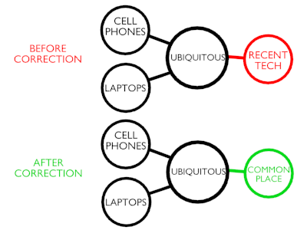
Quine's Web of Belief

Slide 28
Conclusion
This model explains communication failures
Other species appear to have language
  Elephants, dolphins
  Koko the signing gorilla
Can explain how new languages are formed
  Nigerian Signed Language

Slide 29
Questions?

