Slide 1

Incident Reporting System for Street Safety
A Java-based application to improve street safety in the UK
Eleni Christoforidou
CFG Java Challenge 2023

Slide 2
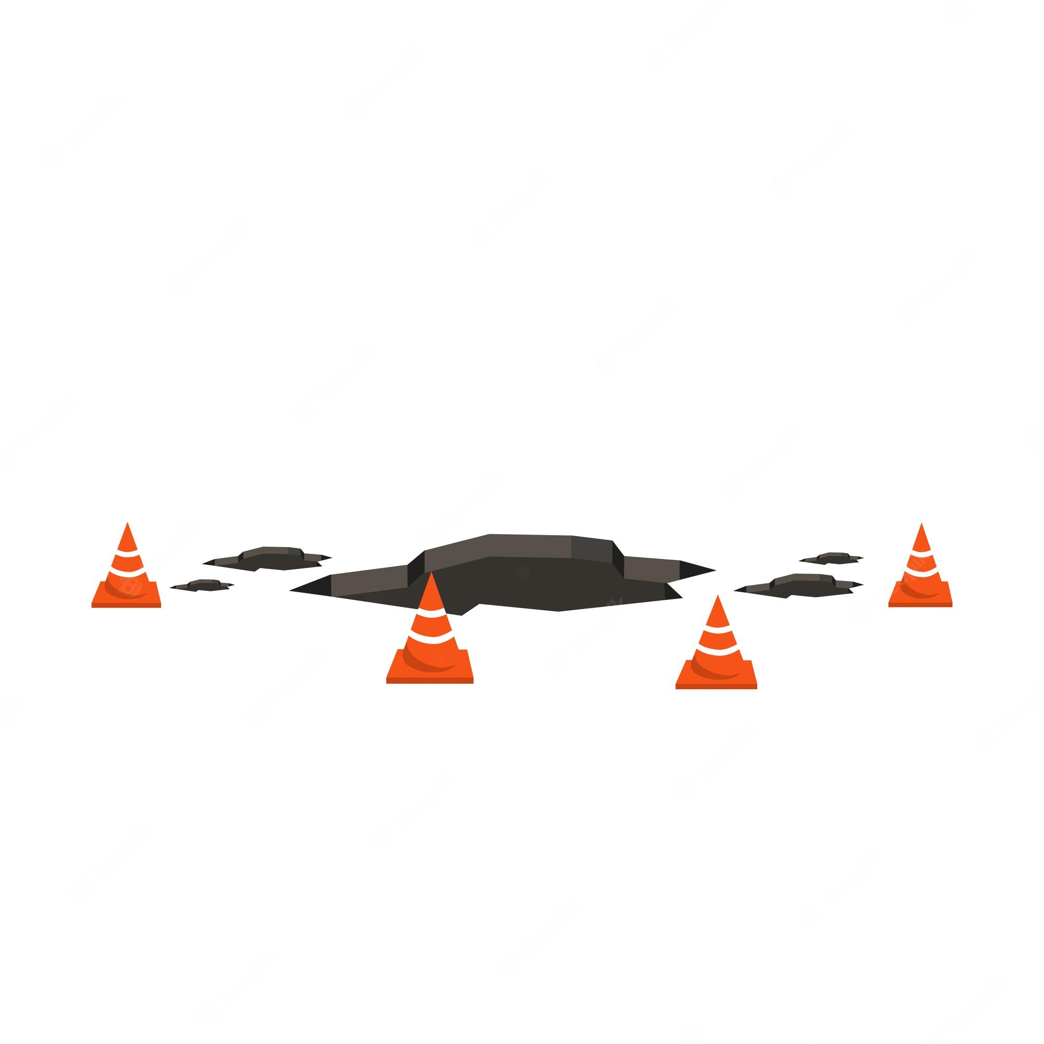


Project Overview
Street safety issues in the UK
Hazards such as poorly lit streets, broken pavements, and obstructed pathways lead to increased risk of accidents and injuries for pedestrians and cyclists
Objective: To create an application that:
allows users to report street safety incidents
helps local authorities identify problem areas
Importance of community involvement
Local residents are more aware of the issues in their neighbourhoods
Timely reporting of street safety incidents can help prevent accidents

Slide 3

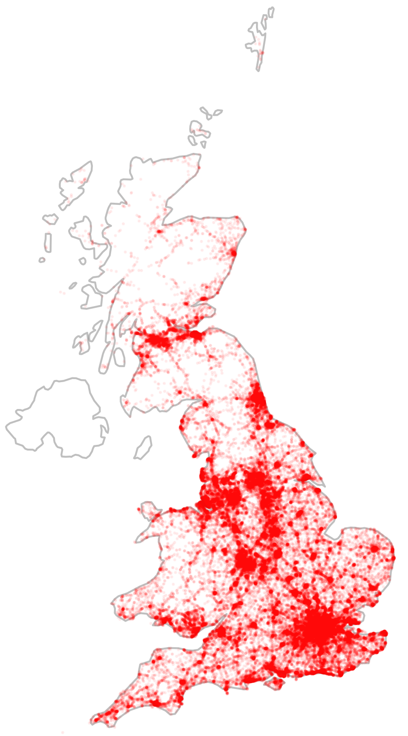

Key Features of the App
Users can submit incident reports with descriptions and locations
Incident data is aggregated to create heatmaps and identify problem areas
Local authorities can use the data to prioritise street safety improvements
Incident | Location | Unresolved incidents
Broken pavement | London | 12
 | Brighton | 7
 | …
Poorly lit street | London | 9
 | Brighton | 14
 | …
… | London

Slide 4
Code Summary
Main class:
Interacts with the UserInput class to gather user input for incident descriptions and locations.
UserInput class:
Responsible for collecting user input through a series of prompts and selections.
Incident class:
Represents individual incidents reported by users, containing a description and location.
IncidentReporter class:
Stores and manages a collection of Incident objects.
Provides methods for adding incidents, displaying all incidents, generating heatmaps, and identifying problem areas.

Slide 5
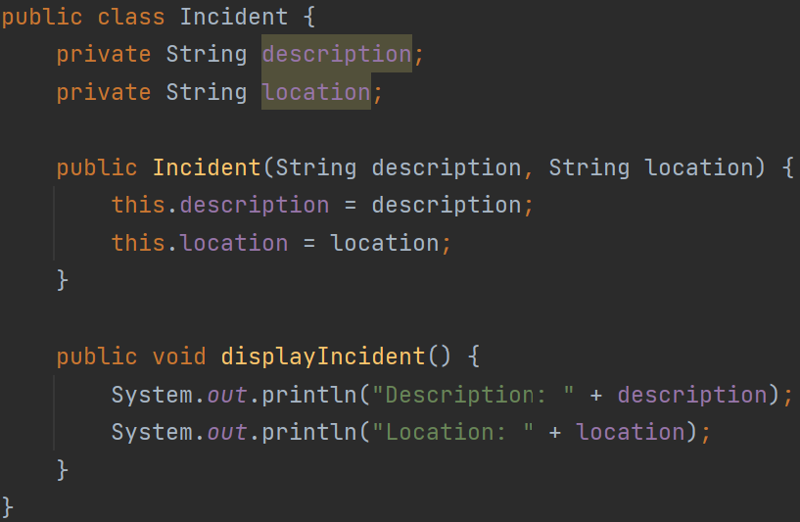
Overview of Incident Class
Purpose:
This class represents a street safety incident reported by users.
It stores information about the incident, such as description and a location.
Attributes:
description: A String that describes the nature of the incident (e.g., "Broken pavement").
location: A String that represents the location of the incident (e.g., "Oxford Street, London").
Methods:
Incident: This constructor initialises its attributes with the provided values.
displayIncident(): Displays the incident's details (description and location).

Slide 6
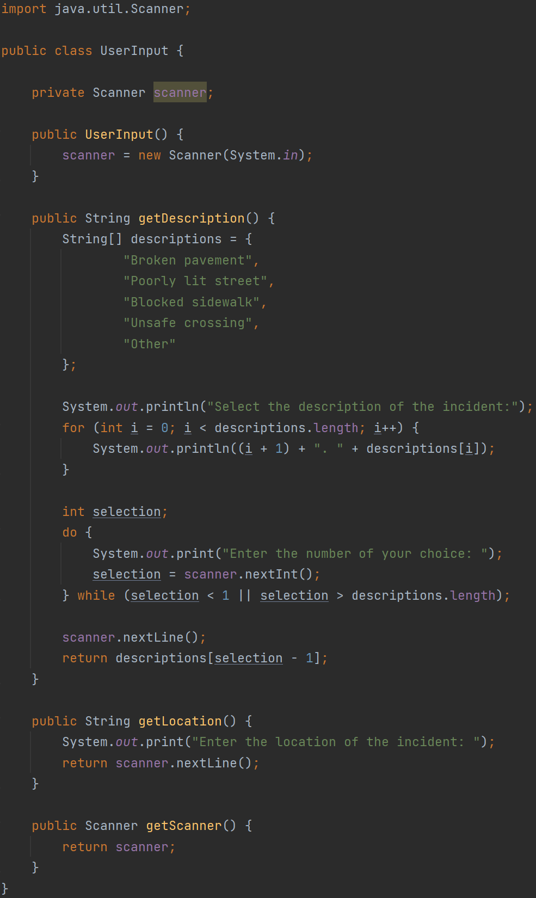
Overview of UserInput Class
Purpose:
This class provides a set of methods to prompt users for the necessary information.
Methods:
UserInput(): This constructor initialises the Scanner instance used for reading user input.
getDescription(): Presents a list of predefined incident descriptions to the user and allows them to select the most appropriate one.
getLocation(): Asks the user to enter the location of the incident.
getScanner(): Returns the Scanner object used for user input
Interaction with Other Classes:
The UserInput class is used by the Main class to gather user input when reporting a new incident.

Slide 7
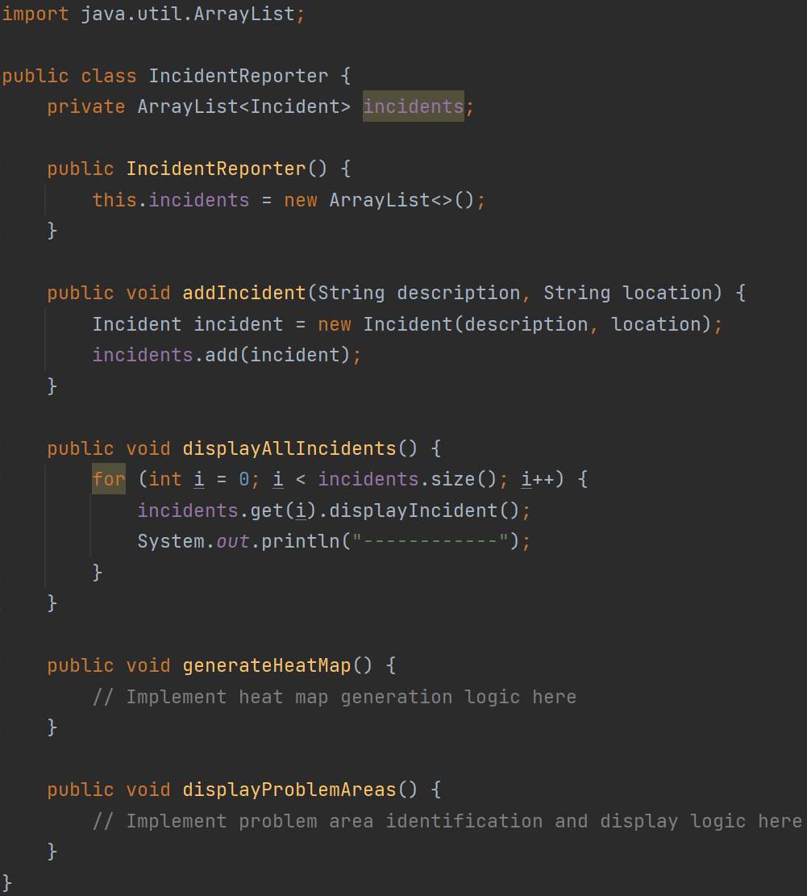
Overview of IncidentReporter Class (incomplete code)
Purpose:
This class manages a collection of street safety incidents and provides functionality for reporting, analysing, and visualising these incidents.
Attributes:
incidents: An ArrayList of Incident objects that stores all reported incidents.
Methods:
IncidentReporter(): This constructor initialises the incidents attribute as an empty ArrayList.
addIncident(…): Instantiates as a new incident and adds it to the list of reported incidents.
displayAllIncidents(): Iterates through the list of incidents and calls the displayIncident() method on each Incident object to display its details.
generateHeatMap(): Generates a heat map based on the reported incidents' locations. (not implemented in the basic example)
displayProblemAreas(): Identifies and displays problem areas based on incident patterns. (not implemented in the basic example)

Slide 8
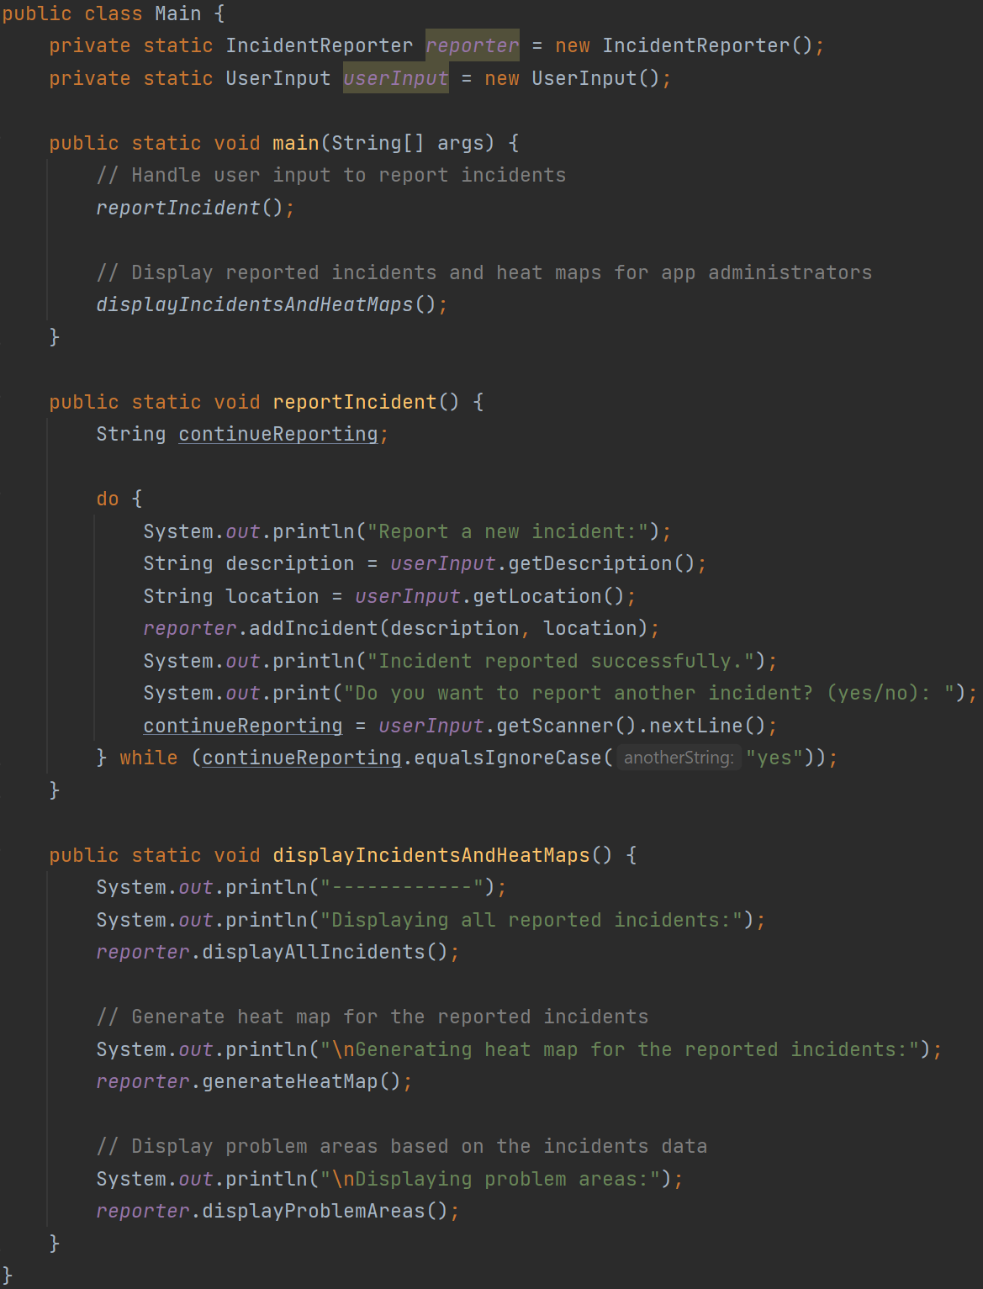
Overview of Main Class
Purpose:
This class handles user input, manages interactions between the Incident, IncidentReporter, and UserInput classes, and controls the overall flow of the application.
Methods:
reportIncident(): Collects user input for new incidents, creates Incident objects, and adds them to the IncidentReporter. It also asks the user if they want to report more incidents.
displayIncidentsAndHeatMaps(): Displays all reported incidents, generates heatmaps, and identifies problem areas based on the collected data.
Interaction with Other Classes:
The Main class interacts with the IncidentReporter and UserInput classes to gather user input and sends them to the IncidentReporter class.

Slide 9
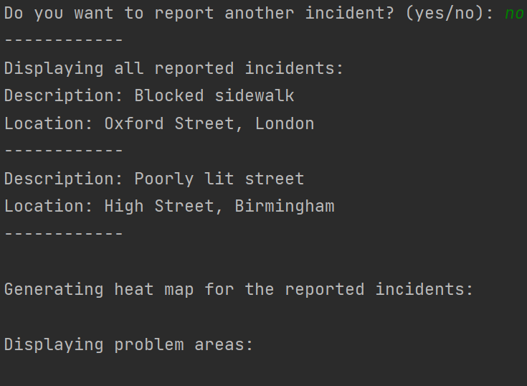
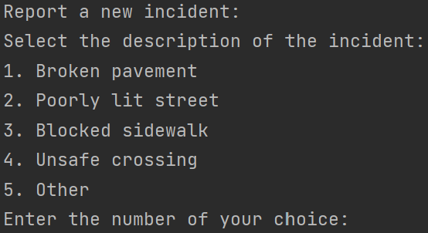
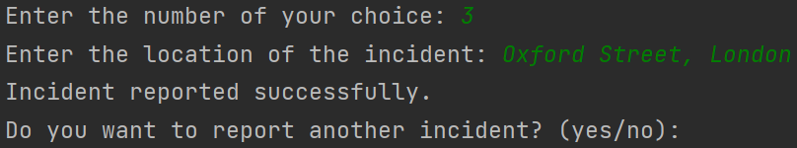
Example Implementation
4. Output (for app administrators):
1. Output (for user):
3b. If input is ‘no’
3a. If input is ‘yes’
2. User gives
the input
Note: In this example, both users and administrators run the same Main class. In a real-world scenario, the user interface and the administrative interface would be separate.

Slide 10
Future Enhancements
Data Persistence and Database Integration:
Allow for data persistence as the number of reported incidents grows.
Integrate the application with a database to store, manage, and retrieve incident data.
Graphical User Interface (GUI):
Develop a user-friendly GUI to streamline the process of reporting incidents and visualising data.
Allow user to select the location on a map, or select from a pre-defined location list, rather than typing the location.
Mapping Services Integration:
Integrate with mapping services (e.g., Google Maps) to visualise incident locations and generate heatmaps more effectively.
Enhance the application's ability to identify problem areas and provide actionable insights for local authorities.

