Slide 1
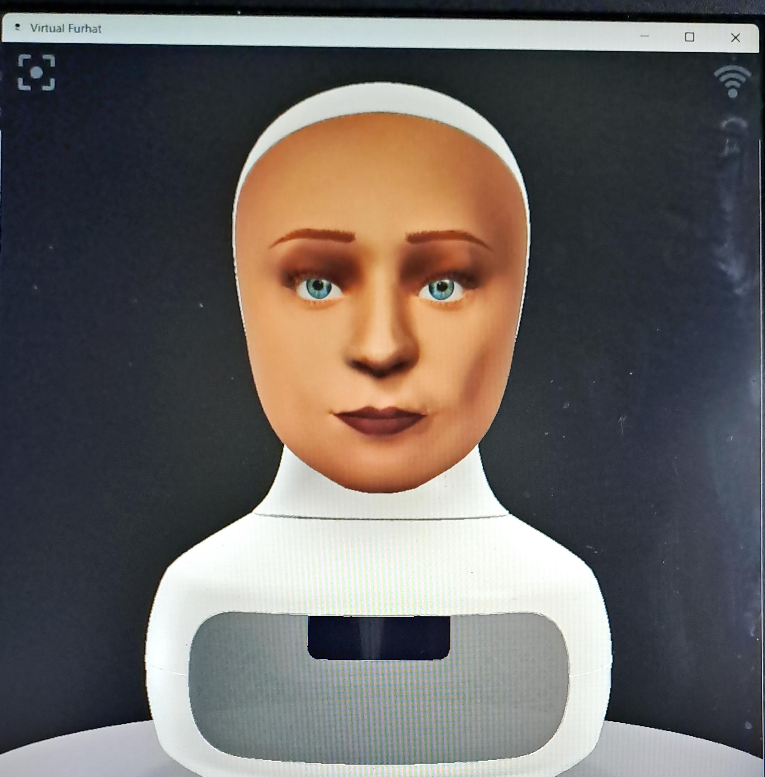
Interview coaching
With Furhat

Slide 2

Motivation
Interviews can be very challenging and having the skill is a necessity.
It can be incredibly beneficial for a range of job seekers and students by simulating realistic interview experiences, offering personalized feedback, and improving preparedness.

Slide 3
Design
Prompting
Naturalness
Dialogue Management
Acknowledgments
Repairs
Furhat
API
Gemma2
Typescript
LLM
Programming

Slide 4
Prompts
You are an interview coach helping the user prepare for an upcoming interview. Your goal is to help them answer questions about their personal traits and soft skills. Please, be brief when talking. Greet the user and explain your purpose. You need to first ask the user what field of employment they are interested in. If the user doesn't answer repeat the question. Please refrain from using emojis.
The field the user is interested in is ${{event.output[1]}. If the user's answer isn't there repeat the question. As an interviewer please ask the user questions about their personal traits and soft skills but not technical skills about the field . Try to ask questions like "tell me a little bit about yourself", "what is your strongest attribute", "tell me one time you worked in stress/in a team, one time you failed in a task, you had to persuade someone, where do you see yourself in 5 years etc. If the user asks to finish the conversation say goodbye and good luck. If the user asks for help please give some guidelines. Don't ask technical questions. If the user changes the topic please remind them what you are doing. Don't forget to be brief.

Slide 5
3. The answer was ${event.output[1]}. If they asked for help answering, give some guidelines. If not please give briefly some feedback about their response and ask if they want to repeat their answer if it was an inadaquate answer or move on to the next question. If they ask to move on ask another question. If the user doesn't answer repeat the question. Ask follow up questions about what you learn but also change the question after some time.

Slide 6
CHALLENGES
1
Prompting/controlling LLMs
2
Making the listening state longer.
Working with LLMs and trying to convince them to do specific tasks is quite problematic.
3
Acknowledgments (sounds , facial expressions)
4
Making Furhat more natural

Slide 7
Future WOrk
Incorporate technical skills as well.
Maybe fine-tune the LLM for better results.
Add more facial expressions.
Have two parts : coaching and simulation without feedback.

