Slide 1
ALLELE FRENZY
A simulator of change in minor allele frequencies over time in multiple populations with different initial allele frequencies and SNP values
By a humble student
Eleni Theofania Skorda

Slide 2

AGENDA
Background​
The tool
​Significance and novelty
Methodology
​Results & Experience

Slide 3

BACKGROUND
What is the biological system?
Change in minor allele frequencies over time in a population due to genetic drift.
Why is it important?
Observed genetic variation in populations and how it changes over time!
Do we really need it?
Yes! Patterns and trends!
How Allele Frenzy solve it?
Plot!
Allele frenzy | a simulator
3/13/2023
Notes:
The biological system was the change in allele frequencies over time in a population due to genetic drift. This is an important concept in population genetics as it helps to explain the observed genetic variation in populations and how it changes over time.

Slide 4
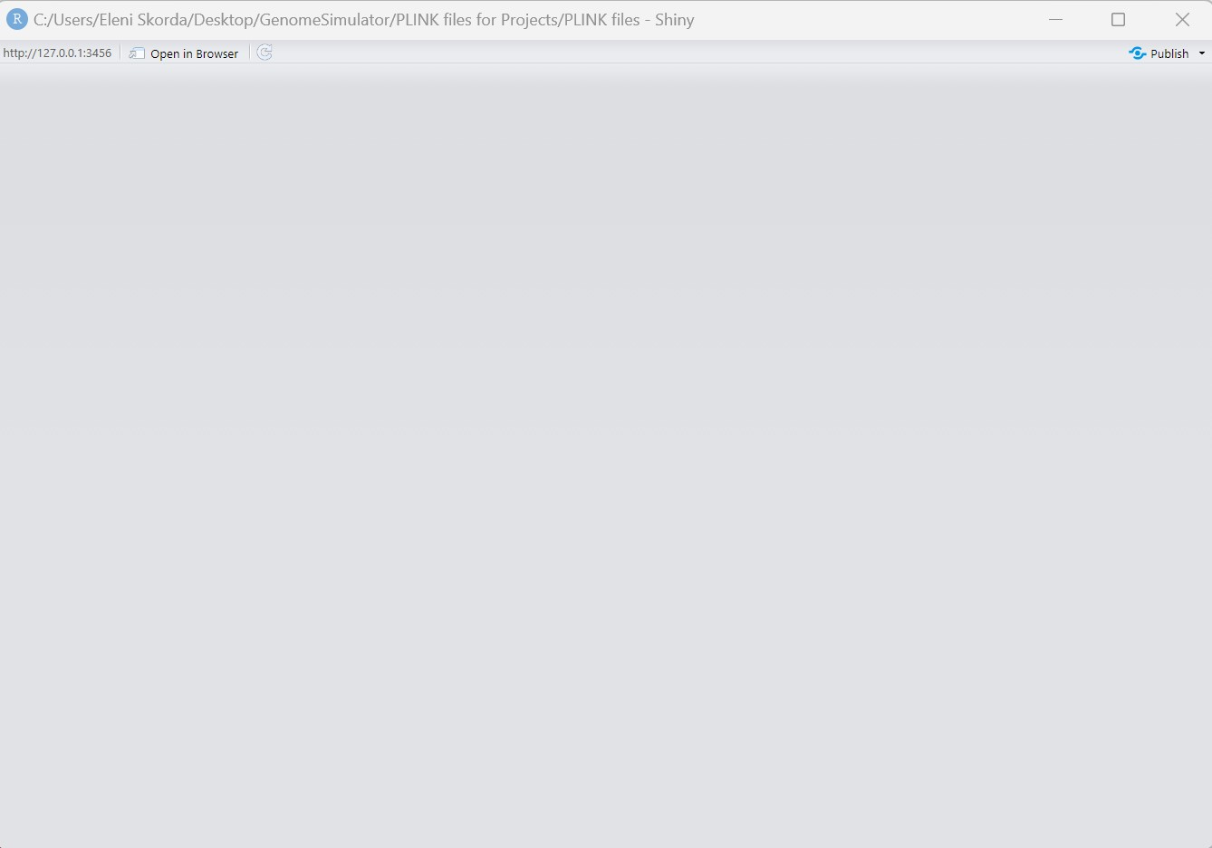
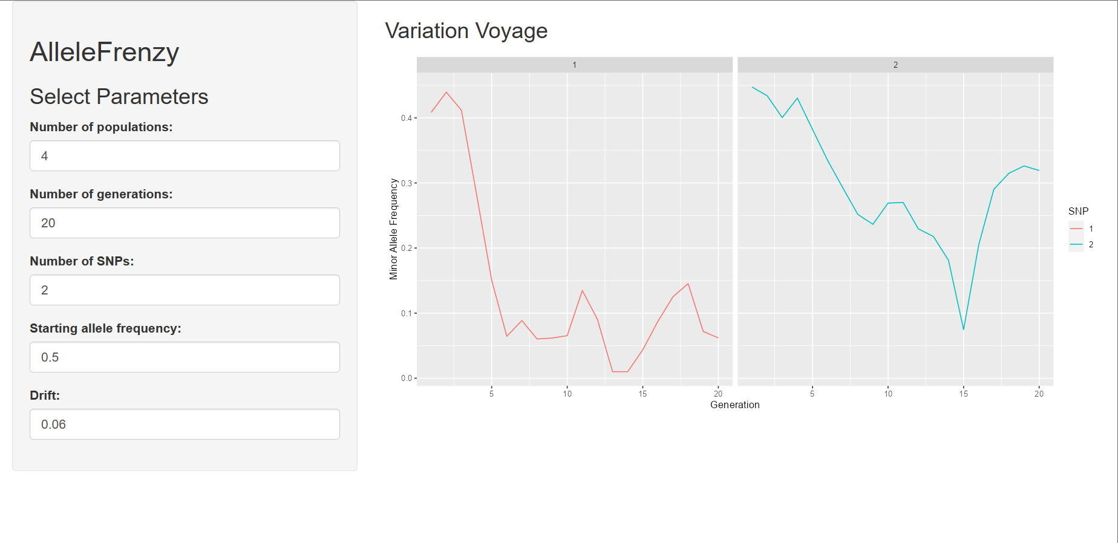


The tool
Allele frenzy | a simulator
3/13/2023
Notes:
The tool is built using the Shiny web framework in the R programming language. The R programming language was chosen for this tool because it is widely used in population genetics research and has a rich ecosystem of packages for data analysis and visualization. The Shiny web framework was chosen because it allows for easy creation of interactive web applications without extensive knowledge of web development.
It simulates the evolution of allele frequencies in a set of populations over time using a simplified model of genetic drift. The methodology involves the following steps:
Simulation: The tool applies a Gaussian distribution with mean zero and standard deviation equal to the user input drift rate to each element of the allele frequency matrix.
Data storage: The tool stores the allele frequency data for each SNP at each generation in a data frame.
Data visualization: The tool uses ggplot2 to visualize the allele frequency data over time, with plots for each population and SNP.
In building this algorithm, the tool uses a simplified model of genetic drift that assumes populations are non-overlapping and have equal sizes. Additionally, the tool assumes that allele frequencies evolve independently for each SNP, which is not always the case in real-world populations. These simplifications were necessary to make the tool computationally tractable and to provide a clear visualization of the results.

Slide 5


Significance and novelty
A simple tool
There are Limitations, of course!
Features:
SNP
Generations
Populations
Genetic drift
Allele frenzy | a simulator
3/13/2023
Notes:
The tool created by this script is relatively simple, as it only simulates the change in allele frequencies over time in multiple populations due to genetic drift. To test the tool, one could compare the simulated results to theoretical expectations for allele frequency changes due to genetic drift. IT appears to be robust in terms of the input parameters, as it allows for a wide range of values and produces expected results.
One limitation of the tool is that it only models the effects of genetic drift and does not take into account other factors that can affect frequency changes in populations, such as mutation, migration, and natural selection. Additionally, the simulations may not accurately represent real-world populations, as they are simplified and assume a number of idealized conditions.
Applications:
Education: The tool can be used in biology and genetics classes to teach students about the effects of genetic drift on allele frequency changes in populations. It can help students visualize and understand the concept in a more interactive way.
Research: The tool can be used by researchers in population genetics to simulate and analyze the effects of different parameters on allele frequency changes over time. This can help to generate hypotheses, test predictions, and deepen understanding of the mechanisms of genetic drift.
Outreach: The tool can be used in science outreach programs and public engagement events to demonstrate the principles of population genetics and the effects of genetic drift on allele frequency changes. It can help to increase public understanding and appreciation of genetics and evolution.
Genetic counseling: The tool can be used by genetic counselors to help explain to patients and families the probabilities of different allele frequencies in populations over time. It can help to illustrate the complex factors that contribute to genetic diversity and variability in human populations.

Slide 6

RESULTS & EXPERIENCE
Applications
Testing Predictions
Generating hypotheses
Educational purposes
Experience
Data analysis
Programming
Visualization
Allele frenzy | a simulator
3/13/2023
Notes:
How useful are these results? The usefulness of the results generated by this tool depends on the specific application and research question being addressed. For example, the tool can be useful for generating hypotheses, testing predictions, and deepening understanding of the mechanisms of genetic drift
How challenging was your project? for individuals without a strong background in programming or population genetics. Developing a tool like this requires a good understanding of the underlying biological concepts, as well as skills in data analysis, programming, and visualization.
What did you learn? gain a deeper understanding of genetic drift and the factors that influence allele frequency changes over time. I also gained experience in data analysis, programming, and visualization. Additionally, I learned how to create interactive tools that can be used for education, research, and public engagement.

Slide 7
Thank you!

