Slide 1





Informe web:
{{periodo_actual}}

Slide 2

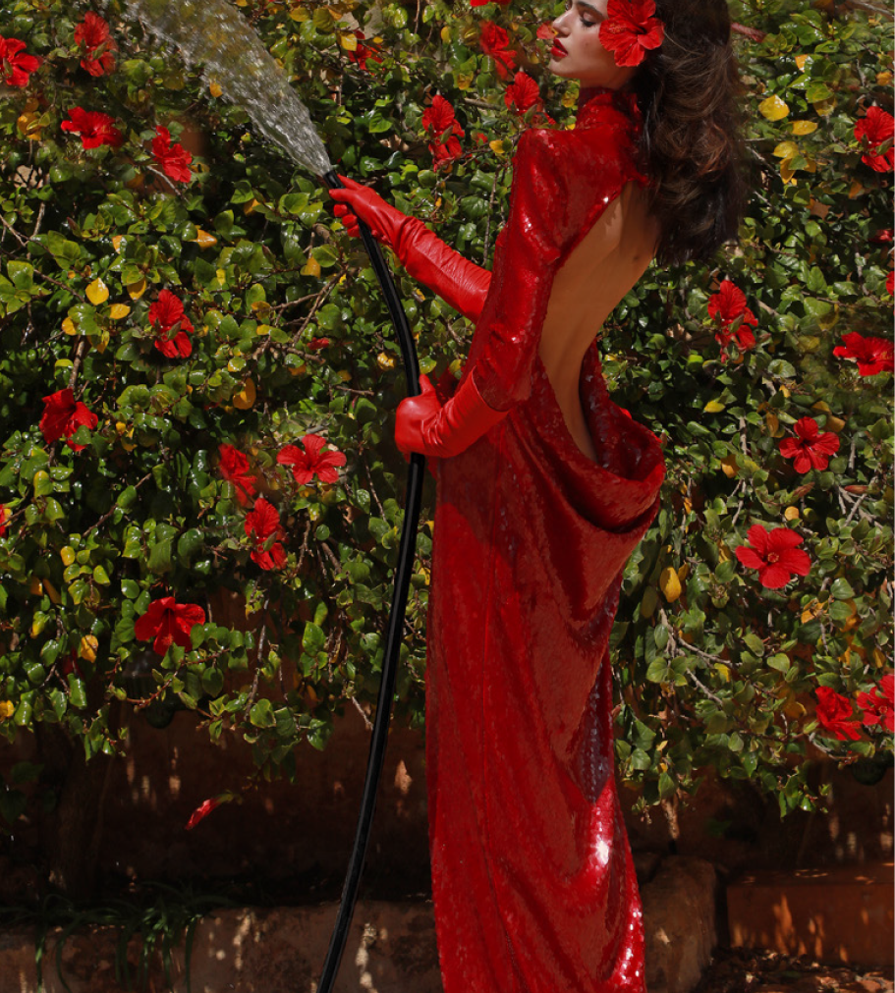

Índice
03
Tráfico, visibilidad y posicionamiento keywords
05
Sesiones, usuarios, clics e impresiones
09
Eventos principales y personalizados
11
Conclusiones y next steps

Slide 3
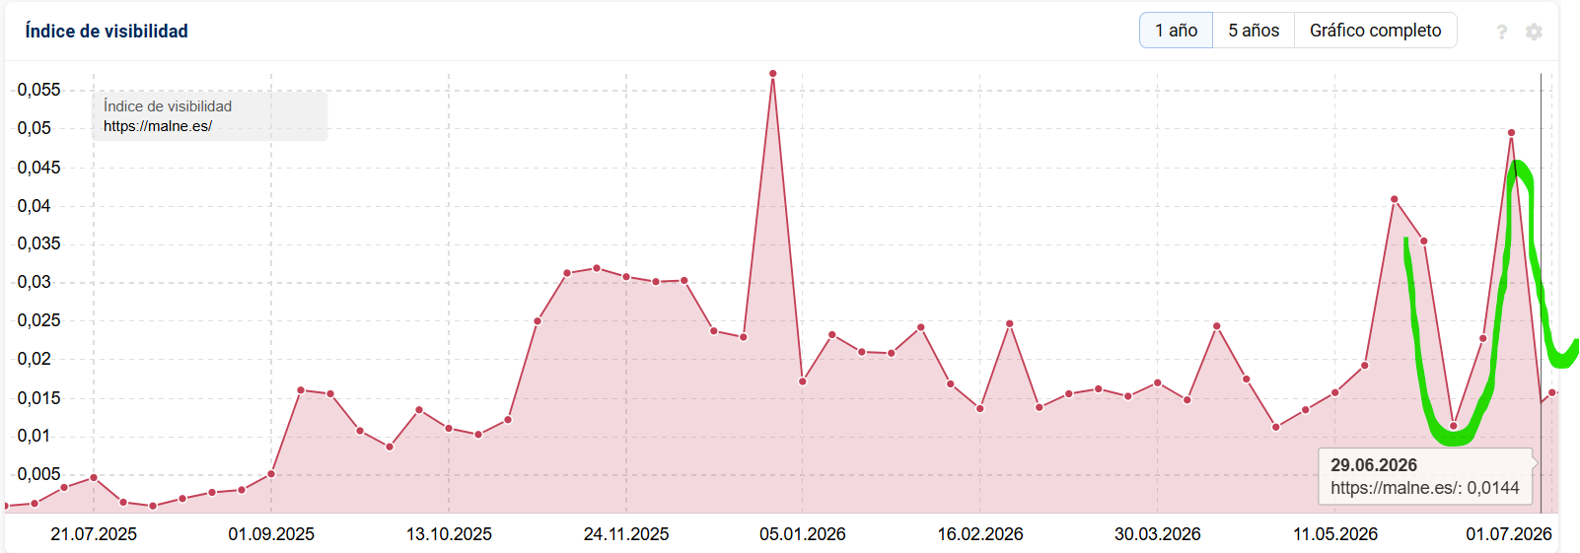
Evolución de la visibilidad de Malne - {{mes_actual_nombre_cap}}
{{comentario_visibilidad}}

Slide 4
Posicionamiento keywords web Malne
Keywords que han mejorado
Keywords han empeorado
Keyword | Volumen | Anterior | Actual
{{kw_up_1_name}} | {{kw_up_1_vol}} | {{kw_up_1_prev}} | {{kw_up_1_curr}}
{{kw_up_2_name}} | {{kw_up_2_vol}} | {{kw_up_2_prev}} | {{kw_up_2_curr}}
{{kw_up_3_name}} | {{kw_up_3_vol}} | {{kw_up_3_prev}} | {{kw_up_3_curr}}
{{kw_up_4_name}} | {{kw_up_4_vol}} | {{kw_up_4_prev}} | {{kw_up_4_curr}}
{{kw_up_5_name}} | {{kw_up_5_vol}} | {{kw_up_5_prev}} | {{kw_up_5_curr}}
Keyword | Volumen | Anterior | Actual
{{kw_down_1_name}} | {{kw_down_1_vol}} | {{kw_down_1_prev}} | {{kw_down_1_curr}}
{{kw_down_2_name}} | {{kw_down_2_vol}} | {{kw_down_2_prev}} | {{kw_down_2_curr}}
{{kw_down_3_name}} | {{kw_down_3_vol}} | {{kw_down_3_prev}} | {{kw_down_3_curr}}
{{kw_down_4_name}} | {{kw_down_4_vol}} | {{kw_down_4_prev}} | {{kw_down_4_curr}}
{{kw_down_5_name}} | {{kw_down_5_vol}} | {{kw_down_5_prev}} | {{kw_down_5_curr}}
  {{kw_ganadas}} keywords han ganado posiciones en Google
  {{kw_total}} keywords en total posicionadas
  {{kw_perdidas}} keywords han perdido posiciones

Slide 5
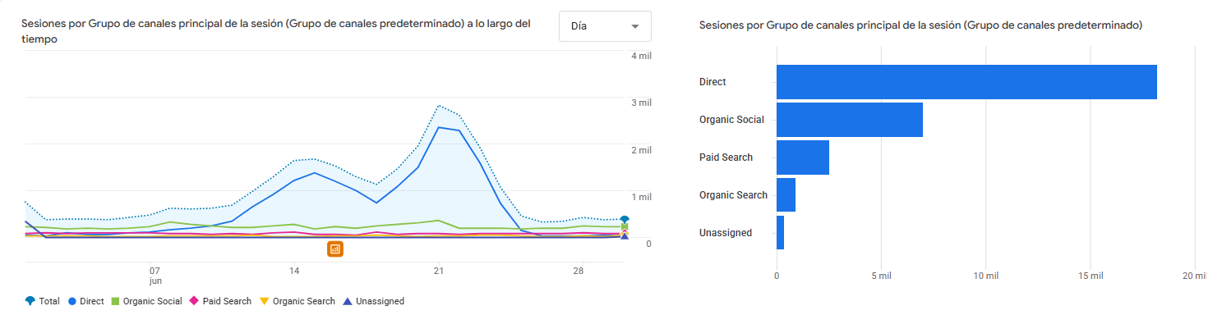
Adquisición de tráfico - {{mes_actual_nombre_cap}}
{{comentario_trafico}}

Slide 6
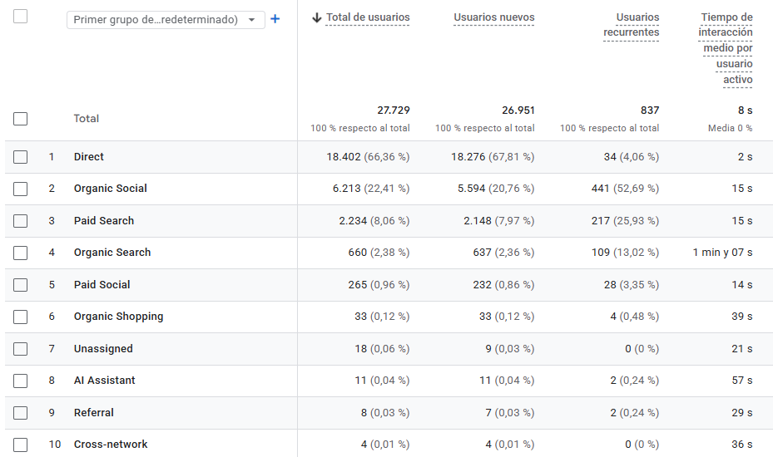
Adquisición de usuarios - {{mes_actual_nombre_cap}}
{{comentario_usuarios}}

Slide 7
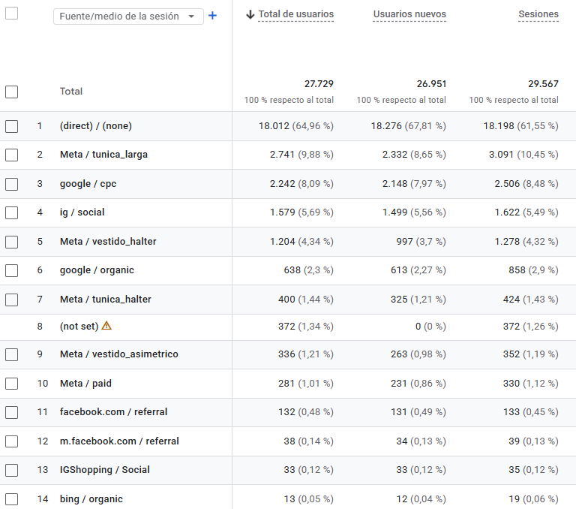
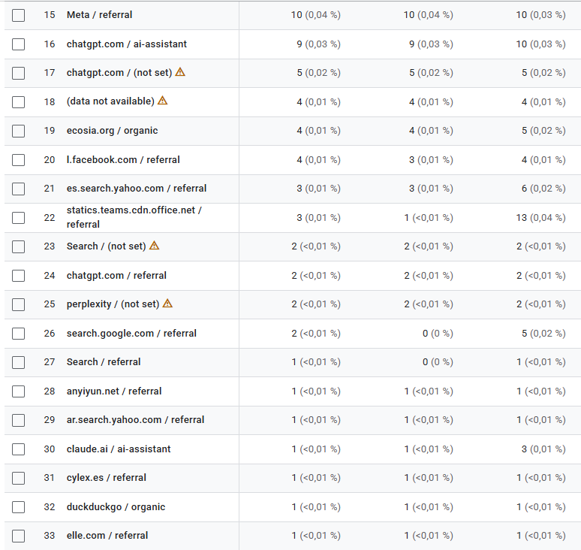
Adquisición de usuarios (fuente/medio) - {{mes_actual_nombre_cap}}
Fuente / Medio | Usuarios | Sesiones | % Engagement
{{fm_1_source}} | {{fm_1_users}} | {{fm_1_sessions}} | {{fm_1_engagement}}
{{fm_2_source}} | {{fm_2_users}} | {{fm_2_sessions}} | {{fm_2_engagement}}
{{fm_3_source}} | {{fm_3_users}} | {{fm_3_sessions}} | {{fm_3_engagement}}
{{fm_4_source}} | {{fm_4_users}} | {{fm_4_sessions}} | {{fm_4_engagement}}
{{fm_5_source}} | {{fm_5_users}} | {{fm_5_sessions}} | {{fm_5_engagement}}
{{fm_6_source}} | {{fm_6_users}} | {{fm_6_sessions}} | {{fm_6_engagement}}
{{fm_7_source}} | {{fm_7_users}} | {{fm_7_sessions}} | {{fm_7_engagement}}
{{fm_8_source}} | {{fm_8_users}} | {{fm_8_sessions}} | {{fm_8_engagement}}
{{fm_9_source}} | {{fm_9_users}} | {{fm_9_sessions}} | {{fm_9_engagement}}
{{fm_10_source}} | {{fm_10_users}} | {{fm_10_sessions}} | {{fm_10_engagement}}
{{fm_11_source}} | {{fm_11_users}} | {{fm_11_sessions}} | {{fm_11_engagement}}
{{fm_12_source}} | {{fm_12_users}} | {{fm_12_sessions}} | {{fm_12_engagement}}
{{fm_13_source}} | {{fm_13_users}} | {{fm_13_sessions}} | {{fm_13_engagement}}
{{fm_14_source}} | {{fm_14_users}} | {{fm_14_sessions}} | {{fm_14_engagement}}
{{fm_15_source}} | {{fm_15_users}} | {{fm_15_sessions}} | {{fm_15_engagement}}
{{fm_16_source}} | {{fm_16_users}} | {{fm_16_sessions}} | {{fm_16_engagement}}
{{fm_17_source}} | {{fm_17_users}} | {{fm_17_sessions}} | {{fm_17_engagement}}
{{fm_18_source}} | {{fm_18_users}} | {{fm_18_sessions}} | {{fm_18_engagement}}
{{fm_19_source}} | {{fm_19_users}} | {{fm_19_sessions}} | {{fm_19_engagement}}
{{fm_20_source}} | {{fm_20_users}} | {{fm_20_sessions}} | {{fm_20_engagement}}

Slide 8
Tráfico y usuarios web, seo y social
TRAFICO | {{mes_anterior_nombre_cap}} | {{mes_actual_nombre_cap}} | % Δ | total
Web | {{tra_web_prev}} | {{tra_web_curr}} | {{tra_web_delta}} | {{tra_web_total}}
SEO | {{tra_seo_prev}} | {{tra_seo_curr}} | {{tra_seo_delta}} | {{tra_seo_total}}
SOCIAL | {{tra_soc_prev}} | {{tra_soc_curr}} | {{tra_soc_delta}} | {{tra_soc_total}}
USUARIOS | {{mes_anterior_nombre_cap}} | {{mes_actual_nombre_cap}} | % Δ | TOTAL
Web | {{usu_web_prev}} | {{usu_web_curr}} | {{usu_web_delta}} | {{usu_web_total}}
SEO | {{usu_seo_prev}} | {{usu_seo_curr}} | {{usu_seo_delta}} | {{usu_seo_total}}
SOCIAL | {{usu_soc_prev}} | {{usu_soc_curr}} | {{usu_soc_delta}} | {{usu_soc_total}}
{{comentario_tabla_trafico}}

Slide 9
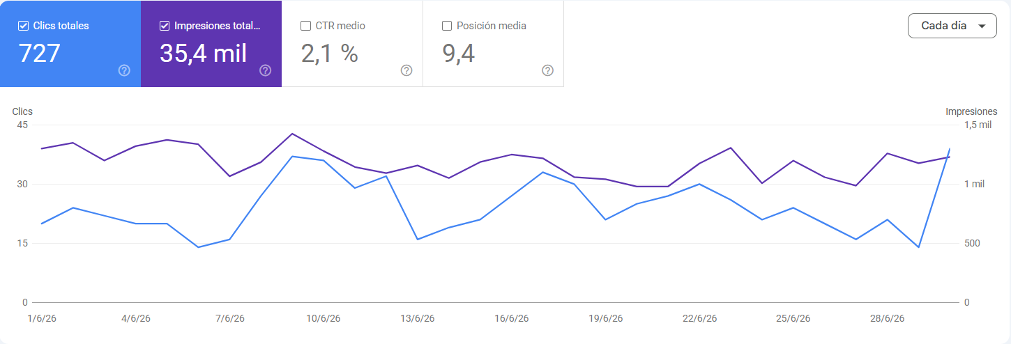
Clics e impresiones web - {{mes_actual_nombre_cap}}
{{comentario_gsc}}
Páginas con más clics de la web:
{{top_page_1}}
{{top_page_2}}
{{top_page_3}}
{{top_page_4}}
{{top_page_5}}

Slide 10
Eventos principales y eventos personalizados
{{comentario_eventos}}
Eventos principales | {{mes_anterior_nombre_cap}} | {{mes_actual_nombre_cap}} | % Δ | total
Page view | {{ev_pageview_prev}} | {{ev_pageview_curr}} | {{ev_pageview_delta}} | {{ev_pageview_total}}
User engagement | {{ev_engagement_prev}} | {{ev_engagement_curr}} | {{ev_engagement_delta}} | {{ev_engagement_total}}
Session start | {{ev_sessionstart_prev}} | {{ev_sessionstart_curr}} | {{ev_sessionstart_delta}} | {{ev_sessionstart_total}}
First visit | {{ev_firstvisit_prev}} | {{ev_firstvisit_curr}} | {{ev_firstvisit_delta}} | {{ev_firstvisit_total}}
Scroll | {{ev_scroll_prev}} | {{ev_scroll_curr}} | {{ev_scroll_delta}} | {{ev_scroll_total}}
Shop Malne colección | {{ev_shopmalne_prev}} | {{ev_shopmalne_curr}} | {{ev_shopmalne_delta}} | {{ev_shopmalne_total}}
Shop Mar Flores colección | {{ev_shopmarflores_prev}} | {{ev_shopmarflores_curr}} | {{ev_shopmarflores_delta}} | {{ev_shopmarflores_total}}
Click home – vestidos novias | {{ev_clickhomenovias_prev}} | {{ev_clickhomenovias_curr}} | {{ev_clickhomenovias_delta}} | {{ev_clickhomenovias_total}}

Slide 11
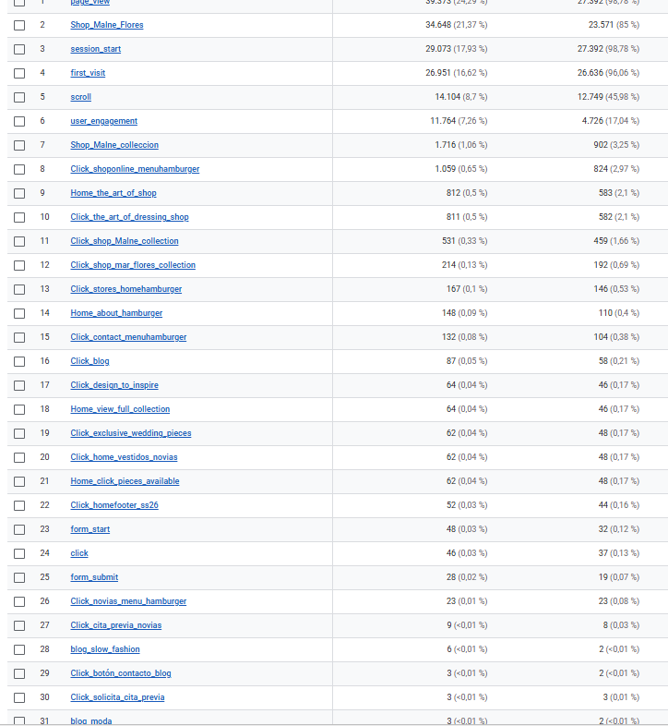
Eventos principales y eventos personalizados
# | Nombre del evento | {{mes_actual_nombre_cap}} | {{mes_anterior_nombre_cap}}
1 | {{ev_full_1_name}} | {{ev_full_1_curr}} | {{ev_full_1_prev}}
2 | {{ev_full_2_name}} | {{ev_full_2_curr}} | {{ev_full_2_prev}}
3 | {{ev_full_3_name}} | {{ev_full_3_curr}} | {{ev_full_3_prev}}
4 | {{ev_full_4_name}} | {{ev_full_4_curr}} | {{ev_full_4_prev}}
5 | {{ev_full_5_name}} | {{ev_full_5_curr}} | {{ev_full_5_prev}}
6 | {{ev_full_6_name}} | {{ev_full_6_curr}} | {{ev_full_6_prev}}
7 | {{ev_full_7_name}} | {{ev_full_7_curr}} | {{ev_full_7_prev}}
8 | {{ev_full_8_name}} | {{ev_full_8_curr}} | {{ev_full_8_prev}}
9 | {{ev_full_9_name}} | {{ev_full_9_curr}} | {{ev_full_9_prev}}
10 | {{ev_full_10_name}} | {{ev_full_10_curr}} | {{ev_full_10_prev}}
11 | {{ev_full_11_name}} | {{ev_full_11_curr}} | {{ev_full_11_prev}}
12 | {{ev_full_12_name}} | {{ev_full_12_curr}} | {{ev_full_12_prev}}
13 | {{ev_full_13_name}} | {{ev_full_13_curr}} | {{ev_full_13_prev}}
14 | {{ev_full_14_name}} | {{ev_full_14_curr}} | {{ev_full_14_prev}}
15 | {{ev_full_15_name}} | {{ev_full_15_curr}} | {{ev_full_15_prev}}
16 | {{ev_full_16_name}} | {{ev_full_16_curr}} | {{ev_full_16_prev}}
17 | {{ev_full_17_name}} | {{ev_full_17_curr}} | {{ev_full_17_prev}}
18 | {{ev_full_18_name}} | {{ev_full_18_curr}} | {{ev_full_18_prev}}
19 | {{ev_full_19_name}} | {{ev_full_19_curr}} | {{ev_full_19_prev}}
20 | {{ev_full_20_name}} | {{ev_full_20_curr}} | {{ev_full_20_prev}}
21 | {{ev_full_21_name}} | {{ev_full_21_curr}} | {{ev_full_21_prev}}
22 | {{ev_full_22_name}} | {{ev_full_22_curr}} | {{ev_full_22_prev}}
23 | {{ev_full_23_name}} | {{ev_full_23_curr}} | {{ev_full_23_prev}}
24 | {{ev_full_24_name}} | {{ev_full_24_curr}} | {{ev_full_24_prev}}
25 | {{ev_full_25_name}} | {{ev_full_25_curr}} | {{ev_full_25_prev}}
26 | {{ev_full_26_name}} | {{ev_full_26_curr}} | {{ev_full_26_prev}}
27 | {{ev_full_27_name}} | {{ev_full_27_curr}} | {{ev_full_27_prev}}
28 | {{ev_full_28_name}} | {{ev_full_28_curr}} | {{ev_full_28_prev}}
29 | {{ev_full_29_name}} | {{ev_full_29_curr}} | {{ev_full_29_prev}}
30 | {{ev_full_30_name}} | {{ev_full_30_curr}} | {{ev_full_30_prev}}
31 | {{ev_full_31_name}} | {{ev_full_31_curr}} | {{ev_full_31_prev}}
32 | {{ev_full_32_name}} | {{ev_full_32_curr}} | {{ev_full_32_prev}}
33 | {{ev_full_33_name}} | {{ev_full_33_curr}} | {{ev_full_33_prev}}
Elenco de los {{eventos_total_count}} eventos de conversiones, entre los principales y los personalizados.
La suma de los eventos y usuarios se refiere al mes de {{mes_actual_lower}}.

Slide 12

Conclusiones
{{comentario_conclusiones}}
Next Steps
{{comentario_next_steps}}
Conclusiones y next steps

Slide 13
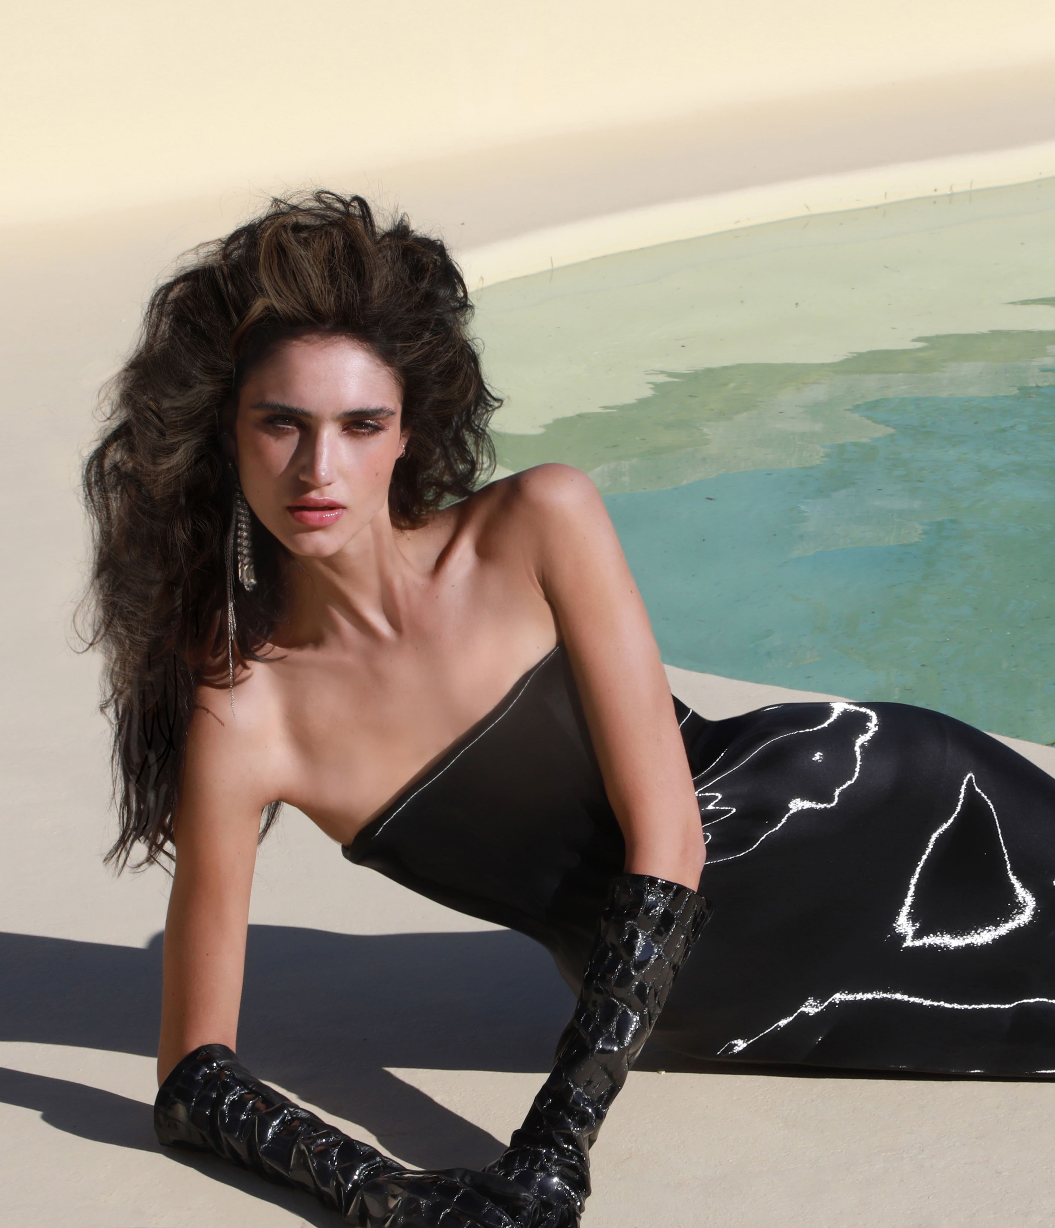
¡Muchas Gracias!

