Slide 1




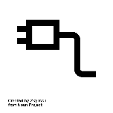
Wind_1
Pmax = 50 MW
P = 40 MW
Wind_2
Pmax = 20 MW
P = 18 MW
Alta
Pmax = 200 MW
P = 200 MW
1000 A
1
2
Park_city
Pmax = 100 MW
P = 42 MW
Load_2
P = 300 MW
Load_1
P = 0 MW

