Slide 1
CSc 134
Database Management and File Organization
5. Relational Algebra
Ying Jin
Computer Science Department
California state University, Sacramento

Slide 2
Relational Algebra
A set of operations for the relational model.
Enable a user to specify basic retrieval requests.
The algebra operations produce new relations.
  The result of a retrieval is a new relation.
A sequence of relational algebra operations forms a relational algebra expression
  result
    a relation
    represents the result of a database query.

Slide 3
Topics on relational algebra
Unary Relational Operations
  Select
  project
Relational Algebra Operations From Set Theory
  Union, intersection, minus
  Cartesian product
Binary Relational Operations
  Join
  equijoin, natural join variations of join

Slide 4
The SELECT Operation
σ _{<selection condition>} (R)
Filter - only those tuples that satisfy a qualifying condition appear in the result.
Result: subset of the tuples
Examples

Slide 5
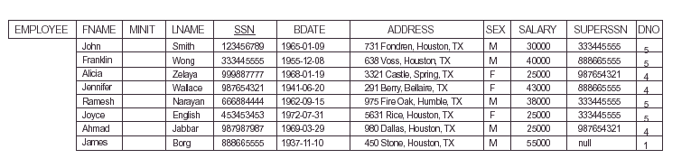

Slide 6
The SELECT Operation (Cont.)
Commutative
σ _{<cond1>} (σ _{<cond2>} (R)) = σ _{<cond2>} (σ _{<cond1>} (R))
A cascaded SELECT operation may be applied in any order
  σ _{<condition1>}(σ _{< condition2>} (σ _{<condition3>} ( R))
  = σ _{<condition2>} (σ _{< condition3>} (σ _{< condition1>} ( R)))
Cascade of SELECT operations into a single SELECT operation
σ _{<cond1>} (σ _{<cond2>} (… (σ _{<condn>}(R))…) =
σ _{<cond1> and} _{<cond2> and}… _{and <condn>}(R)

Slide 7

The Project Operation
This operation selects certain columns from the table and discards the other columns.
Creates a vertical partitioning –
  one with the needed columns (attributes) containing results of the operation
  other containing the discarded Columns.
π _{<list>} (R)
Example

Slide 8
The Project Operation (Cont.)
π removes any duplicate tuples
The result of π is a set of tuples – a valid relation
π_{sex, salary}(EMPLOYEE)
The number of tuples in the result of projection π _{<list>} (R)is always less or equal to the number of tuples in R.
π _{<list1>} (π _{<list2>} (R) ) = π _{<list1>} (R)

Slide 9
Sequence of Operations
Relational algebra expression
e.g. π_{FNAME, LNAME, SALARY}(σ _{DNO=5}(EMPLOYEE))
Intermediate results
e.g. TEMP ← σ _{DNO=5}(EMPLOYEE)
RESULT ← π _{FNAME, LNAME, SALARY} (TEMP)

Slide 10
UNION
R ∪ S
includes all tuples that are either in R or in S or in both R and S.
Duplicate tuples are eliminated.
Example: To retrieve the social security numbers of all employees who either work in department 5 or directly supervise an employee who works in department 5:

Slide 11
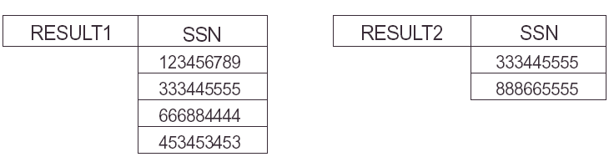
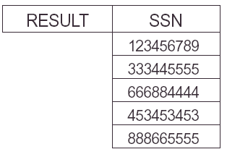
Union Example

Slide 12
Union Compatibility
The operand relations R₁(A₁, A₂, ..., A_{n}) and R₂(B₁, B₂, ..., B_{n}) must
    have the same number of attributes, AND
    the domains of corresponding attributes must be compatible: dom(A_{i})=dom(B_{i}) for i=1, 2, ..., n.

Slide 13
Intersection
R ∩ S
includes all tuples that are in both R and S
The two operands must be Union compatible

Slide 14
Set Difference (MINUS)
R – S
The two operands must be Union compatible
Result: a relation that includes all tuples that are in R but not in S

Slide 15
Commutative and associative
Union and Intersection are commutative operations
R ∪ S = S ∪ R, and R ∩ S = S ∩ R
Union and intersection are associative operations
R ∪ (S ∪ T) = (R ∪ S) ∪ T, and (R ∩ S) ∩ T = R ∩ (S ∩ T)
The minus operation is not commutative
R - S ≠ S – R

Slide 16
Cartesian Product
R X S
Combine tuples from two relations in a combinatorial fashion
Q(A₁, A₂, . . ., A_{n}, B₁, B₂, . . ., B_{m}) <-R(A₁, A₂, . . ., A_{n}) x S(B₁, B₂, . . ., B_{m})
  m+n attributes
  if R has n_{R} tuples (denoted as |R| = n_{R} ), and S has n_{S} tuples, then
  Q have n_{R} * n_{S} tuples.

Slide 17
Cartesian Product Example
Retrieve a list of names each female employee’s dependents (employee’s first name, last name, dependent’s name

Slide 18


Slide 19
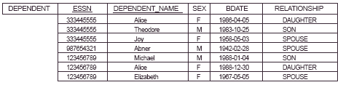

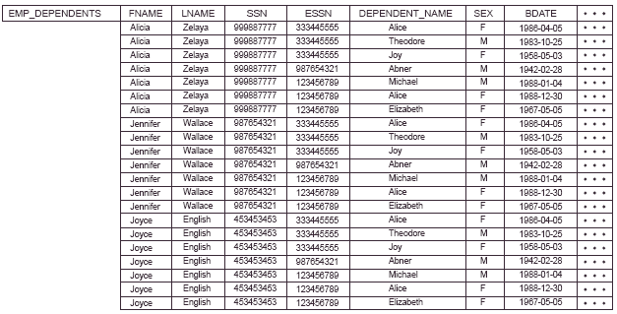

Slide 20
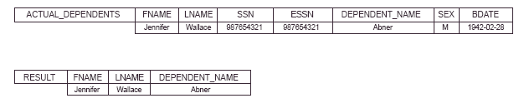

Slide 21
JOIN
Example
EMP_DEPENDENTS ← EMPNAMES x DEPENDENT
ACTUAL_DEPENDENTS ← σ _{SSN=ESSN}(EMP_DEPENTS)
Replace with a single JOIN operation
ACTUAL_DEPENDENTS ← EMPNAMES _{SSN=ESSN} DEPENDENT

Slide 22
JOIN (Cont.)
a join operation on two relations R(A₁, A₂, . . ., A_{n}) and S(B₁, B₂, . . ., B_{m}) is:
R _{<join condition>}S
  where R and S can be any relations that result from general relational algebra expressions.
<condition> AND <condition> AND ... AND <condition>
Each condition: Ai Ѳ Bj
  Ai: an attribute of R
  Bj: an attribute of S
  Ai and Bj have the same domain
  Ѳ: =, < ,>, ≠, ≥, ≤

Slide 23
EQUIJOIN
The join conditions with “=“ only
e.g.
DEPT_MGR ← DEPARTMENT _{MGRSSN=SSN} EMPLOYEE
The result of an EQUIJOIN:
  Always have one or more pairs of attributes that have identical values in every tuple

Slide 24
Natural join
*
A equijoin without superfluous attributes
Any two join attributes have the same name in both relations.
Join attributes
Equating all attributes pairs that have the same name in the two relations.
Rename when necessary before applying nature join
e.g. DEPT_LOCS ← DEPARTMENT * DEPT_LOCATIONS

Slide 25
Join Selectivity
R _{<join condition>}S
R has n_{R} tuples, S has n_{S} tuples
Result:
  min:empty relation with 0 tuples
    No combination of tuples satisfies the join condition
  max: n_{R} * n_{S}

Slide 26
Complete Set of Relational Operations
σ, π , ∪, - , X
Any other relational algebra expression can be expressed by a combination of these five operations
Examples
R ∩ S = (R ∪ S ) – ((R − S) ∪ (S − R))
R _{<join condition>}S = σ _{<join condition>} (R X S)

Slide 27
Examples of queries in relational algebra - 1
Retrieve the name (fname,lname) and address of all employees who work for the ‘Research’ department.

Slide 28
Examples of queries in relational algebra - 2
Retrieve the names (fname, lname) of employees who have no dependents.

Slide 29
These slides are is based on the textbook:
R. Elmaseri and S. Navathe, Fundamentals of Database Systems, 6th Edition, Addison-Wesley. Chapter 6.

