Slide 1
CSc 134
Database Management and File Organization
7. Functional Dependencies and Normalization for Relational Databases
Ying Jin
Computer Science Department
California state University, Sacramento

Slide 2
Introduction
What is relational database design?
The grouping of attributes to form relation schemas
What are good relational design?
Formal measures

Slide 3
Functional Dependencies
FDs are constraints that are derived from
  meaning and interrelationships of the data attributes
A functional dependency is a property of the semantics or meaning of the attributes.

Slide 4
Definition of functional dependency
A functional dependency, denoted by X → Y, between two sets of attributes X and Y that are subsets of R specifies a constraint on the possible tuples that can form a relation state r of R. The constraint is that, for any two tuples t1 and t2 in r that have t1[X] = t2[X], they must also have t1[Y]=t2[Y].

Slide 5
FD example
A set of attributes X functionally determines a set of attributes Y if the value of X determines a unique value for Y.
Social security number functionally determines employee name
SSN → ENAME

Slide 6
Notation of Functional Dependencies
X → Y
  function dependency from X to Y
  Y is functionally dependent on X
  X: left hand side FD. Y: right hand side FD
X → Y holds if whenever two tuples have the same value for X, they must have the same value for Y
A FD is a property of the relation schema R, not of a particular legal relation state r of R.
X → Y in R specifies a constraint on all relation instances r(R)

Slide 7
Examples of FD
Social security number determines employee name
SSN → ENAME
Project number determines project name and location
PNUMBER → {PNAME, PLOCATION}
Employee ssn and project number determines the hours per week that the employee works on the project
{SSN, PNUMBER} → HOURS

Slide 8
Infer additional FDs
Given a set of FDs F, we can infer additional FDs that hold whenever the FDs in F hold.
Given a set of functional dependencies F
  F= {SSN → ENAME
  PNUMBER → {PNAME, PLOCATION}
  {SSN, PNUMBER} → HOURS }
Infer?
  {ssn,bdata} → {ename,bdata}
  Pnumber → pname
  ssn → hours

Slide 9
Inference Rules for FDs
Notation: XZ stands for {X,Z}
Armstrong's inference rules:
IR1. (Reflexive)
If Y ⊆ X, then X → Y
IR2. (Augmentation)
If X → Y, then XZ → YZ
IR3. (Transitive)
If X → Y and Y → Z, then X → Z

Slide 10
Additional Inference Rules
IR 4:(Decomposition)
If X → YZ, then X → Y and X → Z
IR 5: (Union)
If X → Y and X → Z, then X → YZ
IR6: (Psuedotransitivity)
If X → Y and WY → Z, then WX → Z
Deduced from IR1, IR2, and IR3

Slide 11
Closure
F⁺: Closure of F. The set of all dependencies that include F as well as all dependencies that can be inferred from f is called the closure of F.
X⁺: Closure of X under F. The set of attributes that are functionally determined by X based on F.
X ⁺ can be calculated by repeatedly applying IR1, IR2, IR3 using the FDs in F

Slide 12
Algorithm to calculate X⁺
Determining X⁺, the closure of x under F
X⁺: =X;
Repeat
oldX⁺ := X⁺;
for each functional dependency Y->Z in F do
if Y ⊆ X⁺ then X⁺ := X⁺ U Z;
Until (X⁺ =oldX⁺ );

Slide 13
Example of calculate X⁺
F= {SSN-> ENAME,
PNUMBER -> {PNAME, PLOCATION},
{SSN,PNUMBER} ->HOURS}
{SSN}⁺= {SSN, ENAME}
{SSN,PNUMBER}⁺ = {SSN, PNUMBER, ENAME, PNAME, PLOCATION, HOURS}
{PNUMBER}⁺ = ___?

Slide 14
Equivalence of Sets of FDs
Two sets of FDs F and G are equivalent if:
- every FD in F can be inferred from G, and
- every FD in G can be inferred from F
F and G are equivalent if F ⁺ =G ⁺
Definition: F covers G if every FD in G can be inferred from F (i.e., if G ⁺ ⊆ F ⁺)
F and G are equivalent if F covers G and G covers F

Slide 15
Minimal Sets of FDs
A set of FDs is minimal if it satisfies the following conditions:
Every dependency in F has a single attribute for its right hand side.
We cannot replace any dependency X -> A in F with a dependency Y -> A, where Y ⊆ X, and still have a set of dependencies that is equivalent to F.
We cannot remove any dependency from F and have a set of dependencies that is equivalent to F.

Slide 16
Minimal Sets of FDs
Every set of FDs has an equivalent minimal set
There can be several equivalent minimal sets
We can always find at least one minimal set using Algorithm 10.2

Slide 17
Algorithm 10.2 Finding a Minimal Cover F for a set of functional Dependencies E
Set F: = E;
Replace each functional dependency X → {A1, A2,…, An} in F by the n functional dependencies X → A1, X → A2,…, X → An
For each functional dependency X →A in F
for each attribute B that is an element of X
if {{F-{X →A}} U {{x-{B}} →A}} is equivalent to F
then replace X → A with (X-{B}) → A in F
For each remaining functional dependency X→A in F
if (F-{X →A}) is equivalent to F,
then remove X →A from F.

Slide 18
What is normalization?
Normalization: The process of decomposing unsatisfactory relations by breaking up their attributes into smaller relations
  Use
    keys
    FDs
  to certify whether a relation schema is in a particular normal form

Slide 19
Practical Use of Normal Forms
Normalization is carried out so that the resulting designs are of high quality and meet the desirable properties
The practical utility of these normal forms becomes questionable when the constraints on which they are based are hard to understand or to detect
The database designers need not normalize to the highest possible normal form.
Denormalization: the process of storing the join of higher normal form relations as a base relation—which is in a lower normal form

Slide 20
Definitions of Keys and Attributes Participating in Keys
A superkey of a relation schema R = {A₁, A₂, ...., A_{n}} is a set of attributes S ⊆ R with the property that no two tuples t₁ and t₂ in any legal relation state r of R will have t₁[S] = t₂[S]
(k)⁺ = ____ ?
A key K is a superkey with the additional property that removal of any attribute from K will cause K not to be a superkey any more.

Slide 21
Definitions of Keys and Attributes Participating in Keys (Cont.)
If a relation schema has more than one key, each is called a candidate key. One of the candidate keys is arbitrarily designated to be the primary key, and the others are called secondary keys.

Slide 22
First Normal Form
Disallows composite attributes, multivalued attributes
Disallows attributes whose values for an individual tuple are non-atomic
Considered to be part of the definition of relation

Slide 23
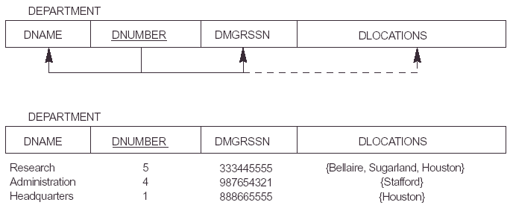
Figure 10.8 Normalization into 1NF

Slide 24
Normalization into 1 NF
Solution 1 (best)
  Department(dname,dnumber, dmgrssn)
  dept_loc(dnumber, dlocation)
Solution 2
  department(dnumber,dlocation,dname,dmgrssn)
Solution 3
  department(dnumber,dname,dmgrssn, dlocation1,dlocation2,dlocation3)

Slide 25
Full functional dependency
Full functional dependency
  a FD Y → Z, where removal of any attribute from Y means the FD does not hold any more
  e.g. {SSN, PNUMBER} → HOURS
Partial dependency
  e.g. {SSN, PNUMBER} → ENAME

Slide 26
2 NF
General definition
Take into account relations with multiple candidate keys
Prime attribute: An attribute that is part of any candidate key
A relation schema R is in second normal form (2NF) if every non-prime attribute A in R is fully functionally dependent on every key of R.

Slide 27
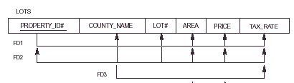
2NF - Example
Keys:
  property_id#
  {county_name,lot#}
Violate/satisfy? 2NF

Slide 28
3NF
X → Y is trivial if Y ⊂ X, otherwise, it is nontrival.
A relation schema R is in third normal form (3NF) if, whenever a non-trivial FD X → A holds in R, then either:
(1) X is a superkey of R, or
(2) A is a prime attribute of R

Slide 29
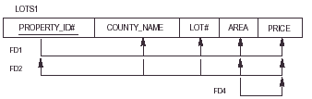
3NF - example
Keys:
  property_id#
  {county_name,lot#}
Violate/satisfy? 3NF

Slide 30
BCNF (Boyce-Codd Normal Form)
A relation schema R is in Boyce-Codd Normal Form (BCNF) if whenever an nontrivial FD X → A holds in R, then X is a superkey of R
Each normal form is strictly stronger than the previous one
  Every 2NF relation is in 1NF
  Every 3NF relation is in 2NF
  Every BCNF relation is in 3NF
There exist relations that are in 3NF but not in BCNF

Slide 31
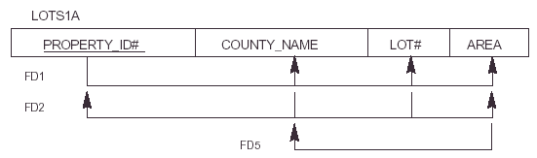
BCNF - example
Keys:
  property_id#
  {county_name,lot#}
Violate/satisfy? BCNF

Slide 32
These slides are based on the textbook of:
R. Elmaseri and S. Navathe, Fundamentals of Database Systems, 6th Edition, Addison-Wesley. Chapter 15.

