Slide 1
Module 1 — AI Systems for WAF Engineers
Copyright © 2026 by Elephant Scale, All Rights Reserved

Slide 2
Module 1 Agenda
What are LLMs and how do they differ from normal apps
AI inference pipelines
Prompt anatomy and flow
RAG architecture and vector databases
Agentic workflows and tool calling
AI gateways and copilots
MCP and agent protocols
Where WAF visibility exists — and where it disappears
Copyright © 2026 by Elephant Scale, All Rights Reserved

Slide 3
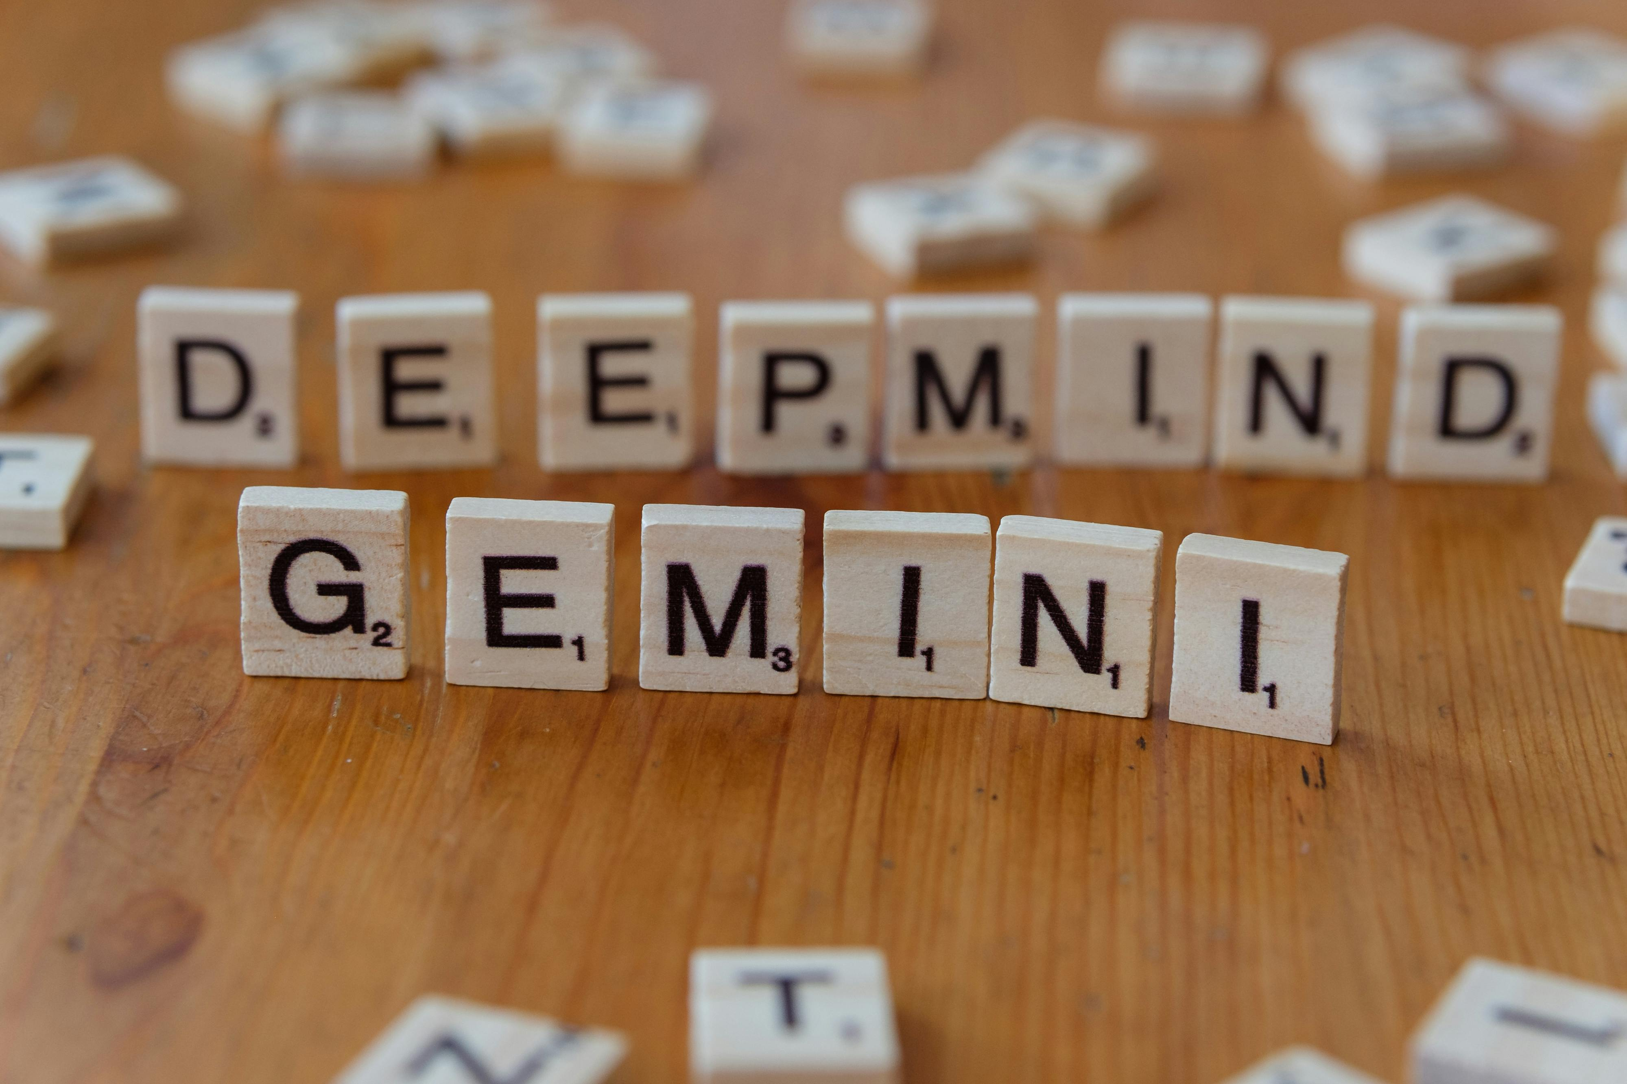
What Is a Large Language Model?
An LLM is a statistical model trained to predict the next token in a sequence.
Key properties:
Input and output are text (tokens), not structured data
No deterministic logic — output is probabilistic
Behavior is shaped by training data and prompts
Context window limits how much it "remembers" per request
Copyright © 2026 by Elephant Scale, All Rights Reserved

Slide 4

LLMs vs Traditional Web Apps
Property | Traditional App | LLM App
Input type | Structured (forms, JSON) | Freeform text
Logic | Deterministic | Probabilistic
Attack surface | Known endpoints | Open-ended prompt
Output | Predictable | Variable
State | Session-managed | Context window
Injection | SQL, XSS, LDAP | Prompt injection
Copyright © 2026 by Elephant Scale, All Rights Reserved

Slide 5

Tokens — The Unit of AI Processing
LLMs don't process characters or words — they process tokens .
A token ≈ 4 characters on average
"Hello world" = 2 tokens
gpt-4o : 128K token context window
Tokens drive cost and rate limiting
Security implication:
Attackers can craft prompts to maximize token consumption (denial-of-wallet)
Token limits can be abused to truncate safety instructions
Copyright © 2026 by Elephant Scale, All Rights Reserved

Slide 6
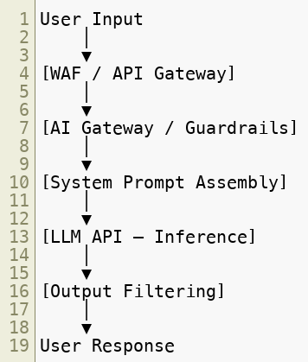
The AI Inference Pipeline
WAF visibility exists at the edges. The middle is often opaque.
Copyright © 2026 by Elephant Scale, All Rights Reserved

Slide 7
Anatomy of a Prompt
A prompt typically has three parts:
System prompt — instructions set by the developer
Context — retrieved documents, history, tool output
User message — what the end user typed
Together these form the full context window sent to the model.
Copyright © 2026 by Elephant Scale, All Rights Reserved

Slide 8
Why the System Prompt Matters for Security
The system prompt is the developer's primary security control at the model layer.
It can:
Define the model's role and constraints
Block certain topics
Set output format requirements
It cannot:
Reliably prevent a determined attacker
Override injected instructions in retrieved content
Enforce cryptographic guarantees
Copyright © 2026 by Elephant Scale, All Rights Reserved

Slide 9
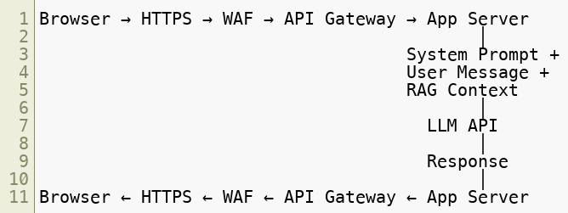
Prompt Flow — From Browser to Model
WAF sees HTTP traffic. It does not see what the LLM receives internally.
Copyright © 2026 by Elephant Scale, All Rights Reserved

Slide 10

Streaming APIs — A WAF Complication
Most LLM APIs support streaming responses (Server-Sent Events).
WAF challenges:
Cannot inspect full response before delivery
Buffering for inspection defeats latency goals
Malicious content may arrive in fragments
Copyright © 2026 by Elephant Scale, All Rights Reserved

Slide 11
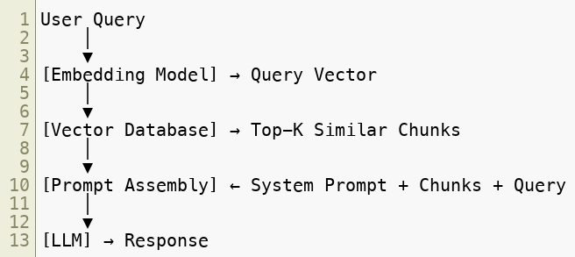
RAG Architecture Overview
Retrieval-Augmented Generation grounds LLM responses in external documents.
RAG is now the standard architecture for enterprise AI assistants.
Copyright © 2026 by Elephant Scale, All Rights Reserved

Slide 12
RAG — The Components
Component | Role | Security Concern
Document store | Source of truth | Poisoned documents
Chunker | Splits docs into pieces | Hidden instructions in chunks
Embedding model | Converts text to vectors | Adversarial embeddings
Vector database | Stores/retrieves vectors | Unauthorized retrieval
Retriever | Finds relevant chunks | Retrieval manipulation
Prompt assembler | Builds final prompt | Injection via retrieved text
Copyright © 2026 by Elephant Scale, All Rights Reserved

Slide 13
Vector Databases
A vector database stores documents as high-dimensional numerical vectors .
Popular options: Pinecone, Weaviate, Qdrant, pgvector, Chroma
How retrieval works:
Query is converted to a vector by the embedding model
Database finds nearest vectors (cosine similarity)
Source text for those vectors is returned
Security issue: nearest neighbor is a semantic match, not an exact string match — hard to filter with traditional rules.
Copyright © 2026 by Elephant Scale, All Rights Reserved

Slide 14

Embeddings — What They Are
An embedding is a vector representation of text that captures semantic meaning.
Why this matters:
Semantic attacks bypass keyword filters
Poisoned documents can be designed to be retrieved for specific queries
Filtering by content requires ML classifiers, not regex
Copyright © 2026 by Elephant Scale, All Rights Reserved

Slide 15
Agentic AI — What Are Agents?
An AI agent is an LLM that can take actions, not just answer questions.
Agents can:
Call APIs and external services
Read and write files
Execute code
Browse the web
Send emails and messages
Spawn sub-agents
Copyright © 2026 by Elephant Scale, All Rights Reserved

Slide 16
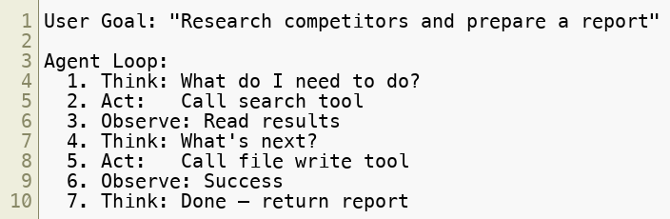
Agentic Workflow Pattern
Each Act step is a real action with real consequences. WAF may see some of these API calls — but not the agent's reasoning.
Copyright © 2026 by Elephant Scale, All Rights Reserved

Slide 17
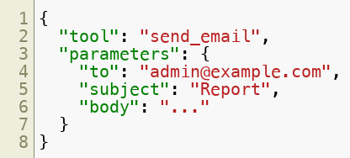
Tool Calling
LLMs request tools using structured output:
The application executes the tool and returns results to the model.
Security risk: An attacker who controls the prompt can influence which tools are called with what parameters .
Copyright © 2026 by Elephant Scale, All Rights Reserved

Slide 18
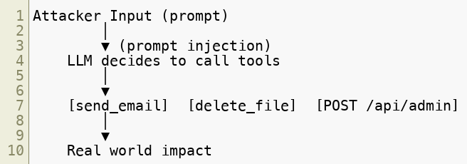
Tool Calling — The Attack Surface
WAF sees the HTTP requests the agent makes — but may not know they originated from an attacker-controlled prompt.
Copyright © 2026 by Elephant Scale, All Rights Reserved

Slide 19
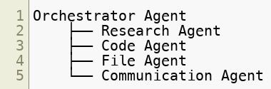
Multi-Agent Architectures
Modern AI systems often chain multiple agents:
Attack implications:
An attacker injecting into one agent can propagate to others
Agent-to-agent calls may bypass WAF entirely (internal network)
Trust boundaries between agents are often undefined
Copyright © 2026 by Elephant Scale, All Rights Reserved

Slide 20
Copilots — The Business Context
A copilot is an AI assistant embedded in a business workflow.
Examples:
GitHub Copilot (code completion)
Microsoft 365 Copilot (email, calendar, documents)
Salesforce Einstein (CRM)
Custom enterprise chatbots
From a WAF perspective:
Copilots access sensitive internal data via APIs
They act on behalf of users — often with elevated permissions
They are prime targets for indirect prompt injection
Copyright © 2026 by Elephant Scale, All Rights Reserved

Slide 21
AI Gateways
An AI gateway sits between your application and LLM providers.
Functions:
Route requests to different models
Apply prompt/response filtering
Enforce rate limits (token-based)
Log all prompts and completions
Apply guardrails and classifiers
Manage API keys and quotas
Examples: AWS Bedrock, Azure AI Studio, Cloudflare AI Gateway, Kong AI Gateway, Portkey, LiteLLM
Copyright © 2026 by Elephant Scale, All Rights Reserved

Slide 22
AI Gateway vs Traditional WAF
Capability | WAF | AI Gateway
HTTP filtering | ✓ | ✓
Rate limiting | ✓ (request-based) | ✓ (token-based)
Prompt inspection | ✗ | ✓
Response filtering | Limited | ✓
Semantic analysis | ✗ | ✓
Model routing | ✗ | ✓
Cost enforcement | ✗ | ✓
WAF and AI gateway are complementary , not alternatives.
Copyright © 2026 by Elephant Scale, All Rights Reserved

Slide 23
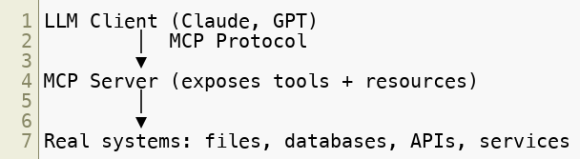
MCP — Model Context Protocol
MCP (Anthropic, 2024) is an open protocol for connecting LLMs to external tools and data.
MCP is becoming the standard for agent tool connectivity — analogous to USB for peripherals.
Copyright © 2026 by Elephant Scale, All Rights Reserved

Slide 24
MCP Security Concerns
MCP introduces new attack surfaces:
Tool poisoning — malicious MCP server exposes dangerous tools
Resource injection — MCP resource returns attacker-controlled text
Privilege escalation — agent inherits MCP server's permissions
Confused deputy — agent acts on behalf of attacker via MCP
WAF relevance:
MCP uses HTTP/SSE transport — WAF can inspect at the transport layer
Content inspection of MCP payloads requires custom rules
Copyright © 2026 by Elephant Scale, All Rights Reserved

Slide 25
Agent Protocols — The Ecosystem
Protocol | Purpose | Transport
MCP | Tool/resource connectivity | HTTP, SSE, stdio
OpenAI function calling | Tool use | JSON over HTTPS
LangChain tools | Framework tool abstraction | Various
A2A (Google) | Agent-to-agent | HTTP
AutoGen | Multi-agent orchestration | Internal
Most use HTTP — WAF has transport-layer visibility. Semantic content requires AI-aware inspection.
Copyright © 2026 by Elephant Scale, All Rights Reserved

Slide 26
Where WAF Visibility Exists
WAF can see and control:
Initial HTTP request to AI endpoint ( /v1/chat/completions )
Request headers, source IP, auth tokens
Request body (prompt as raw text)
Response body (before delivery to client)
HTTP method, status codes, response size
Tool call HTTP requests made by agents
Rate limiting by request count or token estimate
Copyright © 2026 by Elephant Scale, All Rights Reserved

Slide 27
Where WAF Visibility Disappears
WAF cannot see:
What the LLM reasons internally
Injected instructions hidden inside retrieved documents
Agent-to-agent calls over internal networks
Content inside encrypted sub-requests
Semantic meaning of obfuscated prompts
Multi-turn context accumulating across requests
Decisions made by the model about tool use
Copyright © 2026 by Elephant Scale, All Rights Reserved

Slide 28
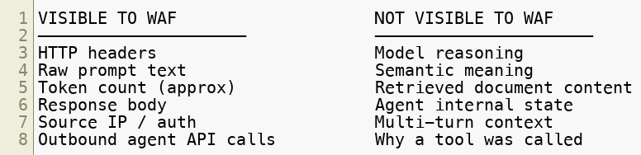
The Visibility Gap
Bridging this gap requires AI gateways + guardrails working alongside WAF.
Copyright © 2026 by Elephant Scale, All Rights Reserved

Slide 29
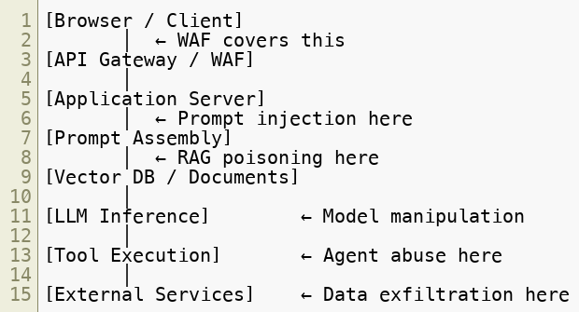
The New Attack Surface
Copyright © 2026 by Elephant Scale, All Rights Reserved

Slide 30
Mapping Architecture to Threats
Component | Primary Threat
HTTP endpoint | DDoS, scraping, auth bypass
System prompt | Prompt injection, override
User input | Direct prompt injection, jailbreak
RAG / vector DB | Document poisoning, retrieval manipulation
LLM model | Model extraction, adversarial inputs
Tool execution | Unauthorized actions, privilege escalation
Output | Sensitive data disclosure, indirect injection
Copyright © 2026 by Elephant Scale, All Rights Reserved

Slide 31
Traditional vs AI Threat Models
Traditional WAF mindset:
Attack is in the HTTP request
Block malicious patterns
Enforce allow/deny rules
AI WAF mindset:
Attack may be in retrieved documents, not the request
Semantic intent matters, not just syntax
The model itself can be the attack vector
Output can carry attacks downstream
Copyright © 2026 by Elephant Scale, All Rights Reserved

Slide 32
Key Architectural Patterns You Will Defend
Over this course you will build defenses for:
Chatbot APIs — prompt injection at the HTTP layer
RAG pipelines — document poisoning and retrieval abuse
Agentic systems — tool abuse and privilege escalation
LLM APIs — denial-of-wallet and model scraping
Copilot integrations — indirect injection through business data
Multi-agent workflows — cross-agent propagation attacks
Copyright © 2026 by Elephant Scale, All Rights Reserved

Slide 33
Module 1 Summary
LLMs are probabilistic, token-based systems — not deterministic apps
AI inference pipelines have multiple layers, each with its own attack surface
RAG adds document retrieval as a new injection vector
Agents transform AI from read-only to read-write risk
Tool calling gives attackers a path from text to real-world actions
WAF visibility is strong at HTTP boundaries, weak inside the AI stack
AI gateways and guardrails extend WAF coverage into the semantic layer
Copyright © 2026 by Elephant Scale, All Rights Reserved

Slide 34
What's Next
Module 2 — OWASP GenAI Top 10
We move from architecture to the specific attack categories:
Prompt Injection
Insecure Output Handling
Training Data Poisoning
Model DoS
And six more...
Copyright © 2026 by Elephant Scale, All Rights Reserved

Slide 35
Lab Preview — Lab 1
Attack a chatbot with prompt injection
You will:
Interact with an intentionally vulnerable AI chatbot
Attempt to override its system prompt
Extract hidden instructions
Observe what basic WAF rules catch — and what they miss
Environment: provided Docker-based lab Time: 45 minutes
Copyright © 2026 by Elephant Scale, All Rights Reserved

