Slide 1
Practical AI Security for Security Teams
Copyright © 2026 by Elephant Scale, All Rights Reserved

Slide 2
Agenda
Module | Topic
1 | AI Systems for Security Engineers
2 | OWASP GenAI Top 10
3 | Prompt Injection Detection
4 | AI-Aware WAF Rules
5 | Securing RAG Pipelines
6 | Agentic AI Security
7 | API Security for AI
8 | Detection Engineering & SOC Integration
9 | Cloud WAFs and AI Security
10 | Building a Layered AI Defense
Copyright © 2026 by Elephant Scale, All Rights Reserved

Slide 3
Pre-requisites and Expectations
Basic coding knowledge is assumed
Have a coding development environment
We will set this up in class
Or on the cloud
Curiosity!
Ask a lot of questions
This is an AI security class
Intermediate to advanced; comfort with HTTP/API security and the OWASP Top 10 helps
Class will be based on the pace of majority of the students
Notes
Copyright © 2026 by Elephant Scale, All Rights Reserved

Slide 4
Our Teaching Philosophy
Emphasis on concepts & fundamentals
API - no need to learn anything by heart
Highly interactive (questions and discussions are welcome)
Hands-on (learn by doing)
Notes
Copyright © 2026 by Elephant Scale, All Rights Reserved

Slide 5
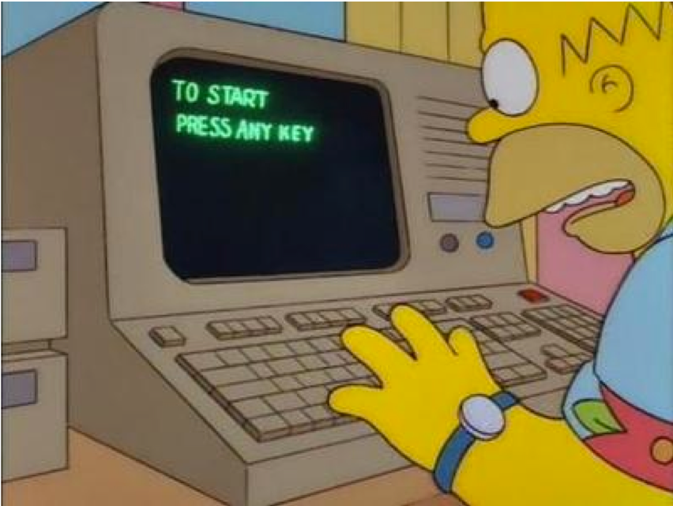
Lots of Labs: Learn By Doing
Notes
Copyright © 2026 by Elephant Scale, All Rights Reserved

Slide 6

Analogy: Learning To Fly...
Copyright © 2026 by Elephant Scale, All Rights Reserved

Slide 7
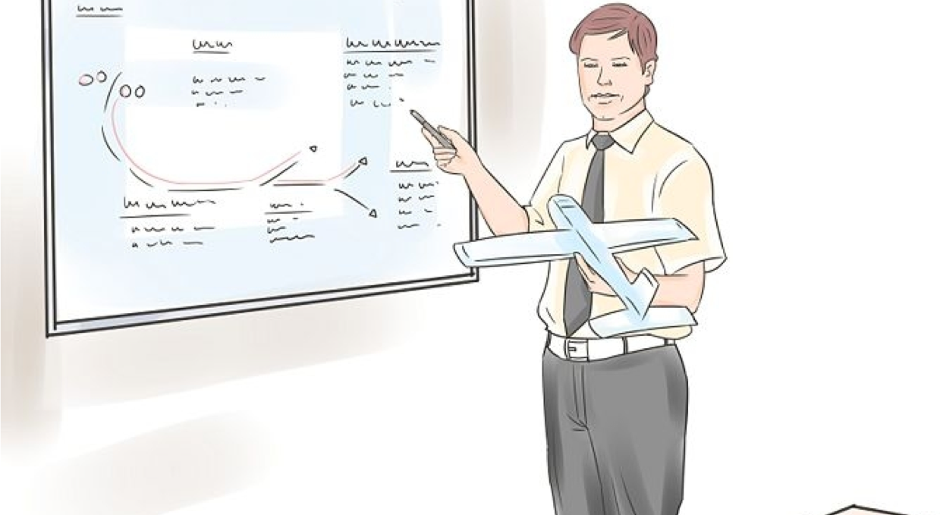
Introductions
Notes
Copyright © 2026 by Elephant Scale, All Rights Reserved

Slide 8
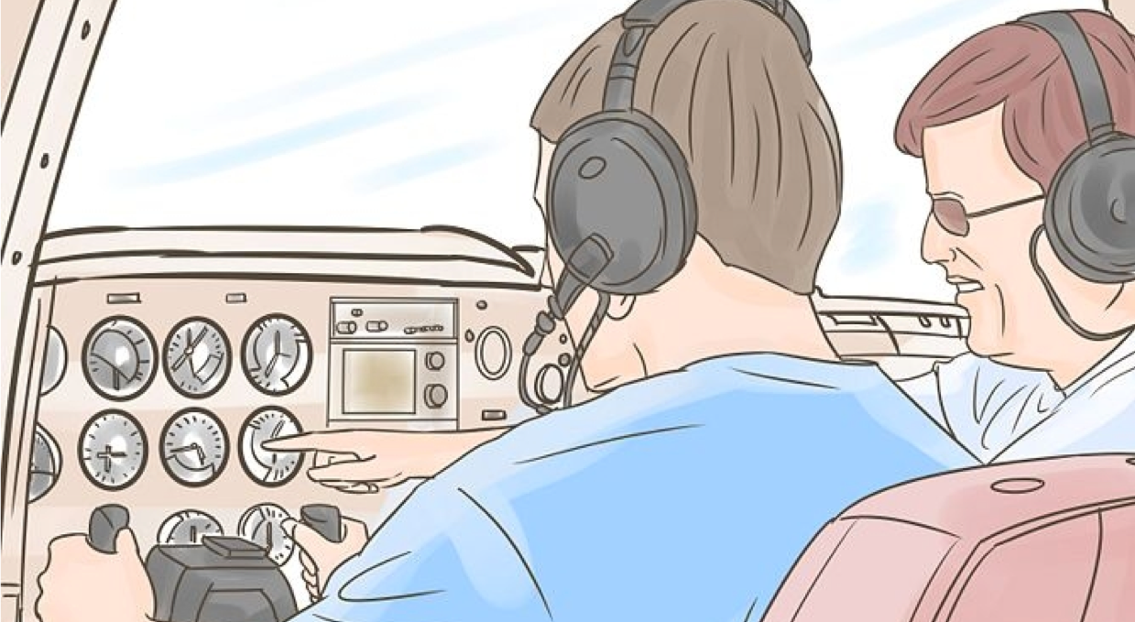
+ Flight Time
Copyright © 2026 by Elephant Scale, All Rights Reserved

Slide 9
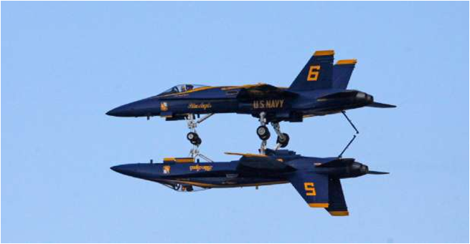
This Will Take A Lot Of Practice
Copyright © 2026 by Elephant Scale, All Rights Reserved

Slide 10



About You And Me
About Instructor
About you
Your Name
Your background (developer, admin, manager, ...)
Technologies you are familiar with
Familiarity with AI security (scale of 1 - 4 ; 1 - new, 4 - expert)
Something non-technical about you!(favorite ice cream flavor / hobby...)
Copyright © 2026 by Elephant Scale, All Rights Reserved

