Slide 1
AI for Business Leaders
Let's Begin
Copyright © 2026 by Elephant Scale, All Rights Reserved

Slide 2
Two Days, One Question
Someone is going to ask you that. Probably soon. Possibly this week.
By Wednesday evening you will have an answer you can defend — with a use case, a number, a risk register, and a name next to it.
"So what are we doing about AI?"
Copyright © 2026 by Elephant Scale, All Rights Reserved
Notes:
Open with this. Ask the room who has already been asked the question, and by whom. It surfaces the real pressure people are under and sets the tone that this is a decision-making course, not a technology tour.

Slide 3
Pre-requisites and Expectations
No technical background is assumed
  No programming, no math, no prior AI exposure
  If you can use a web browser, you can do every exercise in this course
Bring a real problem
  A process, a bottleneck, a pile of documents from your own area
  You will work on it for two days and leave with a plan for it
Curiosity, and skepticism
  Ask a lot of questions
  Argue with me — the claims in this course should survive being challenged
Copyright © 2026 by Elephant Scale, All Rights Reserved

Slide 4
Our Teaching Philosophy
Emphasis on judgment , not tools
  Tools change every six months; the questions don't
Highly interactive — questions and disagreement are welcome at any moment
Learn by doing — every module ends with you applying it to your own organization
Honest about limits — you will see this technology fail, on purpose, in front of you
Copyright © 2026 by Elephant Scale, All Rights Reserved
Notes:
Stress that we deliberately show failures. Leaders who have only seen polished demos make bad decisions.

Slide 5

Analogy: Learning To Fly...
Copyright © 2026 by Elephant Scale, All Rights Reserved
Notes:
You can read about flying all day. At some point you have to sit in the seat.

Slide 6
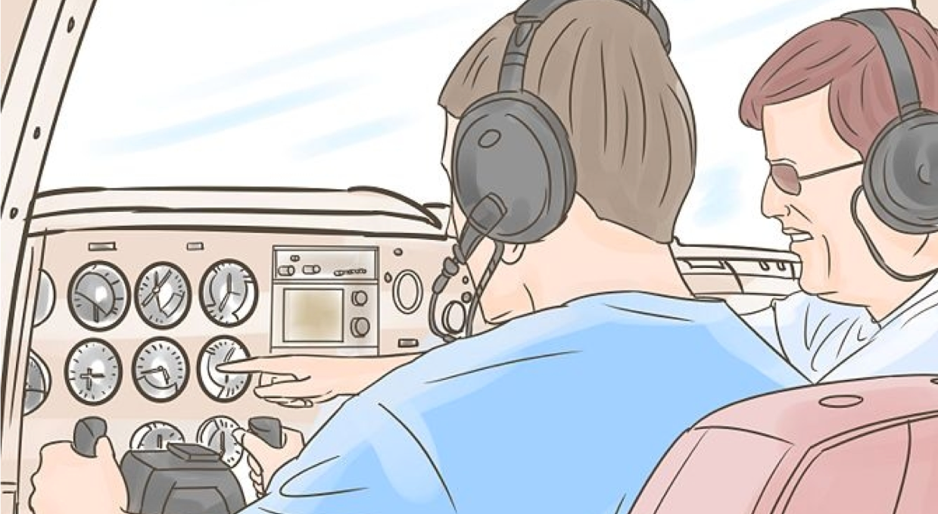
+ Flight Time
Copyright © 2026 by Elephant Scale, All Rights Reserved
Notes:
The exercises are the flight time. Half of this course is you working, not me talking.

Slide 7
What You Will Walk Out With
Not notes. Artifacts.
Day 1 | Day 2
A personal prompt library | An honest maturity assessment
Trust thresholds for your work | A communication playbook
A scored use-case portfolio | Three governance controls
 | A one-page business case
 | A 30/60/90 day plan
Copyright © 2026 by Elephant Scale, All Rights Reserved
Notes:
Show this early. It tells people the course produces something and makes the exercises feel like work, not filler.

Slide 8
The Shape of the Two Days
Day 1 — Understanding AI and finding the value
What AI actually is (and isn't)
Working with AI: prompting as a leadership skill
Capabilities, limits, and trust
Finding and prioritizing business value
Day 2 — Leading the organization through AI
AI strategy and the stages of AI success
Building an AI-ready culture
Responsible AI, risk, and governance
Planning, investing, and no-code enablement — then the pitch
Copyright © 2026 by Elephant Scale, All Rights Reserved

Slide 9
Ground Rules
Ask the question when you have it. Not at the end.
The parking lot is real. Anything organization-specific goes on the board and gets answered before we close.
No stupid questions, and no stupid answers. If I don't know, I will say so.
Nothing sensitive goes into a public AI tool during this class. We will talk about exactly why in Module 7.
Copyright © 2026 by Elephant Scale, All Rights Reserved
Notes:
That last rule matters. Say it on day one and enforce it — participants will be tempted to paste real internal documents into the exercises.

Slide 10



About You And Me
About the instructor
About you
  Your name and what you're responsible for
  How much of your week is spent on decisions vs. execution
  Your familiarity with AI (1–4; 1 = new, 4 = I've shipped something)
  What you personally want to walk out with
  Something non-technical about you
Copyright © 2026 by Elephant Scale, All Rights Reserved
Notes:
Capture the "what do you want to walk out with" answers on the board. Refer back to them at the close and check them off. It is the cheapest engagement device in the course.

Slide 11
Where Are You On This Curve?
Quick poll, hands up:
I have never used an AI assistant
I've tried it a few times
I use it weekly
I use it daily and would miss it
My team has already put something into production
Copyright © 2026 by Elephant Scale, All Rights Reserved
Notes:
Do this literally. It tells you how to pace Module 2, and it shows the room its own distribution — which is usually much wider than anyone expects.

Slide 12
Let's Begin
Let's Begin
Copyright © 2026 by Elephant Scale, All Rights Reserved

