Slide 1
Working With AI: Prompting as a Leadership Skill
Principle 1 — Clear and Specific
Principle 2 — Give It Time to Think
The Four Workhorse Patterns
Two More Things That Matter
Exercise 2 — The Prompting Workshop
Copyright © 2026 by Elephant Scale, All Rights Reserved

Slide 2
Why This Module Exists
Two people, same tool, same day. One says "it's a toy." The other has cut four hours a week out of their job.
The difference is almost never the model. It is how they ask.
The same model, given a better prompt, goes from useless to production-ready.
Copyright © 2026 by Elephant Scale, All Rights Reserved
Notes:
This is the module where skepticism turns around. Do not rush it. Everything in Day 2 — use cases, business cases, adoption — is easier once people have personally felt the difference.

Slide 3
Why a
You could delegate this. You shouldn't. Three reasons:
You cannot evaluate what you have never done. Every AI proposal you see for the next five years is prompting underneath.
Your own work is full of this. Briefings, summaries, drafts, reviews, analysis. You are the use case.
Adoption follows the leader. A leader who uses the tool badly, or not at all, cannot credibly ask anyone else to.
Copyright © 2026 by Elephant Scale, All Rights Reserved
Notes:
Ask: how many of you have delegated "figuring out AI" to someone else? Then ask how that's going.

Slide 4
What a Prompt Really Is
Not "the question." The whole package you hand the model:
Role — who it should act as
Task — what you want done, specifically
Context — the material to work from
Constraints — length, format, tone, audience, what to leave out
Examples — one or two demonstrations of good output
Most people type the task and nothing else, then conclude the tool is mediocre.
Copyright © 2026 by Elephant Scale, All Rights Reserved

Slide 5
Two Principles Carry Almost Everything
Everything else in this module is a tactic under one of those two.
Principle 1 — Write clear and specific instructions.
Principle 2 — Give the model time to think.
Copyright © 2026 by Elephant Scale, All Rights Reserved
Notes:
These two principles are the backbone of our developer course as well. They hold at every level of sophistication.

Slide 6
"Clear" Is Not "Short"
The single most common mistake: writing a brief prompt and thinking that's a clear one.
A longer prompt with role, context, and constraints beats a terse one nearly every time.
The model cannot read your mind. Every ambiguity you leave is a decision it makes for you — and it will make the average choice, not yours.
Copyright © 2026 by Elephant Scale, All Rights Reserved

Slide 7
Principle 1 — Clear and Specific
Principle 1 — Clear and Specific
Principle 2 — Give It Time to Think
The Four Workhorse Patterns
Two More Things That Matter
Exercise 2 — The Prompting Workshop
Copyright © 2026 by Elephant Scale, All Rights Reserved

Slide 8
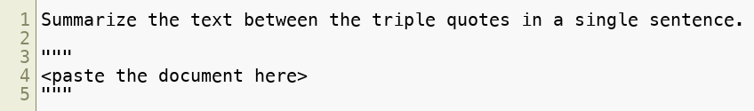
Tactic 1 — Use Delimiters
Separate your instructions from your material . Fence the material with quotes, triple backticks, or tags.
Why it matters to you: without a boundary, the model can't tell your instruction from the text — and if the pasted text happens to contain instructions of its own, it may follow them. That is the seed of prompt injection, which we cover in Module 7.
Copyright © 2026 by Elephant Scale, All Rights Reserved
Notes:
Plant the security connection here. It pays off on Day 2.

Slide 9
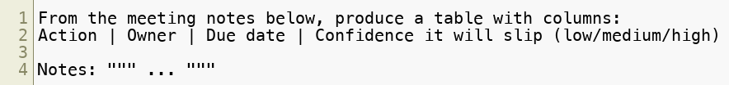
Tactic 2 — Ask for a Structured Output
Don't accept prose when you want data.
Why it matters to you: structured output is what makes AI output usable — it can be pasted into a tracker, compared across documents, reviewed at a glance. "Give me a table with these exact columns" is the highest-value nine words in this course.
Copyright © 2026 by Elephant Scale, All Rights Reserved
Notes:
Demo this live with a real (non-sensitive) set of meeting notes. It gets an audible reaction every time.

Slide 10
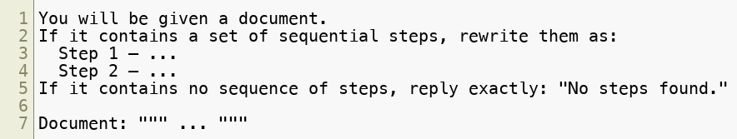
Tactic 3 — Ask It to Check Conditions First
Why it matters to you: this is how you stop the model from inventing structure that isn't there. You have given it a legitimate way to say nothing is here — otherwise it will helpfully make something up.
Copyright © 2026 by Elephant Scale, All Rights Reserved
Notes:
This tactic is the direct antidote to a whole class of hallucination. Emphasize it.

Slide 11
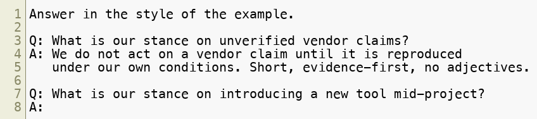
Tactic 4 — Give It an Example (Few-Shot)
Why it matters to you: describing a tone is hard; showing it is easy. One good example beats a paragraph of instructions about style. This is how organizations get consistent output across many people.
Copyright © 2026 by Elephant Scale, All Rights Reserved

Slide 12
Principle 2 — Give It Time to Think
Principle 1 — Clear and Specific
Principle 2 — Give It Time to Think
The Four Workhorse Patterns
Two More Things That Matter
Exercise 2 — The Prompting Workshop
Copyright © 2026 by Elephant Scale, All Rights Reserved

Slide 13
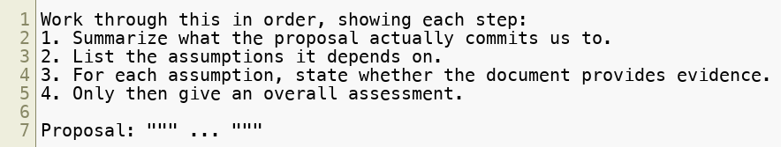
Tactic 5 — Ask for Steps, in Order
Instead of: "Is this proposal sound?"
Why it matters to you: asking for a verdict first gets you a confident guess. Asking for the work first gets you reasoning you can audit — and you can check step 3 yourself.
Copyright © 2026 by Elephant Scale, All Rights Reserved

Slide 14
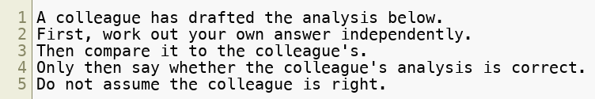
Tactic 6 — Make It Do the Work Before It Judges
Why it matters to you: models are agreeable by default. Ask "is this right?" and you will often be told yes. Force independent work first and the agreement bias drops sharply.
Copyright © 2026 by Elephant Scale, All Rights Reserved
Notes:
This is a genuinely important slide for leaders — they will be tempted to use AI to "check" work, which is exactly the case where sycophancy bites.

Slide 15
Tactic 7 — Iterate. Your First Prompt Is a Draft
Nobody writes the right prompt first. The professional loop:
Write the obvious prompt
Look at what's wrong with the output — specifically
Add the missing instruction
Repeat
"Too long" → add a word limit. "Wrong audience" → name the audience. "Missing the technical detail" → say which details matter. "I can't use this format" → specify the format.
Copyright © 2026 by Elephant Scale, All Rights Reserved
Notes:
Live-demo the iteration loop. The product-description example from our developer course works well: first draft is too long and too fluffy, then constrain length, then name the audience, then demand a table of specifications. Four rounds, thirty seconds, visibly better each time.

Slide 16
The Four Workhorse Patterns
Principle 1 — Clear and Specific
Principle 2 — Give It Time to Think
The Four Workhorse Patterns
Two More Things That Matter
Exercise 2 — The Prompting Workshop
Copyright © 2026 by Elephant Scale, All Rights Reserved

Slide 17
Almost All Business Value Is One of Four Shapes
Pattern | You give it | You get back
Summarize | Something long | Something short, for a purpose
Infer | Unstructured text | Themes, sentiment, categories, extracted facts
Transform | Content in one form | The same content in another form
Expand | A little | A lot, in the right shape
Learn these four and you have covered most of what leaders and their teams actually do with AI.
Copyright © 2026 by Elephant Scale, All Rights Reserved
Notes:
This taxonomy comes straight from our developer course, where it's taught as code. It survives the translation to a chat window perfectly.

Slide 18
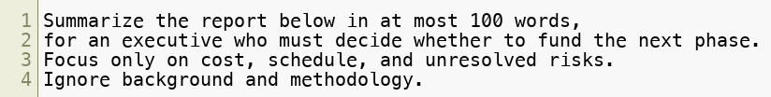
Pattern 1 — Summarize
The obvious one, done badly by almost everyone.
Weak: "Summarize this report."
Strong:
The lesson: a summary is not a shrinking operation. It is a selection operation, and only you know what to select for. Summarize for a purpose and an audience.
Copyright © 2026 by Elephant Scale, All Rights Reserved
Notes:
Demonstrate the same document summarized twice for two different audiences. The outputs share almost no sentences. That contrast makes the point better than any explanation.

Slide 19
Pattern 1 — Summarize: Where It Pays
A 90-page report → a one-page decision brief
A week of meeting transcripts → what actually got decided, and by whom
Fifty status updates → the three things that are actually slipping
A regulation or standard → what changes for our department specifically
Ask for what you would have asked a smart analyst for. That's the prompt.
Copyright © 2026 by Elephant Scale, All Rights Reserved

Slide 20
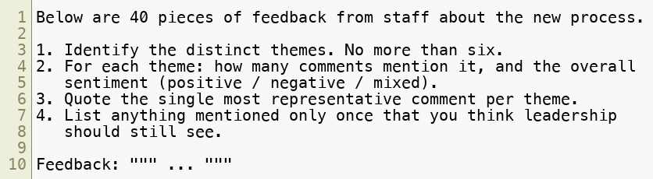
Pattern 2 — Infer
Pulling structure out of unstructured text.
Copyright © 2026 by Elephant Scale, All Rights Reserved
Notes:
Point 4 is the one leaders love — the signal that would be lost in a normal aggregation.

Slide 21
Pattern 2 — Infer: Where It Pays
Free-text survey responses → themes, without three weeks of coding them by hand
Incident and defect reports → recurring causes across years of records
Customer or stakeholder correspondence → what people are actually asking for
Long email threads → who committed to what
Caution: this pattern produces numbers ("14 comments mention scheduling"). Those numbers feel like data. Spot-check them. This is exactly where confident wrongness does the most damage — Module 3.
Copyright © 2026 by Elephant Scale, All Rights Reserved
Notes:
Make the caution stick. Counting is the thing language models are worst at, and it is the output leaders are most tempted to put on a slide.

Slide 22

Pattern 3 — Transform
Same content, different form.
Technical writing → plain language for a general audience
A specification → a checklist
Notes → a formal memo
One language → another
Prose → a table; a table → prose
An angry draft → a professional one
Copyright © 2026 by Elephant Scale, All Rights Reserved
Notes:
The angry-email transform gets the biggest laugh and is genuinely one of the most-used patterns in real leadership work.

Slide 23
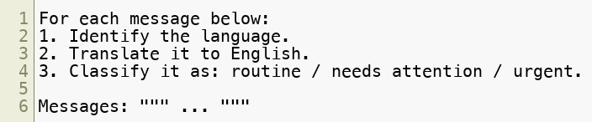
Pattern 3 — Transform: The Universal Translator
A classic demonstration: messages arrive in many languages, from many places.
One prompt replaces a translation service and a triage step.
Copyright © 2026 by Elephant Scale, All Rights Reserved
Notes:
This example comes from our developer course and lands equally well here. If the organization has any international footprint, ask where this would apply.

Slide 24
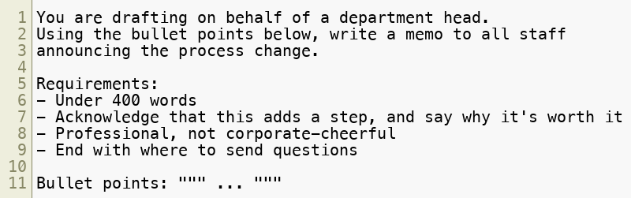
Pattern 4 — Expand
A little input, a lot of correctly-shaped output.
Copyright © 2026 by Elephant Scale, All Rights Reserved

Slide 25
Pattern 4 — Expand: The Honest Caveat
Expansion is where AI is most impressive and least trustworthy.
It will happily generate:
A confident recommendation your data doesn't support
A policy justification you never made
A citation to a document that does not exist
Rule: expansion is a drafting tool. The words are the model's; the claims must be yours.
If you would be embarrassed to be quoted saying it, read it before you send it.
Copyright © 2026 by Elephant Scale, All Rights Reserved
Notes:
This is the bridge into Module 3. End Module 2 having built genuine enthusiasm, then immediately install the discipline.

Slide 26
Two More Things That Matter
Principle 1 — Clear and Specific
Principle 2 — Give It Time to Think
The Four Workhorse Patterns
Two More Things That Matter
Exercise 2 — The Prompting Workshop
Copyright © 2026 by Elephant Scale, All Rights Reserved

Slide 27
The Conversation Is Part of the Prompt
Chat tools remember the conversation so far. That's a feature and a trap.
Use it: refine across turns. "Shorter." "More technical." "Now as a table." You don't need to restate everything.
Watch it: a long thread accumulates your earlier corrections, bad turns, and assumptions. When answers get strange, start a fresh conversation.
Reuse it: when a prompt works well, save it. That's the start of your prompt library — and of organizational standardization.
Copyright © 2026 by Elephant Scale, All Rights Reserved
Notes:
"Start a new chat" solves an astonishing share of "the AI got worse" complaints.

Slide 28
Where Your Data Goes
Before you paste anything, know which of these you are using:
A consumer account — your text goes to a third party under consumer terms
An enterprise tenant — your organization controls the terms, retention, and in many cases the data never leaves your boundary
A self-hosted model — it never leaves at all
The rule for this classroom, and probably for your Monday: nothing sensitive, nothing controlled, nothing you'd have to report. Use public or synthetic material for practice.
We come back to this properly in Module 7.
Copyright © 2026 by Elephant Scale, All Rights Reserved
Notes:
State this firmly. Participants will be tempted to paste a real internal document into the exercise because it's more interesting. Have sample documents ready so they don't need to.

Slide 29
Exercise 2 — The Prompting Workshop
Principle 1 — Clear and Specific
Principle 2 — Give It Time to Think
The Four Workhorse Patterns
Two More Things That Matter
Exercise 2 — The Prompting Workshop
Copyright © 2026 by Elephant Scale, All Rights Reserved

Slide 30
Exercise 2 — The Prompting Workshop
Format: pairs, 60 minutes. One working AI account per pair is enough.
Working from the supplied (non-sensitive) sample document set, run the four patterns:
Summarize — the same report, for two different audiences. Compare.
Infer — themes and sentiment from the feedback set. Then spot-check the counts.
Transform — the technical section into plain language, and the notes into a table.
Expand — the bullets into a memo. Then mark every sentence you couldn't sign.
Then the head-to-head: naive prompt vs. engineered prompt , same task. Keep both.
Copyright © 2026 by Elephant Scale, All Rights Reserved
Notes:
Materials, sample documents, and the facilitator script are in exercises/02-prompting-workshop.md . Pair participants so every pair has at least one working account; there is a paper-based variant for pairs with no access.

Slide 31
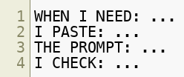
Exercise 2 — Your Deliverable
Each participant leaves with a personal prompt library : three to five prompts, written down, that you will actually use next week.
Format for each one:
That last line — what you verify before trusting it — is not optional.
Copyright © 2026 by Elephant Scale, All Rights Reserved
Notes:
The "I CHECK" line is the whole pedagogical point. It converts an enthusiasm exercise into a discipline exercise, and it sets up Module 3.

Slide 32
Exercise 2 — Debrief
Which pattern surprised you most?
Where did the engineered prompt beat the naive one by the widest margin?
Did anyone catch the model getting something confidently wrong?
What did you write on your "I CHECK" lines?
Copyright © 2026 by Elephant Scale, All Rights Reserved
Notes:
Someone always catches an error in the inference counts. Let the room find it rather than pointing it out — it lands ten times harder.

Slide 33
Module 2 — Takeaways
Prompt quality beats model choice, and it is free
Two principles: be clear and specific , and give it time to think
Four patterns cover most business work: summarize, infer, transform, expand
Your first prompt is a draft — iterate against specific defects
Summarize for a purpose ; verify anything that looks like a number
The words can be the model's. The claims are yours.
Copyright © 2026 by Elephant Scale, All Rights Reserved

