Slide 1
Module 7 — High-Volume Fan-Out Best Practices
Copyright © 2026 by Elephant Scale, All Rights Reserved

Slide 2
Module 7 Agenda
The fan-out problem: 10M msg/sec, 10 overlapping consumers
Topic design strategies: single topic vs pre-filtered sub-topics
Partition key design and consumer group topology
Efficient filtering: headers, schemas, Kafka Streams branching, Flink SQL
Benchmark: duplication vs filtering
Broker and topic configuration for high volume
KEDA autoscaling based on consumer lag
Copyright © 2026 by Elephant Scale, All Rights Reserved

Slide 3
The Fan-Out Problem
Scenario:
A dataset arrives at 10 million messages per second
10 consumer teams each need a different but overlapping subset
Goal: minimize storage and network duplication on Kafka
Goal: minimize consumer CPU overhead for filtering unwanted messages
Copyright © 2026 by Elephant Scale, All Rights Reserved

Slide 4

Fan-Out, Intuitively — The Mailroom
One firehose of mail; ten desks, each wanting a different slice.
Photocopy the whole paper for every desk — dead simple, but 10× the paper and the copier runs hot. (= duplicate the topic per consumer.)
Sort and tag at the mailroom; each desk grabs only its pile — a little upfront work, huge savings downstream. (= header / stream filtering.)
The whole module is one question: where do you pay — storage (copies) or CPU
Copyright © 2026 by Elephant Scale, All Rights Reserved

Slide 5
Topic Design Options
Design | Storage | Network | Consumer CPU | Ops Complexity
1 broad topic + client-side filter | Low | Low | High | Low
10 pre-filtered topics | 10× | 10× producer writes | Low | High (topic sprawl)
Streams-branched derived topics | Moderate | Moderate | Low | Moderate
1 topic + header-based skip | Low | Low | Low–Moderate | Low
Rule of thumb: topic proliferation trades CPU for storage. At 10M msg/sec, every deserialization matters.
Copyright © 2026 by Elephant Scale, All Rights Reserved

Slide 6
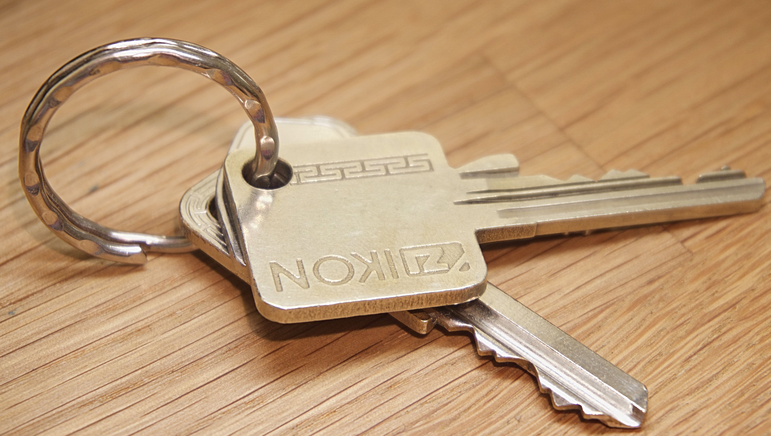
Partition Key Design
Partition by the field that co-locates related data for consumers:
Anti-pattern: random or null keys → even distribution but no co-location, no filtering leverage.
Copyright © 2026 by Elephant Scale, All Rights Reserved

Slide 7
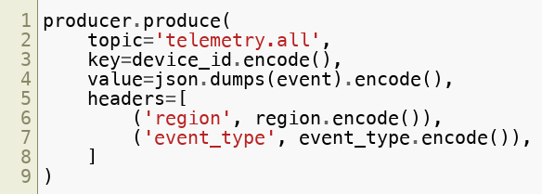
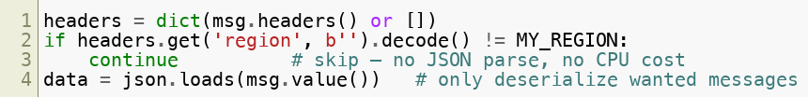
Header-Based Filtering
Producers tag messages with routing metadata:
Consumers skip by header — no deserialization for unwanted records:
Copyright © 2026 by Elephant Scale, All Rights Reserved

Slide 8
Header Filtering: CPU Savings
At 10M msg/sec with 33% of messages wanted per consumer:
Approach | Deserialization calls/sec | Relative CPU
Full deserialize all | 10,000,000 | 1× (baseline)
Header skip, deserialize wanted | 3,300,000 | ~0.33×
Copyright © 2026 by Elephant Scale, All Rights Reserved

Slide 9
What 3× CPU Actually Saves
The header-skip win isn't abstract — price it out at 10M msg/sec, 10 consumer teams :
Full-deserialize in every consumer: say each needs ~20 cores to keep up → ~200 cores .
Header-skip (33% wanted): ~7 cores each → ~70 cores .
~130 cores saved, continuously — on cloud compute, a five- to six-figure annual line item for a one-line header check.
(Core counts are illustrative — the point is the ratio, not the exact number.)
Copyright © 2026 by Elephant Scale, All Rights Reserved

Slide 10
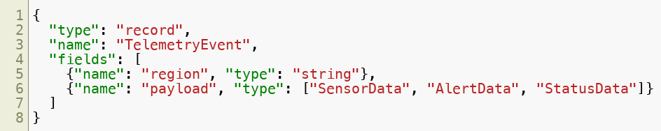
Schema-Based Filtering
Using Avro union types, consumers can deserialize only the outer envelope first:
Consumer reads region from outer record → decides whether to parse payload .
Stronger guarantees than headers (schema-enforced) but higher coupling to Schema Registry.
Copyright © 2026 by Elephant Scale, All Rights Reserved

Slide 11
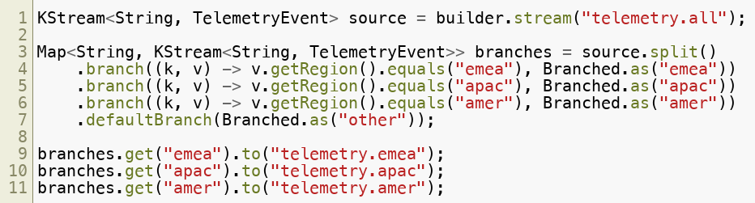

Kafka Streams Branching
Server-side pre-filtering — removes CPU cost from all consumers:
Copyright © 2026 by Elephant Scale, All Rights Reserved

Slide 12
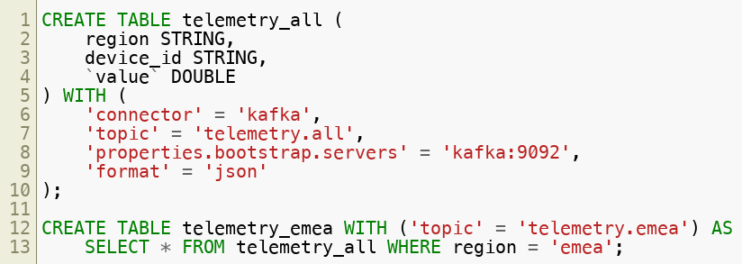
Flink SQL — Declarative Filtering
Declarative SQL alternative to Streams branching (Flink SQL is the 2026 direction; ksqlDB has been de-emphasized by Confluent and Flink is in this course's lab env):
Continuous queries keep derived topics updated as new events arrive.
Copyright © 2026 by Elephant Scale, All Rights Reserved

Slide 13
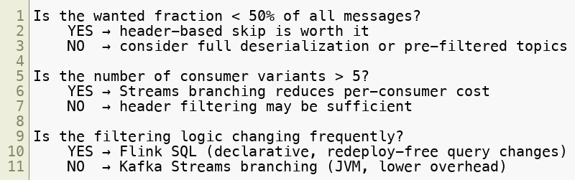
Filtering Strategy Decision Tree
Copyright © 2026 by Elephant Scale, All Rights Reserved

Slide 14
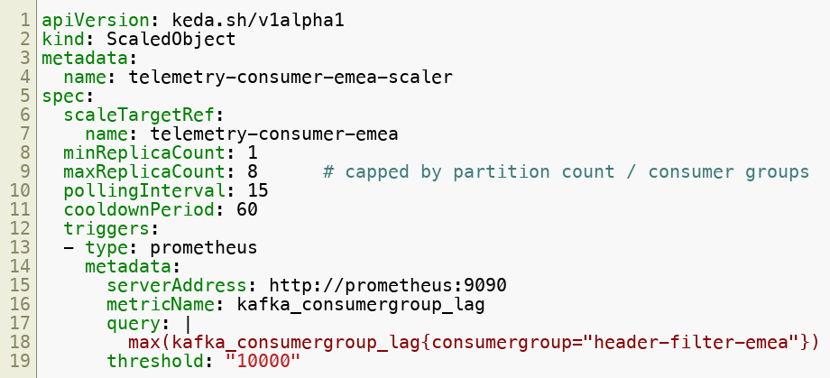
KEDA Autoscaler: Scale on Lag
Scale up when lag > 10,000. Scale down after cooldownPeriod seconds of low lag.
Copyright © 2026 by Elephant Scale, All Rights Reserved

Slide 15
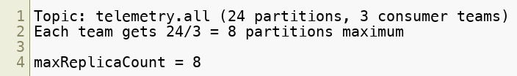
KEDA: Why Cap maxReplicaCount?
Adding more consumers than partitions wastes resources — idle replicas with no partitions assigned.
Copyright © 2026 by Elephant Scale, All Rights Reserved

Slide 16

Benchmark: Duplication vs Filtering
At 50,000 messages with 33% wanted (emea):
Break-even point: when wanted fraction > ~80%, full deserialization may be cheaper (no header overhead).
Strategy | Time (s) | Throughput (msg/s) | Note
Full deserialize all 50K | ~baseline | — | All messages deserialized
Header-skip, deserialize emea only | ~0.33× time | ~3× faster | Skip at metadata level
Copyright © 2026 by Elephant Scale, All Rights Reserved

Slide 17
Broker & Topic Configuration for High Volume
At fan-out scale, configuration is the difference between a cluster that keeps up and one that falls over. The knobs that matter most:
Partitions — the unit of parallelism; size for peak consumer throughput, not today's load. More partitions = more parallel consumers, but also more open files and longer rebalances.
Replication factor = 3 with
min.insync.replicas=2 — the standard durable-yet-available setting for production topics.
retention.ms
— cap what you keep; high-volume topics fill disk fast, so bound retention deliberately.
segment.bytes
— larger segments mean fewer files and less overhead at high throughput.
compression.type=producer
at the topic — the broker stores exactly what the producer sent; use lz4 (low CPU) or zstd (best ratio) for big network and disk savings.
Copyright © 2026 by Elephant Scale, All Rights Reserved
Notes:
This is the "best practices" payoff of the whole module. The one number that matters most is partition count — size it for peak, because repartitioning a live high-volume topic is genuinely painful. Give them the formula out loud: target throughput ÷ per-consumer throughput, rounded up for headroom. Compression is the cheapest win on the slide — lz4 or zstd cut network and disk dramatically for near-zero effort, so it's the first knob I'd turn.

Slide 18
Tuning Throughput vs Durability
Every high-volume setting is a point on the throughput ↔ durability line — choose it deliberately:
Producer batching — raise batch.size and set linger.ms to 5–20 ms: trades a little latency for much higher throughput (fewer, larger requests).
acks
— acks=all (durable, slower) vs acks=1 (faster, risks loss on leader failure). Fan-out ingestion often uses acks=1 ; systems of record use acks=all .
Compression — zstd for best ratio, lz4 for lowest CPU; both cut broker I/O dramatically at volume.
Broker threads — scale num.network.threads and num.io.threads with cores and connection count.
Consumer fetch — larger fetch.min.bytes / fetch.max.wait.ms let consumers pull bigger batches, raising throughput per poll.
Copyright © 2026 by Elephant Scale, All Rights Reserved
Notes:
Frame every knob as a point on a line, not a right answer. The teaching move: set the durability floor FIRST — acks and min.insync.replicas — based on whether this topic is ingestion or a system of record, THEN tune batching and compression for speed underneath it. batch.size plus linger.ms is the highest-leverage producer change: a few milliseconds of latency buys big throughput. Tie it back to fan-out — ingestion often runs acks=1, the downstream record store runs acks=all.

Slide 19
Module 7 Summary
Single broad topic + header filtering is the most storage-efficient fan-out design
Header-based skip avoids deserialization cost for unwanted messages — 3× CPU savings at 33% selectivity
Schema-based filtering provides stronger guarantees but tighter Schema Registry coupling
Kafka Streams branching moves filtering to the server side — best for static, high-volume cases
Flink SQL provides declarative filtering without redeployment (the modern successor to ksqlDB)
KEDA autoscaling ties consumer replica count to Prometheus lag metric
Cap maxReplicaCount to partition count per consumer group
High-volume tuning: size partitions for peak, compress (lz4/zstd), batch producers; set the durability floor ( acks , min.insync.replicas ) first, then tune throughput
Copyright © 2026 by Elephant Scale, All Rights Reserved

Slide 20
Lab Preview — Lab 7
Design and Validate a Fan-Out Strategy
You will:
Create a broad topic and produce events with routing headers
Implement header-based filtering across 3 consumer groups
Benchmark full deserialization vs header-skip
Review Kafka Streams branching pseudocode
Configure and test a KEDA ScaledObject tied to consumer lag
Environment: Docker Compose (3-broker Kafka, Prometheus, KEDA optional) Time: 75–90 minutes
Copyright © 2026 by Elephant Scale, All Rights Reserved

