Slide 1
Module 6 — Modern Kafka & Streaming Trends
Copyright © 2026 by Elephant Scale, All Rights Reserved

Slide 2

Module 6 Agenda
Where Kafka is going
Multi-cluster federation and disaster recovery
Kafka at the edge and IoT architectures
AI-driven event processing and streaming inference
Kafka queues and work-distribution patterns
Modernizing legacy event-processing systems
Serverless Kafka: MSK Serverless and Confluent Cloud
Upgrading Kafka in the KRaft era: safe, fast rolling upgrades
Blue-green cluster migration for changes too big to do in place
Stream processing with Apache Flink and Flink SQL over Kafka
Future directions in event-driven architecture
Copyright © 2026 by Elephant Scale, All Rights Reserved

Slide 3
Where Kafka Is Going
Kafka has evolved from a messaging system into a universal data streaming platform .
Current trends:
Serverless — managed, elastic, consumption-based pricing
Diskless / object-store Kafka — brokers backed directly by S3-class storage (KIP-1150 "diskless topics"; WarpStream, AutoMQ, Confluent Freight) — cheaper, near-infinite retention, no local disks to manage
Edge streaming — Kafka on constrained devices and edge gateways
AI integration — streaming features for ML and real-time inference
Native queue semantics — Share Groups (KIP-932, Kafka 4) make Kafka a work queue, not just a log
Federation — connected multi-cluster topologies across regions and clouds
Copyright © 2026 by Elephant Scale, All Rights Reserved

Slide 4
Trends: Ready Now vs Emerging vs Horizon
A trends module is only useful if you know what to bet on today vs what to just watch:
Production-ready now — MirrorMaker 2 federation · serverless (MSK Serverless, Confluent Cloud) · Share Groups (KIP-932, early access but usable) · Kafka → Iceberg sinks.
Emerging (pilot, not core yet) — diskless / object-store Kafka (KIP-1150; WarpStream, AutoMQ) · Flink-native lakehouse (Tableflow) · edge Kafka (Redpanda / Strimzi).
Horizon (watch, don't build on) — real-time AI agents · LLMs embedded in stream processors · decentralized data mesh.
Copyright © 2026 by Elephant Scale, All Rights Reserved

Slide 5
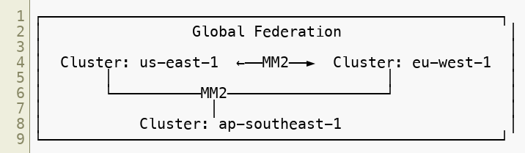
Multi-Cluster Federation
Use cases: data locality (GDPR, latency), blast radius containment, multi-cloud strategy, organizational boundaries.
Copyright © 2026 by Elephant Scale, All Rights Reserved

Slide 6
Federation Patterns
Hub and spoke:
Selective replication:
Active-active DR:
Copyright © 2026 by Elephant Scale, All Rights Reserved

Slide 7
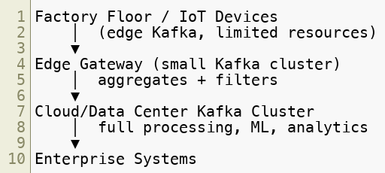
Kafka at the Edge
Implementations:
Strimzi — Kafka on Kubernetes, edge clusters
Redpanda — Kafka-compatible, single-binary, low resource footprint
Copyright © 2026 by Elephant Scale, All Rights Reserved

Slide 8
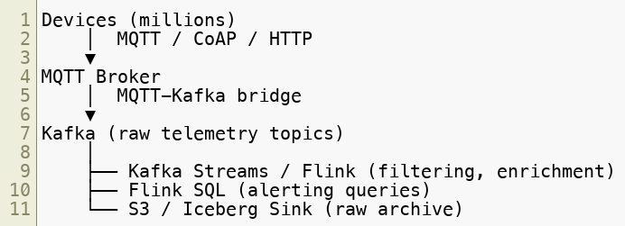
IoT Streaming Architecture
Key design considerations: partition by device_id , idempotent producers, mTLS per device, edge filtering before forwarding.
Copyright © 2026 by Elephant Scale, All Rights Reserved

Slide 9
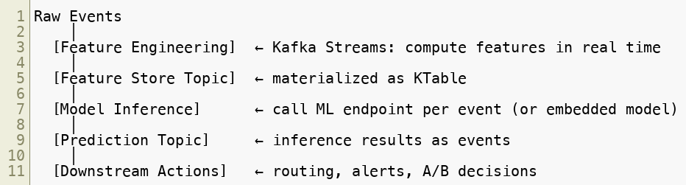
AI-Driven Event Processing
Copyright © 2026 by Elephant Scale, All Rights Reserved

Slide 10

Streaming ML Inference: Two Patterns
Pattern 1: External model server per event:
Pattern 2: Embedded model in stream processor:
Pattern 2: lower latency, no network hop. Pattern 1: model updates without redeploying the stream application.
Copyright © 2026 by Elephant Scale, All Rights Reserved

Slide 11
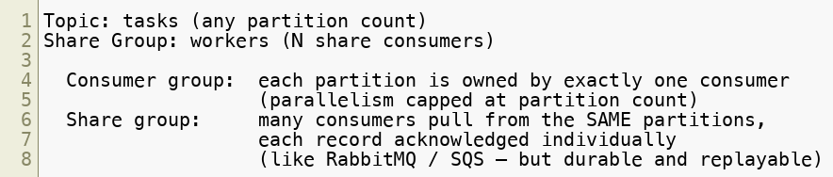
Kafka Queues — Share Groups (KIP-932)
Native queue semantics arrived in Kafka 4.0 as Share Groups (early access):
Consumer count is decoupled from partition count — scale workers past partitions
Per-message ack/redelivery; tooling: kafka-console-share-consumer.sh , kafka-share-groups.sh
Useful for: task queues, job distribution, worker pools — while keeping Kafka's durability and replay
Copyright © 2026 by Elephant Scale, All Rights Reserved

Slide 12
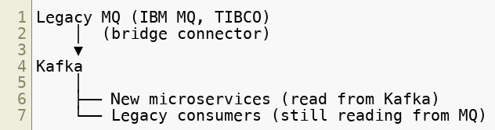
Modernizing Legacy Event Processing
Strangler fig pattern: gradually replace legacy consumers. New services read from Kafka. Legacy producers keep sending to MQ. Bridge replicates to Kafka. No big-bang migration required.
Copyright © 2026 by Elephant Scale, All Rights Reserved

Slide 13
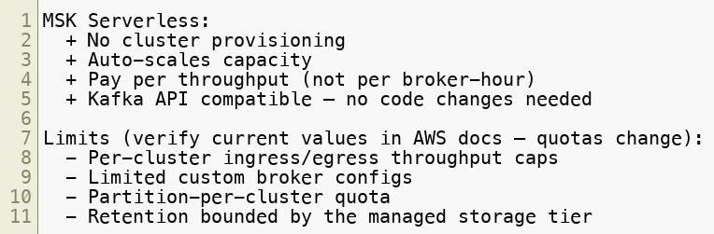
Serverless Kafka — Amazon MSK Serverless
Best for: variable workloads, dev/test, new projects.
Copyright © 2026 by Elephant Scale, All Rights Reserved

Slide 14
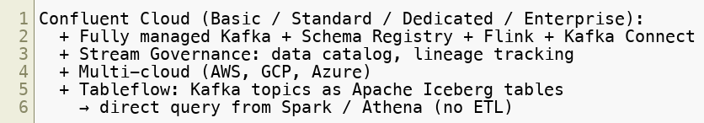
Serverless Kafka — Confluent Cloud
Consumption-based pricing on Basic/Standard tiers.
Copyright © 2026 by Elephant Scale, All Rights Reserved

Slide 15

Serverless Readiness Checklist
Before migrating to a managed/serverless offering:
☐ No broker-specific client assumptions
☐ Retries and idempotence enabled
☐ Topic and ACL provisioning scripted (not manual)
☐ Metrics exported externally (not broker shell scraping)
☐ Schema Registry usage standardized
☐ Cost model understood (traffic + retention pricing)
☐ No reliance on ZooKeeper or self-managed KRaft config
Copyright © 2026 by Elephant Scale, All Rights Reserved

Slide 16
The Future of Event-Driven Architecture
Kafka + Iceberg — streaming-native data lakehouse (no ETL)
Real-time AI agents — event-triggered autonomous agents responding to streams
Unified batch/streaming — Apache Flink Table API, Spark Streaming convergence
AI-native pipelines — embedding LLMs in stream processors
Decentralized data mesh — Kafka as the event backbone of data mesh
Copyright © 2026 by Elephant Scale, All Rights Reserved

Slide 17
Upgrading Kafka in the KRaft Era
Upgrades are where availability promises are tested. KRaft (Kafka 4, ZooKeeper-free) simplified the upgrade story — one system to upgrade, not two — but the discipline is unchanged: never lose the controller quorum, never drop a partition below
What KRaft changed:
No ZooKeeper — there is no separate ensemble to upgrade first; brokers and controllers are the whole system.
Feature flags via — cluster capabilities are gated by a metadata level you raise after every node runs the new binary (the modern replacement for inter.broker.protocol.version , managed with kafka-features.sh ).
Controllers roll like brokers — the KRaft controller quorum upgrades one node at a time, always preserving the majority.
Copyright © 2026 by Elephant Scale, All Rights Reserved
Notes:
The point to land: KRaft made upgrades simpler — one system to upgrade, not two — but the safety rule is unchanged. Frame an upgrade as just a controlled series of broker restarts: everything they learned about ISR and min.insync.replicas in Module 5 is exactly what keeps it zero-downtime. Quick engagement — ask the room: who's run a rolling upgrade, and what went wrong?

Slide 18
Rolling Upgrade — The Safe Procedure
Upgrade one node at a time , and only advance when the cluster is fully healthy again:
Roll the controllers first , one at a time — keep the quorum majority online throughout.
For each broker : stop it, install the new binary, restart, then wait for and the ISR to fully re-expand before touching the next node.
Once every node runs the new version, raise ( kafka-features.sh upgrade ) to enable the new features — never before.
Run a preferred-leader election afterward to rebalance leadership evenly across brokers.
Copyright © 2026 by Elephant Scale, All Rights Reserved
Notes:
Walk the four steps slowly — this is the procedure they'll actually run in production. Emphasize step 2's wait-for-URP-zero: that discipline is what separates a clean upgrade from an outage. The classic failure is impatience — restarting the next broker before the previous one's replicas caught up, taking two replicas of the same partition down together. And metadata.version last, never before: enabling a feature the still-old binaries don't understand will break them.

Slide 19
Optimizing Upgrade Time & Availability
Faster and safer are not in tension — the same design gives you both:
min.insync.replicas=2
— a single broker down (the one being upgraded) still accepts writes, so the roll never blocks producers.
RF ≥ 3 — tolerate the upgrading broker being offline with room to spare.
Watch three signals through the roll: URP (must return to 0 before the next node), consumer lag (should stay flat), request latency (brief blips are fine).
Parallelize safely — brokers in different racks/AZs can roll a bit faster, but never two replicas of the same partition at once.
Automate it — Strimzi (Kubernetes) and Cruise Control run the roll-and-wait loop for you, removing human error and cutting total upgrade time.
Copyright © 2026 by Elephant Scale, All Rights Reserved
Notes:
The reframe to sell: fast and safe are not opposites. With RF=3 and min.insync.replicas=2 you roll under full load — no maintenance window, no draining traffic. That IS the optimization. The three signals (URP, lag, latency) are the go/no-go gate between nodes. Close on automation: nobody should hand-roll a 30-broker cluster — Strimzi and Cruise Control run the wait-and-watch loop for you and cut total upgrade time.

Slide 20
Blue-Green Cluster Migration
Some changes are too big or too risky to do in place. Blue-green migration stands up an entirely new cluster beside the live one, moves everything over, and flips the clients — with the old cluster kept as instant rollback.
Blue = current production cluster (live). Green = new cluster (target version/config), initially idle.
A rolling upgrade changes the cluster you have, one broker at a time; blue-green builds a new cluster and migrates to it.
Use it for what rolling can't safely cover: major version jumps , the historical ZooKeeper → KRaft move, cloud / region / provider migration , or moving to a managed / serverless offering.
Copyright © 2026 by Elephant Scale, All Rights Reserved
Notes:
Frame it as the counterpart to the rolling upgrade they just saw. Rolling = in-place, cheap, but limited. Blue-green = a whole new cluster, more expensive, but the safe path for a migration too big to risk in place — and you always have blue to fall back to. The classic trigger was ZooKeeper-to-KRaft; today it's often on-prem to cloud or a move to a managed service.

Slide 21
Blue-Green — Mechanics & Challenges
Migrating means replicating the data and translating the consumer offsets, so nobody reprocesses or skips on cutover:
Replicate blue → green with MirrorMaker 2 (open source) or Cluster Linking (Confluent): topics, data, ACLs, and consumer-group offsets, kept continuously in sync.
Offset translation is the hard part — offsets differ across clusters. MM2 uses checkpoints to translate them; Cluster Linking preserves offsets byte-for-byte , making cutover much cleaner.
Cut over in order: consumers first (they catch up from mirrored data), then producers — or a coordinated flip. Keep blue running as fallback.
Watch for: duplicates / reordering in the cutover window (→ idempotent consumers), and the cost of running two full clusters at once.
Copyright © 2026 by Elephant Scale, All Rights Reserved
Notes:
The single hardest thing is consumer-offset translation — "resume at offset 12345" is meaningless on a different cluster. MM2 approximates it with checkpoints; Cluster Linking makes it exact. Emphasize cutover order (consumers first), the fallback-to-blue safety net, and that you pay for two clusters during the migration. Note it's the same cross-cluster replication tech as the federation/DR slide, reused for migration.

Slide 22
Stream Processing with Apache Flink
Kafka moves and stores events; it does not process them. Apache Flink is the compute layer — a distributed, true streaming engine that processes each event as it arrives.
Stream-first: record-at-a-time, millisecond latency; batch is just a bounded stream.
Stateful & event-time: first-class keyed state, watermarks for out-of-order data, windowing, exactly-once via distributed checkpoints.
Flink SQL: continuous queries (filter, join, window, aggregate) over Kafka topics in plain SQL — no application code.
The modern successor to ksqlDB — Confluent is investing in Flink (Confluent Cloud for Flink, Tableflow) and de-emphasizing ksqlDB.
Copyright © 2026 by Elephant Scale, All Rights Reserved
Notes:
The one-liner: Kafka transports and stores, Flink computes. Flink is stream-first — batch is a bounded stream, the opposite of Spark. Emphasize Flink SQL: continuous queries over Kafka topics with no code, which is why Confluent pushes it as the ksqlDB replacement. This connects directly to the filtering options in Module 7.

Slide 23
Flink vs Spark vs Kafka Streams
Three ways to process Kafka data — pick by latency, state, and how the logic is deployed:
Apache Flink — true streaming, lowest latency, rich state; a cluster you run. Best for real-time, stateful, event-driven pipelines and Flink SQL.
Apache Spark — batch-first ; its streaming is micro-batch (small batches every few hundred ms to seconds). Huge ecosystem plus ML. Best for large-scale batch ETL and where seconds of latency are fine.
Kafka Streams — a library , not a cluster: you embed it in a JVM service. Lightest weight; best when the logic is static and lives inside one application (the Module 7 "Streams branching" option).
Copyright © 2026 by Elephant Scale, All Rights Reserved
Notes:
The key contrast: Flink is stream-first (batch is a bounded stream); Spark is batch-first (streaming is micro-batches). Kafka Streams is the odd one out — a library, not a cluster, so no separate infra. If asked "doesn't Spark stream now?" — it has an experimental continuous mode, but micro-batch is the norm. Tie Kafka Streams back to the M7 filtering slide.

Slide 24
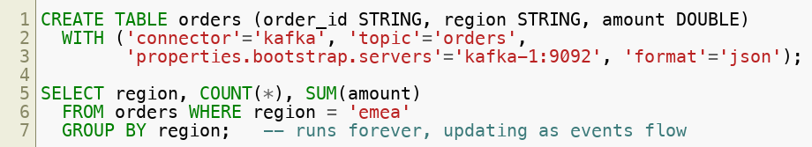
Flink SQL over Kafka — Continuous Queries
Flink SQL turns a Kafka topic into a table you query continuously — the query never ends; it emits results as new events arrive:
Declarative filtering — change the WHERE clause, no redeploy (the Module 7 "logic changes often" branch).
Windowed aggregations, joins, and enrichment — all in SQL, continuously.
Copyright © 2026 by Elephant Scale, All Rights Reserved
Notes:
Show that a Kafka topic becomes a Flink table via the kafka connector, and a SELECT runs forever, emitting updates as events arrive. The payoff is declarative — change the WHERE clause without redeploying code, exactly the "logic churns → Flink SQL" branch from Module 7's filtering decision tree. A good place to tie today's filtering discussion to a live, modern tool.

Slide 25
Module 6 Summary
Multi-cluster federation via MirrorMaker 2 supports global, multi-cloud topologies
Edge streaming: Kafka on Kubernetes (Strimzi) for IoT and factory use cases
AI integration: streaming feature engineering + online inference pipelines
Native queue semantics — Share Groups (KIP-932, Kafka 4) — enable Kafka as a traditional work queue, decoupled from partition count
Serverless Kafka (MSK Serverless, Confluent Cloud) eliminates infrastructure management
Modernizing legacy: strangler fig pattern with bridge connectors
KRaft-era upgrades roll one node at a time, waiting for URP=0; min.insync.replicas + acks=all keep it zero-downtime
Blue-green migration moves to a new cluster via MirrorMaker 2 / Cluster Linking with offset translation — the safe path for changes too big for an in-place upgrade
Apache Flink is the stream-processing compute layer for Kafka; Flink SQL runs continuous queries over topics — the modern successor to ksqlDB (Flink vs Spark = stream-first vs batch-first)
Future: Kafka + Iceberg, AI-native pipelines, data mesh
Copyright © 2026 by Elephant Scale, All Rights Reserved

Slide 26
What's Next
Module 7 — High-Volume Fan-Out Best Practices
Topic layout strategies for 10M msg/sec with 10 overlapping consumers
Header-based filtering
Kafka Streams branching
KEDA autoscaling tied to consumer lag
Copyright © 2026 by Elephant Scale, All Rights Reserved

Slide 27
Lab Preview — Lab 6
Review Emerging Architecture Patterns
You will:
Build a lightweight edge-to-core event pipeline with filtering
Implement a real-time feature enrichment stage
Integrate a mock inference service with Kafka events
Demonstrate queue-style work distribution
Assess a pipeline's serverless readiness
Environment: Docker Compose (Kafka, Python, Flask mock model) Time: 60 minutes
Copyright © 2026 by Elephant Scale, All Rights Reserved

