Slide 1
Module 1 — Modern Event-Driven Architecture with Kafka
Copyright © 2026 by Elephant Scale, All Rights Reserved

Slide 2
Module 1 Agenda
Why Kafka is the backbone of real-time systems
Modern event-driven technology stack
Data flow walkthrough
Event streams vs queue semantics
Integration with external systems
Enterprise streaming evolution
Copyright © 2026 by Elephant Scale, All Rights Reserved

Slide 3
Why Real-Time Matters
Modern enterprises need to act on data as it happens , not hours later.
Use cases that demand real-time streaming:
Fraud detection (milliseconds to block a transaction)
IoT sensor telemetry (millions of devices)
Observability pipelines (logs, metrics, traces)
Personalization engines (act while the user is still on the page)
Supply chain event tracking
Copyright © 2026 by Elephant Scale, All Rights Reserved

Slide 4
What Is Apache Kafka?
Kafka is a distributed event streaming platform .
Core capabilities:
Publish and subscribe to streams of events
Store events durably and reliably — including Tiered Storage (KIP-405, GA in Kafka 4), which offloads older segments to object storage for low-cost long-term retention
Process events as they occur
Key design goals:
High throughput (millions of events/sec)
Low latency (milliseconds)
Fault tolerance (replication)
Horizontal scalability
Copyright © 2026 by Elephant Scale, All Rights Reserved

Slide 5
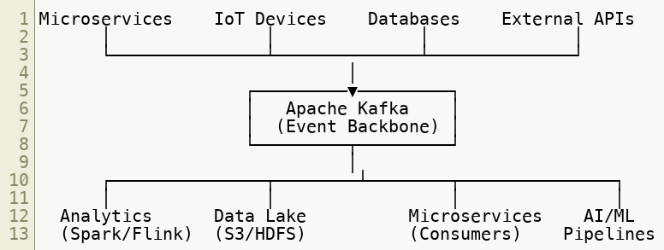
Kafka in the Enterprise Landscape
Kafka is the central nervous system of the modern data platform.
Copyright © 2026 by Elephant Scale, All Rights Reserved

Slide 6
The Modern Event-Driven Technology Stack
Kafka Core — Durable event log, topic management, replication
Kafka Connect — Data integration: source and sink connectors
Kafka Streams — Stream processing library (JVM)
ksqlDB — SQL interface for stream processing
Schema Registry — Schema management (Avro, Protobuf, JSON Schema)
Monitoring Layer — Prometheus, Grafana, Kafka UI, Cruise Control
Security Layer — TLS, SASL, ACLs, RBAC
Copyright © 2026 by Elephant Scale, All Rights Reserved

Slide 7
Kafka Core Concepts
Topic — a named, ordered, immutable log of events
Partition — a topic is split into partitions for parallelism
Offset — position of an event within a partition
Producer — writes events to topics
Consumer — reads events from topics
Consumer Group — a set of consumers that share the work of reading a topic
Broker — a Kafka server that stores and serves partitions
Copyright © 2026 by Elephant Scale, All Rights Reserved

Slide 8
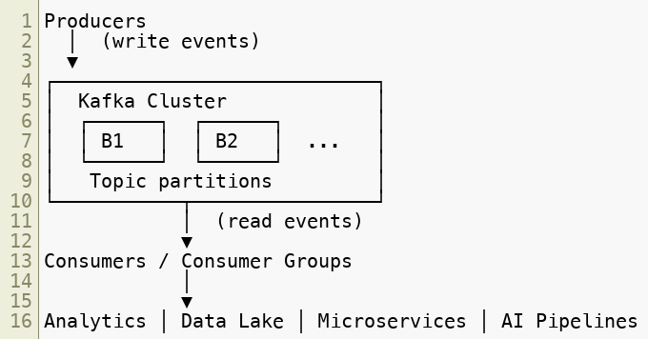
Data Flow Walkthrough
Copyright © 2026 by Elephant Scale, All Rights Reserved

Slide 9
Event Streams vs Queue Semantics
Message deletion — Queue: after consumption · Kafka: configurable retention
Multiple consumers — Queue: competing consumers · Kafka: each group reads independently
Replay — Queue: not possible · Kafka: yes, seek to any offset
Ordering — Queue: per-queue · Kafka: per-partition
Durability — Queue: varies · Kafka: configurable replication
Backpressure — Queue: built-in · Kafka: consumer controls its own pace
Native queues — Share Groups (KIP-932, Kafka 4):
Multiple consumers read from the same partitions cooperatively (no partition-to-consumer binding)
Per-message acknowledgement and redelivery — true queue semantics, not just competing consumer groups
Lets one platform serve both stream (replay, fan-out) and queue (work-distribution) workloads
Copyright © 2026 by Elephant Scale, All Rights Reserved

Slide 10
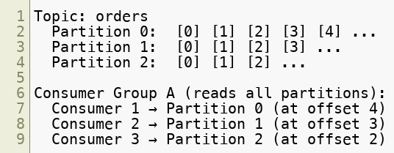
Topics, Partitions, and Offsets
Events within a partition are strictly ordered
Events across partitions are not globally ordered
Partition count = maximum consumer group parallelism
Copyright © 2026 by Elephant Scale, All Rights Reserved

Slide 11
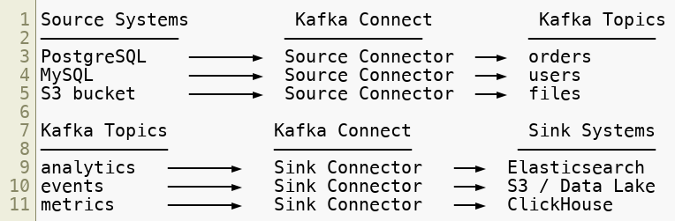
Kafka Connect Overview
Kafka Connect provides pre-built, scalable data pipelines .
700+ connectors available on Confluent Hub.
Copyright © 2026 by Elephant Scale, All Rights Reserved

Slide 12
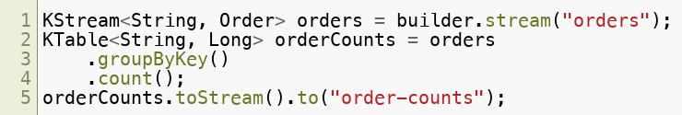
Kafka Streams Overview
Kafka Streams is a Java/Scala library for stream processing.
Key features:
No separate cluster required — runs inside your application
Exactly-once processing semantics
Stateful operations (joins, aggregations, windowing)
Interactive queries (expose state to other services)
Fault-tolerant state backed by changelog topics
Copyright © 2026 by Elephant Scale, All Rights Reserved

Slide 13
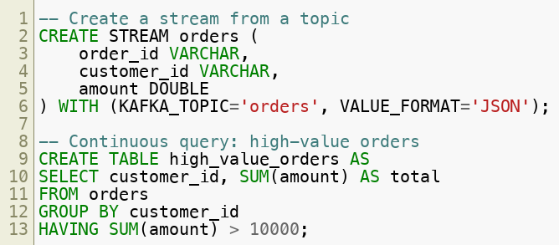
ksqlDB Overview
ksqlDB is a SQL engine for stream processing built on Kafka Streams.
Queries run continuously — results update as new events arrive.
Copyright © 2026 by Elephant Scale, All Rights Reserved

Slide 14
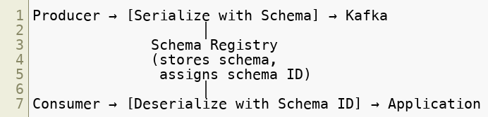
Schema Registry
Schema Registry manages and enforces event schemas.
Benefits:
Schema evolution without breaking consumers
Compatibility checks (BACKWARD, FORWARD, FULL)
Centralized schema governance
Foundation for data contracts — schema plus validation rules, metadata, and ownership agreed between producers and consumers (a key 2026 governance theme)
Copyright © 2026 by Elephant Scale, All Rights Reserved

Slide 15
Integration with External Systems
Kafka integrates with the full data ecosystem:
Apache Spark — Spark Structured Streaming reads from Kafka
Apache Flink — Native Kafka source/sink connectors
REST APIs — Kafka REST Proxy for HTTP-based producers/consumers
AI/ML Pipelines — Feature stores, model serving, inference logging
Cloud (AWS/GCP/Azure) — MSK, Confluent Cloud, Event Hubs
Copyright © 2026 by Elephant Scale, All Rights Reserved

Slide 16
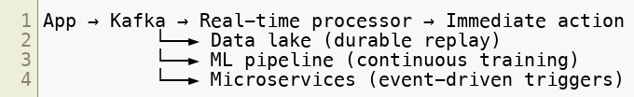
Streaming-First Application Design
Traditional design:
Streaming-first design:
Design principle: events are the source of truth , not the database.
Copyright © 2026 by Elephant Scale, All Rights Reserved

Slide 17
Enterprise Streaming Patterns
Event Sourcing — store all state changes as events, derive state by replaying
CQRS — separate read (query) and write (command) models via events
Saga Pattern — coordinate long-running distributed transactions via events
CDC (Change Data Capture) — stream database changes into Kafka
Fan-out — one event triggers multiple independent consumers
Copyright © 2026 by Elephant Scale, All Rights Reserved

Slide 18
Kafka at Scale — Real Numbers
Production deployments at scale:
LinkedIn — 7 trillion messages/day
Uber — 1 trillion messages/day
Netflix — Trillions of events/day
Cloudflare — Petabytes/day
Walmart — Billions of events during peak
Copyright © 2026 by Elephant Scale, All Rights Reserved

Slide 19
Module 1 Summary
Kafka is the distributed event streaming backbone for modern enterprises
Core abstractions: topics, partitions, offsets, producers, consumers
Event streams differ from queues in durability, replay, and multi-consumer support
The full stack: Kafka Core + Connect + Streams + ksqlDB + Schema Registry
Integrates with Spark, Flink, REST, AI/ML, and cloud-native systems
Streaming-first design treats events as the source of truth
Copyright © 2026 by Elephant Scale, All Rights Reserved

Slide 20
What's Next
Module 2 — Kafka Internals & Cluster Architecture
We go deep inside the broker:
Log segments, indexes, and compaction
KRaft — ZooKeeper-free Kafka
Producer and consumer internals
Exactly-once semantics
Copyright © 2026 by Elephant Scale, All Rights Reserved

Slide 21
Lab Preview — Lab 1
Explore Kafka Cluster Topology and Topic Configuration
You will:
Connect to a running KRaft cluster and inspect broker/quorum metadata
Create topics with different partition counts and replication factors
Examine partition assignment and leader distribution
Configure and observe retention policies and log compaction
Visualize topics, partitions, and lag in Kafka UI
Contrast consumer groups with Share Groups (KIP-932) — native queue semantics
Environment: KRaft Kafka 4 cluster (Docker Compose) + Kafka UI Time: 60–75 minutes
Copyright © 2026 by Elephant Scale, All Rights Reserved

