Slide 1
Module 2 — Kafka Internals & Cluster Architecture
Copyright © 2026 by Elephant Scale, All Rights Reserved

Slide 2
Module 2 Agenda
Broker internals: log segments, indexes, compaction
KRaft — ZooKeeper-free Kafka architecture
Controller quorum and metadata management
Partition assignment and leader election
In-Sync Replicas (ISR) and Eligible Leader Replicas (KIP-966)
Producer internals
Consumer internals and the KIP-848 rebalance protocol
Exactly-once semantics and transactions
Copyright © 2026 by Elephant Scale, All Rights Reserved

Slide 3
The Kafka Broker
A Kafka broker is a JVM process that:
Manages log segments on disk (one per partition)
Handles producer write requests
Handles consumer fetch requests
Participates in replication with other brokers
Maintains partition leadership
Each broker can handle hundreds of thousands of partitions and millions of messages per second.
Copyright © 2026 by Elephant Scale, All Rights Reserved

Slide 4
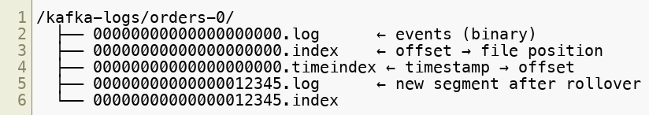
Log Segments — How Kafka Stores Data
Each partition is stored as a sequence of segment files on disk:
Key properties:
Log is append-only — writes are sequential (fast)
Segments are immutable once closed
Older segments are deleted or compacted based on retention policy
Copyright © 2026 by Elephant Scale, All Rights Reserved

Slide 5


Log Indexes
Kafka maintains two indexes per segment for fast lookups:
Offset index — maps logical offset to byte position in the .log file
Time index — maps timestamp to offset
These enable O(log n) seeks without scanning the full log.
Copyright © 2026 by Elephant Scale, All Rights Reserved

Slide 6
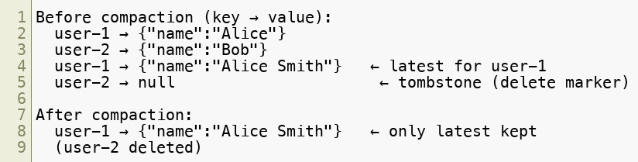
Log Compaction
For state-based topics (e.g., user profiles, configuration), Kafka supports compaction instead of deletion.
Compacted topics guarantee at least the last value per key is retained forever.
Copyright © 2026 by Elephant Scale, All Rights Reserved

Slide 7
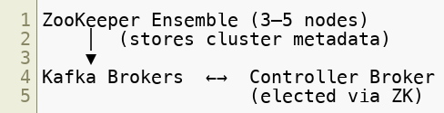
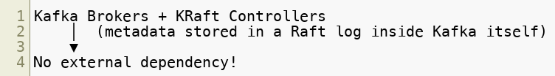
ZooKeeper → KRaft
Legacy (ZooKeeper mode — historical context only):
KRaft mode — the only mode in Kafka 4:
Copyright © 2026 by Elephant Scale, All Rights Reserved

Slide 8
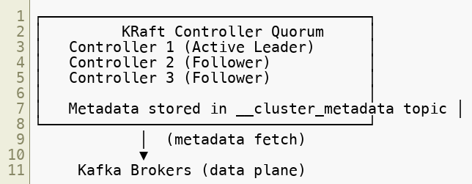
KRaft Architecture
In KRaft mode, Kafka manages its own metadata:
Benefits: faster failover, simpler operations, no ZooKeeper to manage.
Copyright © 2026 by Elephant Scale, All Rights Reserved

Slide 9
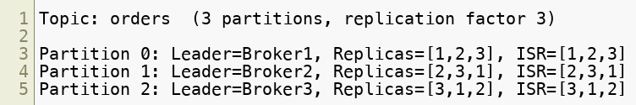
Partition Assignment and Leader Election
When a topic is created, Kafka assigns partitions to brokers:
Partition leader handles all reads and writes
Followers replicate from the leader
If the leader fails, a new leader is elected from the ISR
Copyright © 2026 by Elephant Scale, All Rights Reserved

Slide 10

In-Sync Replicas (ISR)
The ISR is the set of replicas that are fully caught up with the leader.
Key configs:
replica.lag.time.max.ms — max time a follower can be behind before removed from ISR
min.insync.replicas — minimum ISR size required to accept writes (e.g., 2)
acks=all — producer waits for all ISR members to acknowledge
New in Kafka 4 — Eligible Leader Replicas (KIP-966, preview):
The controller now also tracks replicas that left the ISR but are known to hold data up to the high watermark — the ELR
On a clean election with an empty ISR, a replica from the ELR can be elected without data loss — fixing the old "last replica standing" unclean-election dilemma
Separates the replication quorum (ISR, known to the leader) from the election quorum (ISR + ELR, known to the controller)
Enabled by default on new Kafka 4 clusters
Copyright © 2026 by Elephant Scale, All Rights Reserved

Slide 11
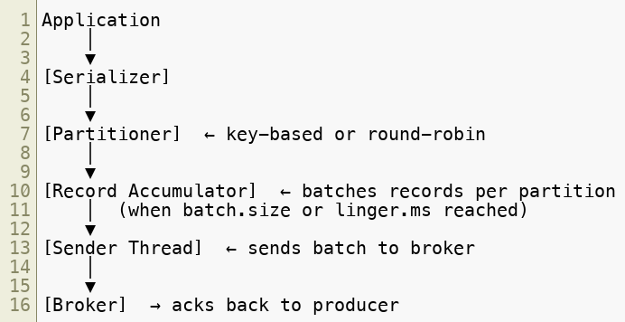
Producer Internals
The Kafka producer is a sophisticated client:
Copyright © 2026 by Elephant Scale, All Rights Reserved

Slide 12
Producer Configuration — Key Parameters
acks
— Durability guarantee (0, 1, all). Default: 1
batch.size
— Max bytes per batch. Default: 16384 (16 KB)
linger.ms
— Wait time to fill a batch. Default: 0 (no wait)
compression.type
— none, gzip, snappy, lz4, zstd. Default: none
max.in.flight.requests.per.connection
— Concurrent unacknowledged requests. Default: 5
retries
— Retry count on failure. Default: MAX_INT
enable.idempotence
— Exactly-once producer semantics. Default: true (Kafka 3.0+)
Copyright © 2026 by Elephant Scale, All Rights Reserved

Slide 13
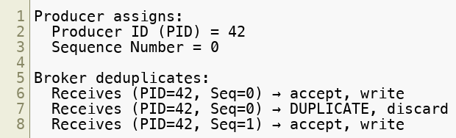
Idempotent Producer
With enable.idempotence=true :
Prevents duplicate writes on retry — essential for exactly-once.
Copyright © 2026 by Elephant Scale, All Rights Reserved

Slide 14
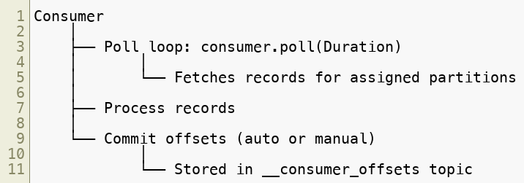
Consumer Internals
The Kafka consumer manages its own position (offset):
Key difference from traditional queues: the consumer controls its own pace .
Copyright © 2026 by Elephant Scale, All Rights Reserved

Slide 15
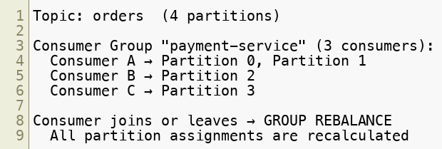
Consumer Group Coordination
Rebalance types:
Eager (stop-the-world) — all consumers stop, reassign
Cooperative (incremental, client-side) — only affected partitions move
New consumer protocol (KIP-848, GA in Kafka 4) — the broker coordinates the assignment instead of a client-side leader. Rebalances become incremental and far less disruptive; opt in per group via group.protocol=consumer
Copyright © 2026 by Elephant Scale, All Rights Reserved

Slide 16

Offset Management
Offsets are committed to the __consumer_offsets internal topic:
Key configs:
enable.auto.commit=true — auto-commit every auto.commit.interval.ms
enable.auto.commit=false — manual commitSync() or commitAsync()
Copyright © 2026 by Elephant Scale, All Rights Reserved

Slide 17
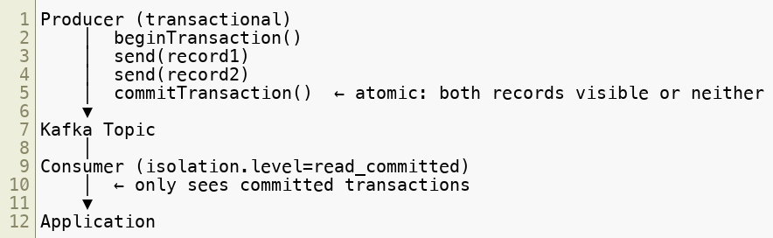
Exactly-Once Semantics (EOS)
Kafka supports end-to-end exactly-once for Kafka-to-Kafka pipelines:
Config: transactional.id=unique-producer-id , isolation.level=read_committed
Copyright © 2026 by Elephant Scale, All Rights Reserved

Slide 18
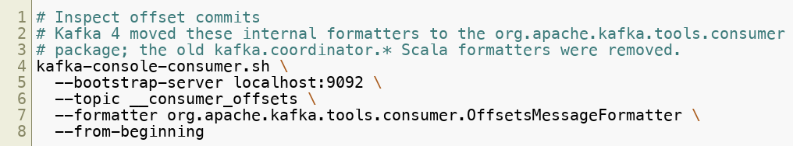
The
Internal topic that stores all committed consumer offsets:
Output format:
Copyright © 2026 by Elephant Scale, All Rights Reserved

Slide 19
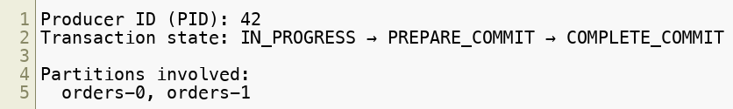
The
Internal topic that tracks transactional producer state:
Used by the broker to:
Deduplicate writes from idempotent producers
Ensure atomicity of transactions
Handle crash recovery
Copyright © 2026 by Elephant Scale, All Rights Reserved

Slide 20
Module 2 Summary
Kafka stores data as append-only log segments with offset and time indexes
Log compaction preserves the latest value per key indefinitely
KRaft replaces ZooKeeper entirely in Kafka 4 — metadata stored in a Kafka Raft log
ISR ensures only fully-caught-up replicas can become leaders; ELR (KIP-966) extends safe election to known-good replicas outside the ISR
Producer batching, compression, and idempotence are key to throughput and correctness
Consumer groups coordinate partition assignment via rebalance protocols — including the new broker-coordinated KIP-848 protocol
Exactly-once semantics require transactional producers + read_committed consumers, hardened by KIP-890 in Kafka 4
Copyright © 2026 by Elephant Scale, All Rights Reserved

Slide 21
What's Next
Module 3 — Kafka Operations & Observability
The metrics that matter: under-replicated partitions, consumer lag, ISR shrink rate
Monitoring stack: Prometheus, Grafana, Kafka UI
Operational procedures: retention, offset resets, security ops
Incident triage runbooks and alerting
Copyright © 2026 by Elephant Scale, All Rights Reserved

Slide 22
Lab Preview — Lab 2
Examine Internal Kafka Topics
You will:
Inspect __consumer_offsets and __transaction_state
Trace a transactional producer's commit sequence
Observe ISR changes during a simulated broker failure
Examine log segment files on disk and the KRaft metadata log
Environment: KRaft Kafka 4 cluster (Docker Compose) Time: ~60 minutes
Copyright © 2026 by Elephant Scale, All Rights Reserved

