Slide 1
Module 6 — Modern Kafka & Streaming Trends
Copyright © 2026 by Elephant Scale, All Rights Reserved

Slide 2
Module 6 Agenda
Where Kafka is going
Multi-cluster federation and disaster recovery
Kafka at the edge and IoT architectures
AI-driven event processing and streaming inference
Kafka queues and work-distribution patterns
Modernizing legacy event-processing systems
Serverless Kafka: MSK Serverless and Confluent Cloud
Future directions in event-driven architecture
Copyright © 2026 by Elephant Scale, All Rights Reserved

Slide 3
Where Kafka Is Going
Kafka has evolved from a messaging system into a universal data streaming platform .
Current trends:
Serverless — managed, elastic, consumption-based pricing
Diskless / object-store Kafka — brokers backed directly by S3-class storage (KIP-1150 "diskless topics"; WarpStream, AutoMQ, Confluent Freight) — cheaper, near-infinite retention, no local disks to manage
Edge streaming — Kafka on constrained devices and edge gateways
AI integration — streaming features for ML and real-time inference
Native queue semantics — Share Groups (KIP-932, Kafka 4) make Kafka a work queue, not just a log
Federation — connected multi-cluster topologies across regions and clouds
Copyright © 2026 by Elephant Scale, All Rights Reserved

Slide 4
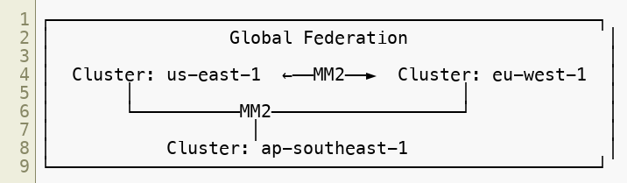
Multi-Cluster Federation
Use cases: data locality (GDPR, latency), blast radius containment, multi-cloud strategy, organizational boundaries.
Copyright © 2026 by Elephant Scale, All Rights Reserved

Slide 5
Federation Patterns
Hub and spoke:
Selective replication:
Active-active DR:
Copyright © 2026 by Elephant Scale, All Rights Reserved

Slide 6
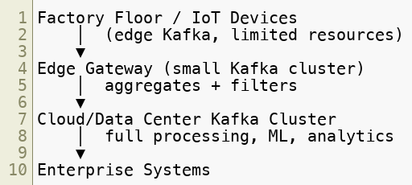
Kafka at the Edge
Implementations:
Strimzi — Kafka on Kubernetes, edge clusters
Redpanda — Kafka-compatible, single-binary, low resource footprint
Copyright © 2026 by Elephant Scale, All Rights Reserved

Slide 7
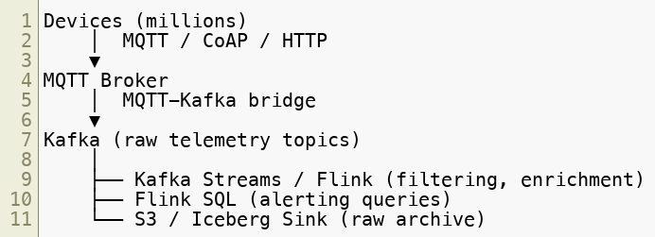
IoT Streaming Architecture
Key design considerations: partition by device_id , idempotent producers, mTLS per device, edge filtering before forwarding.
Copyright © 2026 by Elephant Scale, All Rights Reserved

Slide 8
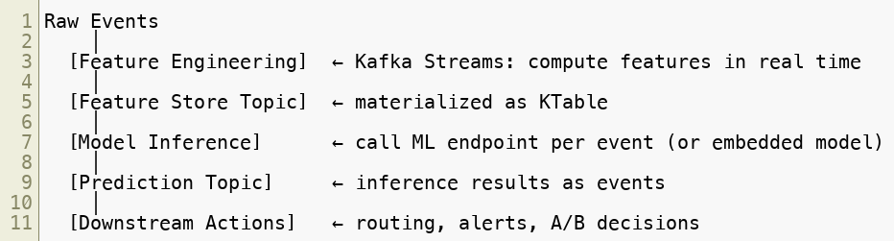
AI-Driven Event Processing
Copyright © 2026 by Elephant Scale, All Rights Reserved

Slide 9

Streaming ML Inference: Two Patterns
Pattern 1: External model server per event:
Pattern 2: Embedded model in stream processor:
Pattern 2: lower latency, no network hop. Pattern 1: model updates without redeploying the stream application.
Copyright © 2026 by Elephant Scale, All Rights Reserved

Slide 10
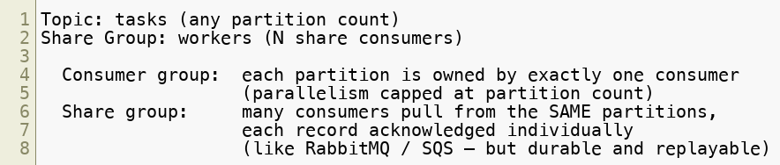
Kafka Queues — Share Groups (KIP-932)
Native queue semantics arrived in Kafka 4.0 as Share Groups (early access):
Consumer count is decoupled from partition count — scale workers past partitions
Per-message ack/redelivery; tooling: kafka-console-share-consumer.sh , kafka-share-groups.sh
Useful for: task queues, job distribution, worker pools — while keeping Kafka's durability and replay
Copyright © 2026 by Elephant Scale, All Rights Reserved

Slide 11
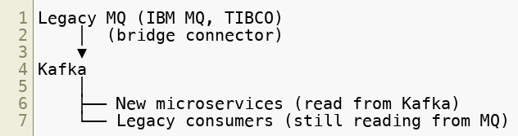
Modernizing Legacy Event Processing
Strangler fig pattern: gradually replace legacy consumers. New services read from Kafka. Legacy producers keep sending to MQ. Bridge replicates to Kafka. No big-bang migration required.
Copyright © 2026 by Elephant Scale, All Rights Reserved

Slide 12
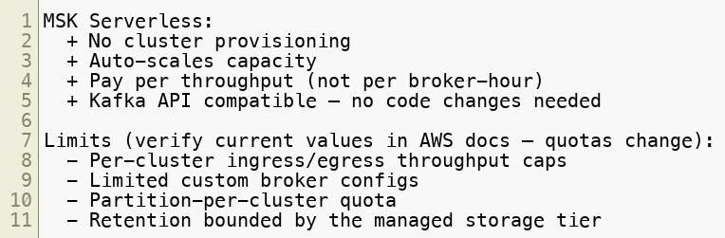
Serverless Kafka — Amazon MSK Serverless
Best for: variable workloads, dev/test, new projects.
Copyright © 2026 by Elephant Scale, All Rights Reserved

Slide 13
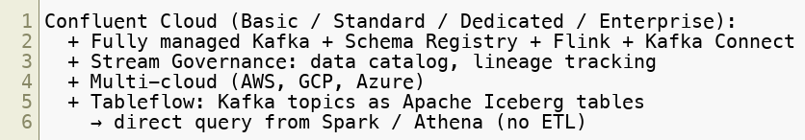
Serverless Kafka — Confluent Cloud
Consumption-based pricing on Basic/Standard tiers.
Copyright © 2026 by Elephant Scale, All Rights Reserved

Slide 14
Serverless Readiness Checklist
Before migrating to a managed/serverless offering:
☐ No broker-specific client assumptions
☐ Retries and idempotence enabled
☐ Topic and ACL provisioning scripted (not manual)
☐ Metrics exported externally (not broker shell scraping)
☐ Schema Registry usage standardized
☐ Cost model understood (traffic + retention pricing)
☐ No reliance on ZooKeeper or self-managed KRaft config
Copyright © 2026 by Elephant Scale, All Rights Reserved

Slide 15
The Future of Event-Driven Architecture
Kafka + Iceberg — streaming-native data lakehouse (no ETL)
Real-time AI agents — event-triggered autonomous agents responding to streams
Unified batch/streaming — Apache Flink Table API, Spark Streaming convergence
AI-native pipelines — embedding LLMs in stream processors
Decentralized data mesh — Kafka as the event backbone of data mesh
Copyright © 2026 by Elephant Scale, All Rights Reserved

Slide 16
Module 6 Summary
Multi-cluster federation via MirrorMaker 2 supports global, multi-cloud topologies
Edge streaming: Kafka on Kubernetes (Strimzi) for IoT and factory use cases
AI integration: streaming feature engineering + online inference pipelines
Native queue semantics — Share Groups (KIP-932, Kafka 4) — enable Kafka as a traditional work queue, decoupled from partition count
Serverless Kafka (MSK Serverless, Confluent Cloud) eliminates infrastructure management
Modernizing legacy: strangler fig pattern with bridge connectors
Future: Kafka + Iceberg, AI-native pipelines, data mesh
Copyright © 2026 by Elephant Scale, All Rights Reserved

Slide 17
What's Next
Module 7 — High-Volume Fan-Out Best Practices
Topic layout strategies for 10M msg/sec with 10 overlapping consumers
Header-based filtering
Kafka Streams branching
KEDA autoscaling tied to consumer lag
Copyright © 2026 by Elephant Scale, All Rights Reserved

Slide 18
Lab Preview — Lab 6
Review Emerging Architecture Patterns
You will:
Build a lightweight edge-to-core event pipeline with filtering
Implement a real-time feature enrichment stage
Integrate a mock inference service with Kafka events
Demonstrate queue-style work distribution
Assess a pipeline's serverless readiness
Environment: Docker Compose (Kafka, Python, Flask mock model) Time: 60 minutes
Copyright © 2026 by Elephant Scale, All Rights Reserved

