Slide 1
Module 7 — High-Volume Fan-Out Best Practices
Copyright © 2026 by Elephant Scale, All Rights Reserved

Slide 2
Module 7 Agenda
The fan-out problem: 10M msg/sec, 10 overlapping consumers
Topic design strategies: single topic vs pre-filtered sub-topics
Partition key design and consumer group topology
Efficient filtering: headers, schemas, Kafka Streams branching, Flink SQL
Benchmark: duplication vs filtering
KEDA autoscaling based on consumer lag
Copyright © 2026 by Elephant Scale, All Rights Reserved

Slide 3
The Fan-Out Problem
Scenario:
A dataset arrives at 10 million messages per second
10 consumer teams each need a different but overlapping subset
Goal: minimize storage and network duplication on Kafka
Goal: minimize consumer CPU overhead for filtering unwanted messages
Copyright © 2026 by Elephant Scale, All Rights Reserved

Slide 4
Topic Design Options
Design | Storage | Network | Consumer CPU | Ops Complexity
1 broad topic + client-side filter | Low | Low | High | Low
10 pre-filtered topics | 10× | 10× producer writes | Low | High (topic sprawl)
Streams-branched derived topics | Moderate | Moderate | Low | Moderate
1 topic + header-based skip | Low | Low | Low–Moderate | Low
Rule of thumb: topic proliferation trades CPU for storage. At 10M msg/sec, every deserialization matters.
Copyright © 2026 by Elephant Scale, All Rights Reserved

Slide 5
Partition Key Design
Partition by the field that co-locates related data for consumers:
Anti-pattern: random or null keys → even distribution but no co-location, no filtering leverage.
Copyright © 2026 by Elephant Scale, All Rights Reserved

Slide 6
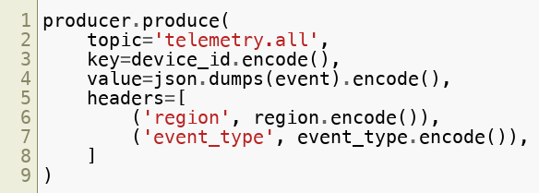
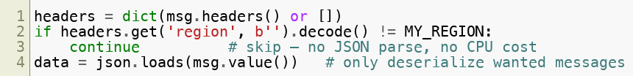
Header-Based Filtering
Producers tag messages with routing metadata:
Consumers skip by header — no deserialization for unwanted records:
Copyright © 2026 by Elephant Scale, All Rights Reserved

Slide 7
Header Filtering: CPU Savings
At 10M msg/sec with 33% of messages wanted per consumer:
Approach | Deserialization calls/sec | Relative CPU
Full deserialize all | 10,000,000 | 1× (baseline)
Header skip, deserialize wanted | 3,300,000 | ~0.33×
Copyright © 2026 by Elephant Scale, All Rights Reserved

Slide 8
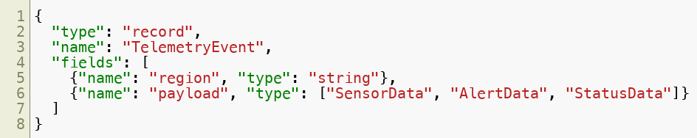
Schema-Based Filtering
Using Avro union types, consumers can deserialize only the outer envelope first:
Consumer reads region from outer record → decides whether to parse payload .
Stronger guarantees than headers (schema-enforced) but higher coupling to Schema Registry.
Copyright © 2026 by Elephant Scale, All Rights Reserved

Slide 9
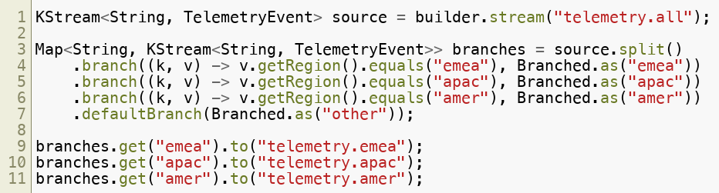
Kafka Streams Branching
Server-side pre-filtering — removes CPU cost from all consumers:
Copyright © 2026 by Elephant Scale, All Rights Reserved

Slide 10
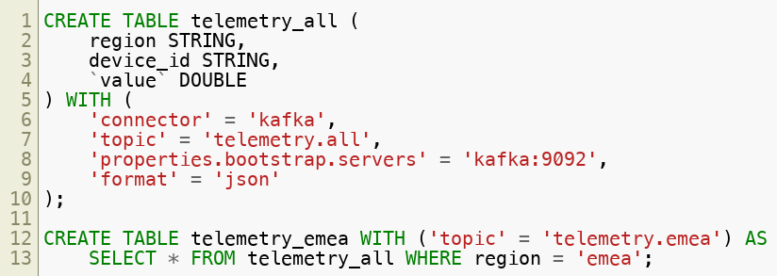
Flink SQL — Declarative Filtering
Declarative SQL alternative to Streams branching (Flink SQL is the 2026 direction; ksqlDB has been de-emphasized by Confluent and Flink is in this course's lab env):
Continuous queries keep derived topics updated as new events arrive.
Copyright © 2026 by Elephant Scale, All Rights Reserved

Slide 11
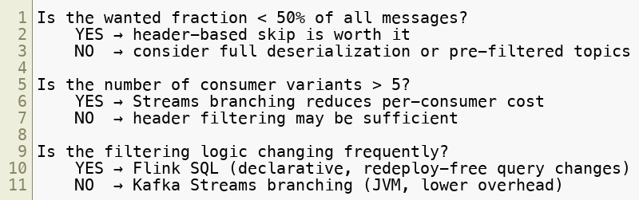
Filtering Strategy Decision Tree
Copyright © 2026 by Elephant Scale, All Rights Reserved

Slide 12
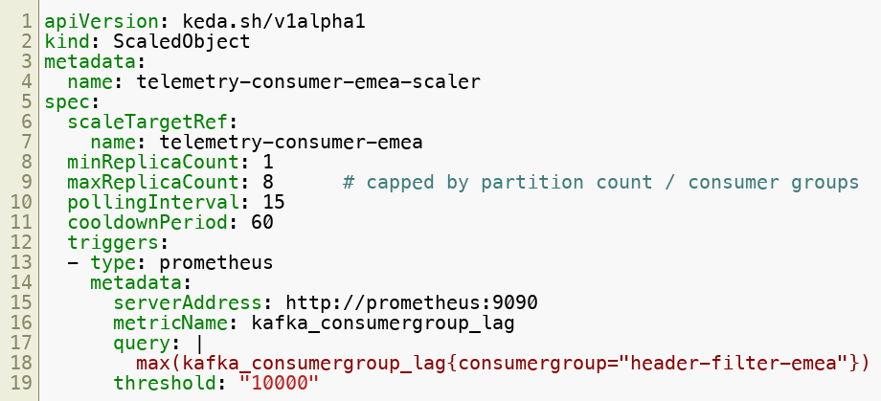
KEDA Autoscaler: Scale on Lag
Scale up when lag > 10,000. Scale down after cooldownPeriod seconds of low lag.
Copyright © 2026 by Elephant Scale, All Rights Reserved

Slide 13
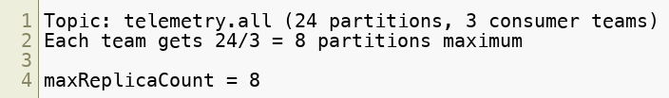
KEDA: Why Cap maxReplicaCount?
Adding more consumers than partitions wastes resources — idle replicas with no partitions assigned.
Copyright © 2026 by Elephant Scale, All Rights Reserved

Slide 14
Benchmark: Duplication vs Filtering
At 50,000 messages with 33% wanted (emea):
Break-even point: when wanted fraction > ~80%, full deserialization may be cheaper (no header overhead).
Strategy | Time (s) | Throughput (msg/s) | Note
Full deserialize all 50K | ~baseline | — | All messages deserialized
Header-skip, deserialize emea only | ~0.33× time | ~3× faster | Skip at metadata level
Copyright © 2026 by Elephant Scale, All Rights Reserved

Slide 15
Module 7 Summary
Single broad topic + header filtering is the most storage-efficient fan-out design
Header-based skip avoids deserialization cost for unwanted messages — 3× CPU savings at 33% selectivity
Schema-based filtering provides stronger guarantees but tighter Schema Registry coupling
Kafka Streams branching moves filtering to the server side — best for static, high-volume cases
Flink SQL provides declarative filtering without redeployment (the modern successor to ksqlDB)
KEDA autoscaling ties consumer replica count to Prometheus lag metric
Cap maxReplicaCount to partition count per consumer group
Copyright © 2026 by Elephant Scale, All Rights Reserved

Slide 16
Lab Preview — Lab 7
Design and Validate a Fan-Out Strategy
You will:
Create a broad topic and produce events with routing headers
Implement header-based filtering across 3 consumer groups
Benchmark full deserialization vs header-skip
Review Kafka Streams branching pseudocode
Configure and test a KEDA ScaledObject tied to consumer lag
Environment: Docker Compose (3-broker Kafka, Prometheus, KEDA optional) Time: 75–90 minutes
Copyright © 2026 by Elephant Scale, All Rights Reserved

