Slide 1
Module 4 — Connectors, Pipelines & Integrations
Copyright © 2026 by Elephant Scale, All Rights Reserved

Slide 2
Module 4 Agenda
Why Kafka Connect exists
Connect architecture and internal topics
Source connectors, sink connectors, offset management
Error handling, retries, and Dead Letter Queues
Custom connector development
Integration patterns: S3, Elasticsearch, Flink, Spark, Iceberg/lakehouse
Stream-to-batch handoff and the lakehouse path
Backpressure management
Enterprise integration patterns
Copyright © 2026 by Elephant Scale, All Rights Reserved

Slide 3

Why Kafka Connect?
Moving data between systems is the hardest part of streaming .
Without Kafka Connect:
Custom code for every integration
Reinventing offset management, error handling, restarts
No standard for connector configuration or monitoring
With Kafka Connect:
700+ production-ready connectors
Built-in offset management and exactly-once delivery (Kafka 3.3+)
REST API for deployment and monitoring
Horizontal scaling via connector tasks
Schema Registry integration
Copyright © 2026 by Elephant Scale, All Rights Reserved

Slide 4
Kafka Connect, Intuitively — The USB Hub for Data
Before Connect, wiring two systems together meant hand-soldering a custom cable every time: bespoke code to read Postgres, more to write S3 — each one reinventing offsets, retries, and restarts.
Connect is the USB hub : a standard socket where you plug in a pre-built connector and it just works — 700+ of them.
You configure, you don't code — a connector is JSON, not a program.
The hub handles the hard parts — offset tracking, retries, scaling, restarts — once, for every connector.
Source = plug data
Copyright © 2026 by Elephant Scale, All Rights Reserved

Slide 5
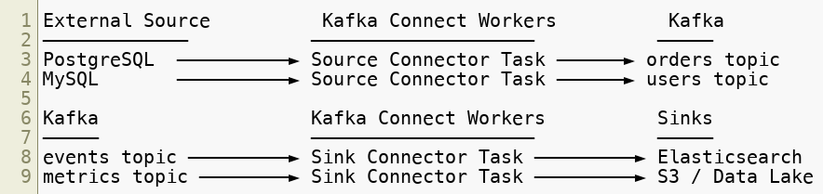
Kafka Connect Architecture
Workers are stateless — all state is stored in Kafka internal topics.
Copyright © 2026 by Elephant Scale, All Rights Reserved

Slide 6
Connect Internal Topics
Topic | Purpose
connect-configs | Connector and task configurations
connect-offsets | Source connector read positions
connect-status | Connector and task status
Benefits:
Workers are completely stateless — any worker can pick up any task
Full state survives cluster restarts and worker failures
Copyright © 2026 by Elephant Scale, All Rights Reserved

Slide 7
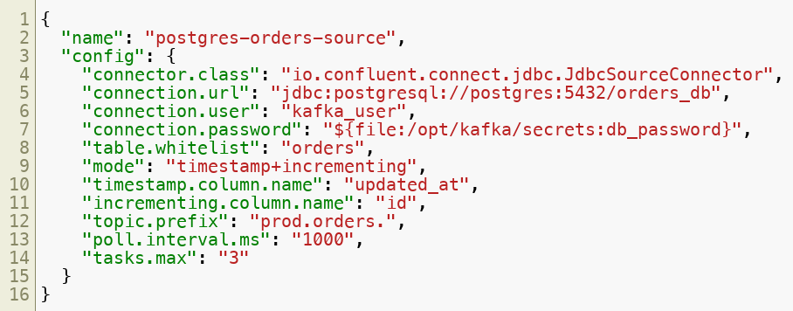

Source Connector — JDBC Example
Copyright © 2026 by Elephant Scale, All Rights Reserved

Slide 8
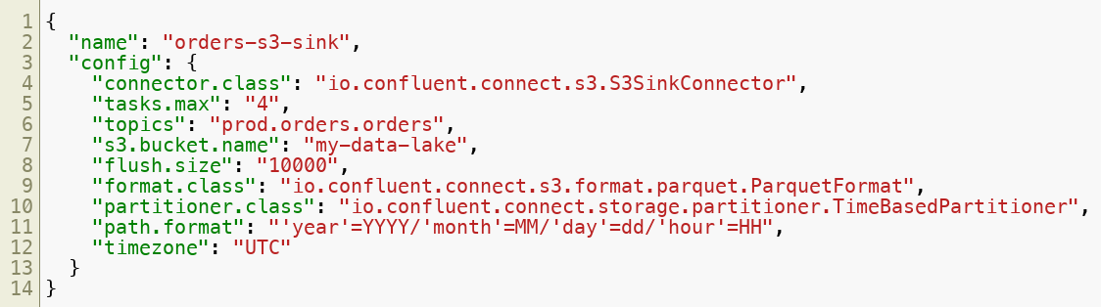
Sink Connector — S3 Example
Copyright © 2026 by Elephant Scale, All Rights Reserved

Slide 9
Offset Management
Source connectors store their read position in connect-offsets :
On restart: connector resumes from last stored offset — no duplicates, no data loss.
For exactly-once source connectors (GA since Kafka 3.3, standard in Kafka 4):
Offsets are committed atomically with the Kafka produce transaction
No duplicates even on connector worker failure
Enable with exactly.once.source.support=enabled on the Connect worker
Copyright © 2026 by Elephant Scale, All Rights Reserved

Slide 10
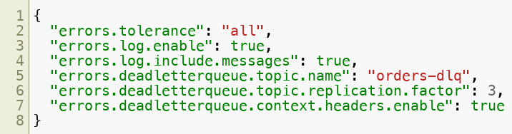

Error Handling and Dead Letter Queues
Failed records go to the DLQ with error headers:
Copyright © 2026 by Elephant Scale, All Rights Reserved

Slide 11
When One Bad Record Stops Everything — Why the DLQ Exists
A real failure: a single malformed record hits a sink connector — one row with a string where a number belongs.
Default behavior ( errors.tolerance=none ): the task throws and stops . The whole connector halts on record #1 of a million.
At 3am your pipeline is dark, lag is climbing, and one corrupt row is the cause.
The fix is the config on the previous slide:
errors.tolerance=all — don't die on a bad record.
errors.deadletterqueue.topic.name — route the poison record aside (with headers saying why ) and keep processing the other 999,999.
Copyright © 2026 by Elephant Scale, All Rights Reserved

Slide 12
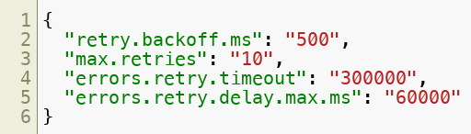
Retry Configuration
Transient failures (network timeouts, unavailability) → retry with exponential backoff
Persistent failures (schema mismatch, corrupt records) → send to DLQ immediately
Copyright © 2026 by Elephant Scale, All Rights Reserved

Slide 13
Lab 4 — Deploy & Tune Connectors
Stop here and run the lab now. Put the Connect config from these slides to work on a live pipeline.
Deploy a JDBC source connector reading from PostgreSQL
Deploy an S3/MinIO sink writing time-partitioned files
Inject a bad record and watch it land in the Dead Letter Queue
Pause, insert rows, resume — verify offset tracking (no loss, no dupes)
Discuss task-scaling limits: JDBC vs file connectors
Environment: Docker Compose (Kafka, PostgreSQL, MinIO, Kafka Connect) · 60–75 minutes
Copyright © 2026 by Elephant Scale, All Rights Reserved

Slide 14
Welcome Back — Kafka in the Wider Pipeline
You've deployed real source and sink connectors, survived a poison record via the DLQ, and watched offsets resume cleanly.
Now zoom out: how Kafka hands off to Flink and Spark , feeds the lakehouse (Iceberg / Tableflow), and the enterprise patterns (outbox, saga) that wire it into a business.
Copyright © 2026 by Elephant Scale, All Rights Reserved

Slide 15
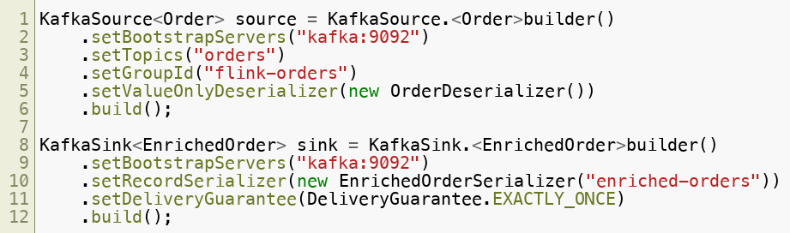
Kafka ↔ Flink
Flink natively reads from and writes to Kafka:
Copyright © 2026 by Elephant Scale, All Rights Reserved

Slide 16
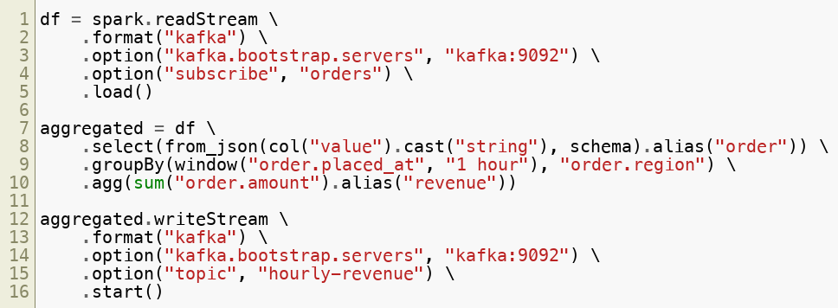
Kafka ↔ Spark
Copyright © 2026 by Elephant Scale, All Rights Reserved

Slide 17
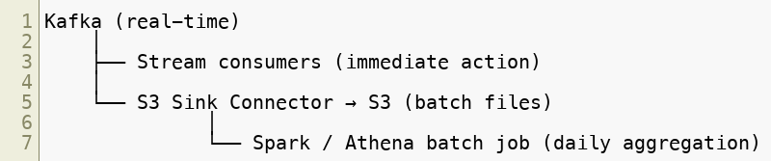
Stream-to-Batch Handoff
Lambda architecture — dual path (real-time + batch), merge results
Kappa architecture — single Kafka path, replay for batch (preferred when retention allows)
Modern lakehouse path (2026): instead of landing raw files, sink directly to Apache Iceberg tables — via the Iceberg Sink Connector, or Confluent Tableflow (Kafka topics materialized as Iceberg/Delta tables). Query from Spark, Flink, Trino, or Athena with no separate ETL job. Pairs naturally with Tiered Storage.
Copyright © 2026 by Elephant Scale, All Rights Reserved

Slide 18
Backpressure Management
When consumers fall behind producers:
Root Cause | Fix
Too few connector tasks | Increase `tasks.max`
Slow sink system | Circuit breaker, async writes
Producer burst | Separate high/low-priority topics
Consumer processing slow | Scale consumer instances
Copyright © 2026 by Elephant Scale, All Rights Reserved

Slide 19
Enterprise Integration Patterns
Outbox Pattern — eliminates dual-write risk:
Saga — distributed transaction coordination via events:
Event-Carried State Transfer — embed full state in the event (avoid lookups):
Copyright © 2026 by Elephant Scale, All Rights Reserved

Slide 20
Module 4 Summary
Kafka Connect provides 700+ connectors with built-in offset management
Internal topics make workers completely stateless and fault-tolerant
Configure errors.tolerance , retries, and DLQ for production resilience
Flink and Spark both have mature native Kafka integrations
Stream-to-batch: S3 sink + Kappa architecture, increasingly going straight to an Iceberg lakehouse (Tableflow)
Enterprise patterns: outbox, saga, event-carried state transfer
Copyright © 2026 by Elephant Scale, All Rights Reserved

Slide 21
What's Next
Module 5 — Reliability, Scaling & Performance
Capacity planning and right-sizing
Expanding Kafka with no data loss
HA and performance tuning: replication, acks, consumer lag monitoring
Copyright © 2026 by Elephant Scale, All Rights Reserved

