Slide 1
Module 5 — Reliability, Scaling & Performance
Copyright © 2026 by Elephant Scale, All Rights Reserved

Slide 2
Module 5 Agenda
Right-sizing Kafka clusters
Expanding Kafka with no data loss
HA and performance tuning
Producer and consumer throughput parameters
Consumer lag detection and remediation
Cooperative rebalancing
Broker failure, failover, and ISR recovery
Capacity planning formula
Copyright © 2026 by Elephant Scale, All Rights Reserved

Slide 3
What Limits Kafka Throughput?
Network bandwidth — bytes in/out per broker
Disk I/O — sequential write throughput
CPU — compression/decompression, serialization
Producer batching — small batches = more overhead
Replication factor — more replicas = more network traffic
Consumer parallelism — limited by partition count
Copyright © 2026 by Elephant Scale, All Rights Reserved

Slide 4
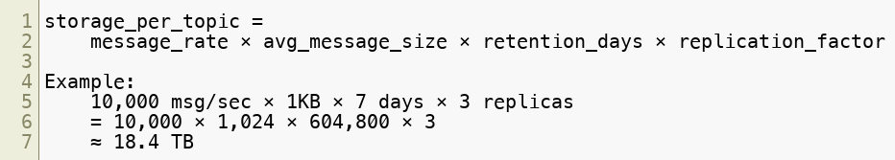
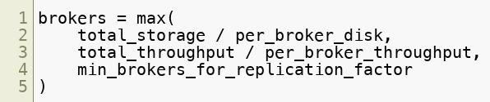
Right-Sizing: Capacity Planning Formula
Broker count:
Copyright © 2026 by Elephant Scale, All Rights Reserved

Slide 5
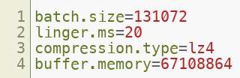
Producer Throughput Tuning
Parameter | Tuning Direction | Effect
batch.size | Increase (64KB–1MB) | Larger batches, fewer requests
linger.ms | Increase (5–100ms) | Wait to fill batches
compression.type | lz4` or `zstd | Smaller network payload
buffer.memory | Increase (64MB+) | More in-flight data
Copyright © 2026 by Elephant Scale, All Rights Reserved

Slide 6
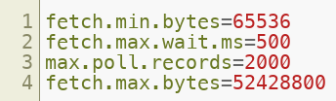
Consumer Throughput Tuning
Parameter | Effect
fetch.min.bytes | Wait for more data per fetch
fetch.max.wait.ms | Max wait time for min bytes
max.poll.records | Records processed per poll
fetch.max.bytes | Larger fetch responses
Copyright © 2026 by Elephant Scale, All Rights Reserved

Slide 7
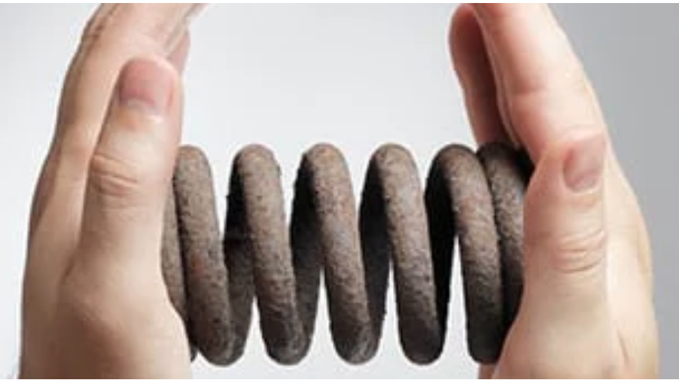
Compression Strategy
Algorithm | Ratio | CPU Cost | Best For
none | 1× | None | Lowest latency
lz4 | Good | Very Low | High-throughput producers
zstd | Best | Medium | Modern choice, storage-sensitive
gzip | Best | High | Legacy compatibility
snappy | Good | Low | Balanced
Enable end-to-end: compress at producer, decompress only at consumer.
Copyright © 2026 by Elephant Scale, All Rights Reserved

Slide 8
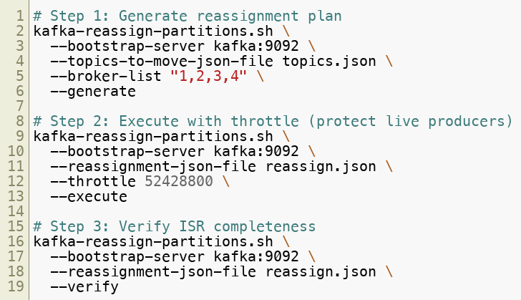
Expanding Kafka with No Data Loss
Copyright © 2026 by Elephant Scale, All Rights Reserved

Slide 9
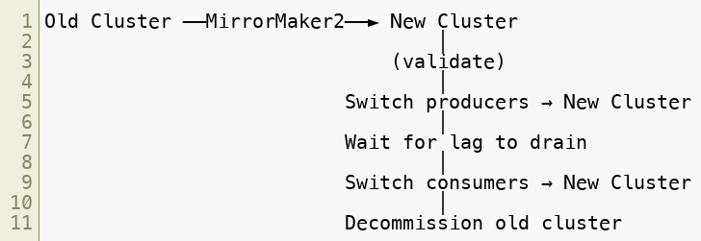

Blue/Green Cluster Migration
Zero-downtime: producers switch first, consumers drain, then switch.
Copyright © 2026 by Elephant Scale, All Rights Reserved

Slide 10
Consumer Lag, Intuitively
Lag is just the checkout line at a supermarket: messages arrive, consumers ring them up, and lag = the shoppers still waiting.
Lag grows whenever arrival rate > processing rate — the line backs up.
Two ways to shrink it: process faster (optimize, go async) or add cashiers (more consumers) — but only up to the number of lanes (partitions).
Steady non-zero lag is fine. Steadily is the alarm.
Copyright © 2026 by Elephant Scale, All Rights Reserved

Slide 11
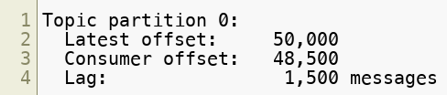

Consumer Lag — The Primary Health Metric
Root cause vs fix:
Root Cause | Fix
Slow processing logic | Optimize code, async processing
Too few consumers | Add instances (up to partition count)
Rebalance storm | Switch to cooperative rebalancing
Message errors | DLQ handling, avoid retry loops
Copyright © 2026 by Elephant Scale, All Rights Reserved

Slide 12


Rebalancing — The Throughput Killer
Eager rebalancing (default before Kafka 2.3):
Cooperative incremental rebalancing (client-side, Kafka 2.4+):
Config:
New consumer protocol — KIP-848 (GA in Kafka 4):
Copyright © 2026 by Elephant Scale, All Rights Reserved

Slide 13
When Rebalancing Goes Wrong — The Rebalance Storm
A real production failure pattern:
A 30-consumer group processes payments. One pod hits a long GC pause and misses a heartbeat → the group rebalances → under the eager protocol, all 30 stop .
The pause only looked like death; the pod rejoins → another rebalance → everyone stops again.
Under load this loops: the group spends more time rebalancing than processing . Lag explodes, latency spikes, on-call gets paged.
The fix is exactly the config from the previous slide:
Cooperative rebalancing — only affected partitions move; the other 29 keep working.
Static membership ( group.instance.id ) — a brief restart no longer triggers a reassignment.
KIP-848 — the broker drives incremental assignment; no stop-the-world barrier.
Copyright © 2026 by Elephant Scale, All Rights Reserved

Slide 14
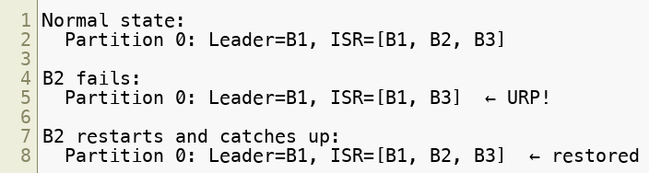
Broker Failure and ISR Recovery
Monitor UnderReplicatedPartitions — non-zero is the first sign of trouble.
Key configs:
replica.lag.time.max.ms — how long before a replica is removed from ISR
min.insync.replicas — minimum ISR required for produce success
Copyright © 2026 by Elephant Scale, All Rights Reserved

Slide 15
HA Configuration Matrix
Scenario |  |  | Result
Maximum durability | all | 2 | No data loss, some throughput cost
High throughput | 1 | 1 | Possible data loss on broker failure
Zero data loss | all | RF (e.g. 3) | Writes fail if any broker is down
Recommendation for production: acks=all , min.insync.replicas=2 , replication-factor=3 .
Copyright © 2026 by Elephant Scale, All Rights Reserved

Slide 16
Module 5 Summary
Capacity planning: model storage per topic before provisioning
Expanding Kafka: use kafka-reassign-partitions with throttle, validate ISR
Producer tuning: larger batches, linger, lz4/zstd compression
Consumer tuning: fetch.min.bytes, max.poll.records
Consumer lag is the primary operational health metric
Cooperative rebalancing dramatically reduces disruption; the KIP-848 broker-driven protocol is the Kafka 4 forward path
Tiered Storage decouples retention from broker disk — size on throughput, not total storage
HA: acks=all , min.insync.replicas=2 , replication-factor=3
Copyright © 2026 by Elephant Scale, All Rights Reserved

Slide 17
What's Next
Module 6 — Modern Kafka & Streaming Trends
Multi-cluster federation and disaster recovery
Kafka at the edge and IoT
AI-driven streaming pipelines
Serverless Kafka: MSK Serverless, Confluent Cloud
Copyright © 2026 by Elephant Scale, All Rights Reserved

Slide 18
Lab Preview — Lab 5
Stress-Test a Kafka Cluster and Analyze Rebalance and Failover Behavior
You will:
Baseline and tuned throughput benchmarks
Consumer lag simulation and group-based remediation
Eager vs cooperative rebalancing comparison
Partition reassignment with throttling on a live cluster
Broker failure simulation with ISR recovery measurement
End-to-end latency measurement
Environment: Docker Compose (3-broker Kafka cluster) Time: 75–90 minutes
Copyright © 2026 by Elephant Scale, All Rights Reserved

