Slide 1
Module 3 — Kafka Operations & Observability
Copyright © 2026 by Elephant Scale, All Rights Reserved

Slide 2
Module 3 Agenda
The four observability signals for Kafka
Critical broker, producer, and consumer metrics
Monitoring and tooling stack: Prometheus, Grafana, Kafka UI, Kafdrop, Confluent Control Center
Operational procedures: topic management, consumer group management, security operations
Incident triage runbook
Copyright © 2026 by Elephant Scale, All Rights Reserved

Slide 3
The Four Observability Signals
Latency — end-to-end produce/consume latency
Traffic — messages/sec, bytes/sec per topic and partition
Errors — failed produce requests, consumer errors, ISR shrinks
Saturation — disk usage, network, CPU, consumer lag
Copyright © 2026 by Elephant Scale, All Rights Reserved

Slide 4
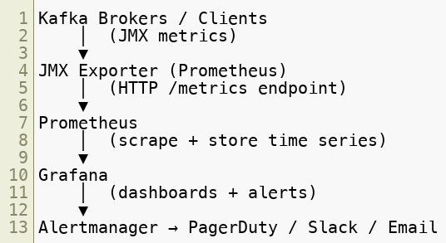
Kafka Metrics Architecture
Copyright © 2026 by Elephant Scale, All Rights Reserved

Slide 5
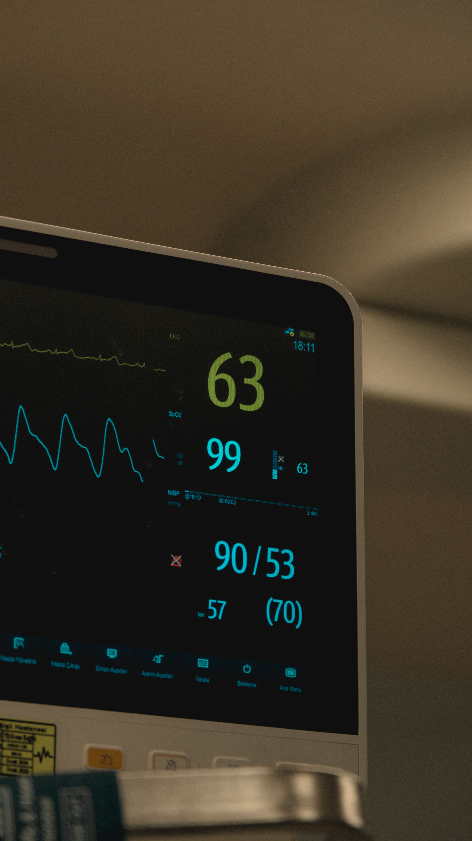
Critical Broker Metrics
Metric | Alert Threshold
Under-replicated partitions | > 0 (page immediately)
Active controller count | != 1 (page immediately)
Request handler idle % | < 30% (warning)
Network processor idle % | < 30% (warning)
Log flush latency p99 | > 500ms
Bytes in/out per sec | > 80% NIC capacity
ISR shrink rate | any non-zero sustained rate
Copyright © 2026 by Elephant Scale, All Rights Reserved

Slide 6
Critical Consumer Metrics
Metric | Alert When
Consumer lag | > SLA threshold
records-consumed-rate | drops unexpectedly
fetch-latency-avg | high → broker issue
rebalance-rate-and-time | frequent → instability
assigned-partitions | imbalanced across consumers
Copyright © 2026 by Elephant Scale, All Rights Reserved

Slide 7
Monitoring & Tooling Stack
Tool | Best For
Prometheus + Grafana | Broker and consumer dashboards, alerting, lag thresholds
Kafka UI | Topic management, consumer group operations, visual inspection
Kafdrop | Lightweight quick inspection of topic contents and consumer state
Confluent Control Center | Commercial option — enterprise observability with schema/connector visibility (not in this course's lab stack)
Copyright © 2026 by Elephant Scale, All Rights Reserved

Slide 8

Prometheus Alerting Strategy
Tier 1 — Page immediately:
UnderReplicatedPartitions > 0 for > 2 minutes
ActiveControllerCount != 1
Broker down (not restarting)
Disk > 90% on any broker
Tier 2 — Notify (Slack/email):
Consumer lag above SLA threshold
Producer error rate > 0
Request handler idle < 30%
Tier 3 — Track in dashboard:
Compression ratios, batch sizes, rebalance frequency
Copyright © 2026 by Elephant Scale, All Rights Reserved

Slide 9


Topic Operational Procedures
Alter retention on a live topic:
Trigger log compaction:
Inspect topic config:
Copyright © 2026 by Elephant Scale, All Rights Reserved

Slide 10

Consumer Group Operations
Check lag across all groups:
Reset offsets to earliest:
Detect stuck consumers:
Lag grows but records-consumed-rate is non-zero → slow processing
Lag grows and records-consumed-rate is zero → consumer stuck or stopped
Copyright © 2026 by Elephant Scale, All Rights Reserved

Slide 11
Security Operations
TLS certificate rotation:
Generate new keystores before expiry
Rolling restart one broker at a time
Verify listeners are up before continuing
SASL credential rotation:
Audit logging:
Raise the kafka.authorizer.logger level in the broker logging config
Note: Kafka 4 moved from Log4j 1.x to Log4j2 — configure this in log4j2.yaml , not the old log4j.properties format
Route authorizer logs to a dedicated topic/SIEM for compliance tracking
Copyright © 2026 by Elephant Scale, All Rights Reserved

Slide 12
Incident Triage Runbook
Apply this 6-step process to every production incident:
Scope — one topic? one consumer group? entire cluster?
Control plane — ActiveControllerCount must be exactly 1
Durability — check UnderReplicatedPartitions and ISR state
Consumer impact — is lag growing or stable?
Mitigation — one safe, reversible action
Recovery — verify the signal clears
Copyright © 2026 by Elephant Scale, All Rights Reserved

Slide 13
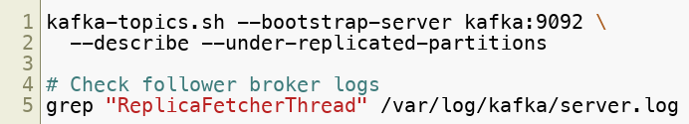

Troubleshooting — Under-Replicated Partitions
Symptom: UnderReplicatedPartitions > 0
Causes: broker failure, network partition, disk full on follower, follower behind on load
Investigation:
Copyright © 2026 by Elephant Scale, All Rights Reserved

Slide 14

Troubleshooting — Consumer Lag Spikes
Investigation checklist:
Are all consumer instances running?
Did processing time increase (slow 3rd-party call)?
Did producer throughput spike?
Did a rebalance occur (consumer instance died)?
Is the consumer JVM GC-ing heavily?
Copyright © 2026 by Elephant Scale, All Rights Reserved

Slide 15
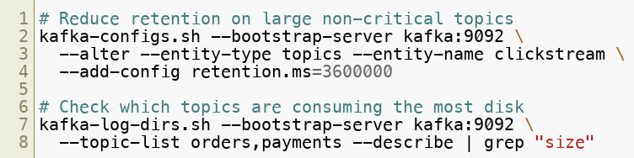

Troubleshooting — Disk Saturation
Immediate actions:
Copyright © 2026 by Elephant Scale, All Rights Reserved

Slide 16
Module 3 Summary
Monitor four signals: latency, traffic, errors, saturation
Critical alert: UnderReplicatedPartitions > 0 , ActiveControllerCount != 1
Use Prometheus + Grafana for metrics; Kafka UI or Kafdrop for operational inspection
Topic management: alter retention and compaction settings on live topics
Consumer group management: describe, reset offsets, detect stuck consumers
Security operations: certificate rotation, SASL credential management, audit logging
Use a structured 6-step runbook for every production incident
Copyright © 2026 by Elephant Scale, All Rights Reserved

Slide 17
What's Next
Module 4 — Connectors, Pipelines & Integrations
Kafka Connect deep dive: source, sink, offset management, DLQ
Integration patterns: S3, Elasticsearch, Flink, Spark, Iceberg/lakehouse
Enterprise integration patterns and backpressure management
Copyright © 2026 by Elephant Scale, All Rights Reserved

Slide 18
Lab Preview — Lab 3
Diagnose Kafka Health Using Monitoring Dashboards and Operational Runbooks
You will:
Verify Prometheus metric scraping and Grafana dashboards
Produce consumer lag and apply the triage runbook
Alter topic retention and reset consumer group offsets
Simulate under-replicated partitions (broker kill) and verify recovery
Test Prometheus alert expressions
Environment: Docker Compose (3-broker Kafka, Prometheus, Grafana, Kafdrop) Time: 60–75 minutes
Copyright © 2026 by Elephant Scale, All Rights Reserved

