Slide 1
Intermediate 3 — Delivery Semantics & Transactions
Copyright © 2026 by Elephant Scale, All Rights Reserved

Slide 2
Agenda
At-most-once, at-least-once, exactly-once — what each requires
Transactions and the consume-process-produce loop
read_committed vs. read_uncommitted
Hands-on: build keyed producers/consumers; a transactional pipeline
Copyright © 2026 by Elephant Scale, All Rights Reserved

Slide 3
Three Delivery Guarantees
Every messaging system makes one of three promises about how many times a record is delivered/processed:
These aren't a single Kafka setting — they emerge from producer config + commit timing +
We've already met the first two; this module builds the third
Guarantee | Meaning | Failure mode
At-most-once | 0 or 1 times | may lose records
At-least-once | 1 or more times | may duplicate records
Exactly-once | exactly 1 time | neither loss nor duplication
Copyright © 2026 by Elephant Scale, All Rights Reserved
Notes:
Emphasize that "exactly-once" is the hardest and most misunderstood. Half this module is defining precisely what it does and doesn't mean.

Slide 4
Where We Already Are
You've built two of the three, across the last two modules:
At-most-once — auto-commit before processing → a crash skips records (Lab 03, Ex 2)
At-least-once — acks=all + retries + manual commit after processing → no loss, possible dups (Lab 02 + Lab 03)
Idempotent producer — removes duplicates from producer retries (Lab 02, Ex 5)
What's missing: making a whole consume → process → produce step atomic, so the output and the input-offset commit either both happen or neither does. That's transactions .
Copyright © 2026 by Elephant Scale, All Rights Reserved

Slide 5
The Problem Transactions Solve
A stream processor reads from one topic, transforms, and writes to another — then commits its read offset. Two writes that must agree:
Crash after writing output but before committing the offset → on restart you re-read and re-write → duplicate output
Crash after committing the offset but before writing → lost output
Idempotence alone can't fix this — it spans two different topics/partitions plus an offset . You need them to be one atomic unit .
Copyright © 2026 by Elephant Scale, All Rights Reserved

Slide 6
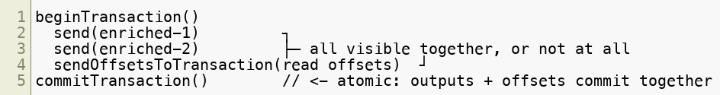
Kafka Transactions
A transaction groups multiple produces across partitions and the consumer offset into one all-or-nothing operation.
Either everything commits (outputs appear, offset advances) or everything aborts (outputs discarded, offset unchanged — safe to retry)
Built on the idempotent producer (transactions require it)
Enables exactly-once processing for consume-process-produce pipelines
Copyright © 2026 by Elephant Scale, All Rights Reserved

Slide 7
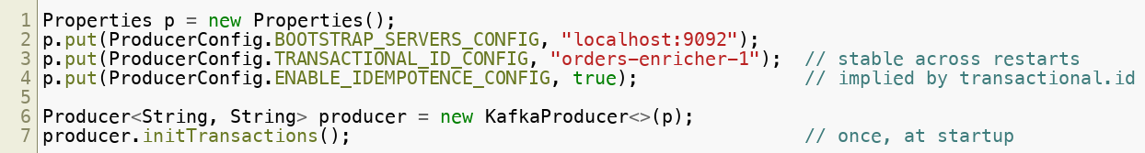
The
Transactions need a stable
transactional.id — the producer's durable identity across restarts.
It lets Kafka fence a previous (possibly zombie) instance with the same id — the old one can no longer commit, so a hung-then-recovered process can't corrupt output
Must be stable per logical processor and unique per instance in a parallel deployment
Copyright © 2026 by Elephant Scale, All Rights Reserved
Notes:
The transactional.id + fencing is what makes exactly-once safe under the nastiest failure — a process that froze, was replaced, then woke up. The zombie can't commit.

Slide 8
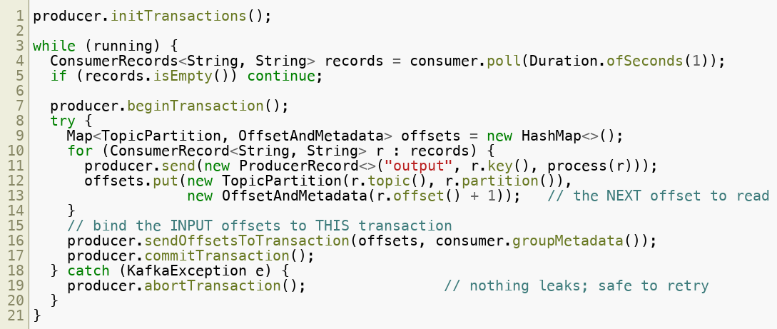
The Consume-Process-Produce Loop
The canonical exactly-once pattern, end to end:
The consumer runs with
enable.auto.commit=false — offsets are committed only via the
Output records and the input-offset advance are now one atomic fact
Copyright © 2026 by Elephant Scale, All Rights Reserved
Notes:
Two details students get wrong. (1) It's r.offset() + 1 — you commit the next offset to read, not the last one processed; committing r.offset() re-delivers the last record forever. (2) Not every exception should be aborted: ProducerFencedException , OutOfOrderSequenceException , and authorization errors are fatal — a newer instance has taken your transactional.id , so you must close() the producer and exit, not abort and retry.

Slide 9
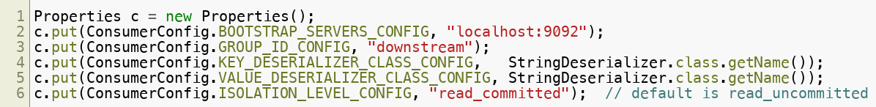
The Consumer Side:
Transactions on the write side only deliver exactly-once if the reader agrees to ignore uncommitted/aborted data.
read_committed readers never see aborted output and won't read past an open transaction on that partition until it resolves
Exactly-once end to end = transactional producer +
 | Sees
read_uncommitted` (default | all records, including aborted/uncommitted
read_committed | only records from committed transactions
Copyright © 2026 by Elephant Scale, All Rights Reserved

Slide 10
Marches in Lockstep: How read_committed Works
A read_committed consumer relies on transaction markers the broker writes into the log.
The broker adds commit/abort markers ; the consumer uses them to filter
An open transaction holds the reader at the Last Stable Offset until it commits or aborts — a stuck transaction can add latency (a reason to keep transactions short)
Copyright © 2026 by Elephant Scale, All Rights Reserved
Notes:
This is why exactly-once isn't "free" — read_committed trades a little latency for correctness. Keep transactions small and fast.

Slide 11
What Exactly-Once Really Means (and Doesn't)
Be precise — this is the most over-claimed term in streaming.
✅ Exactly-once within Kafka: read Kafka → process → write Kafka, atomically, is achievable with transactions
❌ It is not end-to-end across systems Kafka can't transact with — a write to an external DB or a REST call is not in the Kafka transaction
For external side effects you still need idempotent writes (upserts, dedupe keys) — the effectively-once pattern
Exactly-once has a throughput cost ; use it where correctness demands, not everywhere
Rule of thumb: exactly-once inside Kafka = transactions; exactly-once touching the = idempotent side effects.
Copyright © 2026 by Elephant Scale, All Rights Reserved

Slide 12
Choosing a Guarantee
Match the guarantee to the data — don't pay for more than you need.
At-most-once — high-volume telemetry/logs where a dropped record is harmless
At-least-once + idempotent processing — the default for most pipelines; simple and robust
Exactly-once (transactions) — money, counts, ledgers, dedup-critical enrichment — where a duplicate or a gap is unacceptable
Copyright © 2026 by Elephant Scale, All Rights Reserved
Notes:
Most students will reach for exactly-once reflexively. Push back: at-least-once + idempotency covers the majority of real systems at lower cost and complexity.

Slide 13
Summary
Delivery guarantees come from producer config + commit timing + transactions , not one knob
At-least-once + idempotent processing is the sensible default; exactly-once is for correctness-critical flows
Transactions make consume → process → produce atomic: outputs and the offset commit succeed or abort together
Require a stable
transactional.id (enables zombie fencing) and the idempotent producer
Readers must use
read_committed to get the guarantee; it filters aborted/uncommitted data
Exactly-once is within Kafka ; crossing to external systems needs idempotent side effects
Copyright © 2026 by Elephant Scale, All Rights Reserved

Slide 14
Lab 04 Preview
You'll build the full pattern:
A transactional producer and a read_committed consumer
A consume-process-produce pipeline that commits offsets inside the transaction
Force an abort and prove a read_committed reader never sees the aborted records
→
Copyright © 2026 by Elephant Scale, All Rights Reserved

