Slide 1
Intro 1 — What Is Kafka and Why
Copyright © 2026 by Elephant Scale, All Rights Reserved

Slide 2
Agenda
Real-time streaming vs. batch; the problem Kafka solves
Where Kafka came from
Event-driven architecture: publish/subscribe vs. request/response
Kafka use cases and who uses Kafka
Where Kafka fits: the modern data platform
Streaming-first design and common enterprise EDA patterns
Copyright © 2026 by Elephant Scale, All Rights Reserved

Slide 3
The World Got Faster Than Batch
For decades, data moved in batches : collect all day, run a job at night, see results tomorrow.
A bank posts transactions overnight
A retailer recomputes inventory at 2 AM
Analytics dashboards are always "yesterday's numbers"
That was fine when the business ran on a daily cycle. It is not fine when:
A fraud decision has to happen before the payment clears
A rider needs a driver matched now
A dashboard is expected to be live, not 24 hours stale
The world moved to events that must be reacted to as they happen . Batch can't do that.
Copyright © 2026 by Elephant Scale, All Rights Reserved
Notes:
Anchor this in the students' own systems — ask what runs as a nightly job today and what the business wishes were real-time. Almost everyone has an example.

Slide 4
Batch vs. Streaming
 | Batch | Streaming
Unit of work | A file / a big query | A single event
When it runs | On a schedule (nightly, hourly) | Continuously, as data arrives
Latency | Hours | Milliseconds to seconds
Data at rest / in motion | At rest (tables, files) | In motion (a flowing log)
Question it answers | "What happened yesterday?" | "What is happening right now?"
Streaming doesn't replace batch everywhere — it adds the ability to act on data while it is still fresh . Kafka is the platform that makes streaming practical at scale.
Copyright © 2026 by Elephant Scale, All Rights Reserved

Slide 5
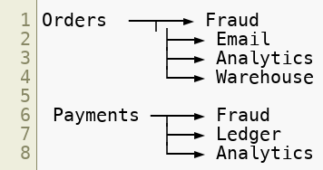
The Problem Kafka Solves: N×M Integration
Without a streaming platform, every system that produces data connects directly to every system that needs it:
Every new consumer means new point-to-point plumbing
Producers must know about — and keep up with — every consumer
One slow or down consumer can stall the producer
N producers × M consumers = an unmaintainable web of integrations
This is the tangle Kafka was built at LinkedIn to untangle.
Copyright © 2026 by Elephant Scale, All Rights Reserved

Slide 6
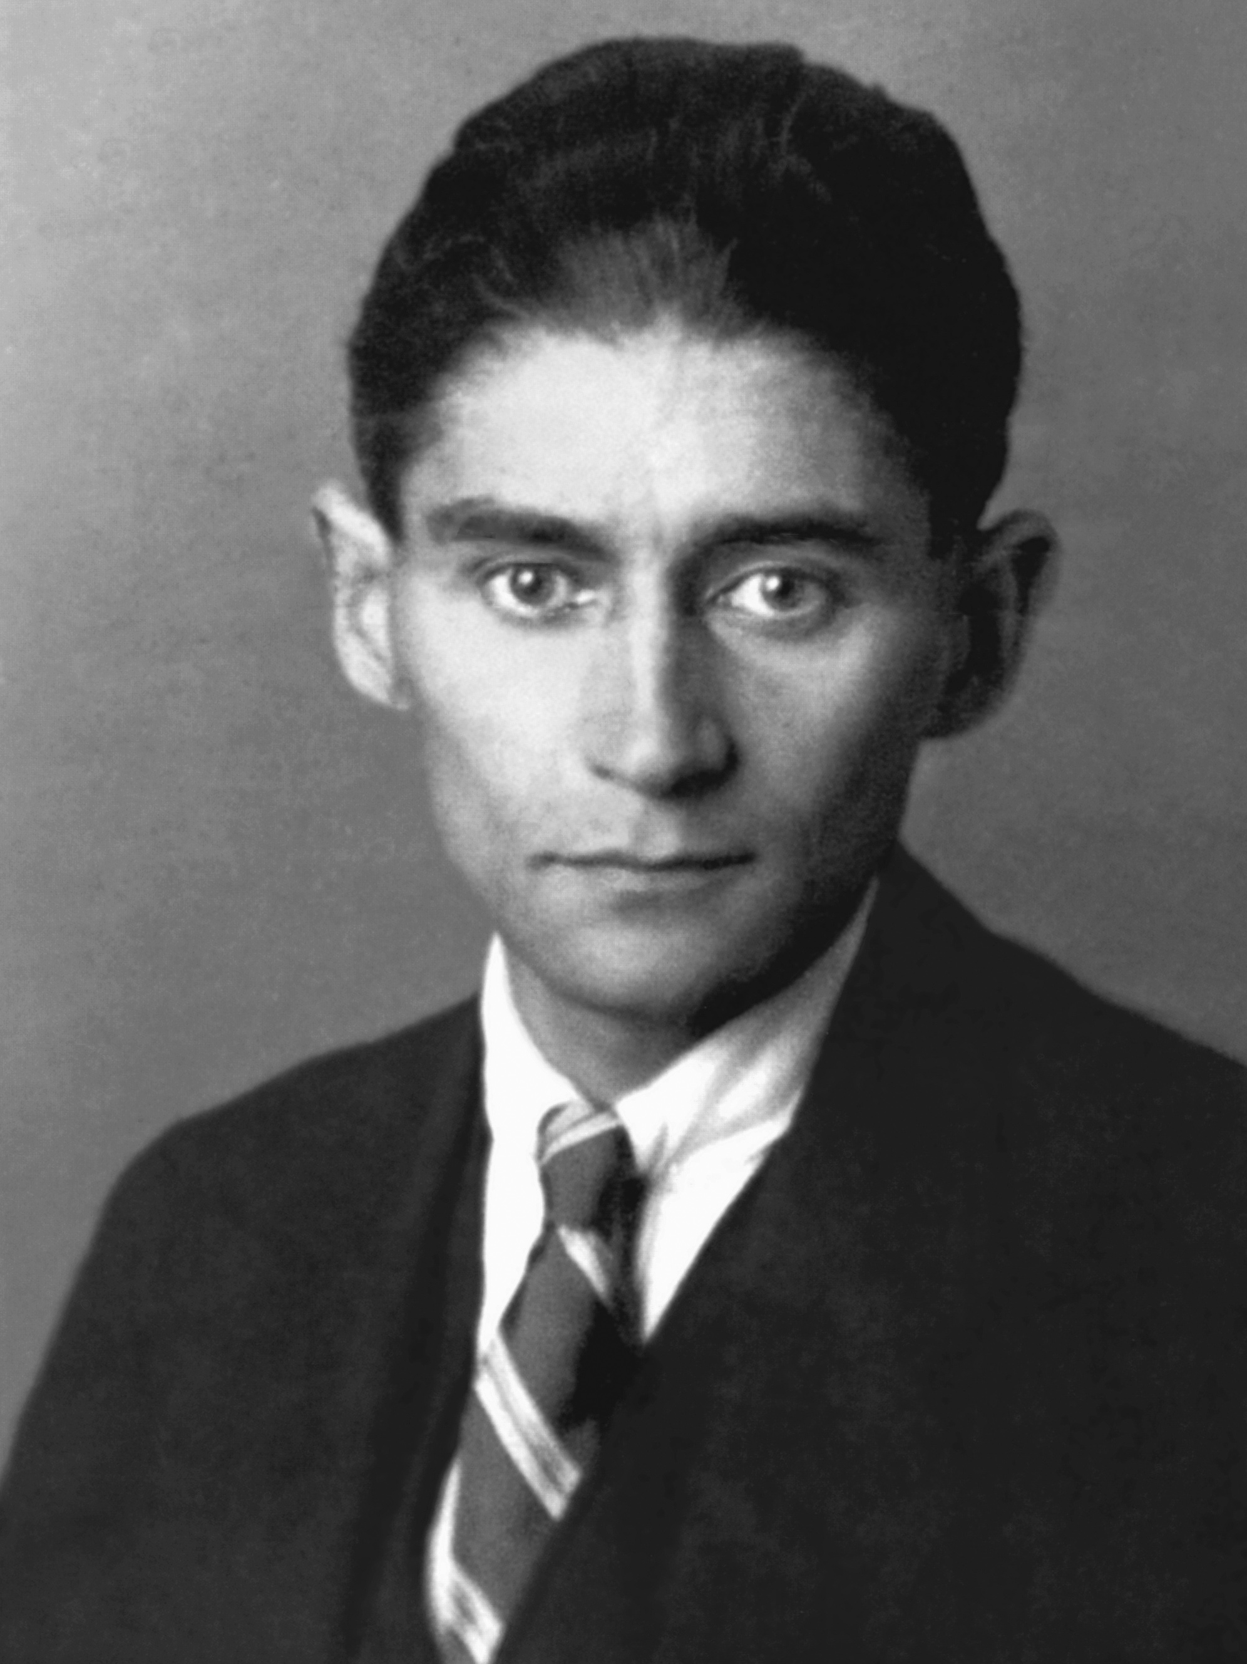

Where Kafka Came From
Built at LinkedIn around 2010 to untangle exactly the mess on the previous slide — every system wired to every other. They needed one high-throughput pipeline for activity and operational data.
Created by Jay Kreps, Neha Narkhede, and Jun Rao ; open-sourced in 2011 , a top-level Apache project by 2012 .
The name: Kreps named it after the writer Franz Kafka — a system "optimized for writing" deserved an author's name.
The three creators left LinkedIn in 2014 to found Confluent , still the main commercial steward of Kafka.
Full circle: LinkedIn today runs Kafka at roughly 7 trillion messages a day .
Copyright © 2026 by Elephant Scale, All Rights Reserved
Notes:
Worth 60 seconds — it makes the technology human and gives the N×M slide a real origin. The Metamorphosis joke lands with most rooms: the one book everyone half-remembers from school, and here it is running your payments.

Slide 7
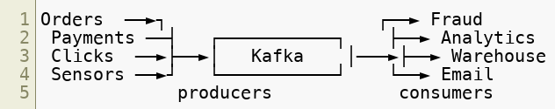
Kafka Decouples Producers From Consumers
Put a durable log in the middle. Producers write to it once; consumers read independently, at their own pace.
Producers don't know or care who reads the data
Consumers read at their own speed, and can replay history
Add a new consumer without touching any producer
A slow consumer can't back-pressure the producer — the log absorbs it
Decoupling is the core idea. Everything else is detail.
Copyright © 2026 by Elephant Scale, All Rights Reserved

Slide 8
What Kafka Actually Is
Apache Kafka is a distributed, fault-tolerant, horizontally scalable streaming — an append-only, replayable log that many producers and consumers share.
Three things at once:
Publish/subscribe — write events, read events (like a messaging system)
Storage — events are persisted durably and can be re-read for days, weeks, or forever
Processing — a stream of events can be transformed, joined, and aggregated in motion
Because it is durable and replayable, Kafka is not just a message bus that forgets — it is the system of record for events in motion .
Copyright © 2026 by Elephant Scale, All Rights Reserved
Notes:
Emphasize "log," not "queue." A queue forgets a message once it is consumed; Kafka keeps it, which is what enables replay and multiple independent consumers.

Slide 9
Event-Driven Thinking
An event is a fact that already happened: "Order 1234 was placed at 10:02."
Immutable — you don't edit the past, you append a new event
Named in the past tense — OrderPlaced , PaymentCaptured , ItemShipped
Carries just enough data for consumers to react
Event-driven systems are built by producing these facts and letting any number of interested parties react — without the producer orchestrating them.
Copyright © 2026 by Elephant Scale, All Rights Reserved

Slide 10
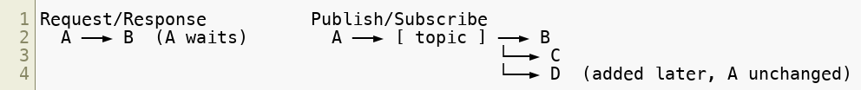
Publish/Subscribe vs. Request/Response
Request/Response (the familiar REST call):
Caller asks a specific service and waits for an answer
Tight coupling: the caller must know the callee and it must be up right now
Adding a new interested party means changing the caller
Publish/Subscribe (the Kafka way):
Producer publishes an event and moves on — no waiting, no knowledge of subscribers
Any number of consumers subscribe independently
Add a new subscriber with zero changes to the producer
Copyright © 2026 by Elephant Scale, All Rights Reserved
Notes:
Both patterns coexist in real systems. The point isn't "REST is bad" — it's that fan-out, decoupling, and replay are exactly where request/response gets painful and pub/sub shines.

Slide 11
Common Use Cases
Event-driven microservices — services communicate through events instead of brittle direct calls
Log & metrics aggregation — funnel logs, metrics, and traces from many services into one pipeline
Website / app activity tracking — clicks, page views, and user actions as a live stream (Kafka's original use at LinkedIn)
Real-time analytics & dashboards — compute metrics continuously instead of nightly
Data integration / pipelines — move data between databases, warehouses, search, and object storage (via Kafka Connect)
Stream processing — fraud detection, alerting, enrichment, feature computation on data in motion
ML feature stores — feed models with fresh, real-time features
Copyright © 2026 by Elephant Scale, All Rights Reserved

Slide 12
Who Uses Kafka
Kafka runs the real-time backbone at companies operating at enormous scale:
Plus thousands of enterprises across banking, government, retail, telecom, logistics, and IoT.
It has become the de facto standard for event streaming — which is why fluency with Kafka is now a core skill for developers, not a specialty.
 | Scale
LinkedIn — where Kafka was created | ~7 trillion messages/day
Uber — matching, pricing, fraud | ~1 trillion messages/day
Netflix — telemetry and data pipelines | trillions of events/day
Cloudflare — edge logs and analytics | petabytes/day
Walmart — peak retail events | billions/day
Copyright © 2026 by Elephant Scale, All Rights Reserved
Notes:
The numbers are headroom, not a target — the point is that nothing you build in this course will strain Kafka. Ubiquity matters more than scale: join almost any data-heavy engineering team and Kafka is somewhere in the architecture.

Slide 13
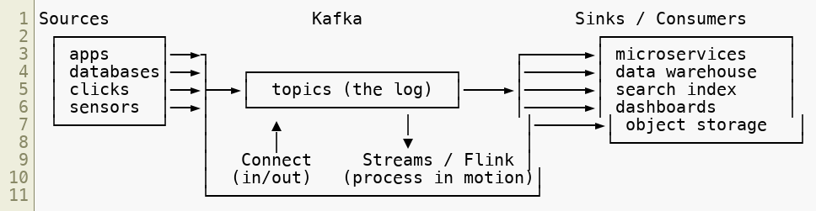
Where Kafka Fits: The Modern Data Platform
Kafka usually sits in the center , as the pipe that everything flows through:
Kafka Connect moves data in and out without custom code
Kafka Streams / Flink process the stream as it flows
Schema Registry keeps producers and consumers agreeing on data shape
We'll meet each of these in this course.
Copyright © 2026 by Elephant Scale, All Rights Reserved

Slide 14
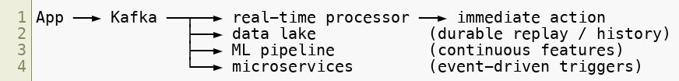
Streaming-First Application Design
The architectural shift Kafka enables — where the event , not the database row, is the source of truth.
Traditional:
Streaming-first:
One write, many independent readers — each added without touching the producer
The database becomes a consumer of the log, not the single gatekeeper of truth
History is retained, so a new consumer can be added later and replay from the beginning
Copyright © 2026 by Elephant Scale, All Rights Reserved
Notes:
This is the mental shift that's harder than any API. Teams that keep treating the DB as the source of truth and Kafka as "just a queue in between" never get the benefits. Ask the room where their current source of truth lives.

Slide 15
Enterprise Streaming Patterns
Names you'll hear once Kafka is in the architecture — worth recognizing early:
Event Sourcing — store every state change as an event; derive current state by replaying the log rather than overwriting a row
CQRS — separate the write model (commands) from the read model (queries), connected by events
Saga — coordinate a long-running transaction across services as a chain of events with compensating actions, instead of a distributed lock
CDC (Change Data Capture) — stream a database's changes into Kafka, so existing systems become event sources without being rewritten
Fan-out — one event, many independent consumers reacting on their own
Copyright © 2026 by Elephant Scale, All Rights Reserved
Notes:
Don't teach these in depth here — just plant the vocabulary so the terms aren't new when they appear in design discussions. CDC is usually the most immediately relevant: it's how an organization with established databases starts an event-driven journey without a rewrite.

Slide 16
A Developer's Mental Model
For the rest of this course, hold onto this:
Kafka is a durable, ordered, replayable log you publish events to and subscribe from
Producers and consumers are decoupled — that decoupling is the whole point
Events are immutable facts ; you append, you don't overwrite
Everything else — partitions, offsets, consumer groups, delivery guarantees — exists to make that log fast, scalable, and reliable
Next module: the core concepts that make this log work — topics, partitions, offsets, and consumer groups.
Copyright © 2026 by Elephant Scale, All Rights Reserved

Slide 17
Summary
Batch answers "what happened yesterday"; streaming answers "what's happening now"
Kafka replaces the N×M integration tangle with one durable log in the middle
It decouples producers from consumers and lets consumers replay history
Publish/subscribe adds new consumers with zero producer changes
Streaming-first design treats events, not database rows, as the source of truth
Patterns to recognize: Event Sourcing, CQRS, Saga, CDC, fan-out
Kafka is the de facto standard for event streaming and the hub of the modern data platform
Copyright © 2026 by Elephant Scale, All Rights Reserved

