Slide 1
Intro 2 — Core Concepts
Copyright © 2026 by Elephant Scale, All Rights Reserved

Slide 2
Agenda
Topics, partitions, and offsets — the log abstraction
Producers, consumers, brokers — and translating Kafka's vocabulary
Consumer groups and parallelism
Replication, leaders, and fault tolerance (ISR) at a high level
Retention: time, size, and log compaction
Copyright © 2026 by Elephant Scale, All Rights Reserved

Slide 3
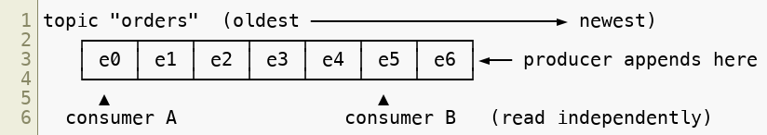
The One Idea: A Topic Is a Log
Everything in Kafka is built on one data structure: an append-only log .
A topic is a named log — e.g. orders , clicks , payments
Producers append events to the end; consumers read forward from any position
Events are immutable — once written, never changed
Reads don't remove data — many consumers read the same log independently
Copyright © 2026 by Elephant Scale, All Rights Reserved
Notes:
If students remember only one thing today, it's "topic = append-only log." Partitions, offsets, and consumer groups all follow from this.

Slide 4
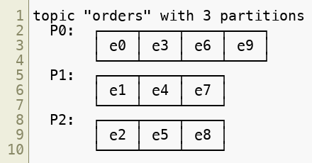
Partitions — Splitting the Log for Scale
A single log on one machine can't scale. So Kafka splits each topic into partitions , and spreads them across brokers.
A topic has N partitions , chosen when you create it
Each partition is its own ordered log , on some broker
Partitions give Kafka its parallelism and capacity — more partitions, more throughput
Key trade-off: ordering is guaranteed within a partition , never across partitions.
Copyright © 2026 by Elephant Scale, All Rights Reserved

Slide 5
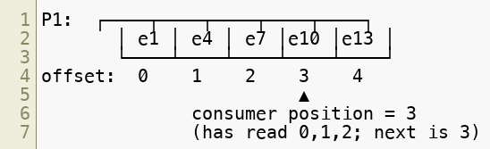
Offsets — A Message's Address
Within a partition, every event gets a monotonically increasing offset : 0, 1, 2, 3, …
An offset is per-partition — partition 0's offset 5 is unrelated to partition 1's offset 5
A message is uniquely identified by (topic, partition, offset)
Offsets never go backward and are never reused within a partition
A consumer's position is just "the next offset I will read"
Copyright © 2026 by Elephant Scale, All Rights Reserved
Notes:
This is the mechanism behind replay — seek a consumer back to an earlier offset and it re-reads history. We'll do exactly that in the labs.

Slide 6

Keys and Partitioning
How does a producer decide which partition an event goes to? By the message key .
With a key — Kafka hashes the key; the same key always lands in the same partition
order_id=1234 → always partition 2 → all events for that order stay ordered
Without a key — events are spread across partitions (round-robin-ish) for balance
This is the central design decision for a producer: pick a key when you need per-entity ordering (per user, per order, per device); go keyless when you just want even spread.
Copyright © 2026 by Elephant Scale, All Rights Reserved

Slide 7
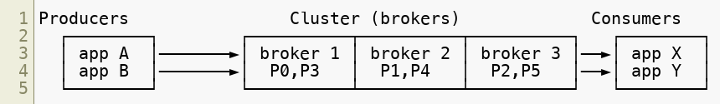
Producers, Consumers, Brokers
Three roles make up the system:
Broker — a Kafka server. It stores partitions on disk and serves reads/writes. A cluster is several brokers working together.
Producer — a client that appends events to topic partitions.
Consumer — a client that reads events forward from partitions.
Producers and consumers are your code (Java in this course). Brokers are the Kafka cluster — for us, three Docker containers.
Copyright © 2026 by Elephant Scale, All Rights Reserved

Slide 8
If Kafka Were Named Today
Kafka's vocabulary is from 2010 and predates today's streaming and database conventions. If you come from other systems, this translation makes it click faster:
Kafka says | Everyone else says
Broker | Server, or Node
Producer | Publisher, or Writer
Consumer | Subscriber, or Reader
Topic | Stream, or Channel
Partition | Shard — a horizontal slice, exactly the database idea
Offset | Cursor — your position in the log
Consumer Group | Subscription, or a worker pool sharing the load
Copyright © 2026 by Elephant Scale, All Rights Reserved
Notes:
This slide saves an hour of confusion later. "Partition = shard" and "offset = cursor" are the two that unlock the most — developers already own both concepts, they just don't recognize them under Kafka's names. Invite the room to name the equivalent in whatever they use today (JMS, MQ, SQS, a database read cursor).

Slide 9
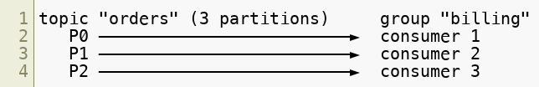
Consumer Groups — Scaling Consumption
One consumer may not keep up with a busy topic. A consumer group lets several consumers share the work.
Consumers that share a group.id form one group
Kafka assigns each partition to exactly one consumer in the group
Add consumers → each handles fewer partitions → more throughput
The group tracks its progress via committed offsets
Copyright © 2026 by Elephant Scale, All Rights Reserved
Notes:
This is the heart of Kafka's scaling model on the read side. The next slide shows the limit and what "different groups" means.

Slide 10
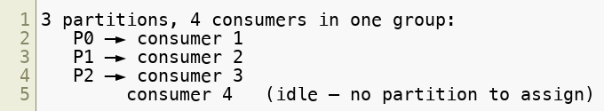
Parallelism: Partitions Are the Unit
The number of partitions caps the parallelism of a single consumer group.
3 partitions → at most 3 active consumers in a group; a 4th sits idle
More consumers than partitions doesn't help — one consumer per partition is the max
So partition count is a scaling decision you make up front
Rule of thumb: choose partition count for the parallelism you'll eventually need — it's easy to add partitions, awkward to remove them.
Copyright © 2026 by Elephant Scale, All Rights Reserved

Slide 11
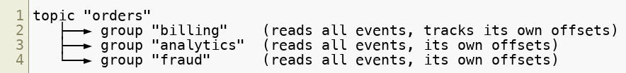
Same Data, Many Consumers: Different Groups
A partition goes to one consumer within a group — but every group reads the .
This is pub/sub : add a new group and it sees the full stream, with zero producer changes
Each group's progress (offsets) is completely separate
One team's slow consumer never affects another team's group
This is how one topic feeds many independent applications at once.
Copyright © 2026 by Elephant Scale, All Rights Reserved

Slide 12
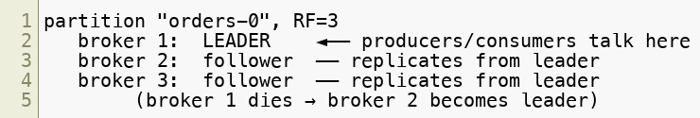
Replication — Surviving Broker Failure
Each partition is replicated across brokers so no single failure loses data.
Replication factor = number of copies (e.g. RF=3 → 3 copies on 3 brokers)
One replica is the leader — all reads and writes go through it
The others are followers — they copy the leader's log
If the leader's broker dies, a follower is promoted to leader automatically
Copyright © 2026 by Elephant Scale, All Rights Reserved

Slide 13
ISR — In-Sync Replicas
The ISR is the set of replicas that are caught up with the leader.
A follower that keeps up is in-sync ; one that falls behind drops out of the ISR
Only an in-sync replica is eligible to become leader — so no acknowledged data is lost
Producers can require a write to reach a minimum number of in-sync replicas before it's considered durable (we'll tune acks and min.insync.replicas later)
High-level takeaway for now: replication + ISR is why Kafka can lose a broker and keep running without losing your data. The knobs come in the intermediate days.
Copyright © 2026 by Elephant Scale, All Rights Reserved
Notes:
Keep this conceptual in the intro. Module 11 (Reliability) is where acks, min.insync.replicas, and the durability trade-offs get hands-on.

Slide 14
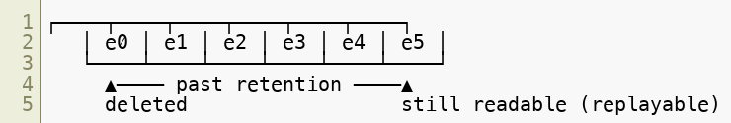
Retention — How Long Events Live
Kafka is storage, not just a pipe — but not infinite storage. Retention decides how long events stay before deletion.
Time-based — keep events for N hours/days (e.g. retention.ms=7 days )
Size-based — keep up to N bytes per partition, then drop the oldest
Retention is per topic — a short-lived clickstream and a long-lived audit log can differ
Consumers can re-read anything still within retention — that's replay
Copyright © 2026 by Elephant Scale, All Rights Reserved

Slide 15
Log Compaction — Keep the Latest per Key
A second retention mode: instead of deleting by age, keep the latest value for .
For keyed topics that represent current state — "the latest address for each user"
Compaction removes superseded values, keeping at least the most recent per key
Perfect for changelog / state topics; a new consumer can rebuild current state from the log
Copyright © 2026 by Elephant Scale, All Rights Reserved
Notes:
Compaction underpins Kafka Streams' KTables and Connect's offset storage. Introduce the idea here; it returns in the stream-processing module.

Slide 16
Putting It Together
A topic is an append-only log , split into partitions for scale
Every event has an offset ; a message key decides its partition and preserves per-key order
Producers append, consumers read, brokers store — a consumer group shares the work
Partition count sets the parallelism ceiling; different groups each read the whole topic
Replication + ISR keep data safe across broker failures
Retention and compaction decide how long — or in what form — events live
Next module: how these pieces are arranged into a Kafka 4 cluster , and how KRaft replaced ZooKeeper.
Copyright © 2026 by Elephant Scale, All Rights Reserved

Slide 17
Summary
topic = log , partition = ordered shard , offset = position
key → partition , and ordering holds within a partition
consumer group scales reads; partitions cap the parallelism
replication + ISR provide fault tolerance
retention (time/size) and compaction (latest-per-key) govern the log's lifetime
Copyright © 2026 by Elephant Scale, All Rights Reserved

