Slide 1
Intro 3 — Kafka 4 Architecture
Copyright © 2026 by Elephant Scale, All Rights Reserved

Slide 2
Agenda
The Kafka cluster: brokers and the controller
KRaft — ZooKeeper-free Kafka (what changed and why it matters)
The Kafka ecosystem: Connect, Streams, Schema Registry, Flink
Copyright © 2026 by Elephant Scale, All Rights Reserved

Slide 3
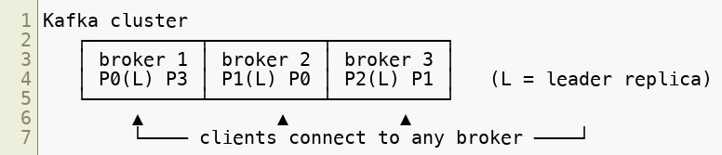
The Cluster: A Set of Brokers
A Kafka cluster is just a group of brokers that coordinate to serve one set of topics.
Each broker stores some partitions and handles reads/writes for the partitions it leads
Partitions and their replicas are spread across brokers for scale and fault tolerance
Clients connect to any broker (the bootstrap server ) and discover the rest automatically
Our lab cluster is exactly this: three brokers as Docker containers.
Copyright © 2026 by Elephant Scale, All Rights Reserved
Notes:
"Bootstrap" only means the first contact point. The client immediately pulls full cluster metadata and then talks directly to the right leader for each partition.

Slide 4
Someone Has to Be in Charge: The Controller
A cluster needs coordination — who leads each partition, which brokers are alive, what topics exist. That job is the controller .
The controller manages cluster metadata : topic/partition configuration, replica assignments, and leader election when a broker fails
It's not a separate machine — one of the brokers acts as the controller
If the controller broker fails, another takes over
The interesting question is: where is that metadata stored, and how is it kept That's exactly what changed in Kafka 4.
Copyright © 2026 by Elephant Scale, All Rights Reserved

Slide 5
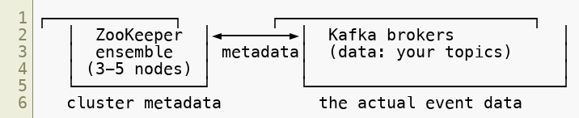
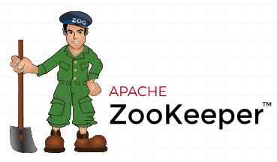
The Old World: Kafka + ZooKeeper
For most of Kafka's history, that metadata lived in a separate system: Apache .
ZooKeeper held cluster state; brokers held the data
Two distributed systems to install, configure, secure, monitor, and upgrade
Metadata had a scaling ceiling — very large clusters strained ZooKeeper
Failover and metadata propagation could be slow
It worked for years — but it was a second system to operate, and a bottleneck.
Copyright © 2026 by Elephant Scale, All Rights Reserved
Notes:
If anyone in the room has run Kafka before, this slide is where they nod. Ask who has operated a ZooKeeper ensemble — the war stories sell the next slide better than you can.

Slide 6
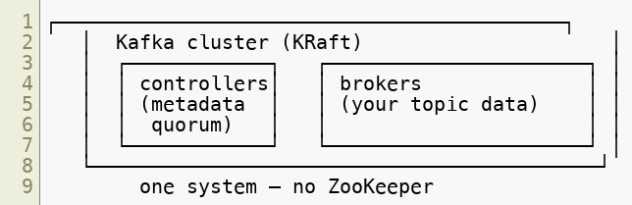
Kafka 4: KRaft — ZooKeeper Is Gone
Apache Kafka 4 removes ZooKeeper entirely. Kafka now manages its own metadata using a built-in consensus protocol called KRaft ( K afka Raft ).
Metadata is stored in Kafka itself , in an internal metadata log
A quorum of controllers agrees on that log using the Raft consensus algorithm
One system to run , not two
Copyright © 2026 by Elephant Scale, All Rights Reserved
Notes:
KRaft has been production-ready for a while; Kafka 4 is the release that makes it the only option. If a student has ZooKeeper-era experience, this is the headline change.

Slide 7
Metadata as a Log
The elegant part: Kafka applies its own core idea — the log — to metadata.
Cluster metadata is itself an append-only log (the metadata topic)
Controllers form a Raft quorum and agree on the order of metadata changes
Brokers subscribe to the metadata log and stay up to date, just like a consumer
The active controller is the quorum leader; if it fails, the quorum elects a new one
This is why KRaft scales: propagating metadata is now the same fast, log-based mechanism Kafka already does extremely well.
Copyright © 2026 by Elephant Scale, All Rights Reserved

Slide 8
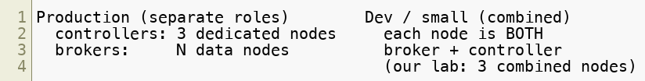
Roles: Broker and Controller
In KRaft, a node runs in one (or both) of two process roles :
broker — stores partition data, serves producers and consumers
controller — participates in the metadata quorum
Two common topologies:
Dedicated controllers are typical for large production clusters
Combined broker+controller nodes are simpler for development — exactly our lab setup
Copyright © 2026 by Elephant Scale, All Rights Reserved
Notes:
Point at the lab's docker-compose — KAFKA_PROCESS_ROLES: "broker,controller" is this slide made real.

Slide 9
Why KRaft Matters — Even to Developers
You won't administer the controller quorum, but KRaft changes things you'll feel:
Simpler environments — one system to spin up; our whole cluster is a single compose file
Faster recovery — leader election and metadata failover are quicker
Higher scale — clusters support far more partitions than the ZooKeeper era
Current knowledge — you learn today's architecture, not legacy patterns to unlearn
Practical upshot: if you read an older tutorial that mentions ZooKeeper, zookeeper.connect , or --zookeeper flags — it's out of date. Kafka 4 is ZooKeeper-free.
Copyright © 2026 by Elephant Scale, All Rights Reserved

Slide 10
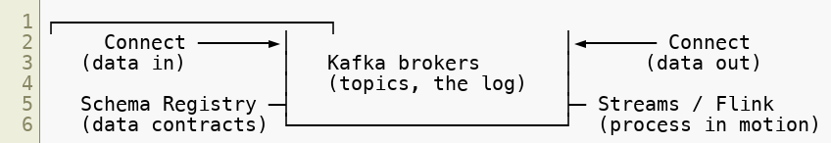
Kafka Is More Than Brokers: The Ecosystem
The brokers are the core, but real systems use the surrounding ecosystem — which is where developers spend most of their time.
Each of these is a module later in the course. Here's the one-line orientation for each.
Copyright © 2026 by Elephant Scale, All Rights Reserved

Slide 11
Kafka Connect
Move data in and out of Kafka without writing code.
A framework of ready-made connectors : databases, object storage (S3), search, and more
Source connectors pull data into Kafka; sink connectors push data out
Configuration-driven — you submit JSON, not a custom app
Handles scaling, offset tracking, retries, and dead-letter queues for you
→ Module 9 (Kafka Connect), with a hands-on source + sink + DLQ lab.
Copyright © 2026 by Elephant Scale, All Rights Reserved

Slide 12
Schema Registry
Keep producers and consumers agreeing on the shape of the data.
A service that stores schemas (Avro, Protobuf, JSON Schema) and hands out schema IDs
Producers and consumers serialize/deserialize against a registered schema
Enforces compatibility as schemas evolve, so a producer change can't silently break consumers
Turns "what's in this topic?" into a governed data contract
→ Module 8 (Serialization & Schema Registry), with an Avro evolve-a-schema lab.
Copyright © 2026 by Elephant Scale, All Rights Reserved

Slide 13
Stream Processing: Kafka Streams & Flink
Transform, join, and aggregate streams as they flow — not in a nightly batch.
Kafka Streams — a Java library for stateful processing built into applications ( KStream / KTable , joins, windows, exactly-once)
Apache Flink (Flink SQL) — a powerful stream processor; write continuous queries in SQL , the modern successor to KSQL/ksqlDB
Both read from Kafka topics, process continuously, and write results back to Kafka
→ Module 10 (Stream Processing), with a stateful streaming lab.
Copyright © 2026 by Elephant Scale, All Rights Reserved

Slide 14
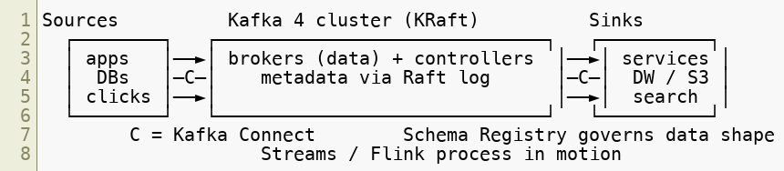
The Full Picture
KRaft at the core: one system, no ZooKeeper
Connect at the edges, Schema Registry for contracts, Streams/Flink for processing
You'll write code against all of it — starting hands-on in the next module
Copyright © 2026 by Elephant Scale, All Rights Reserved

Slide 15
Summary
A cluster is brokers (data) plus a controller role (metadata + leader election)
Kafka 4 removed ZooKeeper ; metadata now lives in Kafka via the KRaft (Raft) quorum
Metadata is itself a log — the same idea that powers topics
Nodes run as broker , controller , or (in dev) both — our lab uses 3 combined nodes
The ecosystem — Connect, Schema Registry, Streams/Flink — is where developers live; each has its own module
Next: hands-on — start the cluster, create topics, produce and consume
Copyright © 2026 by Elephant Scale, All Rights Reserved

