Slide 1
Apache Kafka for Developers
Copyright © 2026 by Elephant Scale, All Rights Reserved

Slide 2
Agenda
Introduction (1 day) — fundamentals + first hands-on
1. What Is Kafka and Why
2. Core Concepts
3. Kafka 4 Architecture
4. Hands-On Fundamentals
Intermediate (3 days) — building production streaming applications
5. Producer Internals
6. Consumer Internals
7. Delivery Semantics & Transactions
8. Serialization & the Schema Registry
9. Kafka Connect
10. Stream Processing (Kafka Streams & Flink SQL)
11. Reliability, Scaling & Operations for Developers
Copyright © 2026 by Elephant Scale, All Rights Reserved
Notes:
Four days end to end, deliverable as one track or as two standalone courses. The intro day makes it accessible to newcomers; the intermediate days give working developers real depth.

Slide 3
Pre-requisites and Expectations
Practical programming experience
Java examples throughout — the Kafka Java client, built with Maven
Comfort with the Linux command line and a text editor
Docker on your machine — that's the whole lab environment (no Kubernetes, no cluster admin)
Basic familiarity with messaging or data-processing concepts is helpful, not required
Curiosity!
Ask a lot of questions
Copyright © 2026 by Elephant Scale, All Rights Reserved
Notes:
This is a developer course — the emphasis is on writing code against Kafka, not administering a cluster. For the intermediate days we assume Kafka fundamentals (the intro day, or equivalent experience).

Slide 4
Our Teaching Philosophy
Emphasis on concepts & fundamentals
Highly interactive (questions and discussions are welcome)
Hands-on (learn by doing)
Real production patterns — not toy examples
Copyright © 2026 by Elephant Scale, All Rights Reserved

Slide 5
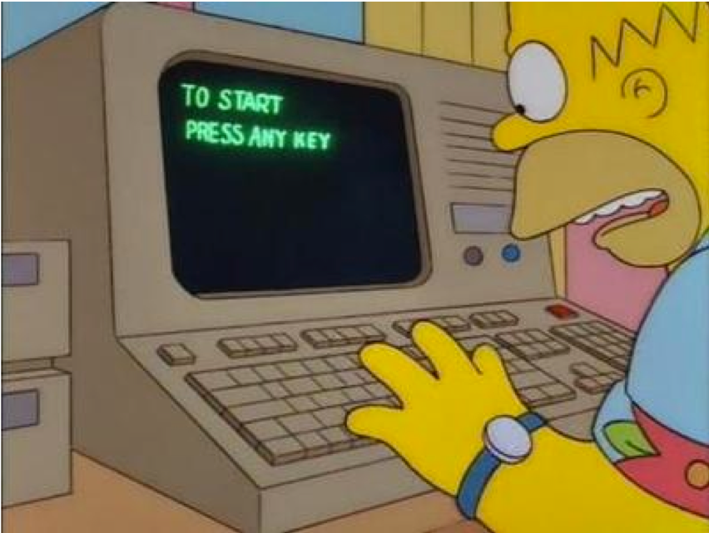
Lots of Labs: Learn By Doing
Copyright © 2026 by Elephant Scale, All Rights Reserved
Notes:
Every concept is reinforced with a lab. All slides, labs, and code are yours to keep in a Git repository — re-run the exercises after the course.

Slide 6

Analogy: Learning To Fly...
Copyright © 2026 by Elephant Scale, All Rights Reserved

Slide 7
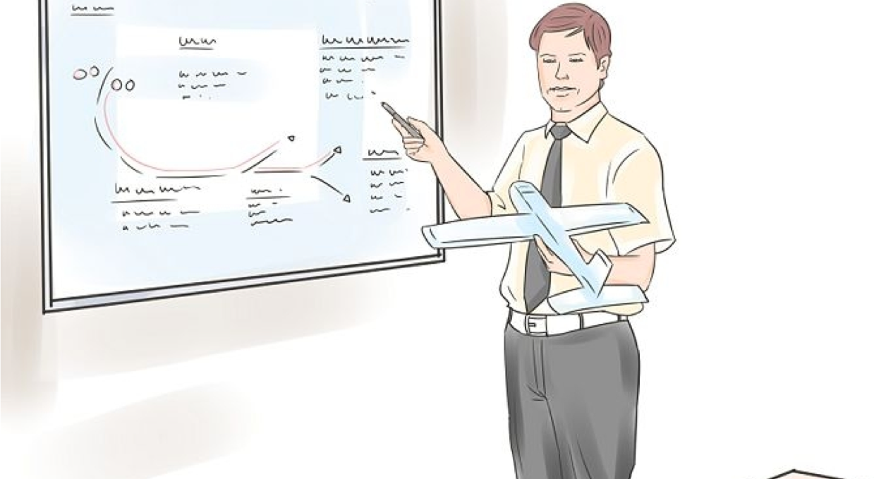
Introductions
Copyright © 2026 by Elephant Scale, All Rights Reserved

Slide 8
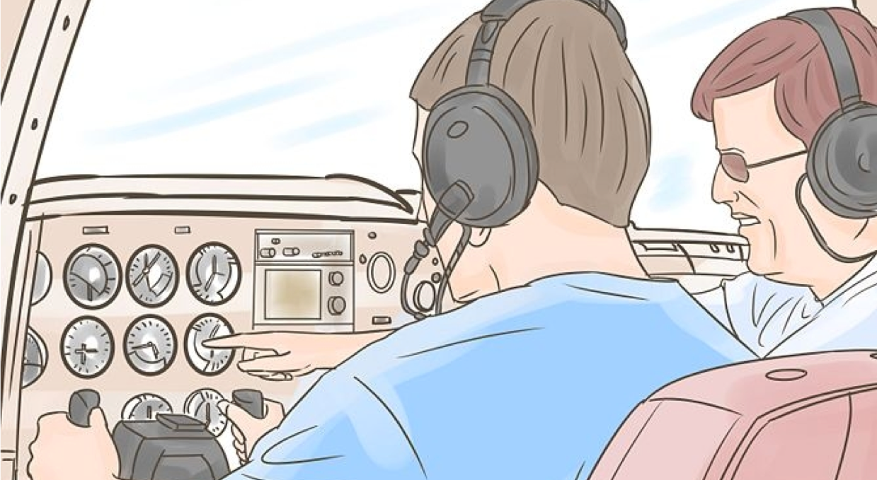
+ Flight Time
Copyright © 2026 by Elephant Scale, All Rights Reserved

Slide 9
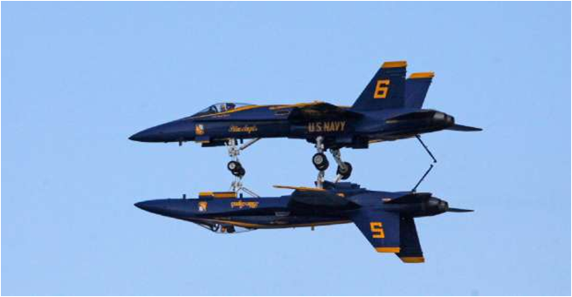
This Will Take A Lot Of Practice
Copyright © 2026 by Elephant Scale, All Rights Reserved

Slide 10
What You'll Be Able to Do
By the end of the track you will be able to:
Explain Kafka's architecture and core abstractions — and how KRaft replaces ZooKeeper
Write producers and consumers , and reason about partitioning, ordering, and parallelism
Choose and configure delivery guarantees — at-least-once, at-most-once, exactly-once
Manage schemas and evolution with the Schema Registry (Avro, Protobuf, JSON Schema)
Build data pipelines with Kafka Connect , and process streams with Kafka Streams & Flink SQL
Apply reliability basics: replication, ISR, consumer lag, and tuning
Copyright © 2026 by Elephant Scale, All Rights Reserved

Slide 11

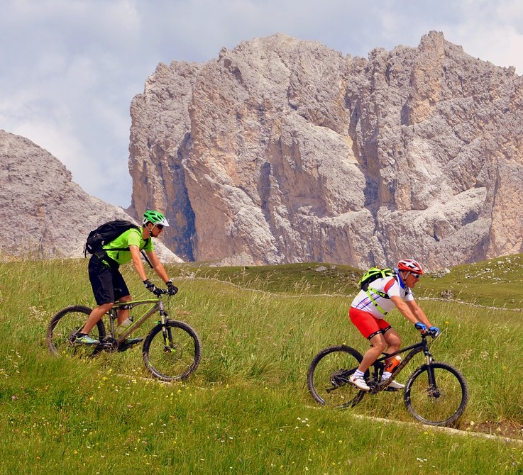

About You And Me
About Instructor
About you
Your Name
Your background (developer, data engineer, architect, ...)
Languages and technologies you work with
Kafka experience (scale of 1 - 4 ; 1 - new, 4 - expert)
Something non-technical about you! (favorite ice cream flavor / hobby...)
Copyright © 2026 by Elephant Scale, All Rights Reserved

