Slide 1
Intermediate 6 — Stream Processing
Copyright © 2026 by Elephant Scale, All Rights Reserved

Slide 2
Agenda
Kafka Streams: KStream / KTable , stateless vs. stateful operations
Joins, aggregations, windowing, and state stores
Exactly-once processing in Streams
Flink SQL — declarative continuous queries (the modern successor to ksqlDB)
Hands-on: build a stateful streaming application
Copyright © 2026 by Elephant Scale, All Rights Reserved

Slide 3
Beyond Produce/Consume: Processing In Flight
So far: producers write, consumers read, Connect moves data. Stream processing transforms the data as it flows — filter, enrich, aggregate, join — continuously.
A consumer that just filters is fine — but joins, windowed aggregations, and stateful counts are hard to hand-roll correctly (state, fault tolerance, exactly-once)
Stream processors give you those as operators , with state and recovery handled for you
This is exactly what real-time reporting and analytics need — compute metrics as events arrive, not in a nightly batch
Copyright © 2026 by Elephant Scale, All Rights Reserved
Notes:
This module is where SSA's "real-time reporting/analytics" and "did that person call?" correlation actually get built. Frame it as the payoff of the whole course.

Slide 4
Two Tools, One Job
We'll look at two ways to process Kafka streams:
Kafka Streams — a Java library you embed in your application. No separate cluster; your app is the processor. Great when the logic lives inside a Java service.
Flink SQL — a powerful stream processor where you write SQL . Declarative, language- neutral, runs on a Flink cluster. The modern successor to KSQL/ksqlDB.
Both read Kafka, process continuously, and write results back to Kafka.
 | Kafka Streams | Flink SQL
Form | Java library | SQL on a Flink cluster
Deploy | inside your app | submit to Flink
Best for | logic embedded in a Java service | analysts/engineers writing declarative queries
Copyright © 2026 by Elephant Scale, All Rights Reserved

Slide 5
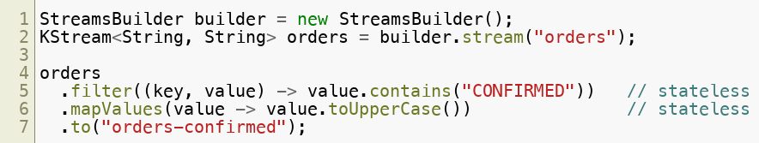
Kafka Streams: KStream
A
KStream models an unbounded stream of events — every record is an independent fact.
Each record flows through the topology independently
Stateless operations — filter , map , mapValues , flatMap , branch — need no memory of past records
This is the easy half: record in, record out
Copyright © 2026 by Elephant Scale, All Rights Reserved

Slide 6
KStream vs. KTable
The key distinction in Kafka Streams:
KStream
= a stream of events (append) — "order 5 was placed", "order 5 was placed again" are two facts
KTable
= a changelog of state (upsert by key) — "the latest status of order 5" — a new record for a key replaces the old
Use a KStream for events/facts; a KTable for current state / lookups
A compacted topic + a KTable = "materialized current state," rebuildable from the log
Copyright © 2026 by Elephant Scale, All Rights Reserved
Notes:
Tie back to Intro 2 log compaction — a KTable is the programmatic face of a compacted "latest-per-key" topic.

Slide 7
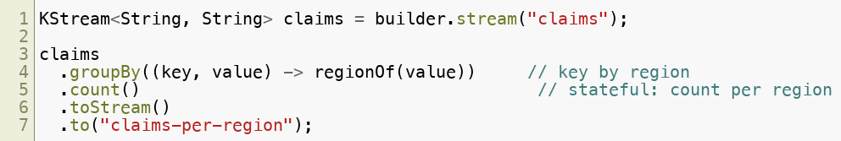
Stateful Operations: Aggregations
Aggregations remember — counts, sums, running metrics per key. That memory is state .
count , reduce , aggregate maintain a running result per key
The result is a KTable (the current aggregate), backed by a state store
"Claims per region," "orders per customer," "no-show rate per office" — all aggregations
Copyright © 2026 by Elephant Scale, All Rights Reserved

Slide 8
State Stores and Fault Tolerance
Where does that state live, and what happens if the app crashes?
Aggregations keep state in a local state store (RocksDB on disk, by default)
Every update is also written to a changelog topic in Kafka
On restart or reassignment, the state store is rebuilt from the changelog — no lost counts
Takeaway: the stream processor gives you durable, recoverable state — the hard part you'd otherwise hand-build.
Copyright © 2026 by Elephant Scale, All Rights Reserved

Slide 9
Windowing
Aggregating "since the beginning of time" is rarely what you want. Windows bucket events by time — the basis of real-time metrics.
Tumbling — fixed, non-overlapping (e.g. count per 1-minute bucket)
Hopping — fixed size, overlapping (every 30s, count the last 1 min)
Session — grouped by activity gaps (a user's burst of clicks)
"Claims per hour," "appointments per office per 15 minutes" — windowed aggregations
Windows need a notion of event time and handling for late events (watermarks)
Copyright © 2026 by Elephant Scale, All Rights Reserved
Notes:
Windowing is the heart of real-time reporting. SSA's "claims per hour/region" is a tumbling-window count.

Slide 10
Joins
Joins correlate two streams/tables by key — combining related events.
Stream–Table — enrich each event with current state (event ⋈ lookup table)
Stream–Stream — correlate two event streams within a time window
Table–Table — keep a joined materialized view up to date
Stream–stream joins are windowed (you can't wait forever for a match)
This is exactly the "did that person call?" correlation — join the claim and contact streams by person id
Copyright © 2026 by Elephant Scale, All Rights Reserved
Notes:
This slide is the SSA correlation use case. A bare consumer can't do this cheaply; a stream processor's windowed join is built for it.

Slide 11
Exactly-Once in Kafka Streams
Everything from Module 7 (transactions) is available in Streams — with one config line .
Streams uses transactions under the hood: input offsets, state-store changelog, and output records all commit atomically
A crash mid-processing leaves no partial output and no double-counting
You get exactly-once stateful processing without writing the transaction code yourself
This is the big win: the hardest correctness problem in streaming, reduced to a setting.
Copyright © 2026 by Elephant Scale, All Rights Reserved

Slide 12
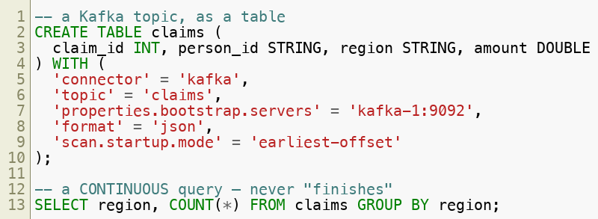
Flink SQL: Streams as Tables
Flink treats a Kafka topic as a table you query with SQL — but the query runs forever , emitting results as new data arrives.
No Java to compile — analysts and engineers write SQL
The same concepts (filter, aggregate, window, join) as declarative queries
Copyright © 2026 by Elephant Scale, All Rights Reserved

Slide 13
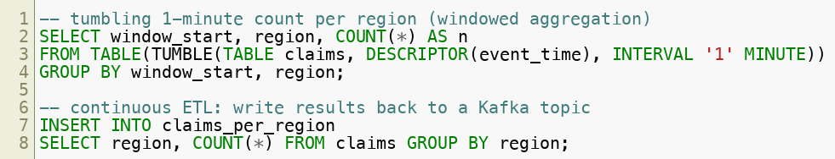
Flink SQL: Windows and Sinks
Real-time analytics in a few lines of SQL.
INSERT INTO a Kafka-backed table = a running pipeline that keeps the sink topic current
This is how a dashboard stays live — Flink writes the aggregate topic, the dashboard reads it
Copyright © 2026 by Elephant Scale, All Rights Reserved
Notes:
This is Lab 07's spine — source table, filter, windowed count, and INSERT INTO a sink, all in SQL. It maps 1:1 to their real-time reporting goal.

Slide 14
Choosing: Streams or Flink SQL
Both are right in different places.
Kafka Streams when the processing logic belongs inside a Java service you already run — no extra cluster, tight integration with app code
Flink SQL when you want declarative analytics, a shared query language for a team, or a dedicated processing platform separate from the apps
They coexist: services embed Streams for operational logic; Flink SQL powers analytics/reporting
For real-time reporting and analytics, Flink SQL is often the faster path — which is why the lab uses it.
Copyright © 2026 by Elephant Scale, All Rights Reserved

Slide 15
Summary
Stream processing transforms data in flight — filter, enrich, aggregate, join — continuously
Kafka Streams (Java library): KStream (events) vs KTable (state); stateless ops vs stateful aggregations backed by fault-tolerant state stores
Windows (tumbling/hopping/session) make real-time metrics; joins correlate streams (the "did they call?" case)
Exactly-once stateful processing is one config line in Streams ( EXACTLY_ONCE_V2 )
Flink SQL expresses the same ideas as continuous SQL — source tables, windows, and INSERT INTO sinks — the modern successor to ksqlDB and a fast path to real-time analytics
Copyright © 2026 by Elephant Scale, All Rights Reserved

